Slide 1
GOOD MORNING
EVERYONE !!!

Slide 2
I. WARM - UP
football
chess
SPORTS
GAMES
Sports: volleyball, tennis, badminton, running, cycling, mountain climbing, ...
Games: chess, card games, computer games, play marbles, skipping, …

Slide 3
Wednesday, January 31, 2024
PERIOD 63: UNIT 8: SPORTS AND GAMES
Lesson 2:
(P. 18)

Slide 4
A. OBJECTIVES:
By the end of the lesson, students will be able to:
1. Knowledge:
use the lexical items related to the topic Sports and games;
- pronounce correctly the sounds /e/ and /æ/.

Slide 5
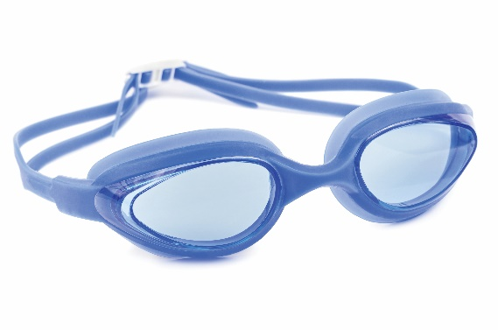
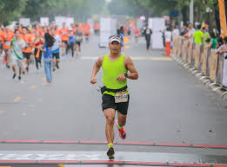
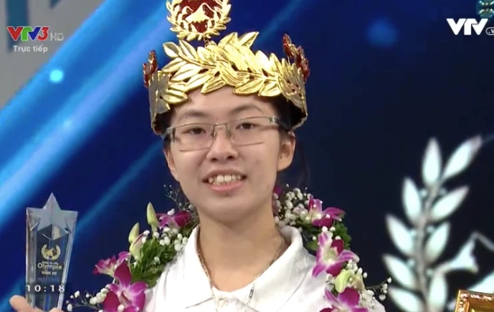
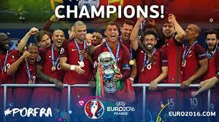
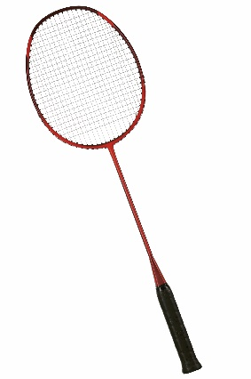
Well done!
II. Vocabulary
- racket (n):
vợt cầu lông
- goggles (n):
kính bơi, kính bảo hộ
- Competition /,kəmpə'ti∫n/
(n): cuộc thi, cuộc tranh tài
- champion /'t∫æmpjən/: (n)
người vô địch, nhà quán quân
- marathon (n) /'mærəθən/ :
cuộc chạy đua maratông ( đường dài)
- congratulations (n):
lời chúc mừng, lời khen ngợi

Slide 6
* Checking vocab
What and Where
racket
champion
marathon
congratulations
goggles
competition

Slide 7
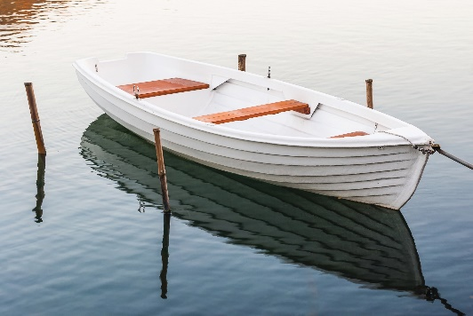
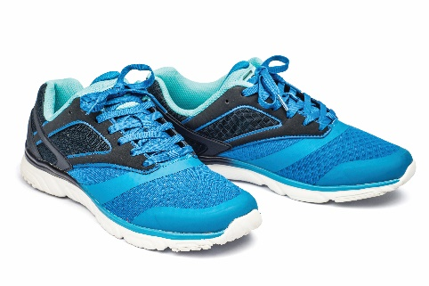
Write the right words under the pictures.
ball
racket
sports shoes
boat
goggles
1. ball
2. sports shoes
3.
1.
2.
3. boat
4. racket
5. goggles
4.
5.

Slide 8
What sports are these things for? Match each thing in column A with a sport in column B.
A
B
1.
bicycle
a.
boating
2.
ball
b.
swimming
3.
boat
c.
cycling
4.
goggles
d.
ball games
5.
racket
e.
badminton

Slide 9
Fill each blank with one of the words from the box.
champion
competition
sporty
marathon
congratulations
practice
1. She won an international sports __________.
2. He became the world tennis _________when he was very young.
3. "Can you send my __________ to the winner of the contest?“
4. My friend David is very ___________ . He does exercise every day.
5. The first __________ took place in 1896.
6. He want to be a footballer, so he __________ playing football every day.

Slide 10
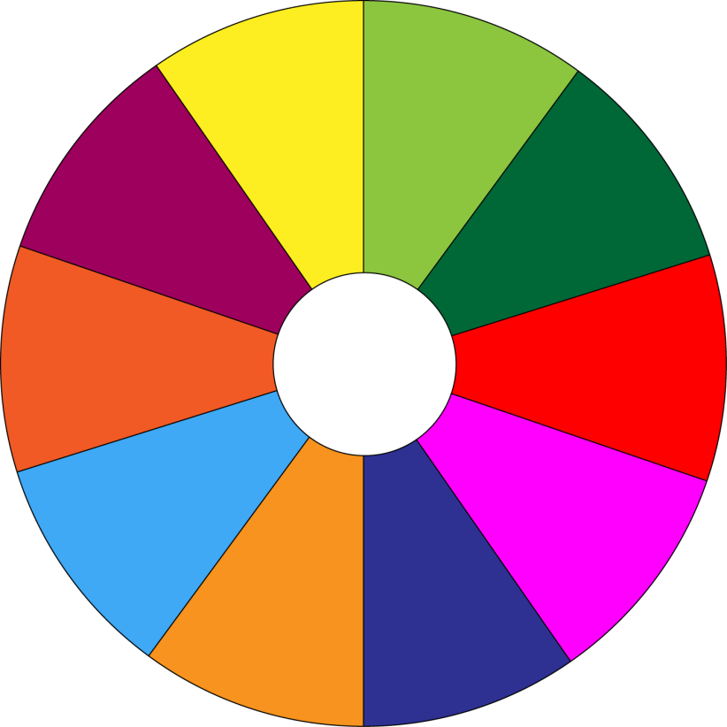
THE BIG WHEEL GAME
QUESTIONS
10
40
1
4
30
50
SPIN
2
5
20
10
-15
-20
3
6
05
60

Slide 11
Fill each blank with one of the words from the box.
champion
competition
sporty
marathon
congratulations
practice
1. She won an international sports __________.
competition.

Slide 12
Fill each blank with one of the words from the box.
champion
competition
sporty
marathon
congratulations
practice
2. He became the world tennis _________when he was very young.
champion

Slide 13
Fill each blank with one of the words from the box.
champion
competition
sporty
marathon
congratulations
practice
3. "Can you send my __________ to the winner of the contest?“
congratulations

Slide 14
Fill each blank with one of the words from the box.
champion
competition
sporty
marathon
congratulations
practice
4. My friend David is very __________. He does exercise every day.
sporty.

Slide 15
Fill each blank with one of the words from the box.
champion
competition
sporty
marathon
congratulations
practice
5. The first __________ took place in 1896.
marathon

Slide 16
Fill each blank with one of the words from the box.
champion
competition
sporty
marathon
congratulations
practice
6. He want to be a footballer, so he __________playing football every day.
practices

Slide 17
Fill each blank with one of the words from the box.
champion
competition
sporty
marathon
congratulations
practices
1. She won an international sports __________.
2. He became the world tennis _________when he was very young.
3. “Can you send my __________ to the winner of the contest?”
4. My friend David is very ___________ . He does exercise every day.
5. The first __________ took place in 1896.
6. He want to be a footballer, so he __________ playing football every day.

Slide 18
III. Pronunciation
/e/ and /æ/

Slide 19
Listen and repeat the words. Pay attention to the sounds /e/ and /æ/.
/e/ | /æ/
chess tennis exerise contest | racket match marathon active

Slide 20
Listen and repeat. Underline the words having the sounds /e/ and /æ/.
1.
They cannot take part in this contest.
2.
They began the match very late.
3.
Please get the racket for me.
4.
We play chess every Saturday.
5.
My grandpa is old, but he’s active.

Slide 21
4. homework
Learn new words by heart x2.
Do ex A1,2 (P. 9).
Prepare A CLOSER LOOK 2.

Slide 22
Thank you!
Goodbye!

