Slide 1
Children's Growth
Here is where your presentation begins
Notes:
亮亮图文旗舰店https://liangliangtuwen.tmall.com

Slide 2
CONTENT
Part 1 Add title here
Part 2 Add title here
Part 3 Add title here
Part 4 Add title here

Slide 3
Add title here
He wants to find a job when he grows up. He came to the barber shop and waved his pincers to cut the hair for the customers. Little crab's haircut is fast and good, but the heat of the hair dryer makes him very uncomfortable, and he can't spit out the bubbles in his mouth.
Part 1

Slide 4
Part 1 Add title here
Add title here
He wants to find a job when he grows up. He came to the barber shop and waved his pincers to cut the hair for the customers. Little crab's haircut is fast and good, but the heat of the hair dryer makes him very uncomfortable, and he can't spit out the bubbles in his mouth.

Slide 5
Part 1 Add title here
Add title here
Add title here
He wants to find a job when he grows up. He came to the barber shop and waved his pincers to cut the hair for the customers.
He wants to find a job when he grows up. He came to the barber shop and waved his pincers to cut the hair for the customers.
Add title here
He wants to find a job when he grows up. He came to the barber shop and waved his pincers to cut the hair for the customers.

Slide 6
Part 1 Add title here
He wants to find a job when he grows up. He came to the barber shop and waved his pincers to cut the hair for the customers.
He wants to find a job when he grows up. He came to the barber shop and waved his pincers to cut the hair for the customers.
He wants to find a job when he grows up. He came to the barber shop and waved his pincers to cut the hair for the customers.

Slide 7
Add title here
He wants to find a job when he grows up. He came to the barber shop and waved his pincers to cut the hair for the customers.
Part 2

Slide 8
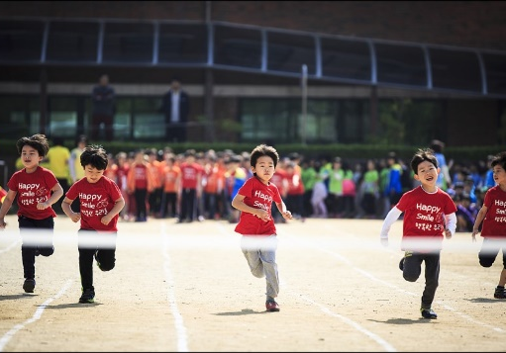
Part 2 Add title here
Add title here
He wants to find a job when he grows up. He came to the barber shop and waved his pincers to cut the hair for the customers.
Healthy growth of children
Parents actively cooperate
Teacher education

Slide 9
Part 2 Add title here
Add title here
He wants to find a job when he grows up. He came to the barber shop and waved his pincers to cut the hair for the customers.
Teacher education

Slide 10
Part 2 Add title here
Add title here
He wants to find a job when he grows up. He came to the barber shop and waved his pincers to cut the hair for the customers
Add title here
He wants to find a job when he grows up. He came to the barber shop and waved his pincers to cut the hair for the customers

Slide 11
Add title here
He wants to find a job when he grows up. He came to the barber shop and waved his pincers to cut the hair for the customers
Part 3

Slide 12
Part 3 Add title here
Add title here
Add title here
Add title here
He wants to find a job when he grows up. He came to the barber shop and waved his pincers to cut the hair for the customers.
He wants to find a job when he grows up. He came to the barber shop and waved his pincers to cut the hair for the customers.
He wants to find a job when he grows up. He came to the barber shop and waved his pincers to cut the hair for the customers.

Slide 13
Part 3 Add title here
He wants to find a job when he grows up. He came to the barber shop and waved his pincers to cut the hair for the customers.
He wants to find a job when he grows up. He came to the barber shop and waved his pincers to cut the hair for the customers.

Slide 14
Part 3 Add title here
He wants to find a job when he grows up. He came to the barber shop and waved his pincers to cut the hair for the customers.
He wants to find a job when he grows up. He came to the barber shop and waved his pincers to cut the hair for the customers.
He wants to find a job when he grows up. He came to the barber shop and waved his pincers to cut the hair for the customers.
He wants to find a job when he grows up. He came to the barber shop and waved his pincers to cut the hair for the customers.

Slide 15
Add title here
He wants to find a job when he grows up. He came to the barber shop and waved his pincers to cut the hair for the customers.
Part 4

Slide 16
Part 4 Add title here
He wants to find a job when he grows up. He came to the barber shop and waved his pincers to cut the hair for the customers.

Slide 17
Part 4 Add title here
Add title here
He wants to find a job when he grows up. He came to the barber shop and waved his pincers to cut the hair for the customers.
Add title here
He wants to find a job when he grows up. He came to the barber shop and waved his pincers to cut the hair for the customers.
Add title here
He wants to find a job when he grows up. He came to the barber shop and waved his pincers to cut the hair for the customers.

Slide 18
Part 4 Add title here
Add title here
Add title here
He wants to find a job when he grows up. He came to the barber shop and waved his pincers to cut the hair for the customers.
He wants to find a job when he grows up. He came to the barber shop and waved his pincers to cut the hair for the customers.
Add title here
Add title here
He wants to find a job when he grows up. He came to the barber shop and waved his pincers to cut the hair for the customers.
He wants to find a job when he grows up. He came to the barber shop and waved his pincers to cut the hair for the customers.

Slide 19
Thank you

