Slide 1










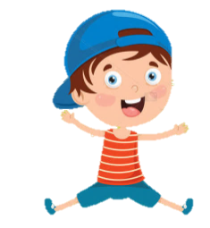





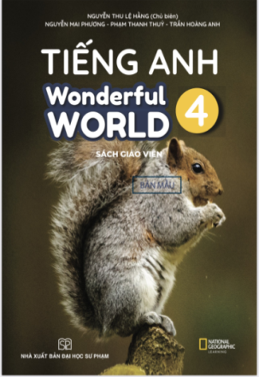



Slide 2



Unit 2 - My House
Lesson 2 – Period 2

Slide 3
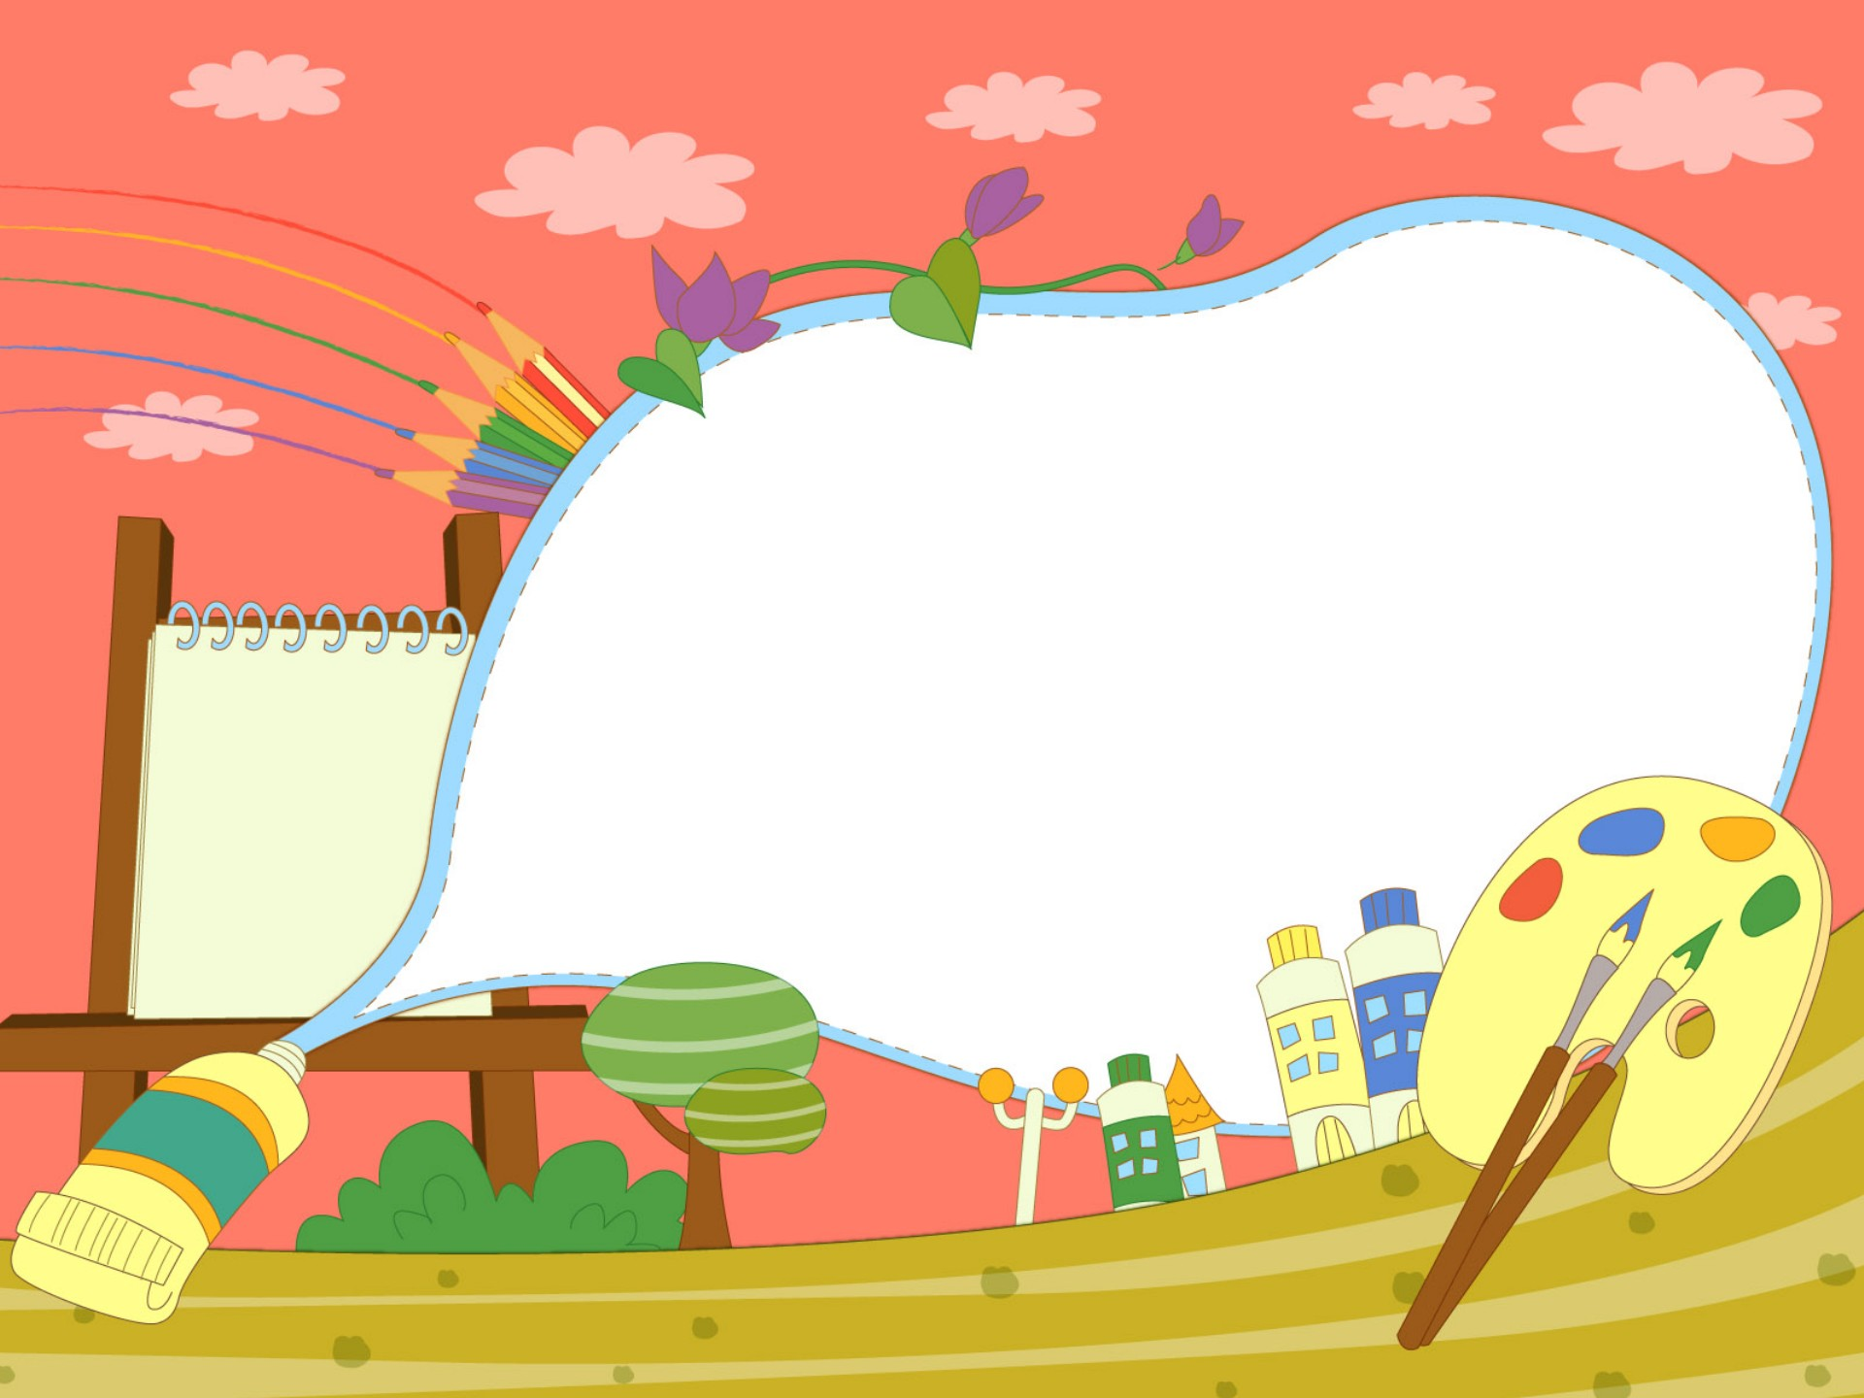

1.Warm up
Matching Time

Slide 4


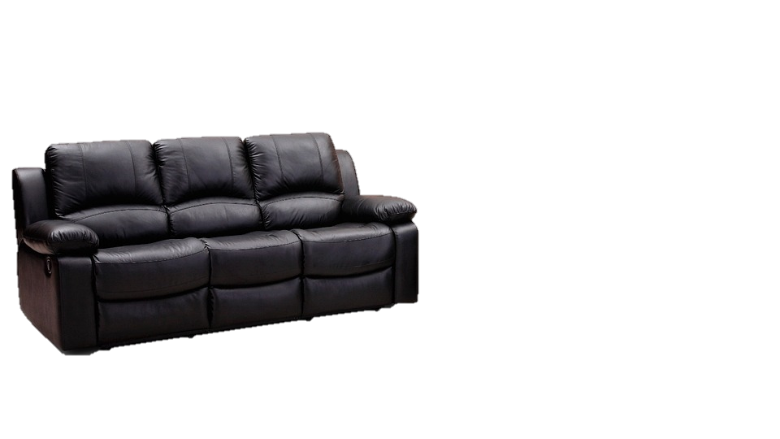

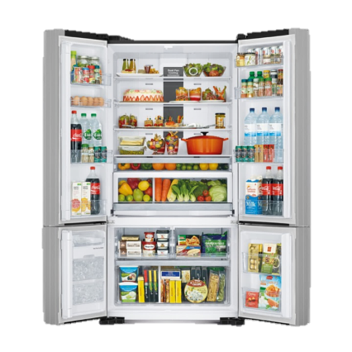
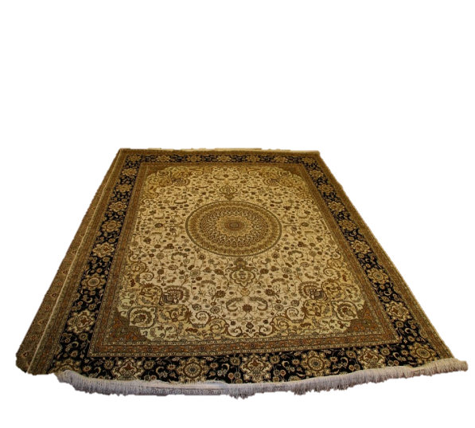
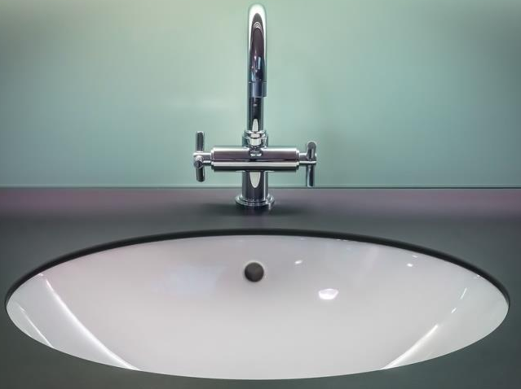
fridge
sink
rug
sofa

Slide 5

Presentation
4
Listen and repeat.

Slide 6

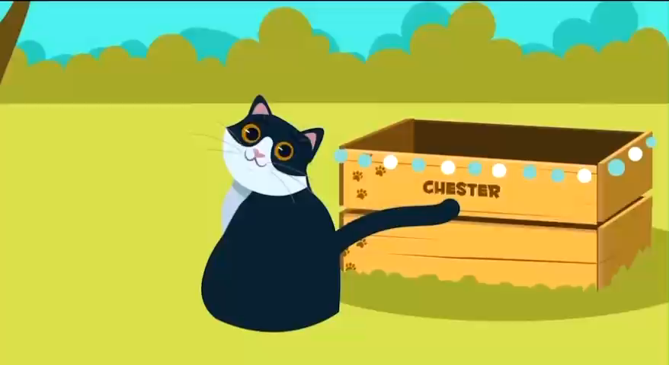

Slide 7
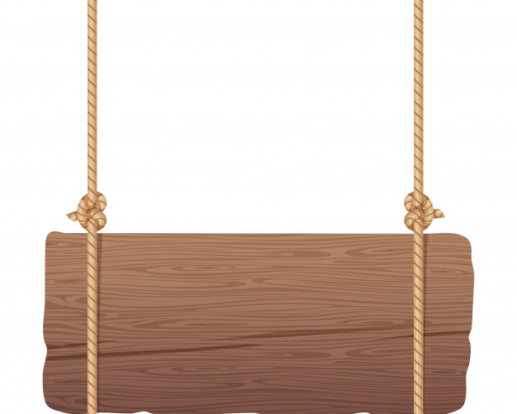
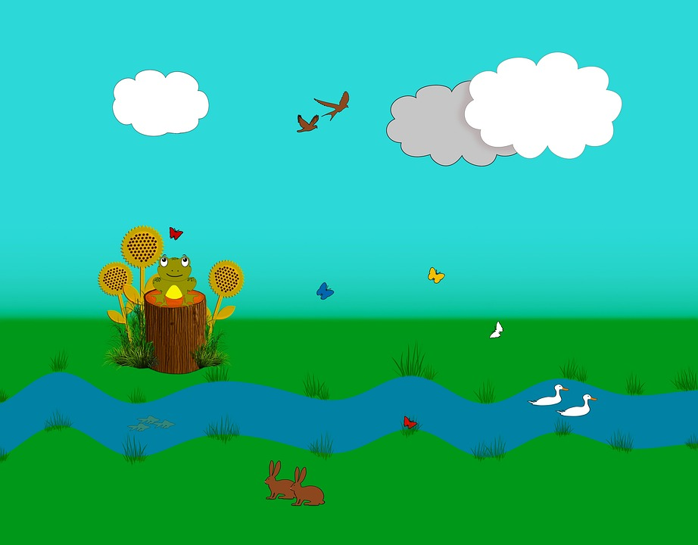

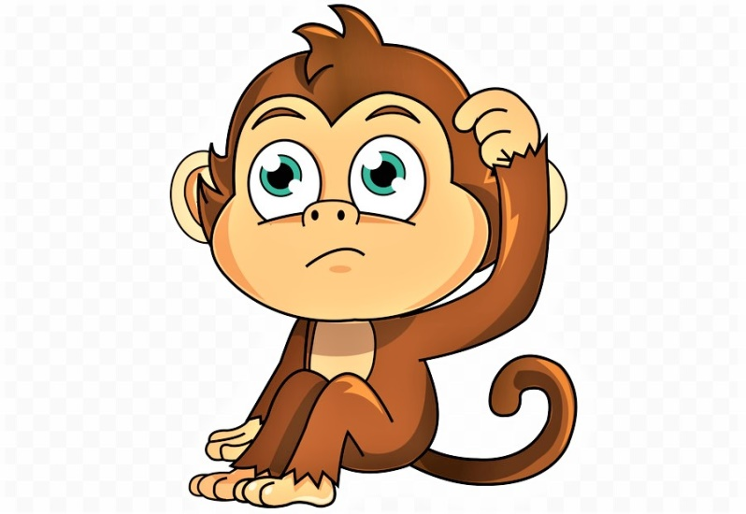
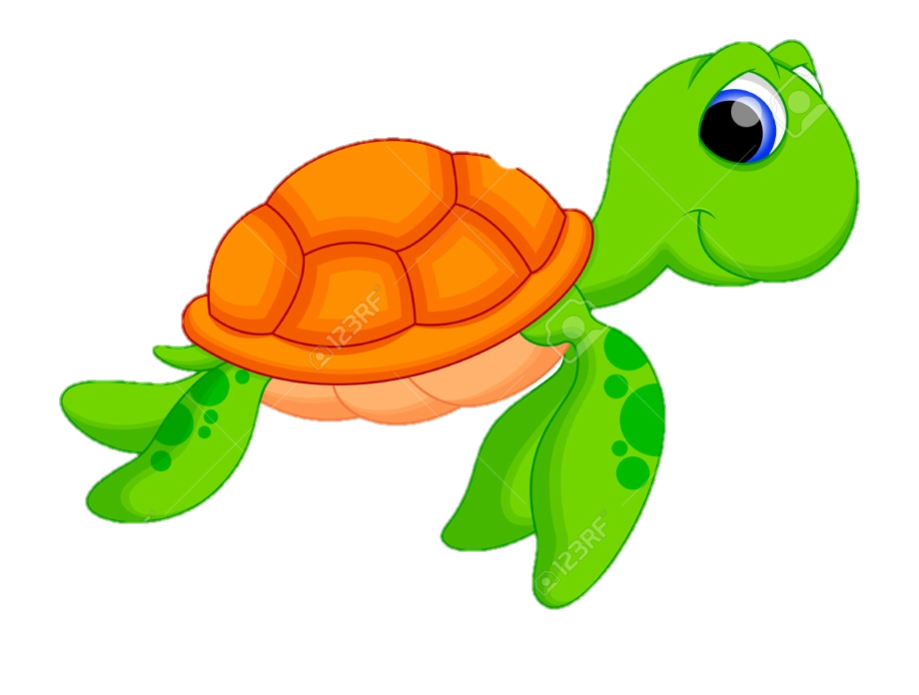
help the monkey

Slide 8

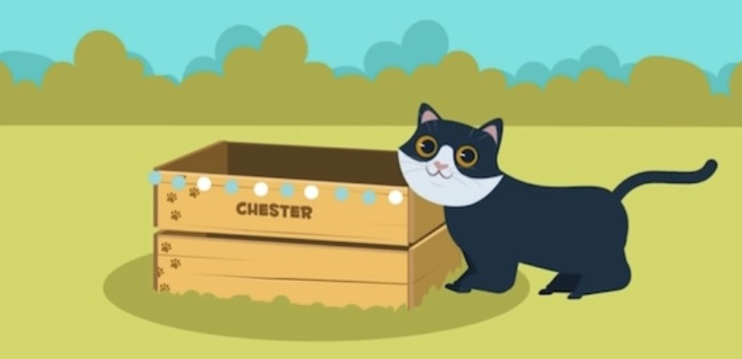
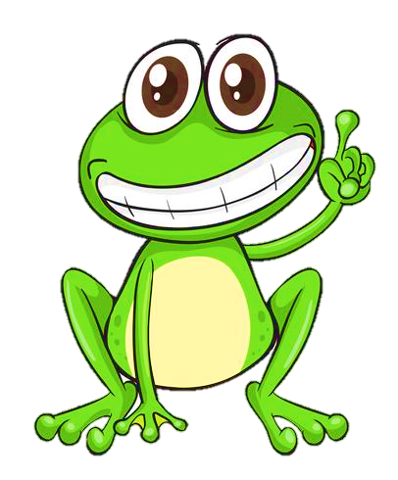

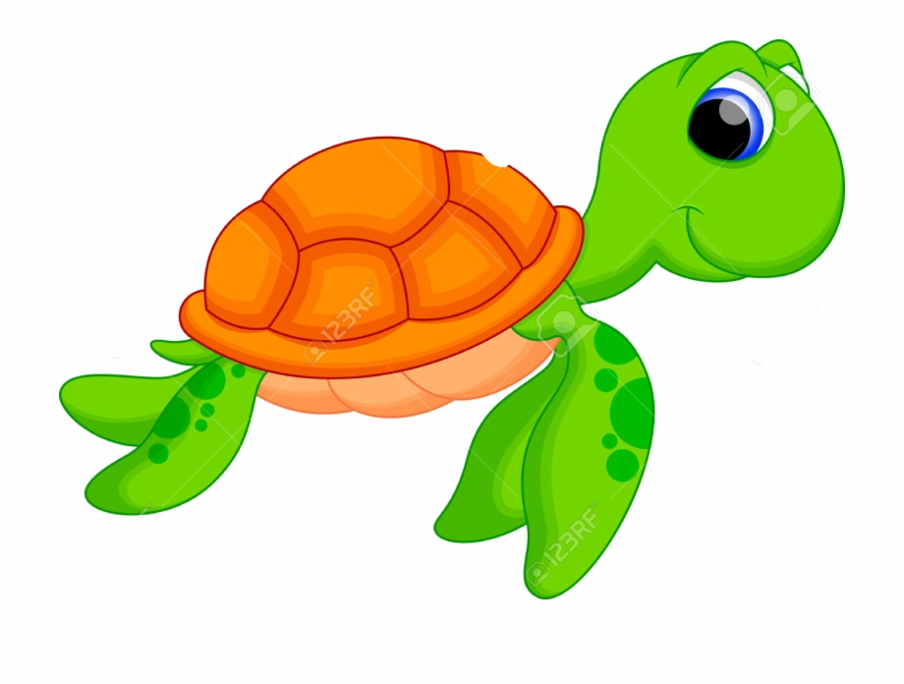
Question 1
The cat is ____ the box.
4 stars
Next to
on
next to
Notes:
Ấn vào con ếch/ chim cánh cụt có đáp án đúng để xem điểm

Slide 9
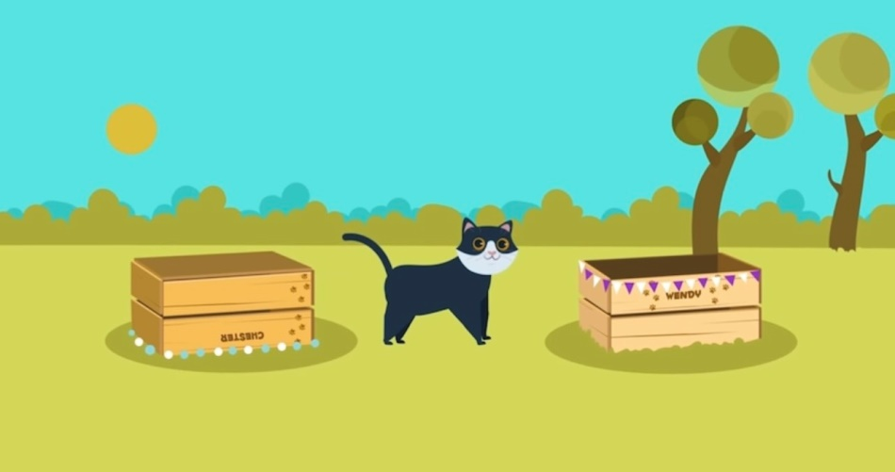


Question 2
It’s ____ the boxes.
behind
between
7 stars

Slide 10
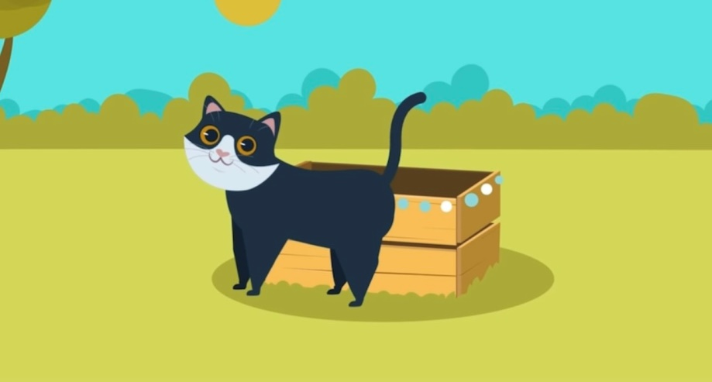
Question 3
The cat is ____ the box.
6 stars
Next to
in
in front
of

Slide 11
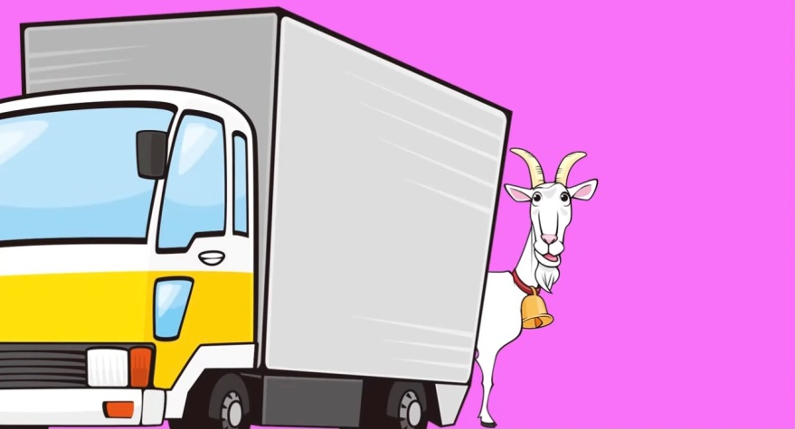
Question 4
The goat is ___ the truck.
under
behind
5 stars

Slide 12

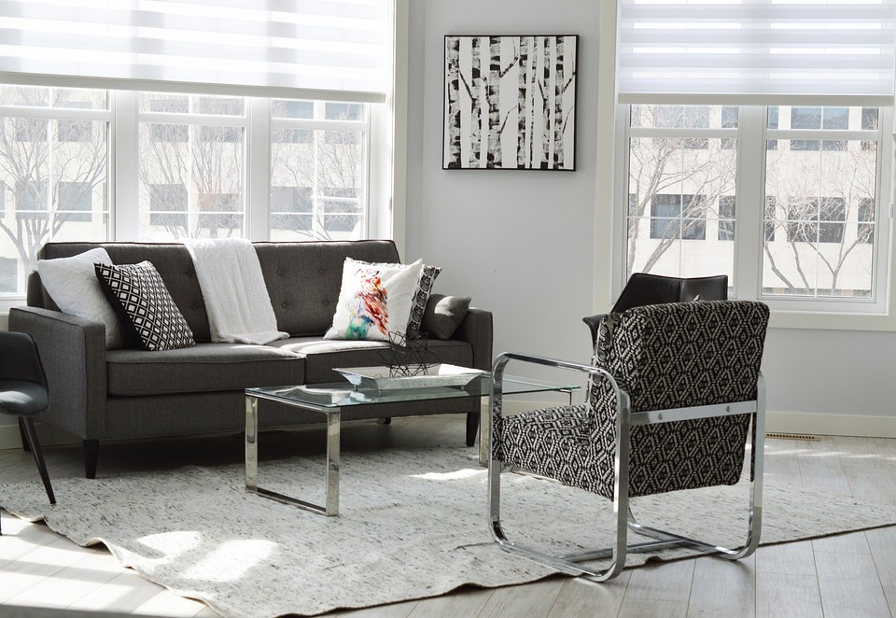
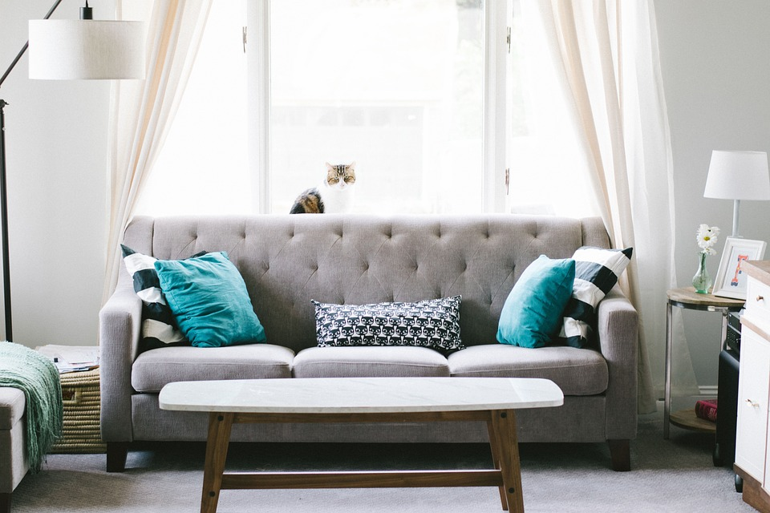
4
Listen and repeat.
2. Where is the sofa?
-It’s between two lamps.
1. Where is the rug?
-It’s in front of the sofa.

Slide 13
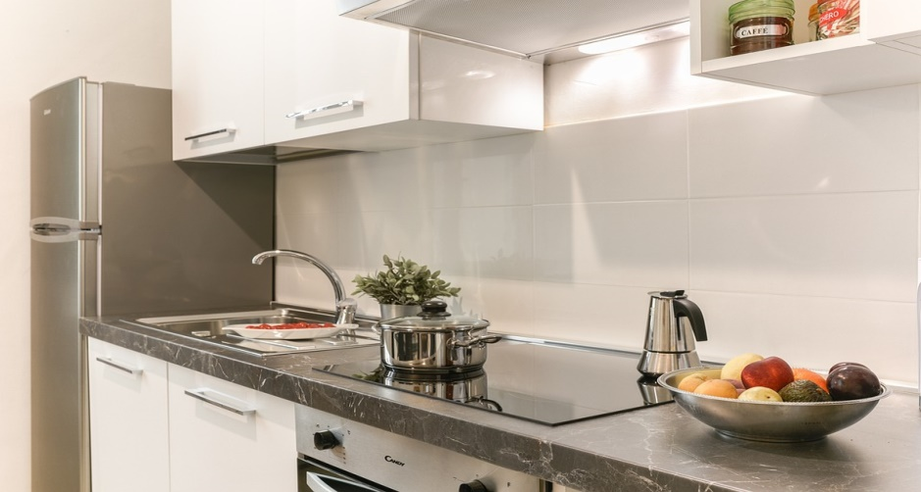
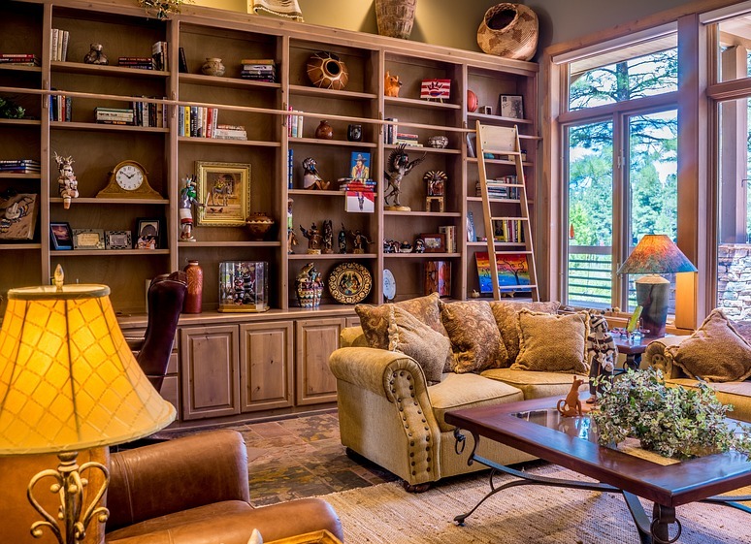
3. Where is the fridge?
4. Where are the books?
-It’s next to the sink.
- They’re behind the sofa.

Slide 14
Monday, September 25th, 2023
Unit 2 – Lesson 2 (cont)
New words
in : bên trong
on: bên trên
under: bên dưới
in front of: phía trước
behind: phía sau
next to: bên cạnh
between: ở giữa
II. Sentences
Where is the cat?
- It’s in the box.
Where are the books?
- They’re behind the sofa.

Slide 15

Practice
5
Look and say.

Slide 16


Yes or No

Slide 17
1. Is this a rug?
2. Is the rug behind the table?
Yes
No
Yes
No
No, it isn’t.
It’s under the table.

Slide 18
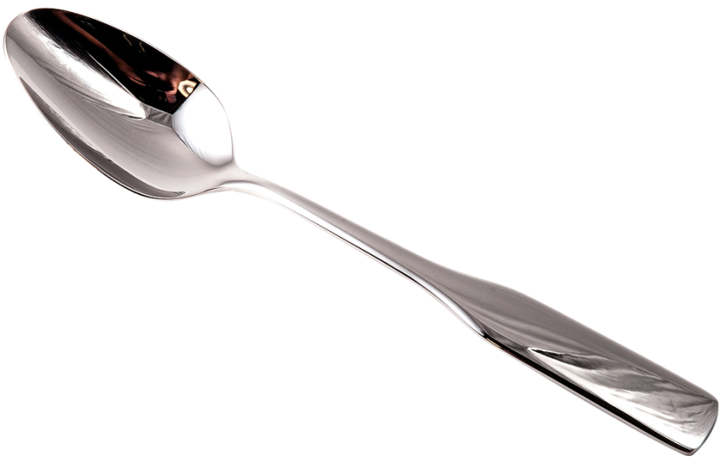
3. Are they two plates?
4. Is the sofa behind the table?
Yes
No
Yes
No
No, they aren’t.
They are spoons.

Slide 19

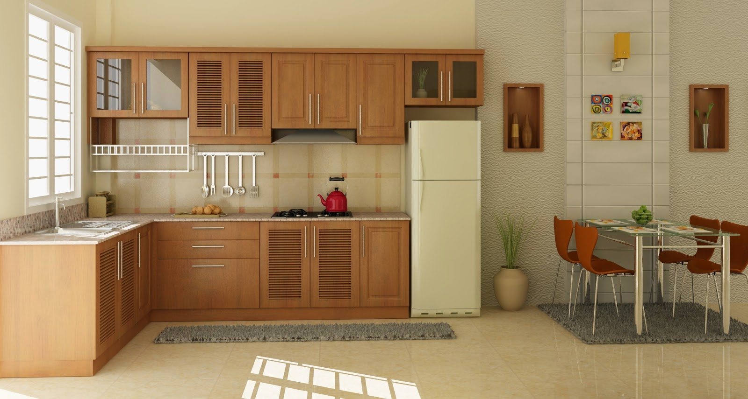


5
Look and say.
The rug/ in front of/ the fridge
Where is the rug?
The rug is in front of the fridge.

Slide 20


The sofa/ behind/ the table
Where is the sofa?
The sofa is behind the table.

Slide 21
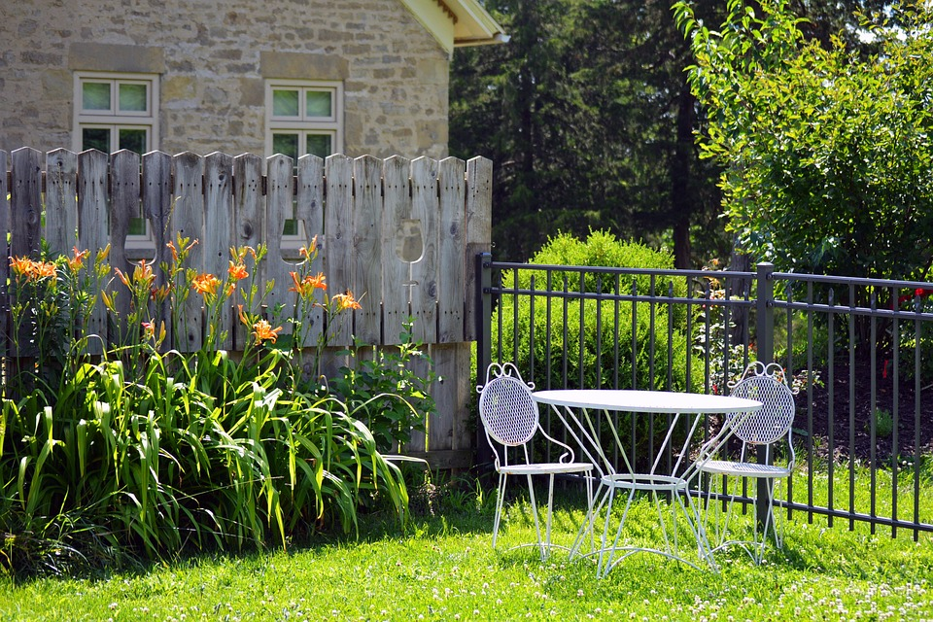
The table/ between/ two chairs
Where is the table?
The table is between two chairs.

Slide 22

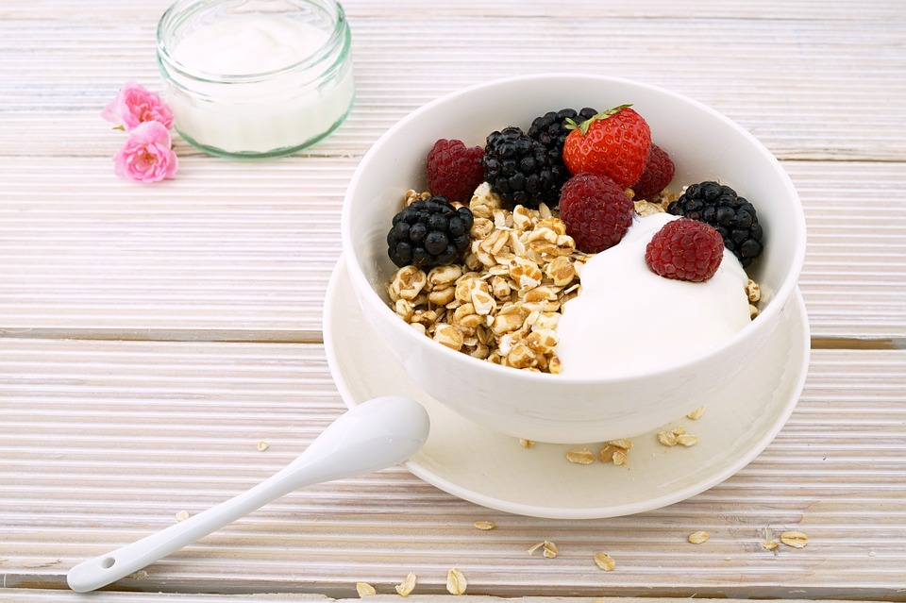
The bowl/ next to/ the spoon
Where is the bowl?
The bowl is next to the spoon.

Slide 23

Production
6
Listen and chant.

Slide 24

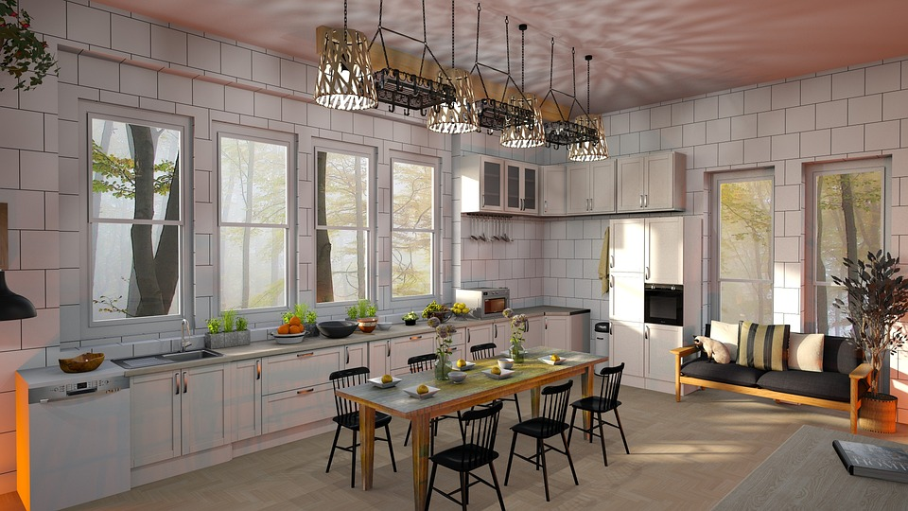
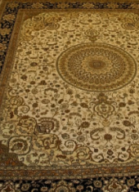
What do you see in the picture?

Slide 25
What do you see in the picture?
big fridge
small sink
brown table
black chairs
colorful rug
some bowls
………………

Slide 26


6
Listen and chant.
This is our kitchen,
our lovely kitchen.
There’s a fridge, a big, big fridge.
There’s a sink,
a small, small sink.
There are some rugs colourful, colourful rugs.
Come and see
our lovely kitchen!
Notes:
Hs nghe bài chant

Slide 27
6
Listen and chant.
This is our kitchen,
our lovely kitchen.
There’s a fridge, a big, big fridge.
There’s a sink,
a small, small sink.
There are some rugs colourful, colourful rugs.
Come and see
our lovely kitchen!
Notes:
Hs học chant từng câu

Slide 28

Let’s chant.
There’s a sink,
a small, small sink.
This is our kitchen,
our lovely kitchen.
There are some rugs colourful, colourful rugs.
There’s a fridge, a big, big fridge.
Come and see
our lovely kitchen!
Notes:
Hs tự hát

Slide 29

Assessment

Slide 30
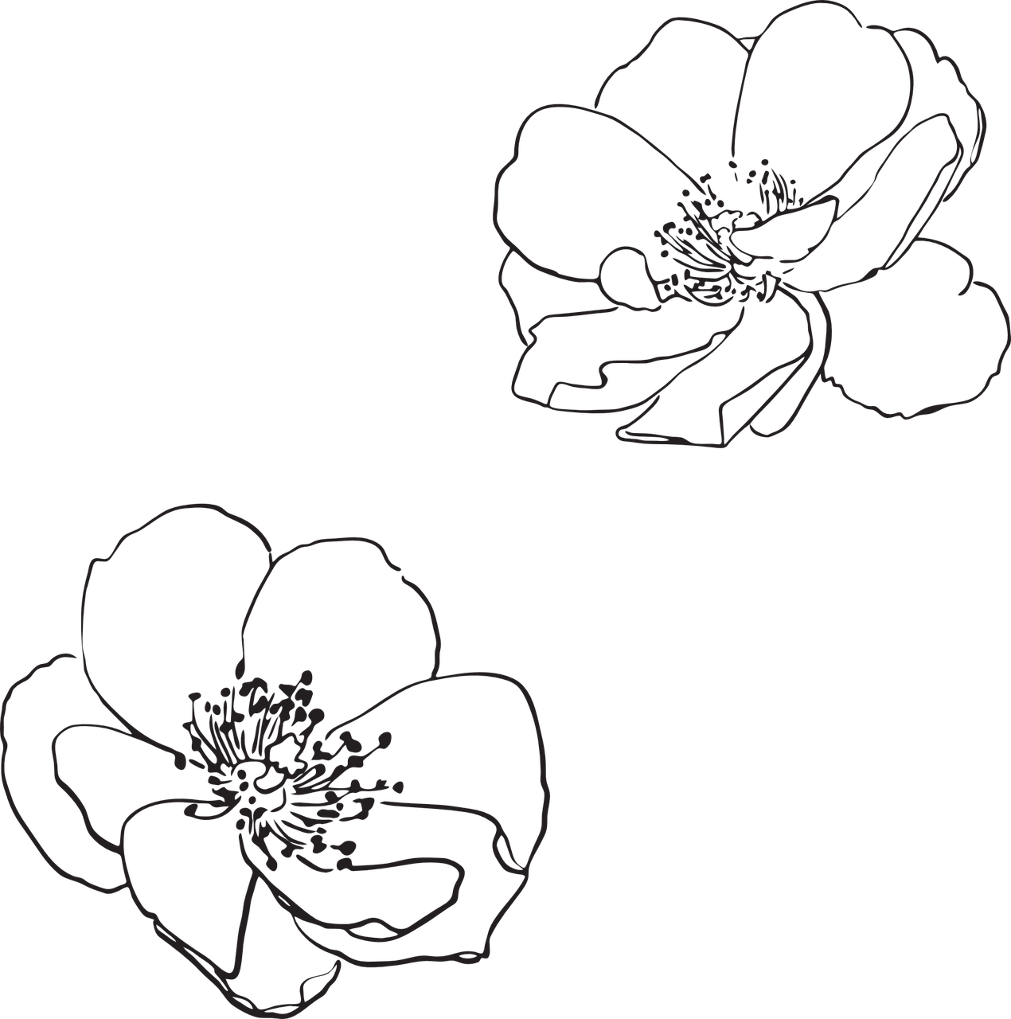
Order the words to make complete sentences
1. This/ our/ is/ kitchen/ lovely.
This is our lovely kitchen.
__________________
2. The/ between/ is/ table/ chairs/ two.
The table is between two chairs.
_________________________
3. Three/ next to/ are/ bowls/ plate/ the.
Three bowls are next to the plate.
_________________________
4. Where/ the/ rug/ is/ ?
Where is the rug?
_____________

Slide 31

Wrap up
Notes:
Đây k phải là extra, đây là hđ 3 của bài

Slide 32
REMEMBER
VOCABULARY:
Behind
Under
Next to
Between
In front of
STRUCTURE:
Where is the rug?
- The rug is in front of the fridge.
32

Slide 33




Thank you & goodbye!

