Slide 1
Unit 3: Community service
LESSON 6: SKILLS 2
Tom and Linda’s community activities last summer.
Listening
Writing
Write an email about your school activities last summer.

Slide 2
WARM-UP
Your plans for school activities next summer holiday?
* Example:
- picking up litter
- planting trees
- donating old clothes, old books,….
- tutoring poor children.
……………….

Slide 3
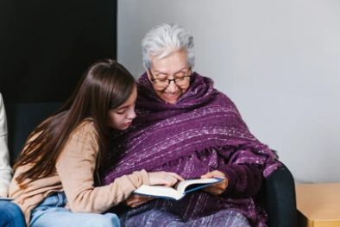
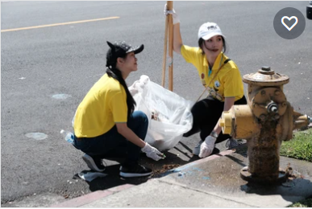
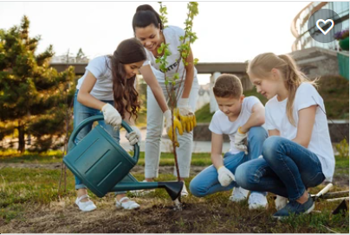
I/ LISTENING
1
What community activities are the children doing in the pictures?
a
b
c
reading books to the elderly
picking up litter
planting trees

Slide 4
2
Listen to Tom and Linda talking about their community activities last summer. Circle the correct answers.
1. Linda and her friends taught ______. A. English and literature B. maths and history C. English and maths 2. Linda and her friends ______ the elderly. A. talked to B. cooked for C. read books to
3. Tom and his friends picked up ______. A. books and paper B. bottles and books C. paper and bottles 4. Tom and his friends ______. A. grew some trees B. tutored maths C. cleaned schools

Slide 5
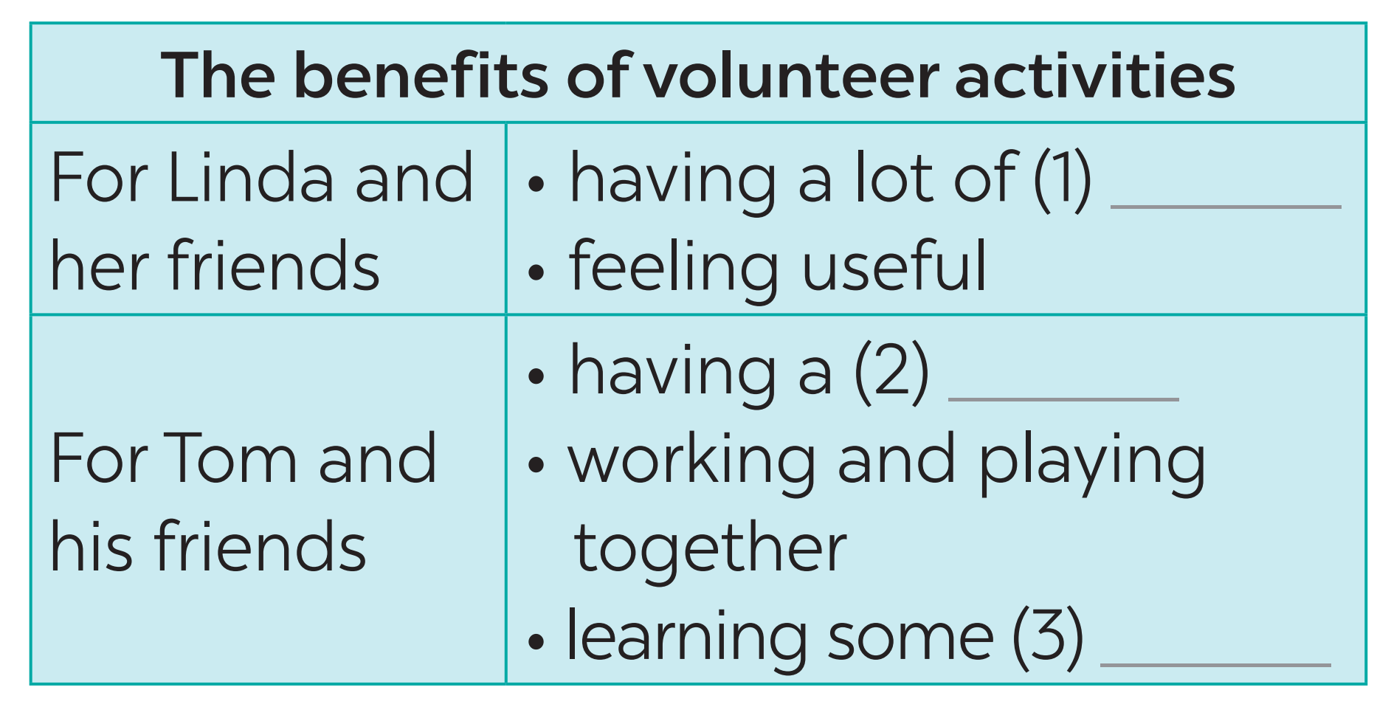
3
Listen again and fill in each blank with no more than two words.
fun
good time
skills

Slide 6
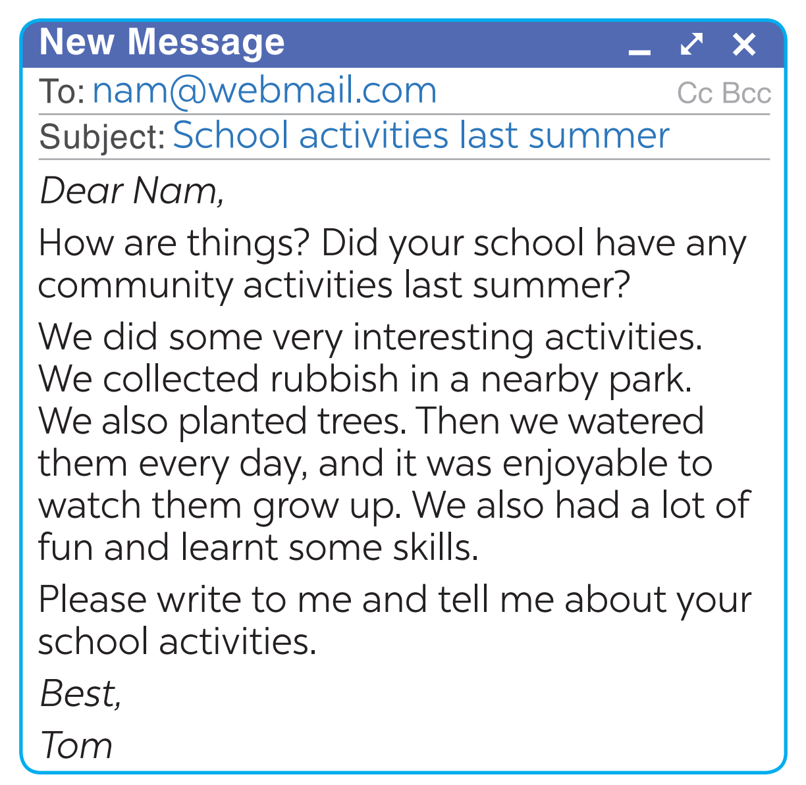
II/ WRITING
4
Read Tom’s email to Nam about his school activities last summer.
Who is writing to whom?
Tom is writing to Nam
What is the subject of the email?
School activities last summer

Slide 7
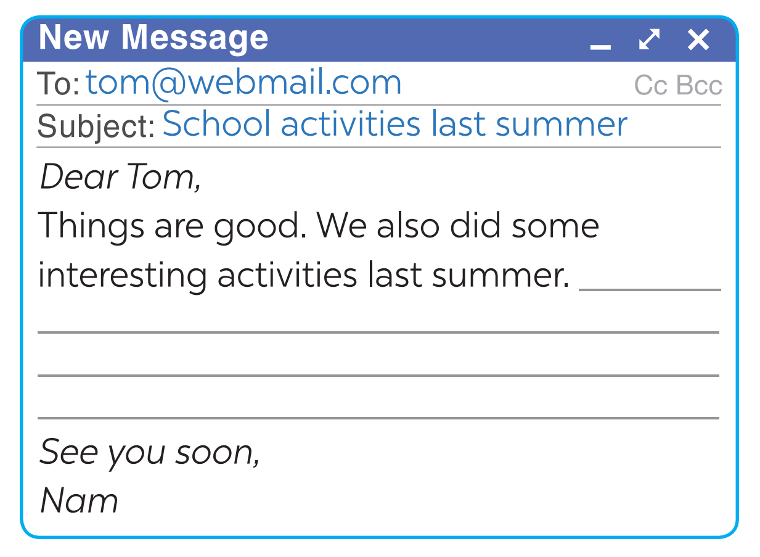
5
You are Nam. Now write an email of about 70 words to Tom about your school activities last summer. Start your email as shown below.

Slide 8
5
You are Nam. Now write an email of about 70 words to Tom about your school activities last summer. Start your email as shown below.
To: tom@webmail.com
Subject: School activities last summer
Dear Tom,
Things are good. We also did some interesting activities last summer. Latest here on Sunday, I and my brother donated books and clothes for a charity organization. In here, I met the orphan’s children. I played with them. Then I gave candies to them. They were all very happy and so did I.
Please write back to me.
See you soon,
Nam

Slide 9
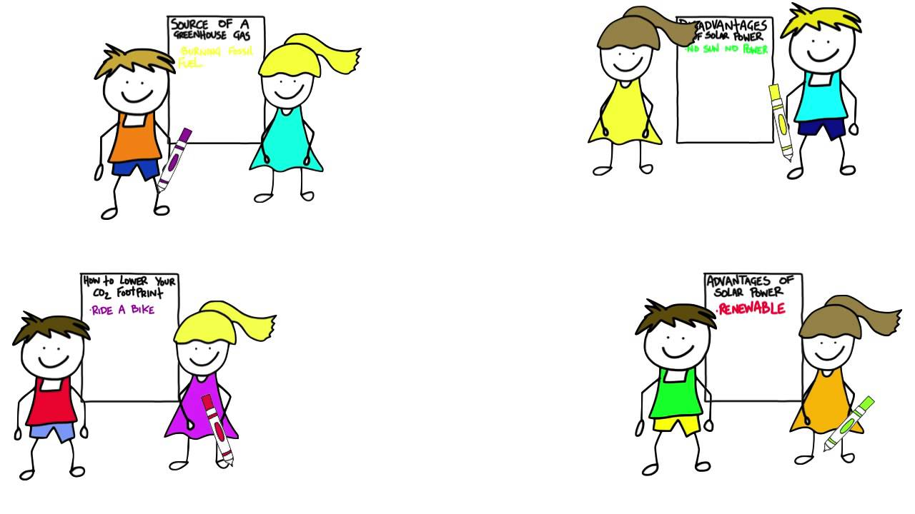
* POST-LISTENING & WRITING
CLASS GALLERY
Students can:
go and see other’s work
give comments to each other

Slide 10
* CONSOLIDATION
1
WRAP-UP
In this lesson, we have learnt to:
listen for specific information about some community activities and their benefits;
write an email about community activities one did last summer.

Slide 11
* CONSOLIDATION
2
HOMEWORK
Rewrite the email on your notebook.
Prepare for the next lesson: Looking back & Project

Slide 12
Goodbye.
See you again.

