Slide 1
Good morning class!!!

Slide 2
* Warm up:
Game: Pelmanism
In the morning
On Monday
1
2
At
5 o’clock
At
home
3
4
On the table
5
6
Ở nhà
Ở trên
cái bàn
8
7
Vào lúc
5 h đúng
9
Vào buổi sáng
Vào thứ 2
10

Slide 3
Unit
6
A VISIT TO A SCHOOL
LESSON 3: A CLOSER LOOK 2
* Grammar:
Prepositions of time
Prepositions of place

Slide 4
* PREPOSITIONS OF TIME AND PLACE
 | at | in | on
Prepositions of time | * A point of time - at six o’clock - at noon - at break time | * A period of time (longer / shorter than a day) - in the morning / afternoon / evening - in December - in 2020 | * A day or a part of day - on Monday - on January 18th - on Christmas Day
Prepositions of place | * A certain point - at home - at school - at work | * Inside sth / a place - in the classroom - in the school garden - in the playground | * On the surface of sth - on the board - on the wall - on the second floor

Slide 5
I. PREPOSITIONS OF TIME
1
Complete the sentences, using suitable prepositions of time.
1. In England, schools usually starts ___ 9 a.m. and finish ___ 4 p.m.
2. They built our school a long time ago, maybe ___ 1990.
3. We are going to visit Thang Long Lower Secondary School ___ January.
4. The school year usually begins ___ September 5th every year.
5. The children like playing badminton and football ___ their break time.
at
at
in
in
on
at

Slide 6
2
Work in pairs. Ask and answer questions about your school.
1. When does your school year start?
2. When do you have English lessons?
3. When do you usually celebrate Teachers’ Day?
4. When are you going to finish the school year?

Slide 7
2
Work in pairs. Ask and answer questions about your school.
When does your school year start?
2. When do you have English lessons?
3. When do you usually celebrate Teachers’ Day?
4. When are you going to finish the school year?
→ My school year starts in September.
→ I have English lessons on Monday and Friday
→ I usually celebrate Teacher's Day on November 20th
→ I am going to finish the school year in May.

Slide 8
II. PREPOSITIONS OF PLACE
3
Complete the sentences with at, in or on.
1. Her classroom is ___ the third floor of that building.
2. When I’m at school, my parents are ___ work.
3. Look! The students are playing football ___ the classroom.
4. My little sister usually has lunch ___ school.
5. The most beautiful posters are ___ the wall ___ the staffroom.
on
at
in
at
on
in

Slide 9
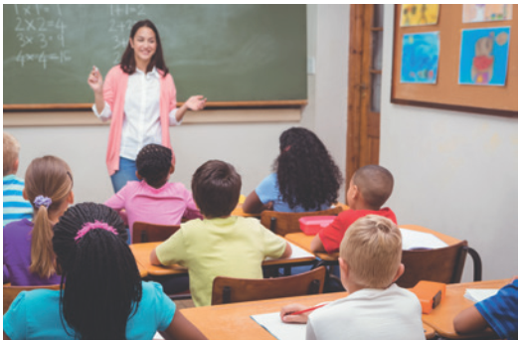
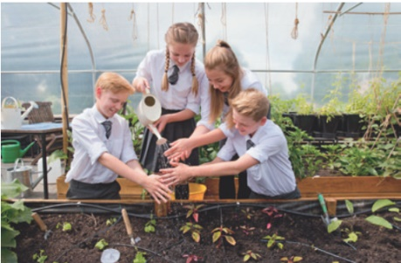
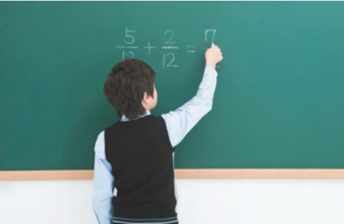
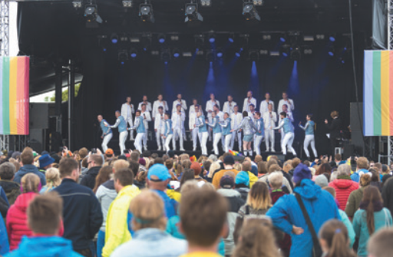
4
Work in pairs. Look at the pictures and answer the questions.
1. Where does Mrs Hien teach maths?
At school.
2. Where do the students water the flowers?
In the school garden.
3. Where is the boy writing?
On the board.
4. Where do they sing English songs on Teachers’ Day?
On the stage.

Slide 10
* FURTHER PRACTICE
5
Complete the passage with at, on or in. Then discuss in groups which prepositions express time and which ones express place.
Tom’s mother is at home, but she is not (1) ___ the kitchen. She usually waters the vegetables in the garden (2) ___ the morning.
Tom’s father is (3) ___ work, but he isn’t in his office at the moment. It is lunch break and he is (4) ___ a travel agent’s, looking at holiday brochures.
Tom is usually at school this time, but he has a bad cold today. He has nothing to do but lying (5) ___ the sofa and looking at the posters (6) ___ the wall.
in
in
in
in
at
at
at
at
on
on
on
on

Slide 11
Discuss in groups which prepositions express time and which ones express place.
Prepositions express time | Prepositions express place
- be at work: đang làm việc | - in the kitchen: trong bếp - in the morning: vào buổi sáng - at a travel agent's : ở đại lý du lịch - on the sofa: trên ghế sô pha - on the wall: trên tường

Slide 12
* CONSOLIDATION
Grammar:
Prepositions of time
Prepositions of place

Slide 13
I. PREPOSITIONS OF TIME
at | in | on
at six o’clock at noon at break time | in the morning / afternoon / evening in December in 2020 | on Monday on January 18th on Christmas Day
A point of time
A period of time
(longer / shorter than a day)
A day or a part of day

Slide 14
II. PREPOSITIONS OF PLACE
at | in | on
at home at school at work | in the classroom in the school garden in the playground | on the board on the wall on the second floor
A certain point
Inside sth / a place
On the surface of sth

Slide 15
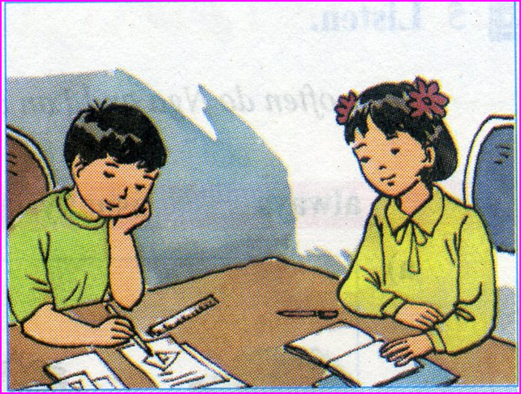
homework
Do exercises in the Workbook.
Make sentences using the prepositions of time and place

Slide 17
Prepositions of time 1. at + giờ (at 5 o’clock, at 4:30 p.m.) + buổi trong ngày (at noon, at night, at weekend) + các kỳ nghỉ lễ (at Christmas, at Easter) + cụm giờ cố định (at the same time) 2. in + tháng (in April) + mùa (in spring, in winter) + năm (in 2022) + buổi trong ngày (in the morning / afternoon / evening) + khoảng thời gian (in 3 days, in 5 minutes, in freetime) 3. on + ngày (on Tuesday, on her birthday) + ngày + tháng (on the 1st of January) hoặc tháng + ngày (on Feb 2nd) + ngày + morning/ afterrnoon / evening (on Sunday morning) + ngày lễ + day (on Christmas day)

Slide 18
* Prepositions of place 1. at - Dùng để chỉ vị trí tại 1 điểm + at home, at the station/airport/door/office + at the top/bottome of, at the beginning/end of - Dùng để chỉ nơi làm việc, học tập: at work, school, university, college Dùng để chỉ địa chỉ cụ thể: at 55 Tran Phu street 2. in - Chỉ vị trí bên trong diện tích, không gian + in the room/ building/restaurant/park + in the sea/in the world/in the sky + in a book/newspaper/photo - Đứng trước tên làng, thị trấn, thành phố, quốc gia + in France, in Ha Noi, in Viet Nam - Dùng với phương tiện đi lại bằng xe taxi hoặc xe hơi + in a car/taxi - Dùng để chỉ phương hướng hoặc một số cụm từ chỉ nơi chốn + in the south/east/west/north

Slide 19
3. on
- Chỉ số tầng (nhà), nơi chốn
+ on the ground, on the 1st/2nd floor,
+ on the platform/railway
- Chỉ bề mặt: on the table/ carpet/wall/ceiling/board/screen/map/page
- Dùng trước tên đường: on the street, on Wall street
- Dùng với phương tiện đi lại công cộng hoặc cá nhân (trừ car &taxi): on a bus/ train/plane/ship/bike/motorbike/horse
- Dùng trong 1 số trường hợp sau: on the left/right, on the front/back of …

