Slide 1
Hello every one !!!

Slide 2
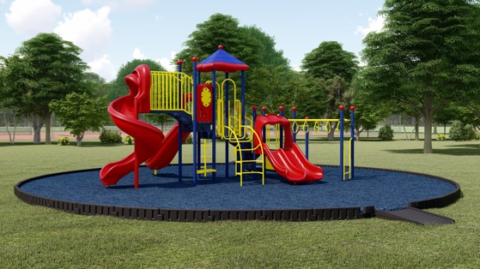
* WARM-UP
Game: The hidden word
1. What is this?
PLAYGROUND
_ _ _ _ _ _ _ _ _ _
SUBJECT
2. My favourite _ _ _ _ _ _ _ is Maths.
CLUB
3. My and Phong are members of “Go Green _ _ _ _ .”
FOUNDED
4. Quoc Hoc – Hue was _ _ _ _ _ _ _ in 1986.
ON
5. The school year usually begins _ _ September 5th every year.

Slide 3
* WARM-UP
Game: The hidden word
The hidden word:
ROTUODO
OUTDOOR
_ _ _ _ _ _ _

Slide 4
Unit
6
A VISIT TO A SCHOOL
LESSON 6: SKILLS 2

Slide 5
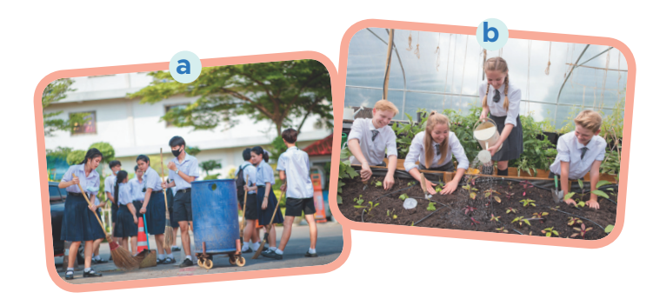
I. LISTENING
1
Work in pairs. Look at the pictures and discuss the questions.
What outdoor activities do they take part in?
Why do they do these activities?
1. They are collecting the garbage and planting trees.
2. Because they want to clean the environment.

Slide 6
2
Listen to an interview between a reporter and two students. Circle the appropriate option (A, B, or C) to complete each sentence.
1. Trang and Phong are talking about _____. A. school subjects B. school timetables C. outdoor activities 2. They are members of _____ club(s). A. one B. two C. three 3. The Go Green Club cleans streets on _____.
A. Saturday afternoons B. Saturday mornings C. Sunday afternoons 4. They grow _____ in the school garden. A. vegetables B. flowers C. trees

Slide 7
Choose the best answer

Slide 8
5
4
1
1. Trang and Phong are talking about _____.
3
2
a. school subjects
b. school timetables
c. outdoor activities

Slide 9
5
4
1
2. They are members of _____ club(s).
3
2
a. one
b. two
c. three

Slide 10
5
4
1
3. The Go Green Club cleans streets on _____.
3
2
a. Saturday afternoons
b. Saturday mornings
c. Sunday afternoons

Slide 11
5
4
1
4. They grow _____ in the school garden.
3
2
a. vegetables
b. flowers
c. trees

Slide 12
3
Listening to the interview again and answer the questions.
1. What do Trang’s club members encourage their classmates to do? 2. What does the reporter think about their activities? 3. When and where do Nam’s club members grow vegetables?
They encourage their classmates to recycle glass, cans and paper.
The reporter thinks their activities protect the environment.
They grow vegetables in the school garden after school.

Slide 13
Tape transcript
Reporter: Hello, Trang and Phong. Can you tell me something about your school outdoor activities?
Trang: Well. School is great. We are busy with our subjects, but we really enjoy the opportunities we have for outdoor activities.
Reporter: Great. What types of outdoor activities do you take part in?
Trang: I'm a member of a club called Go Green Club. And we do lots of activities.
Reporter: What activities, for example?
Trang: Well, our members clean streets on Saturday afternoons. We also encourage our classmates to recycle glass, cans, and paper.
Reporter: Wonderful! I'm sure your activities help us protect our environment. What about you, Phong? What outdoor activities do you do?
Phong: Well. I'm a member of the Green Garden Club. We grow vegetables in the school garden after school. Our school canteen uses the vegetables for our lunches.
Reporter: Sounds interesting. And ...

Slide 14
II. WRITING
4
Work in pairs. Ask and answer questions about your school’s outdoor activities.
1. What outdoor activities do you take part in at school? 2. Which outdoor activity do you like the best?
3. Why do you like doing it?
→ I take part in many outdoor activities in my school like planting trees, picking up rubbish, recycling old paper, donating old books.
→ My favourite outdoor activity is planting trees.
→ Because it is good for the environment and makes me feel happy.

Slide 15
5
Write a paragraph of about 70 words about an outdoor activity at your school. You can use the information in Task 4.
My school is located in the center of my city. On the side of the school, there is a big garden. In my school, I take part in many outdoor activities in my school like planting trees, picking up rubbish, recycling old paper. I take part in many outdoor activities in my school like planting trees, picking up rubbish, ……. We also have other activities in the school such as football, basketball and many more. Planting trees is my favourite outdoor activity. It makes me a more responsible and creative . It also protects our environment.

Slide 16
* Production
CLASS GALLERY
Students can:
go and see others’ work
give comments to one another

Slide 17
* CONSOLIDATION
In this lesson, we have learnt to:
listen for general and special information about school activities
write a short paragraph about outdoor activities at one’s school

Slide 18
homework
Do EX in the workbook.
Prepare for the next lesson: Looking back & Project

Slide 19
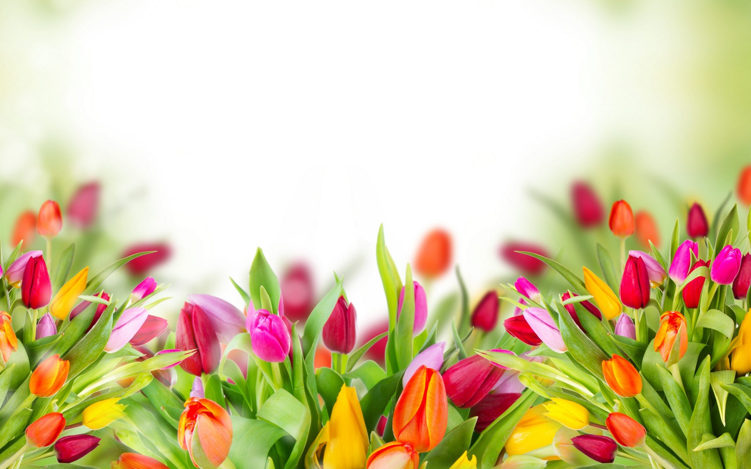
Thank you!
Have a nice day!

