Slide 1
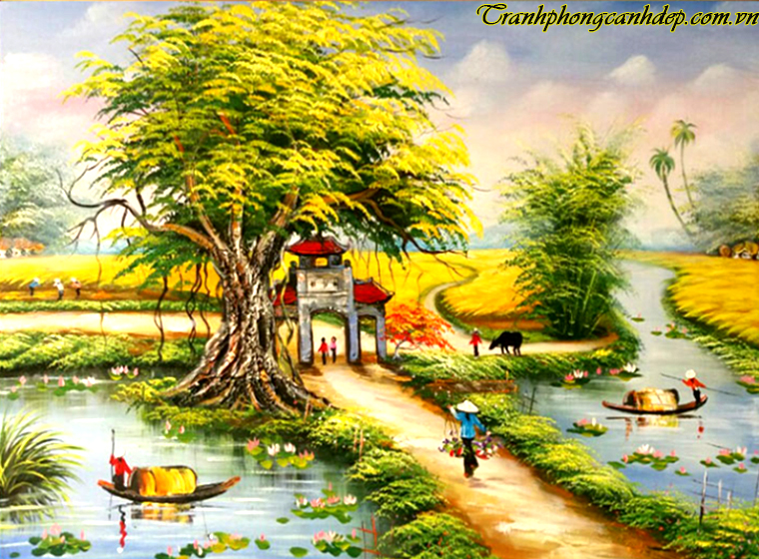
Unit 2:
Life in the countryside
UNIT 2: LIFE IN THE COUNTRYSISE
SKILLS 2
Skills 2

Slide 2
villager
dân làng
brick house
Nhà gạch
earthen house
Nhà đất
oil lamp
Đèn dầu
electric fan
quạt điện
cross a stream
Băng qua suối
visitor
Du khách
rainy season
Mùa mưa

Slide 3
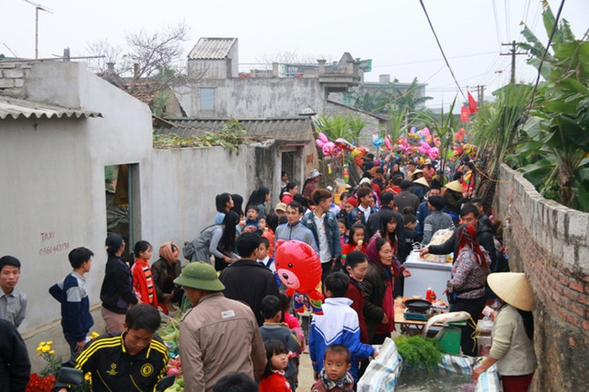
villager

Slide 4
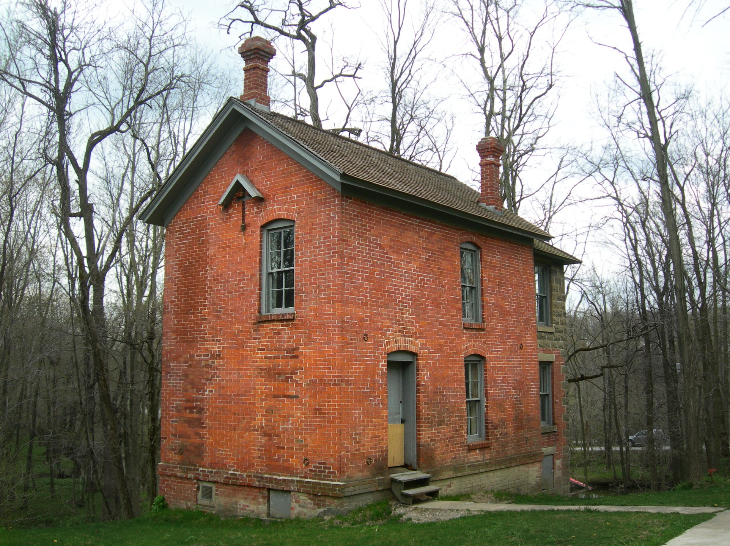
brick house

Slide 5
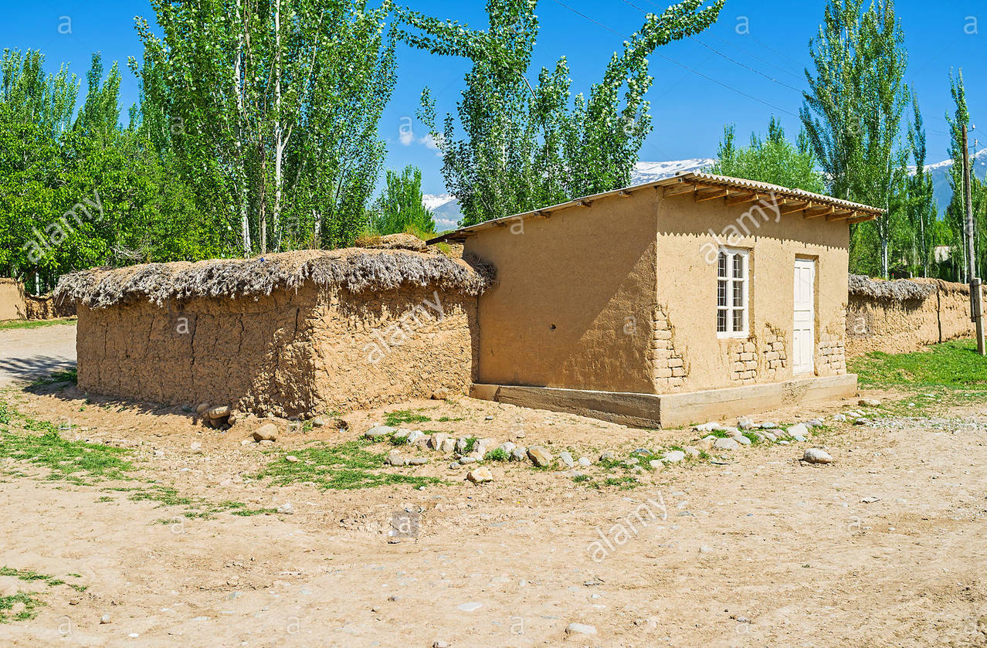
earthen house

Slide 6
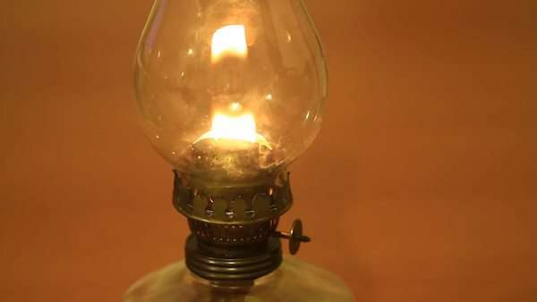
Oil lamp

Slide 7
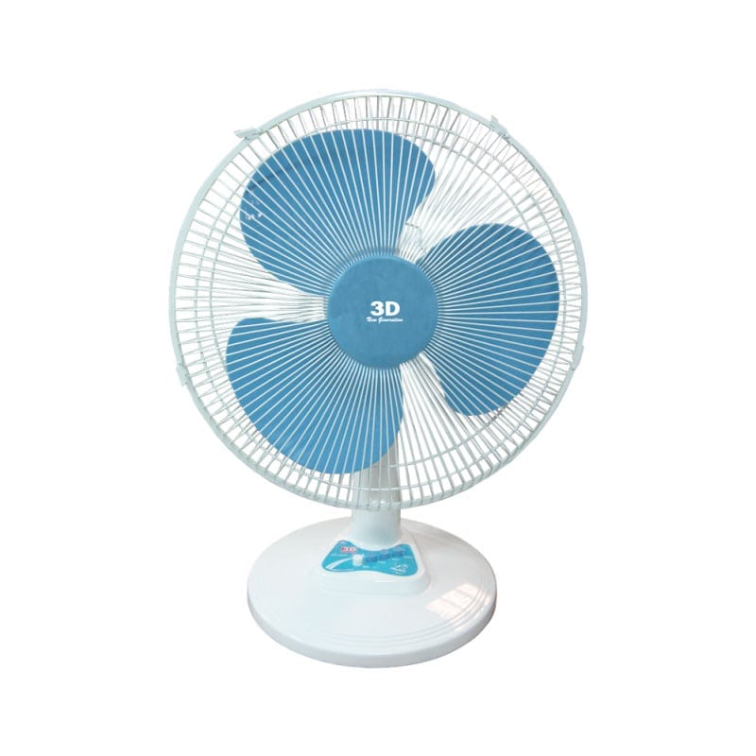
electric fan

Slide 8
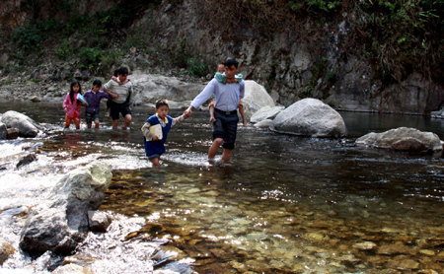
cross a stream

Slide 9
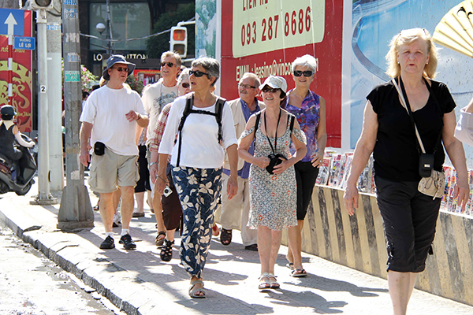
visitor

Slide 10
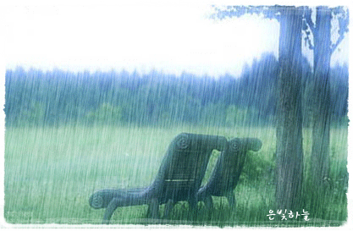
rainy season

Slide 11
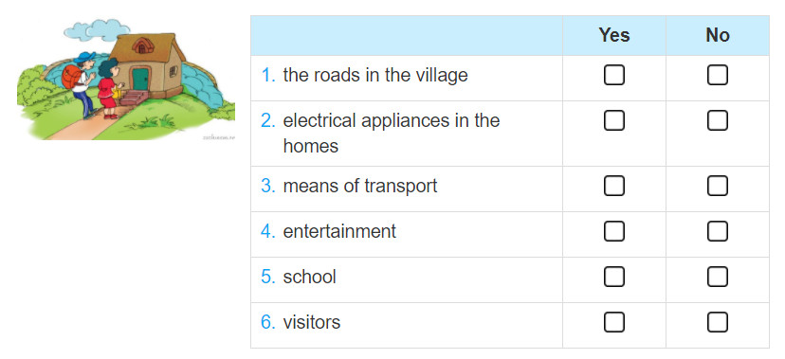
Listen to a boy talking about changes in his village and tick (✓) the changes he mentions.
✓
✓
✓
✓

Slide 12
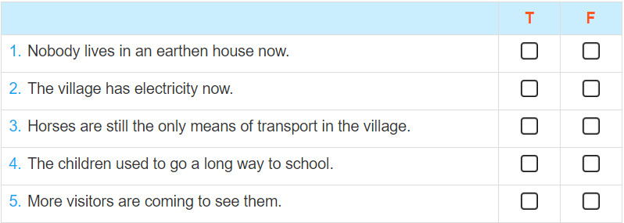
Listen again and say if the sentences are true (T) or false (F)
✓
✓
✓
✓
✓

Slide 13
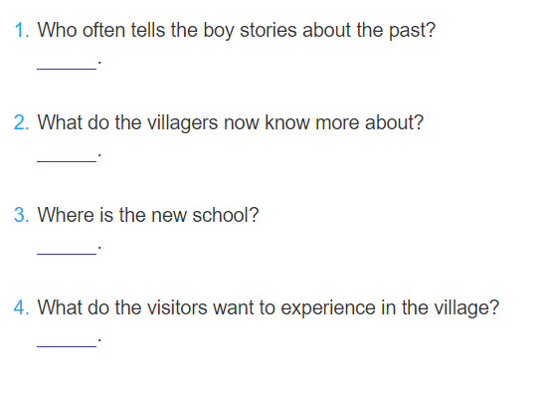
Listen again and answer the questions in no more than FOUR words.
His parents.
Life outside their village.
Near the village
A nomadic life

Slide 14
Audio script
I live in a mountainous village. My parents often tell me stories about their life in the past. It’s not much like the village I can see nowadays.
Some villagers now live in brick houses instead of earthen ones. Our houses are better equipped with electric fans and TVs. Thanks to the TV, we now know more about life outside our village. We don’t use oil lamps any more. We have electric lights which are much brighter. More villagers are using motorcycles for transport instead of riding a horse or walking. We — village children — no longer have to waik a long way and cross a stream to get to school, which is dangerous in the rainy season. Now there’s a new school nearby. We also have more visitors from the city. They come to experience our way of life.

