Slide 1
HELLO MY FRIENDS
WE ARE TEAM 3

Slide 2
TEAM 3
NGUYEN QUYNH ANH NGUYEN DUC MANH
KHUAT THI HONG ANH NGUYEN QUANG HUY
NGUYEN THU PHUONG BUI NGOC HUY
NGUYEN NGUYET NHI DANG MINH HIEU
PHUNG KHANH LY LE THANH HA
NGUYEN NGOC TRUONG SON

Slide 3
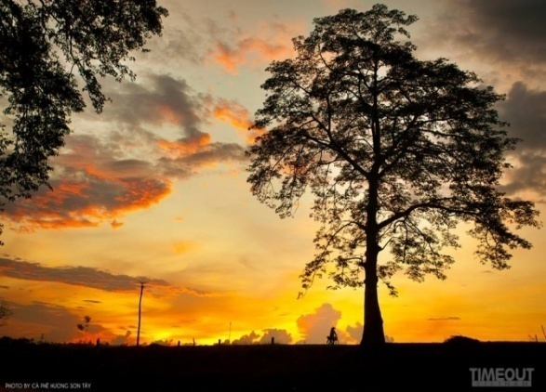
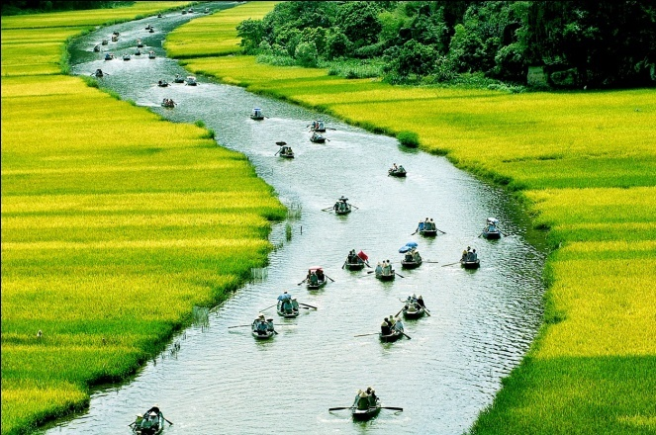
UNIT 2 : LIFE IN THE COUNTRYSIDE
PERIOD 17 : PROJECT
PERIOD 17 : PROJECT
PERIOD 17 : PROJECT
TEAM 3

Slide 4
Work in groups of four or five. Take turns to draw a group picture of a place you would like to live in the countryside. Then make a list of:
1. The things you have in your picture
2. The activities you can do there
Show your drawing to the class and talk about it

Slide 5
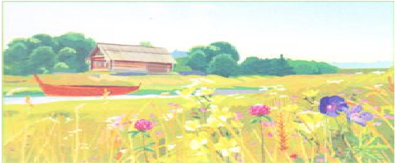
Example:
What is this picture say about ?
Life in the countryside

Slide 6
What do you see in this picture ?

Slide 7
A wooden house
A boat
A field of wild flowers
A beautiful river

Slide 8
What can you do here ?

Slide 9
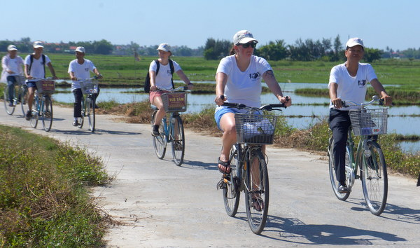
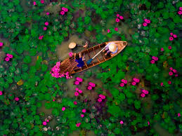
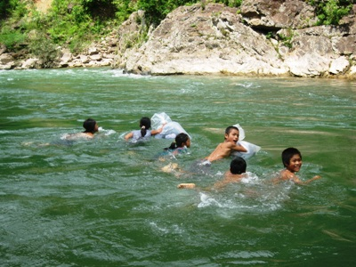
Biking along the river
Picking wild flowers
Swimming in the river
Boating in the river

Slide 10
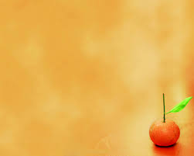
Can you speak ?
Example:
Our place in the countryside has a wooden house. The house is near the river. There is a boat on the river. There is also a field of wild flowers nearby.
We will bike along the river and swim in the river. We will go boating on the river. In the morning we will go picking the wild flowers.

Slide 11
GAME
You guess the activities through the pictures

Slide 12
1
2
3
4
5
6
Pi

Slide 13
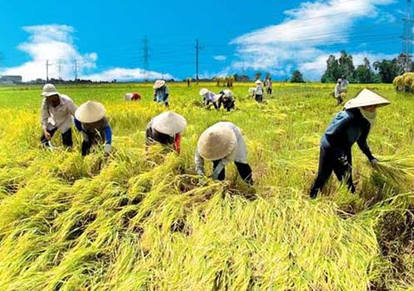
1
What are famers doing ?
Harvesting the rice
Pi

Slide 14
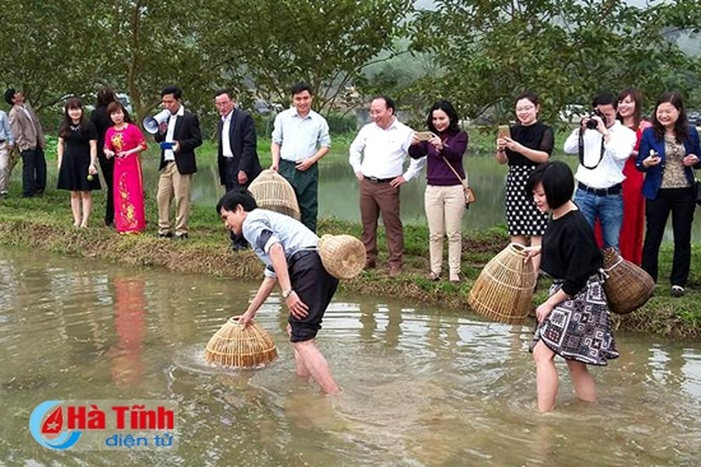
2
What are they doing ?
fishing
Pi

Slide 15
3
Lucky pig
Pi

Slide 16
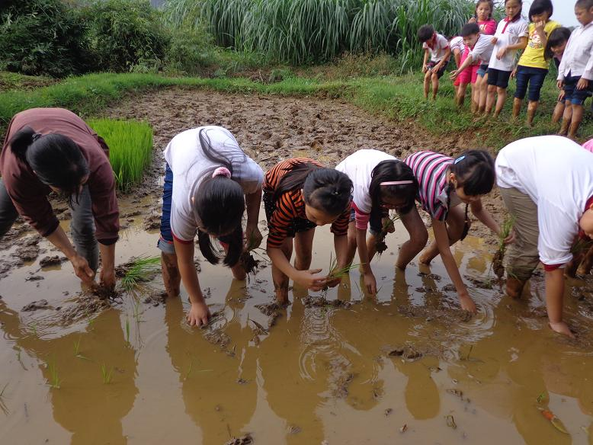
4
What are they doing ?
growing rice
Pi

Slide 17
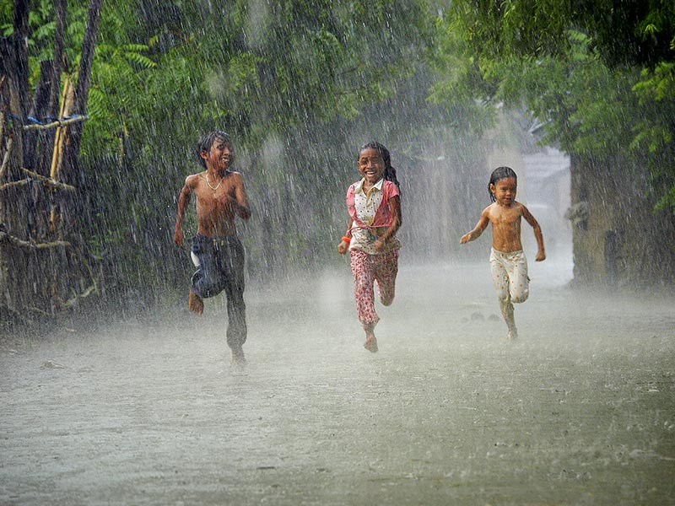
5
What are they doing ?
rain showers
Pi

Slide 18
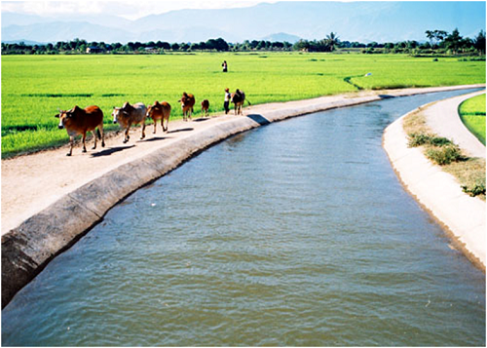
6
What are they doing ?
Cowherding
Pi

Slide 19
What will you do if you live in the contryside ?

Slide 20
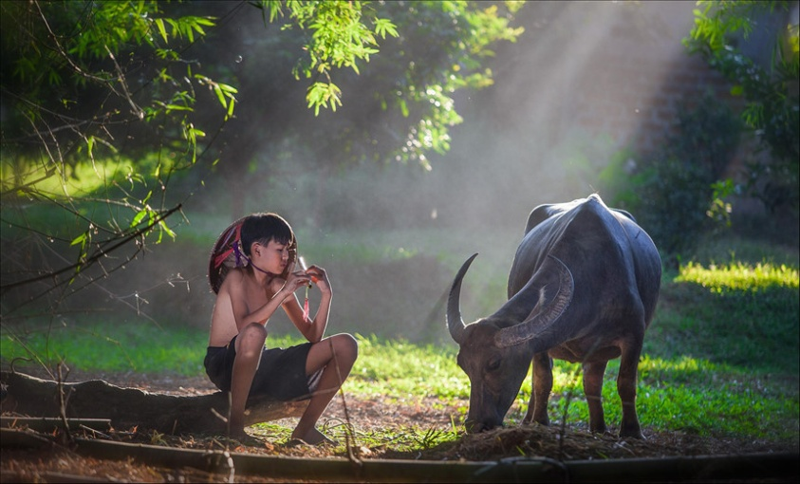
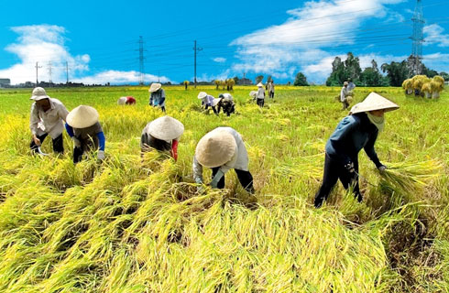
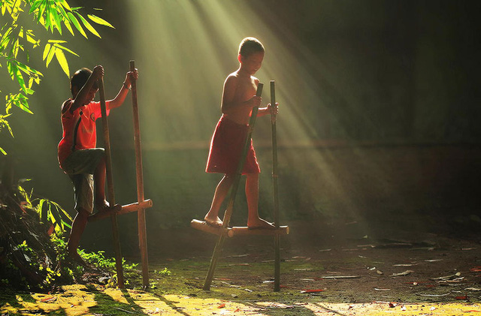
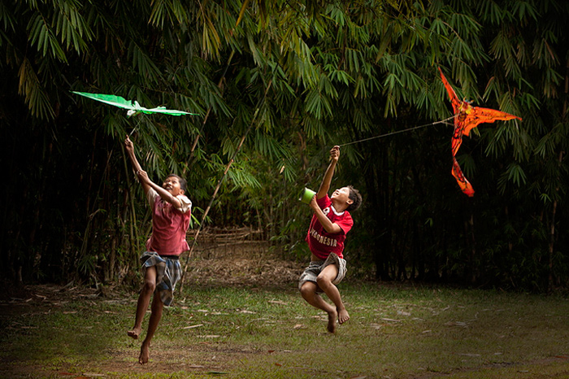
herding
Harvesting the rice
playing stunt
fly a kite

Slide 21
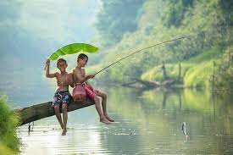
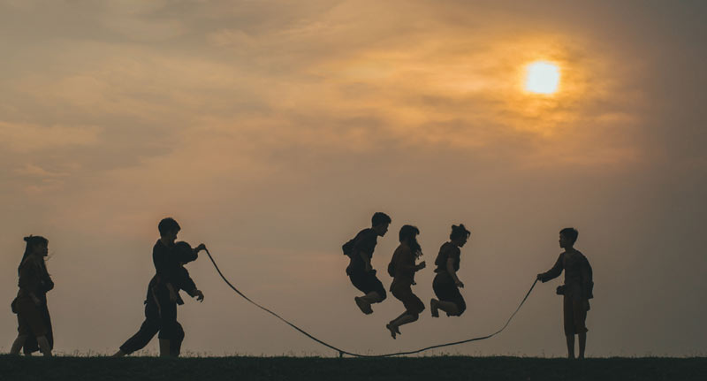
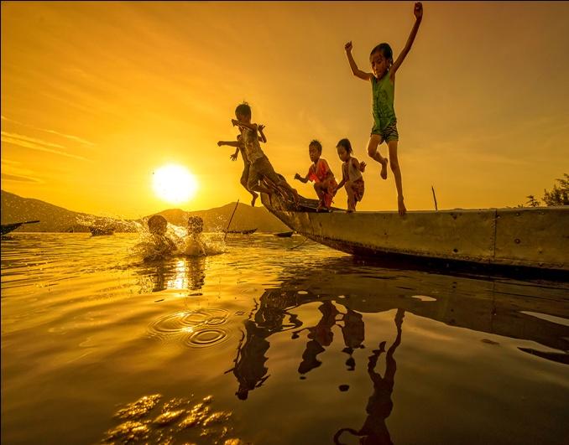
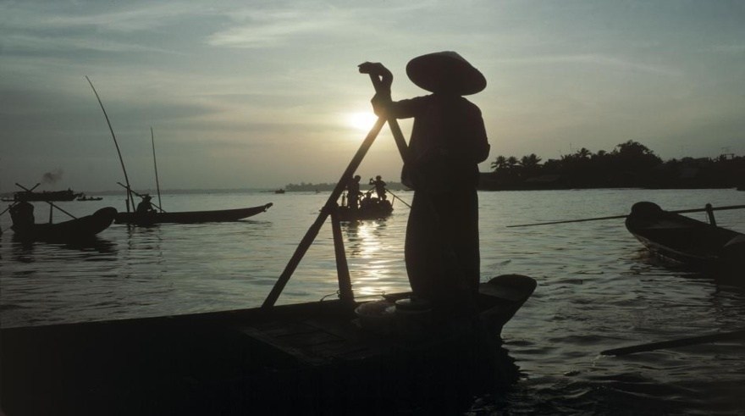
fishing
skip rope
Swimming
boating

Slide 22
Thanks you so much

