Slide 1
Warm up
Rearrange the sentences
1. Work in groups
2. Write your answers in a sheet of paper
3. Stick on the board when finishing

Slide 2
Try as fast as you can! :D
1. engineer/ an/ is/ She /./
2. family/ week/ We/ a/ held/ reunion/ last/./
enjoyable/was/ The/ party/./

Slide 3
Check your answers.
1. She is an engineer.
1. She is an engineer.
2. We held a family reunion last week.
The party was enjoyable.
2. We held a family reunion last week.
The party was enjoyable.
Why do we use articles (a/an/the) in each sentence?
Focus on them.

Slide 4
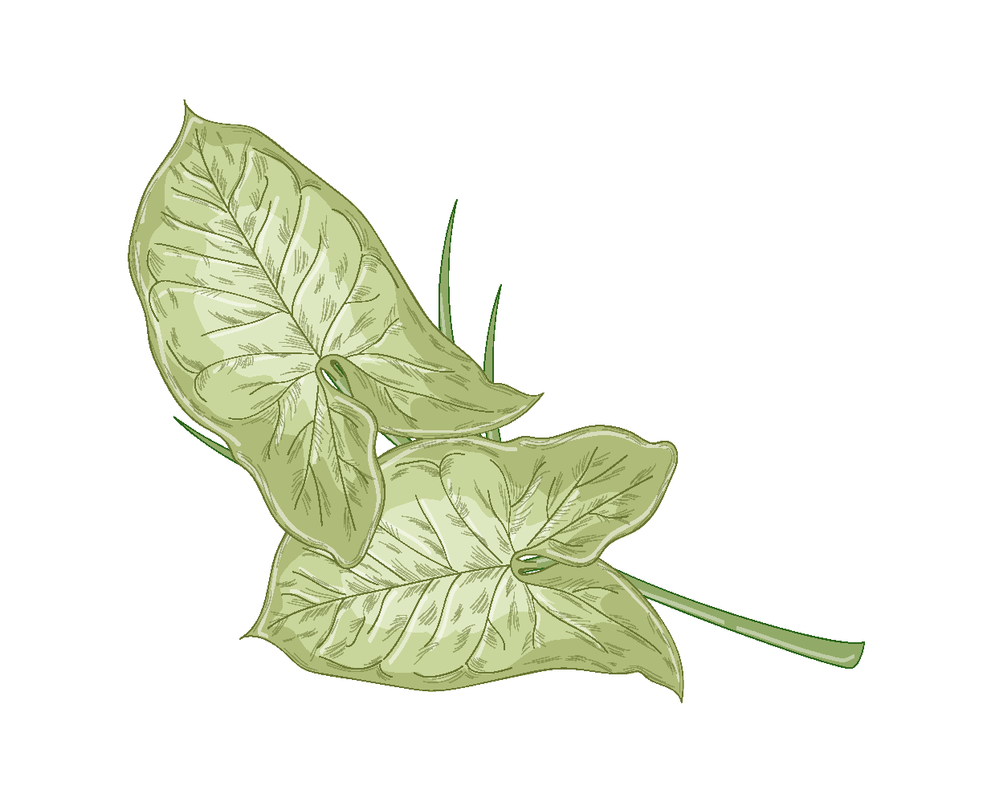
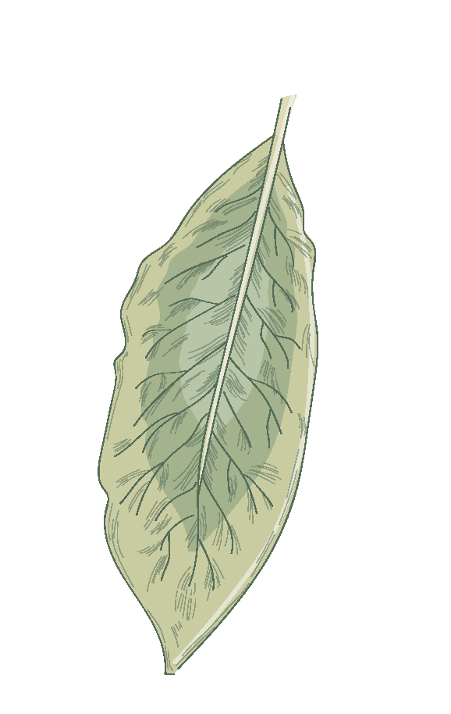
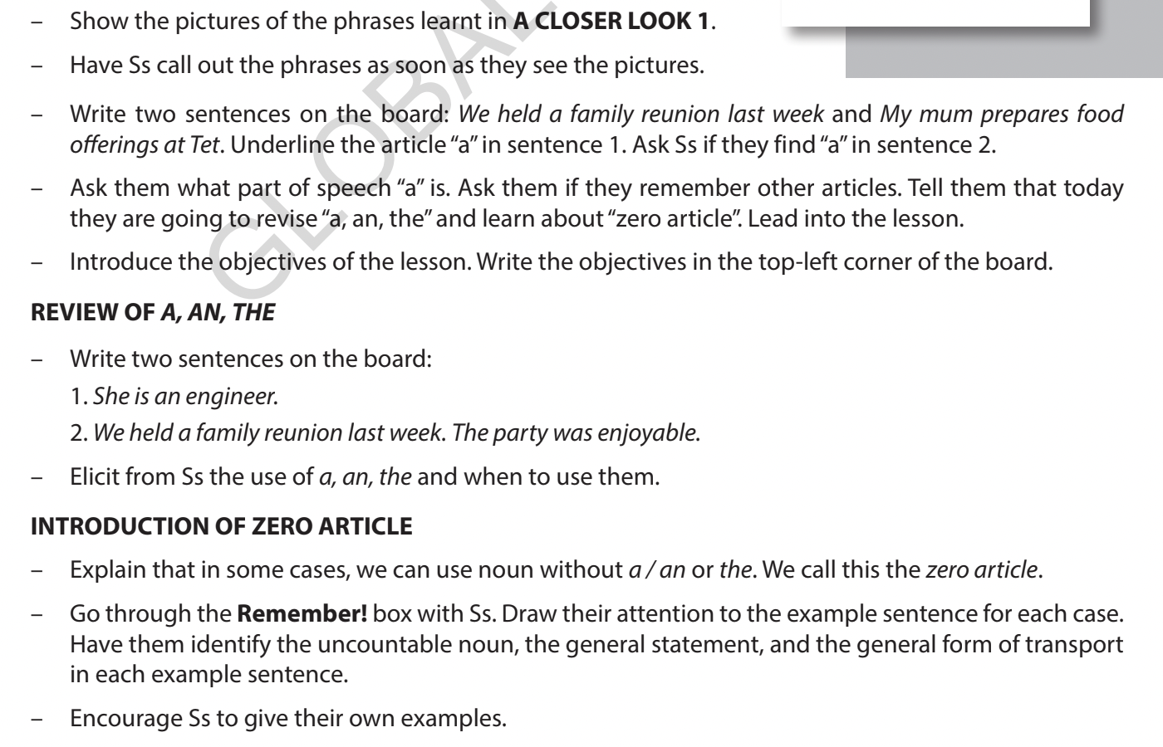
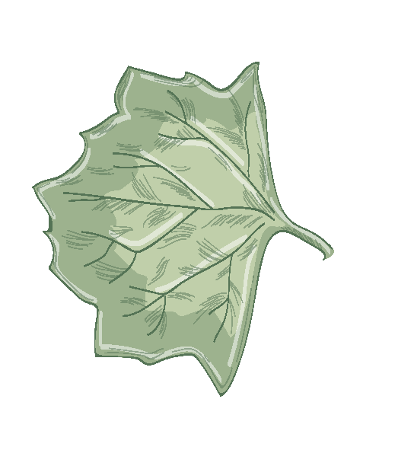
Unit 5
OUR CUSTOMS AND TRADITIONS
Lesson 3: A closer look 2

Slide 5
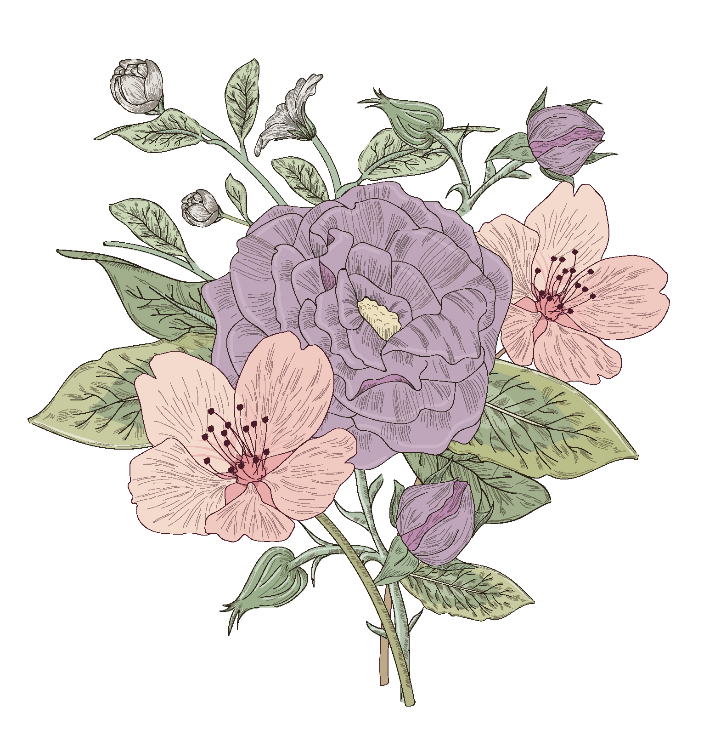
After this lesson, students will be able to:
01
to recall the usage of articles a/an/the.
02
to recognize and use the zero article (∅)

Slide 6
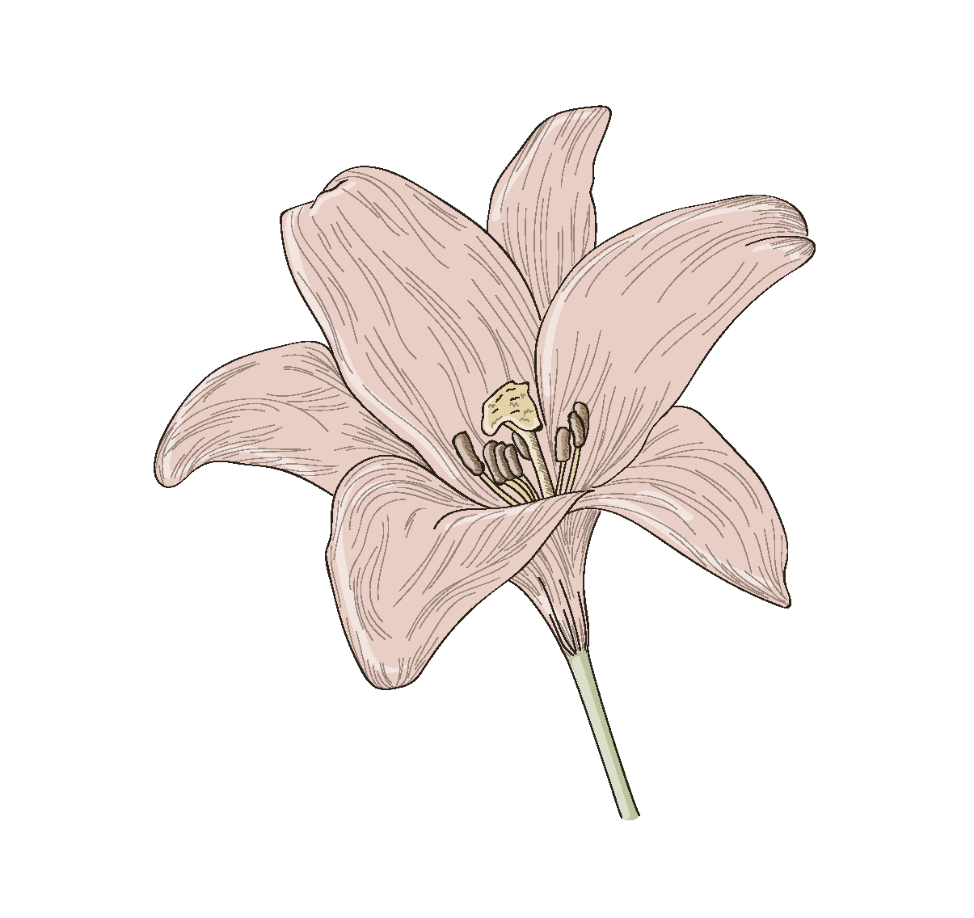
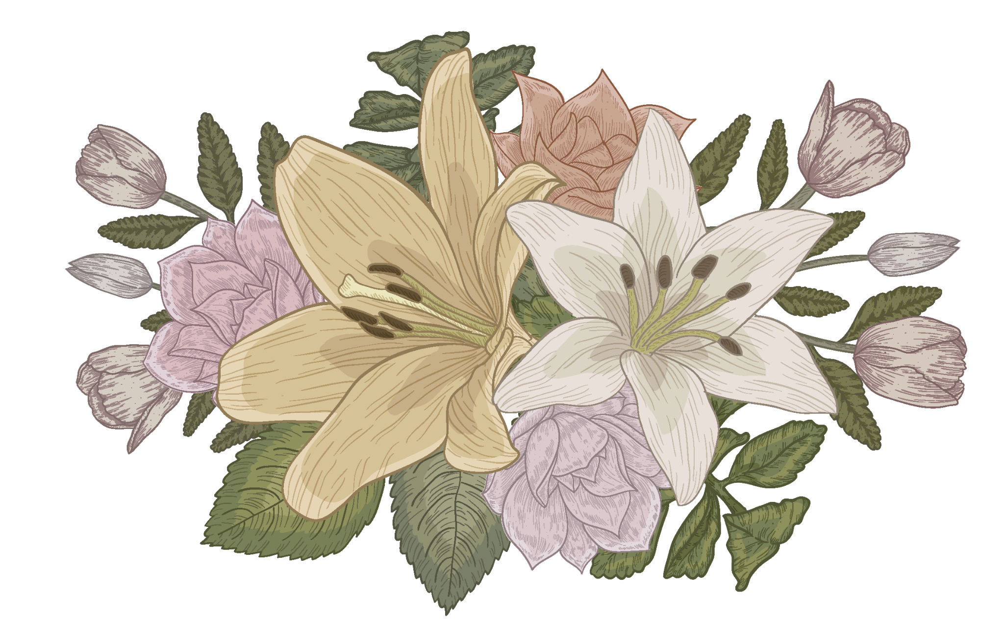
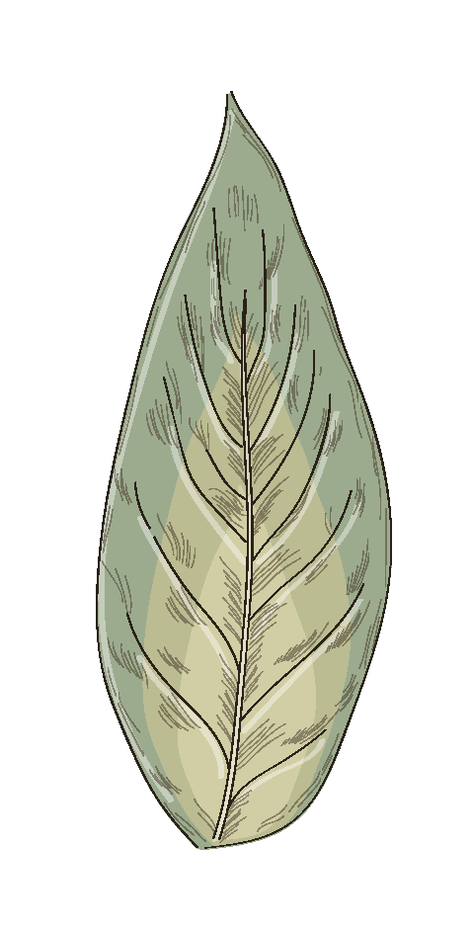
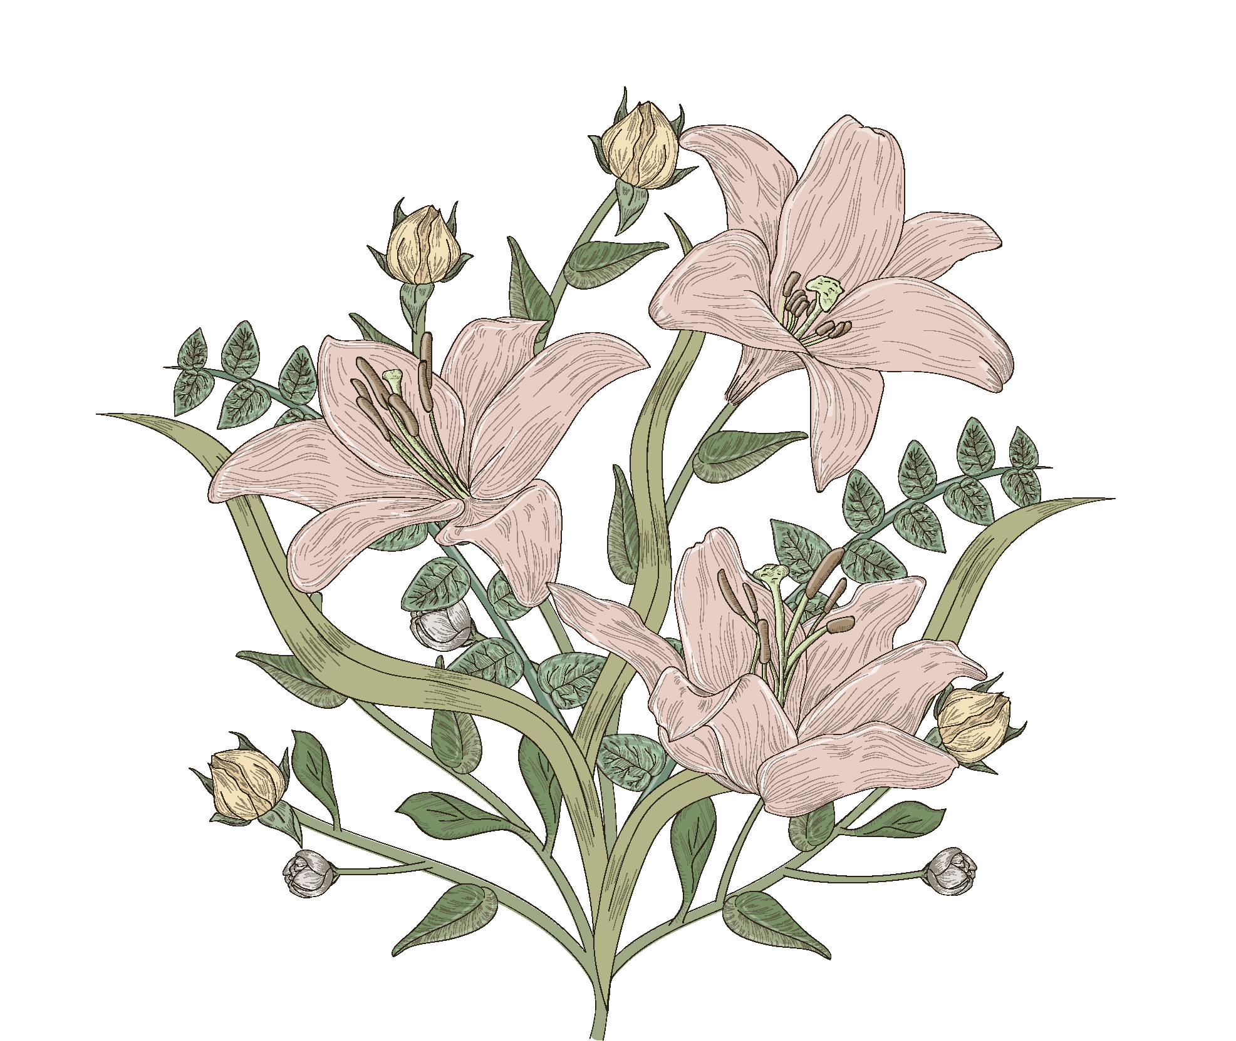
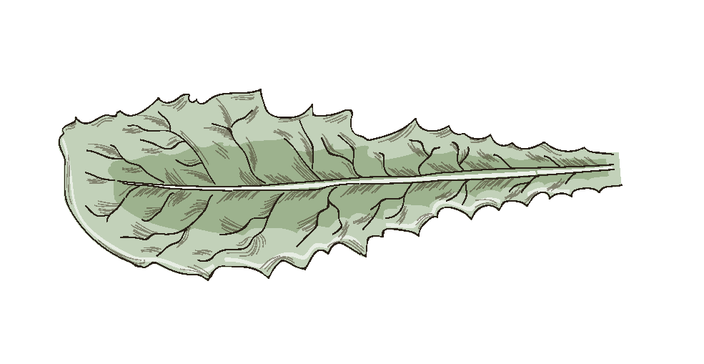
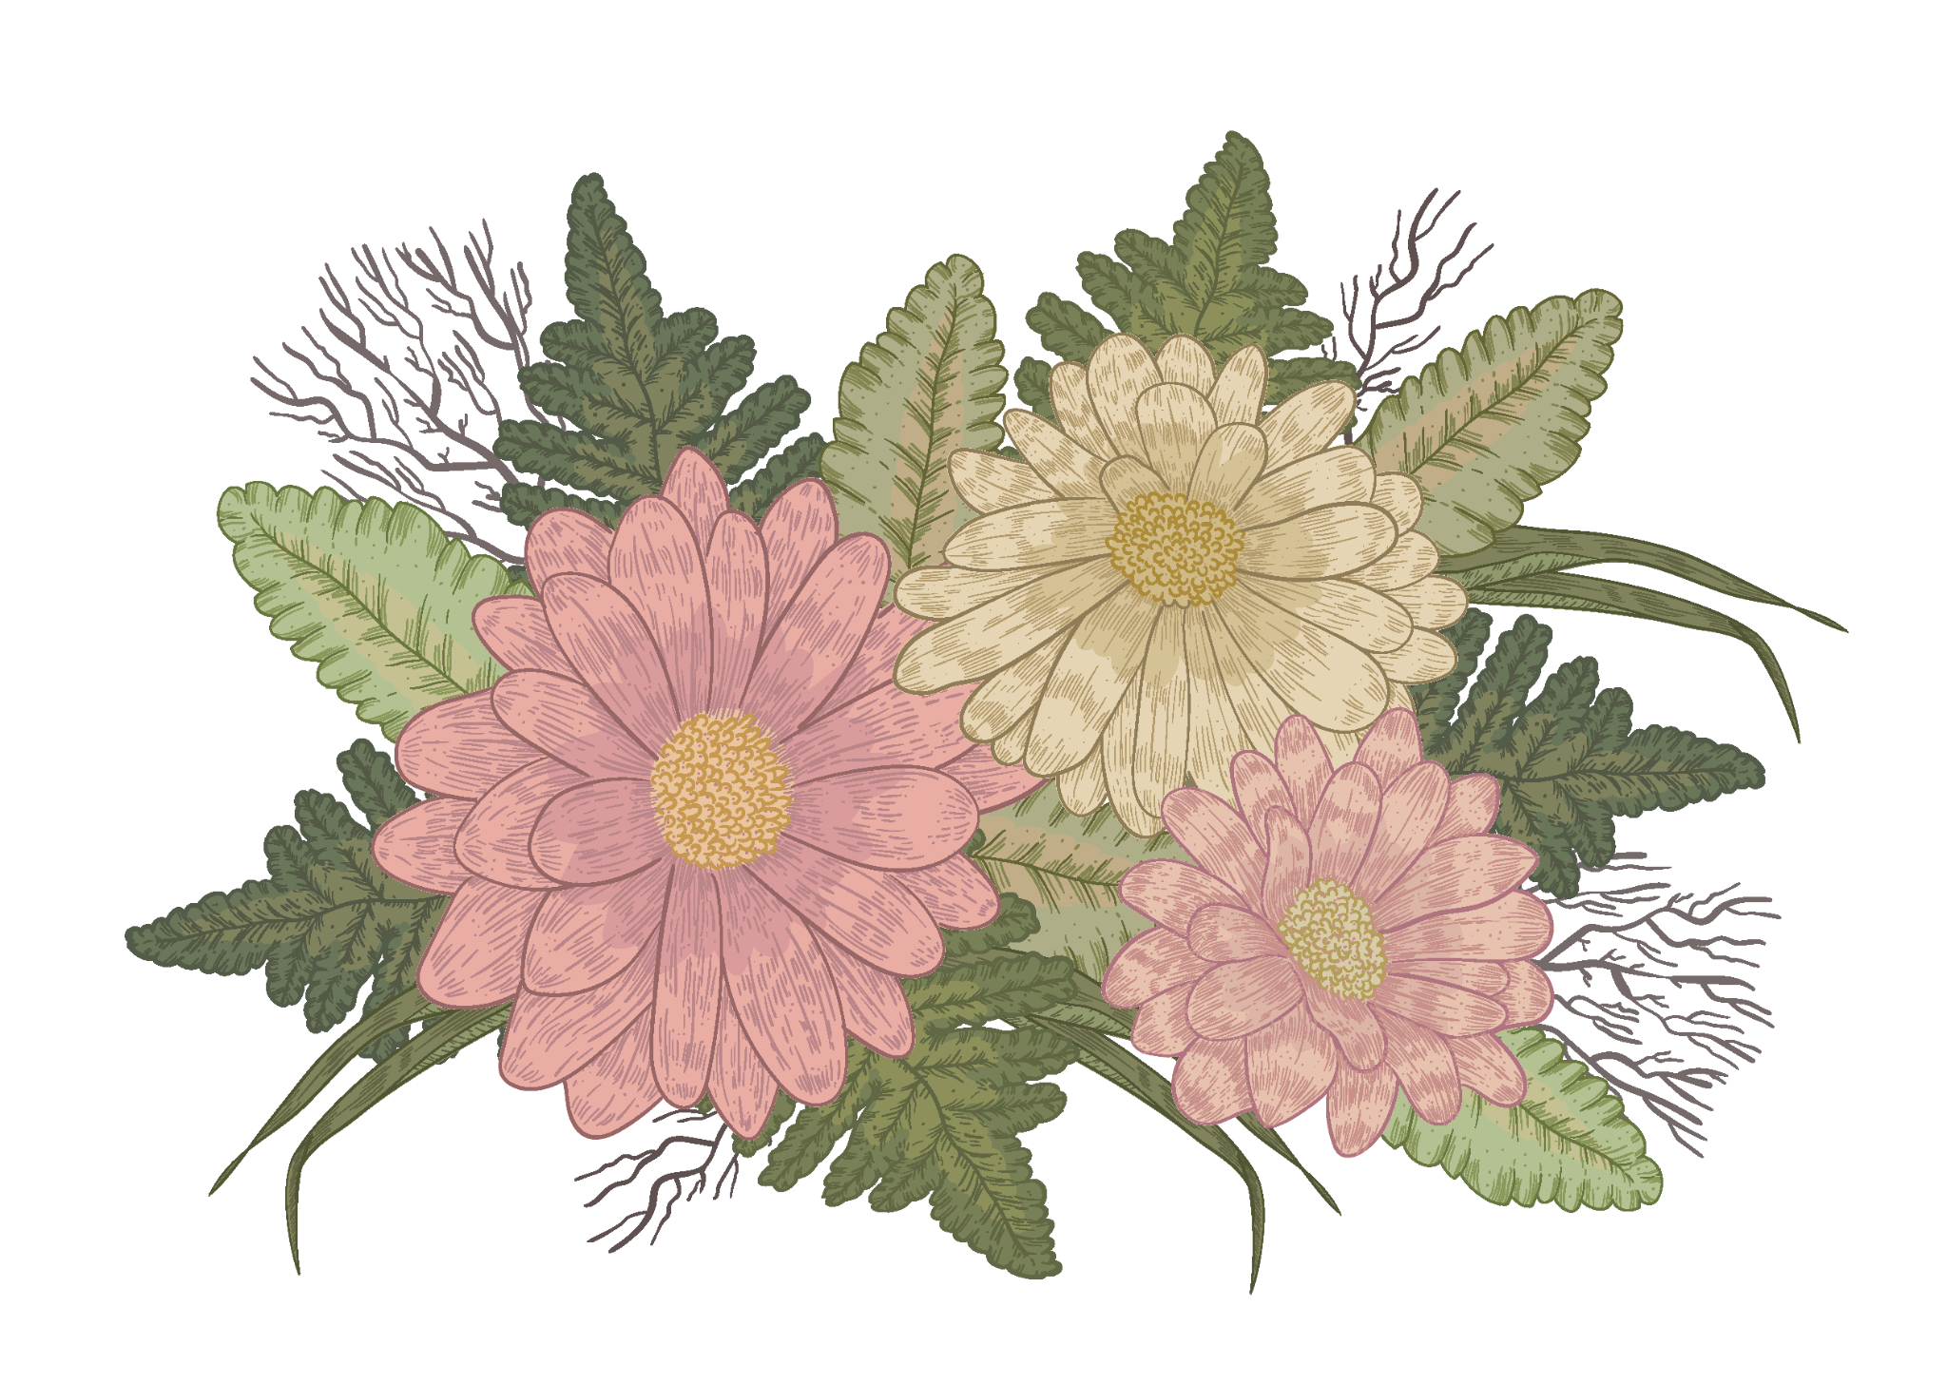
01
RECALL

Slide 7
Usage of articles (a/an/the)
1. She is an engineer.
1. She is an engineer.
We use “A/An” with a singular noun
when we say what people's jobs are.
A
singular nouns begin with consonants (phụ âm)
An
singular nouns begin with vowels (nguyên âm)

Slide 8
Usage of articles (a/an/the)
2. We held a family reunion last week.
The party was enjoyable.
We use “A/An” when we when we talk about something for the first time.
We use “The” when the listener already knows which thing we are talking about because it was mentioned before

Slide 9
Usages of Zero article
Actually, in some cases, we can use noun without a/an/the.
We call this the Zero article.
1
with uncountable or abstract nouns
2
when making general statements
3
when describing general forms of transport

Slide 10
02
PRACTICE

Slide 11
Exercise 1. Choose the correct option in each sentence below. (page 53)
1. It takes more than a / an hour to drive to Can Tho.
2. It’s a / Ø tradition for children to wake up early on Christmas Day.
3. The Ok Om Bok Festival takes place in the / Ø October.
4. We went to Can Tho by an / Ø air.
5. A: Where’s a / the book?
B: I thought you left it next to the TV.

Slide 12
Exercise 1. Check your answer.
1. It takes more than a / an hour to drive to Can Tho.
2. It’s a / Ø tradition for children to wake up early on Christmas Day.
3. The Ok Om Bok Festival takes place in the / Ø October.
/aʊə/ singular noun
starting with a vower
singular noun – mentioning for the 1st time.
referring to the festival
as a general event

Slide 13
Exercise 1. Check your answer.
4. We went to Can Tho by an / Ø air.
5. A: Where’s a / the book?
B: I thought you left it next to the TV.
general form of transport
a specific book which listener and speaker already know about

Slide 14
2
Which of the underlined parts in each question is incorrect? Find and correct it.
1. The worshipping Kitchen Gods is a long-time tradition of the
A B C
Vietnamese.
2. People organise the worshipping ceremony at noon so that a
A B C
Kitchen Gods can leave for Heaven at 12 o’clock.
→ Ø
→ the

Slide 15
3. Most families in the Viet Nam prepare oﬀerings for the Kitchen Gods.
A B C
4. The oﬀerings include a set of flowers and fruits, a paper clothes,
A B C
and three carps.
5. The Vietnamese people believe that the Kitchen Gods go to
A B
Heaven on carps.
C
→ Ø
→ Ø
→ Ø

Slide 16
Exercise 3. Complete the sentences with a, an, the, or Ø (zero article).
1. It is a custom in my family to have ______ breakfast at home on Sundays.
2. When visiting a family home in some countries, you should bring ______ small gift with you.
3. Our village festival is held on the 10th of ______ January.
4. Ancient Egyptians worshipped ______ Sun.
5. Many people think that hard work is ______ important Vietnamese value.

Slide 17
Checking your answers
1. It is a custom in my family to have ______ breakfast at home on Sundays.
2. When visiting a family home in some countries, you should bring ______ small gift with you.
Ø
general thing
a
specific thing
mentioning for the 1st time

Slide 18
Checking your answers
3. Our village festival is held on the 10th of ______ January.
4. Ancient Egyptians worshipped ______ Sun.
5. Many people think that hard work is ______ important Vietnamese value.
Ø
general thing
the
the specific thing
an
a specific thing
starting with a vowel

Slide 19
Exercise 4. Complete the text with the or Ø (zero article).
A recent study in (1) ______ UK shows that family time traditions are good for (2) ______ teens. These traditions include family members playing card games, watching their favourite TV programmes, or performing (3) ______ karaoke shows at weekends with one another. These activities often lead to lots of laughter and (4) ______ fun conversations. By taking part in such activities, teens strengthen (5) ______ bonds with their family.
the
Ø
Ø
Ø
the

Slide 20
BINGO GAME
Notes:
HARD MODE CHO NHÓM NÀO GIỎI HƠN
EASY MODE CHO NHÓM HỌC ĐẠI TRÀ

Slide 21
EASY MODE
- Work in group of 4-5 students.
- There is ONE mistake in each sentence
- Find and correct the mistakes
- Say “BINGO!” as soon as you guys finish

Slide 22
Bingo
1 . I usually meet my cousin at the weekends.
2. My uncle moved to United States three years ago.
3. Our teachers assigned us a homework for our history and science classes.
4.I turn off the light and go to the bed at 11 p.m.
5. Mark often wears red sweater to match his red hair.

Slide 23
Consolidation/ Wrap up
We use the Zero article:
A. With uncountable or abstract nouns
B. When describing general forms of transport
C. When listener already knows what we’re talking about
D. When making general statements

Slide 24
Homework
Learn new words by heart.
Do exercises in the workbook.

Slide 25
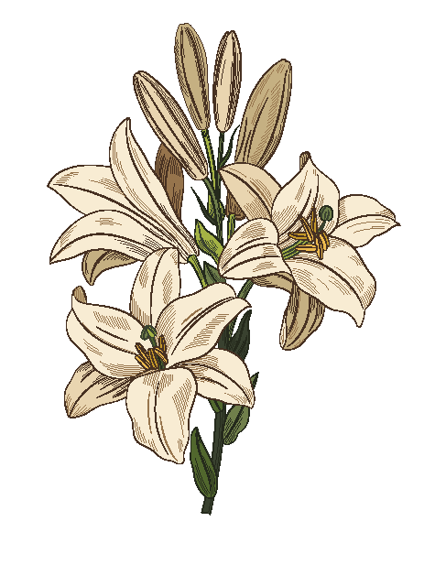
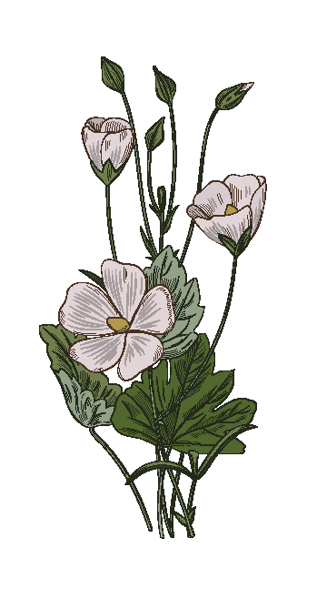
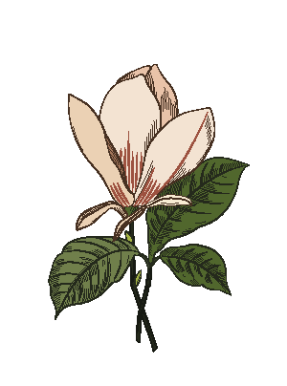
THANKS
DOES ANYONE HAVE ANY QUESTIONS?

