Slide 1
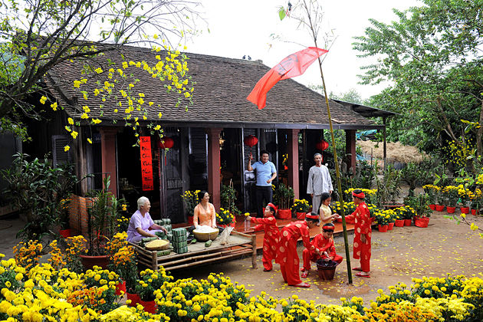
WARM-UP
Can you tell me
name of some festival ?
Game: Who is faster?
LUNAR NEW YEAR / TET HOLIDAY

Slide 2
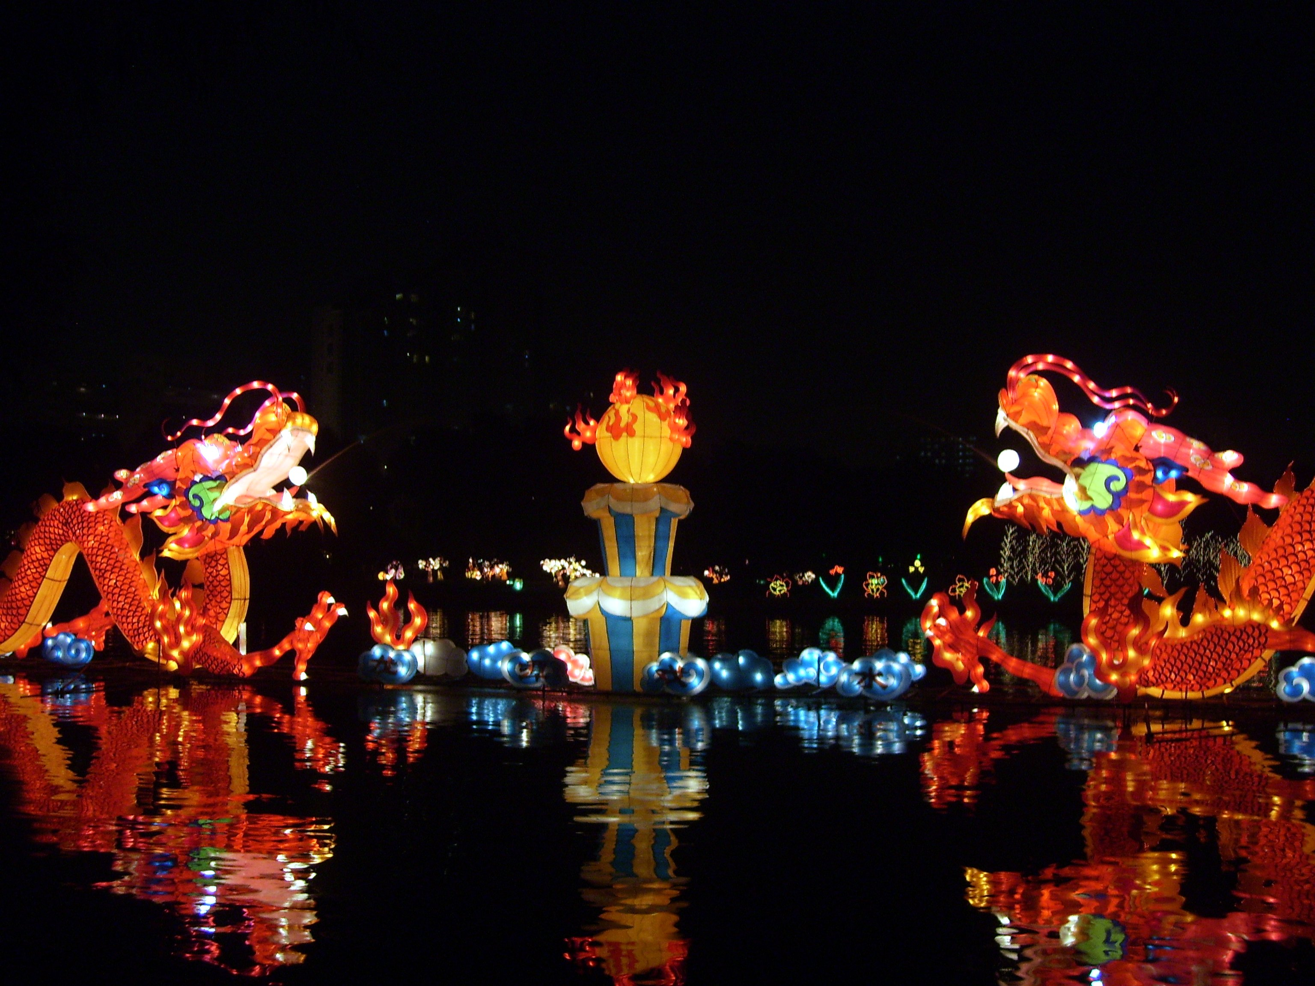
WARM-UP
FULL MOON FESTIVAL / MID-AUTUMN FESTIVAL

Slide 3
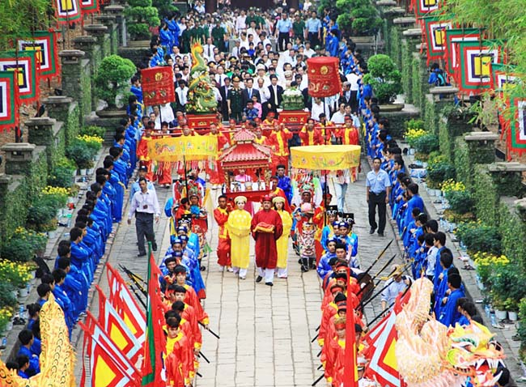
WARM-UP
HUNG KING TEMPLE FESTIVAL

Slide 4
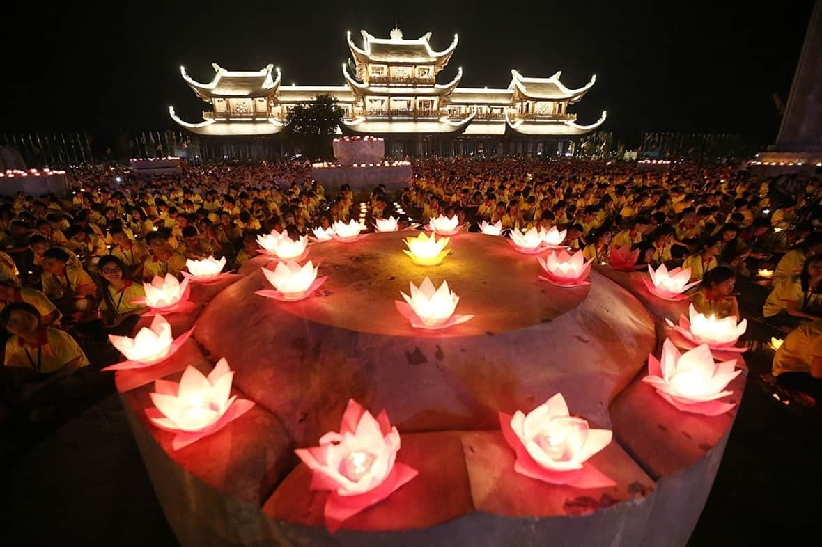
WARM-UP
BUDDHA’S BIRTHDAY

Slide 5
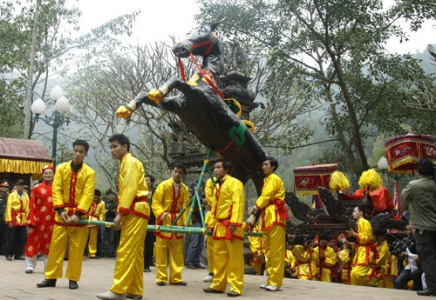
WARM-UP
GIONG FESTIVAL

Slide 6
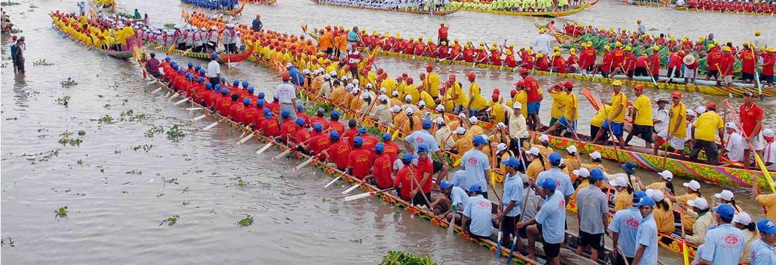
WARM-UP
OK OM BOK FESTIVAL

Slide 7

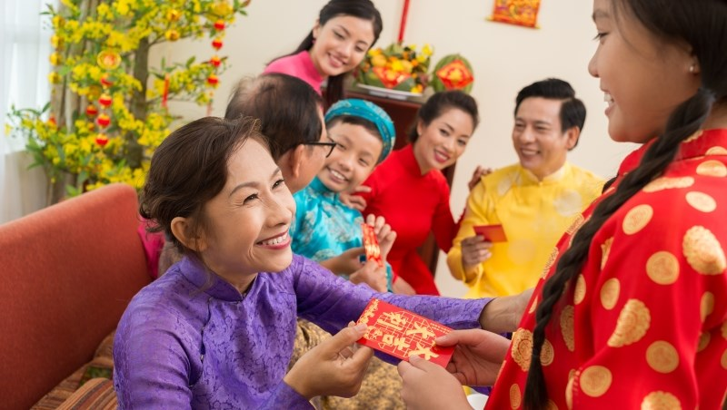
Tet Holiday

Slide 8
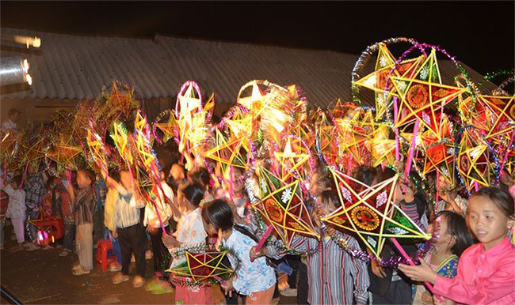
Mid-autumn festival

Slide 9
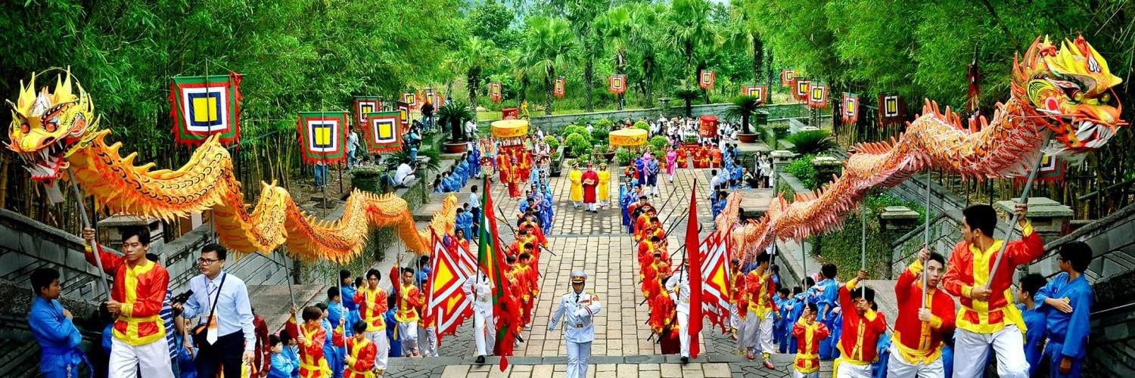
Hung King temple festival

Slide 10
Om Ok Bok festival

Slide 11




Unit 5
Our customs and traditions
Lesson 6: Skills 2
(page 56,57)

Slide 12




After this lesson, Ss will be able to:
Listening
Writing
Listen for specific information about
a festival
Write an email to give advice on taking part in a festival

Slide 13

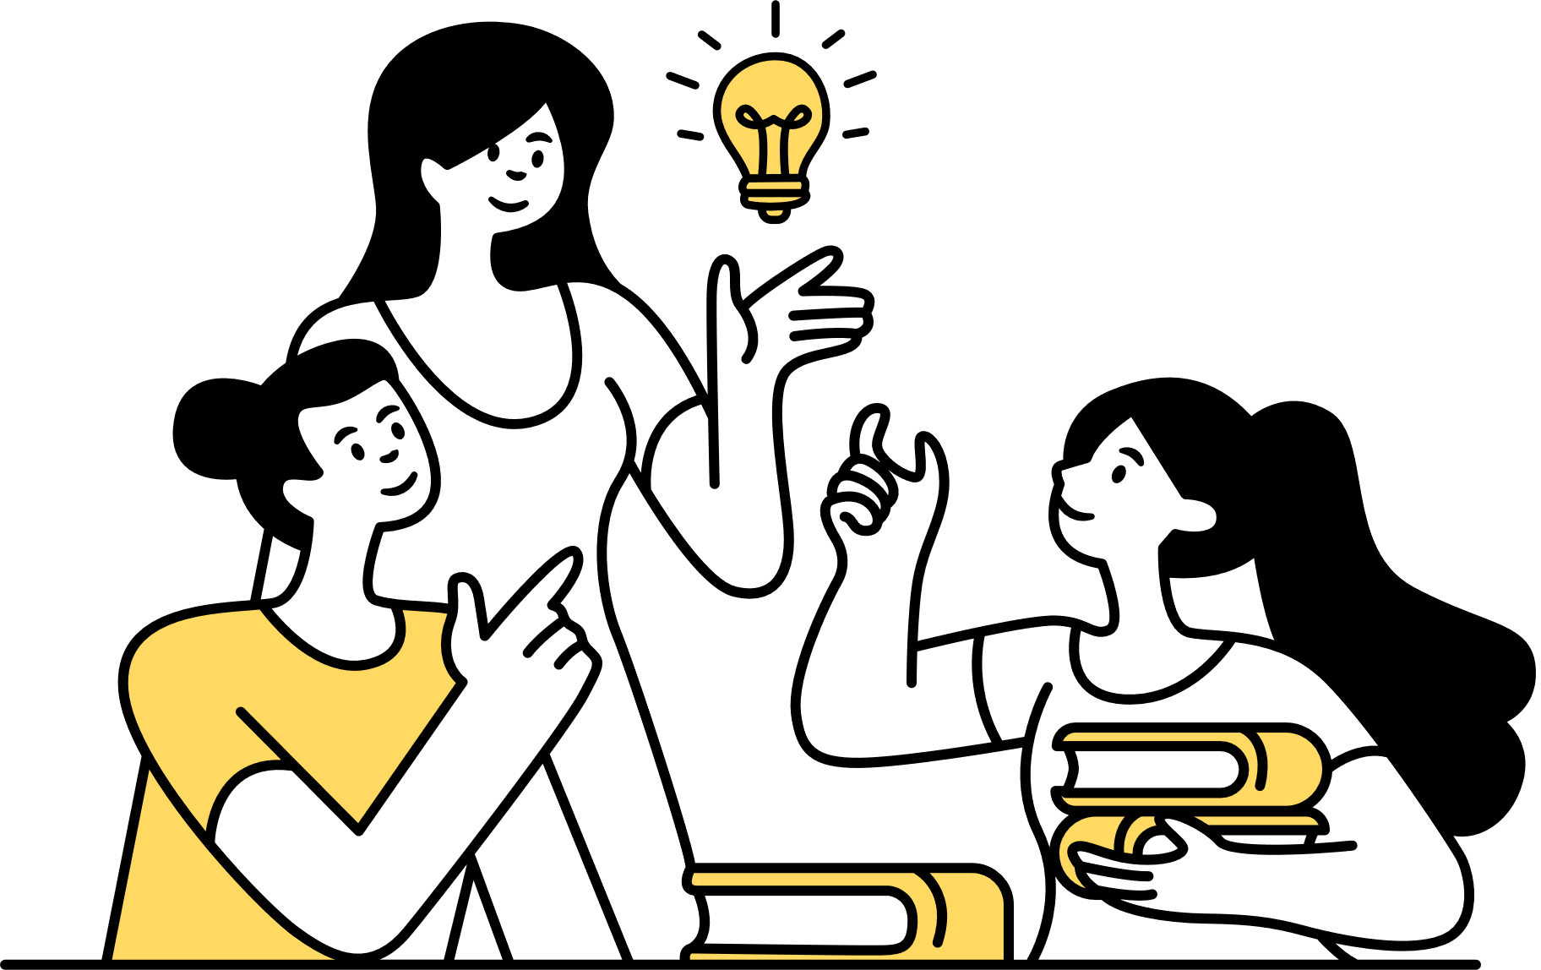
Listening

Slide 14


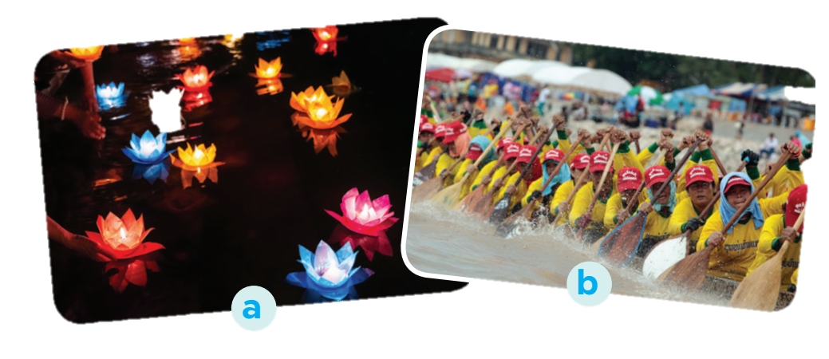
  Om Ok Bok festival
1. What can you see in the photos?
2. In which part of Viet Nam might the festival occur?

Slide 15

LISTENING
2
Listen to part of the programme “Charming Viet Nam”. Fill in each blank with no more than TWO words.
Ok Om Bok Festival
Purposes | - to thank the Moon God - to mark the (1) ______ of the Khmer year
Time | mid-October (lunar calendar)
Offerings | (2) ___________ and fruits
Activities | - singing and dancing - games and traditional (3) ______________ - Ngo Boat (4) ______
end
young rice
fashion shows
Race

Slide 16
Let’s check your memory
 | T | F
1. Ok Om Bok is the Moon Worshipping Festival.
2. On the night of the festival, the elders talk about their wishes.
3. There are lantern contests at the festival.
4. Tourists should wear informal clothes when attending the worshipping ceremony.

Slide 17

Listen again and check your answers
 | T | F
1. Ok Om Bok is the Moon Worshipping Festival.
2. On the night of the festival, the elders talk about their wishes.
3. There are lantern contests at the festival.
4. Tourists should wear informal clothes when attending the worshipping ceremony.

Slide 18

LISTENING
3
Listen again and tick T (True) or F (False).
 | T | F
1. Ok Om Bok is the Moon Worshipping Festival.
2. On the night of the festival, the elders talk about their wishes.
3. There are lantern contests at the festival.
4. Tourists should wear informal clothes when attending the worshipping ceremony.

Slide 19

Writing

Slide 20

Read the following pieces of advice
for tourists at the Ok Om Bok Festival.
a
dress up for the Moon God offering ceremony
b
keep quiet when the monks and
the elders are talking
c
climb on the animal statues in the temple ground
d
show respect to the monks and the elders
e
refuse young rice when the elders offer it to you
f
litter the temple ground

Slide 21
Work in groups.
Put the ideas in the correct column.
a
dress up for the Moon God offering ceremony
Dos
b
keep quiet when the monks and
the elders are talking
a
b
d
c
climb on the animal statues in the temple ground
d
show respect to the monks and the elders
Don’ts
e
refuse young rice when the elders offer it to you
f
c
e
f
litter the temple ground

Slide 22




Tom sent you an email.
Read part of his email below.
Write an email (80 - 100 words) to advise Tom about participating in the Ok Om Bok Festival.
“… Guess what! My dad is taking me with him to Soc Trang Province. We will be there during the Ok Om Bok Festival. What are some dos and don’ts at this festival? ...”

Slide 23
Dear Tom,
Glad to hear you are coming to Soc Trang. You can’t miss the Ok Om Bok Festival. Here are a few things for you to remember when joining the festival.
First, you should wear polite clothes when attending the Moon God offering ceremony. Always show respect to monks and elderly people. Remember to keep quiet when the monks and the elders are talking.
Besides, there are many animal statues in the temple ground. Don’t climb on them. The young rice represents the hope for luck in the new year. Don’t refuse when the elders give you some.
Send me an email if you need more information.
Warm regards,

Slide 24


Wrap up
In this lesson, we have learnt to:
1
listen for specific information about Om Ok Bok festival
2
write an email to give advice on taking part in a festival

Slide 25

2
Homework
Rewrite the passage on the notebook.
Prepare for Lesson 7 – Looking back & project.

Slide 26
Thank you very much!

