Slide 2
UNIT 1: MY NEW SCHOOL
LESSON 7
Vocabulary
Grammar

Slide 3
* Vocabulary

Slide 4
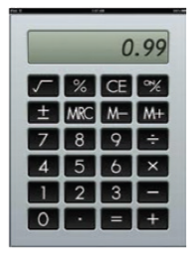
Look at the pictures. Write the correct words in the gaps.
1.
uniform
Our new is very nice.
2.
pencil sharpener
I have a red .
3.
notebook
This is my for writing English words.
4.
compass
We often use a in a
maths class.
5.
calculator
Can you lend me your for a minute?
6.
My new is short.

Slide 5
Match the words in A with the words / phrases in B.
A
B
1.
study
a.
lunch
2.
do
b.
the piano
3.
play
c.
a uniform
4.
have
d.
excerise
5.
wear
e.
new words

Slide 6
* Grammar
Complete the sentences with the present simple.
1.
comes
He (come) from Da Nang.
2.
Do you learn Russian?
No, I (do not) .
don’t
3.
walks
She always (walk) to school with her friends.
4.
do
I often (do) my homework after school.
5.
teaches
Mr Nam (teach) history at my school.

Slide 7
Complete the text with the correct form of the verbs in brackets.
Hoang lives in a small house in the centre of his village. His house (1. be)…..near his new school. Every day, he (2. have) ….breakfast at 6 o’clock. Then he (3. walk)…… to school with his friends. Hoang and his friends (4. study) ………in grade 6 at An Son School. Hoang (5. like) ……… his new school.
Hoang lives in a small house in the centre of his village. His house is near his new school. Every day, he has breakfast at 6 o’clock. Then he walks to school with his friends. Hoang and his friends study in grade 6 at An Son School. Hoang likes his new school.

Slide 8
Put the adverb in brackets in the correct place in each sentence.
1.
I remember to do my homework. (always)
.
I always remember to do my homework.
2.
Nick gets good marks in exams. (usually)
Nick usually gets good marks in exams.
3.
We do not see a rabbit in town. (often)
We do not often see a rabbit in town.
4.
I read in bed at night. (rarely)
I rarely read in bed at night.
5.
Do you sing in the shower? (sometimes)
Do you sometimes sing in the shower?

Slide 9
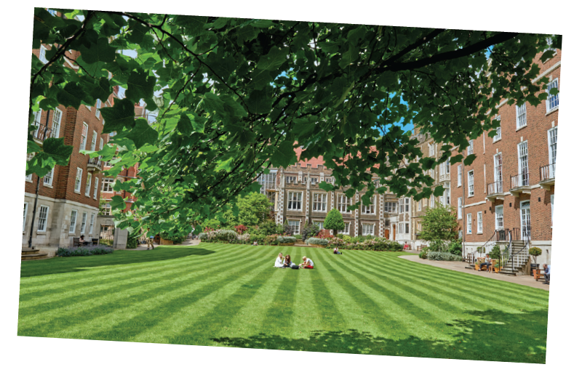
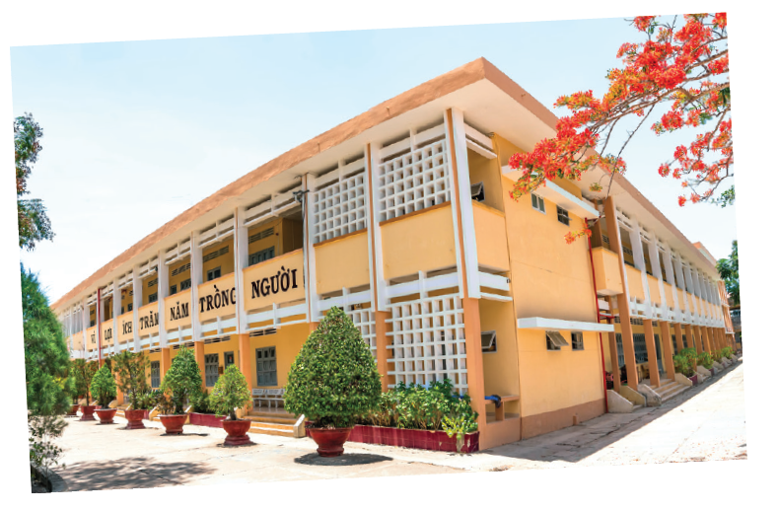
Work in groups.
Design your dream school. What does it look likes?
Is it:
in a town or in the country?
a boarding school?
an international school?
Does it have:
a swimming pool?
a video game room?
a greenhouse and a farm?

Slide 10
Work in groups.
Draw a picture of your dream school.
Present it to the class.

Slide 11
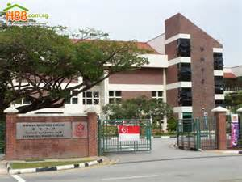
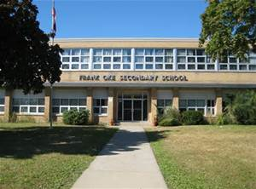
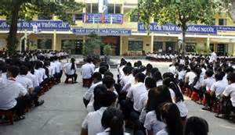
YOUR DREM SCHOOL.
Present it to the class.
* Model writing My dream school is located in Quang Ngai city. It’s new and modern. The school has a big schoolyard with many tall trees. It has a computer room music room, a library , a canteen and swimming pool… The classroom is very large with air conditional and fans. There is a big garden behind the school so that the students plant many kinds of tree, flowers, and vegetables there.

Slide 12
Practice
1. IT / Trong’s favourite subject. 2. . Mrs Hoa / our teacher / English. 3. There / six coloured pencils / my friend’s box. | 4. Where / Ms Lan / live? 5. Shall / introduce you / my best friend, An Son?

Slide 13
Homework
Revise unit 1 for a fifteen-minute test
Prepare Unit 2: Getting started

