Slide 1


Slide 2



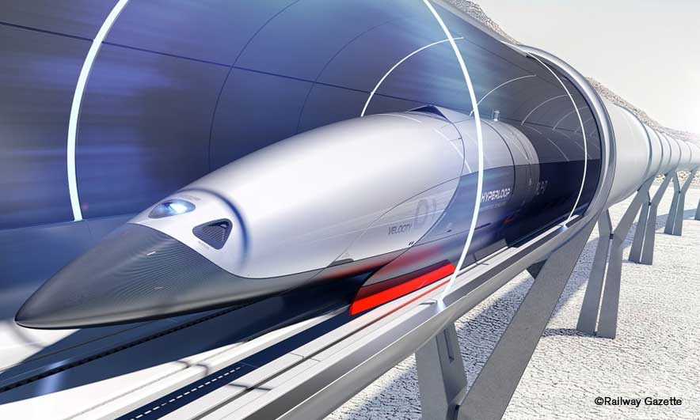
Unit
11
TRAVELLING IN THE FUTURE
LESSON 1: GETTING STARTED
I hope we will have a hyperloop! soon!
Unit
HOBBIES

Slide 3

OBJECTIVES
By the end of the lesson, students will be able to:
An overview about the topic TRAVELLING IN THE FUTURE.
Vocabulary to talk about future means of transport.

Slide 4
LESSON 1: GETTING STARTED
WARM-UP
ChitChatting
PRESENTATION
Vocabulary
Listen and read
Task 1: Listen and read. What are Ann and Minh talking about?
Task 2: Read the conversation again and tick T (True) or F (False).
Task 3: Find the words and phrases that describe the means of transport in the conversation and write them in the correct columns.
PRACTICE
PRODUCTION
Task 4: Quiz
CONSOLIDATION
Wrap-up
Home work

Slide 5

LESSON 1: GETTING STARTED
WARM-UP
ChitChatting
Aims of the stage:
To set the context for the listening and reading text.
To introduce the topic.

Slide 6


WARM-UP: CHITCHATTING

Slide 7
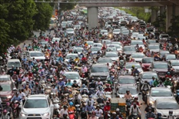
WARM-UP: CHATTING

Slide 8
WARM-UP: CHATTING
+ How do you people travel every day?
+ What do you think about the traffic in the picture?
+ How about traffic in the future?

Slide 9

LESSON 1: GETTING STARTED
WARM-UP
Chatting
PRESENTATION
Vocabulary
Aims of the stage:
To provide students with vocabulary.
To help students well-prepared for the listening and reading tasks.

Slide 10

PRESENTATION
eco – friendly (a)
/ˈiː.kəʊˌfrend.li/
thân thiện với môi trường

Slide 11

PRESENTATION
fume (n)
/fjuːm/
khói

Slide 12

PRESENTATION
hyperloop (n)
/ˈhaɪ.pərluːp/
hệ thống giao thông tốc độ cao

Slide 13

PRESENTATION
teleporter (n)
/ˈtel.ɪ.pɔː.tər/
phương tiện di chuyển tức thời

Slide 14

PRESENTATION
campsite (n)
/ˈkæmp.saɪt/
địa điểm cắm trại

Slide 15
PRESENTATION
New words | Pronunciation | Meaning
1. eco – friendly (a) | /ˈiː.kəʊˌfrend.li/ | thân thiện với môi trường
2. fume (n) | /fjuːm/ | khói
3. hyperloop (n) | /ˈhaɪ.pərluːp/ | hệ thống giao thông tốc độ cao
4. teleporter (n) | /ˈtel.ɪ.pɔː.tər/ | phương tiện di chuyển tức thời
5. campsite (n) | /ˈkæmp.saɪt/ | địa điểm cắm trại

Slide 16
LESSON 1: GETTING STARTED
Chatting
WARM-UP
Vocabulary
Listen and read
PRESENTATION
Task 1: Listen and read. What are Ann and Minh talking about?
Task 2: Read the conversation again and tick T (True) or F (False).
Task 3: Find the words and phrases that describe the means of transport in the conversation and write them in the correct columns.
PRACTICE

Slide 17

PRESENTATION: LISTEN AND READ
Aim of the task:
To set the context for the introductory conversation

Slide 18

PRESENTATION: LISTEN AND READ
Minh: Oh, another traffic jam.
Ann: How will we get to the campsite on time now?
Minh: I don’t know. It’s a pity that we don’t have a hyperloop now!
Ann: What’s a hyperloop?
Minh: It’s a system of tubes. You can go from one place to another in just minutes.
Ann: Amazing! Even faster than a flying car!
Minh: Yes, and there are no traffic jams.
Ann: Will it pollute the environment?
Minh: No. There will be no fumes, and it’s totally safe.
Ann: Like a teleporter?
Minh: A teleporter is also fast, safe and eco-friendly. But it’s a different mode of travel.
Ann: So when we travel in hyperloops, we won’t have to worry about bad weather, right?
Minh: Right.
Ann: Sounds great! I hope we’ll have them soon.

Slide 19
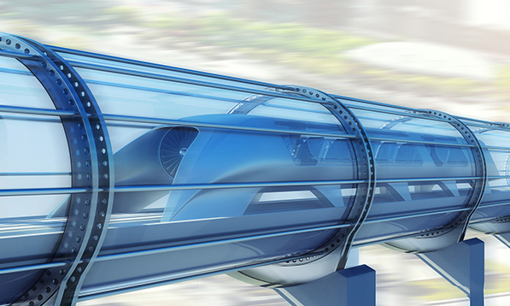
PRACTICE
1
Listen and read. What are Ann and Minh talking about?
Aim of the task:
To practice the targeted language and the background knowledge

Slide 20

PRACTICE
1
Listen and read. What are Ann and Minh talking about?
A. Travelling by teleporter
B. Future modes of travel
C. Being in a traffic jam

Slide 21
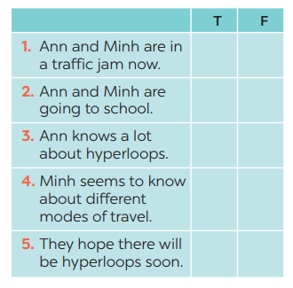

PRACTICE
2
Read the conversation again and tick T (True) or F (False).
→ Ann: How will we get to the campsite on time now?
→ Ann: What’s a hyperloop?

Slide 22

PRACTICE
3
Find the words and phrases that describe the means of transport in the conversation and write them in the correct columns.
Aim of the task:
To help Ss recognise the words / phrases used to describe means of transport;
– To help Ss further understand the text.

Slide 23
PRACTICE
3
Find the words and phrases that describe the means of transport in the conversation and write them in the correct columns.
Hyperloop | Teleporter
a system of tubes
Faster than a flying car
No traffic jams
No fumes
safe
Fast
Safe
Eco - friendly

Slide 24
LESSON 1: GETTING STARTED
WARM-UP
Chatting
PRESENTATION
Vocabulary
Listen and read
Task 1: Listen and read. What are Ann and Minh talking about?
Task 2: Read the conversation again and tick T (True) or F (False).
Task 3: Find the words and phrases that describe the means of transport in the conversation and write them in the correct columns.
PRACTICE
PRODUCTION
Task 4: Quiz

Slide 25


PRODUCTION
4
Quiz

Slide 26
PRODUCTION
4
1. It has two wheels and you pedal it.
2. It has four wheels. It runs on petrol or
electricity, and can carry up to eight
passengers.
3. It carries many passengers and runs
on tracks.
4. It sails on the sea. It needs wind to sail.
5. It travels in space. It can even carry
people to the moon.
Quiz

Slide 27
LESSON 1: GETTING STARTED
WARM-UP
Chatting
PRESENTATION
Vocabulary
Listen and read
Task 1: Listen and read. What are Ann and Minh talking about?
Task 2: Read the conversation again and tick T (True) or F (False).
Task 3: Find the words and phrases that describe the means of transport in the conversation and write them in the correct columns.
PRACTICE
PRODUCTION
Task 4: Quiz
CONSOLIDATION
Wrap-up
Home work

Slide 28
CONSOLIDATION
1
WRAP-UP
TRAVELLING IN THE FUTURE
Topic of the unit
Vocabulary

Slide 29
CONSOLIDATION
HOMEWORK
Prepare the vocabulary for the next lesson: A closer look 1.

Slide 30


