Slide 2
Unit
4
MUSIC AND ARTS
LESSON 3: A CLOSER LOOK 2
Grammar: Comparisons: like, different from, (not) as … as
Unit
HOBBIES

Slide 3
OBJECTIVES
By the end of the lesson, students will be able to:
know how to recognize and write comparisons with “like, different from, (not) as … as”

Slide 4
LESSON 3: A CLOSER LOOK 2
WARM-UP
Brainstorming
PRESENTATION
Comparisons
Task 1: Write like, as, or different in the gaps.
Task 2: Finish the second sentence in each pair.
Task 3: Compare the two museums.
Task 4: Rewrite the sentences.
PRACTICE
PRODUCTION
Task 5: Discuss and write a simple sentence from the two given sentences.
CONSOLIDATION
Wrap-up
Homework

Slide 5
LESSON 3: A CLOSER LOOK 2
WARM-UP
Brainstorming
Aims of the stage:
to activate students’ prior knowledge and vocabulary related to the targeted grammar

Slide 6
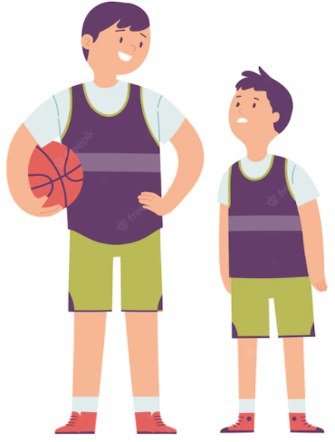
WARM-UP
ADJECTIVES

Slide 7
LESSON 3: A CLOSER LOOK 2
WARM-UP
Brainstorming
PRESENTATION
Comparisons

Slide 8
PRESENTATION
COMPARISONS
→ The yellow pencil is not as long as the orange one.
→ The pen is as long as the orange pencil.

Slide 9
PRESENTATION
COMPARISONS
→ The pen is different from the yellow pencil.

Slide 10
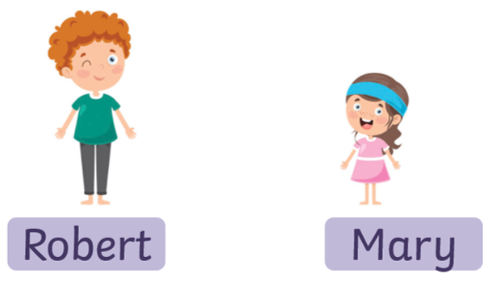
PRESENTATION
COMPARISONS
→ Robert’s pencil case is like Mary’s pencil case.

Slide 11
PRESENTATION
COMPARISONS
(not) as + adj + as
(to) be different from
(to) be like

Slide 12
LESSON 3: A CLOSER LOOK 2
WARM-UP
Brainstorming
PRESENTATION
Comparisons
Task 1: Write like, as, or different in the gaps.
Task 2: Finish the second sentence in each pair.
Task 3: Compare the two museums.
Task 4: Rewrite the sentences.
PRACTICE

Slide 13
PRACTICE
1
Write like, as, or different in the gaps.
This camera is not as expensive ________ I thought at first.
Her room is lovely. It is ________ a princess’s room.
You like folk songs; I like pop music. Your taste is __________ from mine.
My dad is not always as busy ________ my mum.
Some of us think that Spiderman 2 is not too __________ from Spiderman 1.
as
like
different
as
different

Slide 14
PRACTICE
2
Finish the second sentence in each pair, using like, as … as, or different from.
1. Rock is very exciting. It is not like country music.
Rock is very ________________ country music.
2. Composer Hoang Long wrote many good songs for children. Composer Pham Tuyen also wrote many good songs for children. → Composer Hoang Long, ___________ Pham Tuyen, wrote many good songs for children.
3. The Vatican Museum has excellent works of art. The Louvre Museum has excellent works of art too.
→ The Vatican Museum ‘s works of arts are __________ excellent _________ the Louvre Museum’s works of art.
different from
like
as
as

Slide 15
PRACTICE
2
Finish the second sentence in each pair, using like, as … as, or different from.
4. A vacation on the beach is relaxing, while a vacation in a big city may not be.
→ A vacation on the beach is ______________ a vacation in a big city
5. City life is busy, but country life is peaceful.
→ City life is not ____________ peaceful ___________ country life.
different from
as
as

Slide 16
PRACTICE
3
Compare the two museums: History and Science, using like, as … as, or different from.
 | History | Science
1. modern | ** | ***
2. friendly | *** | ***
3. safe | *** | **
4. expensive | ** | **

Slide 17
PRACTICE
4
Rewrite the sentences, using the words given at the beginning.
1. I think action films are more interesting than comedies.
I think comedies are not ________________________________.
2. Our maths homework is more difficult than out history homework. → Our history homework is not ______________________________.
3. This year’s music contest is different from last year’s.
→ This year’s music contest is not ______________________________.
4. The characters in the film are not the same as the ones in the play.
The characters in the film are ________________________________.
5. This picture is brighter than that picture.
→ That picture is not ________________________________.
as interesting as action films
as difficult as our maths homework
like last year’s
different from the ones in the play
as bright as this one

Slide 18
LESSON 3: A CLOSER LOOK 2
WARM-UP
Brainstorming
PRESENTATION
Comparisons
Task 1: Write like, as, or different in the gaps.
Task 2: Finish the second sentence in each pair.
Task 3: Compare the two museums.
Task 4: Rewrite the sentences.
PRACTICE
PRODUCTION
Task 5: Discuss and write a simple sentence from the two given sentences.

Slide 19
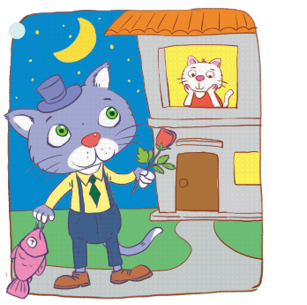
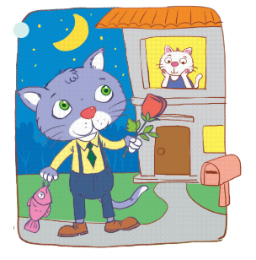
PRODUCTION
5
Look at the two pictures and compare them, using like, as … as, or different from.

Slide 20
LESSON 3: A CLOSER LOOK 2
WARM-UP
Brainstorming
PRESENTATION
Comparisons
Task 1: Write like, as, or different in the gaps.
Task 2: Finish the second sentence in each pair.
Task 3: Compare the two museums.
Task 4: Rewrite the sentences.
PRACTICE
PRODUCTION
Task 5: Discuss and write a simple sentence from the two given sentences.
CONSOLIDATION
Wrap-up
Homework

Slide 21
CONSOLIDATION
1
WRAP-UP
Grammar: Comparisons: like, different from, (not) as … as

Slide 22
CONSOLIDATION
2
HOMEWORK
Do exercises in the workbook.

Slide 23
Website: sachmem.vn
Fanpage: facebook.com/sachmem.vn/

