Slide 1








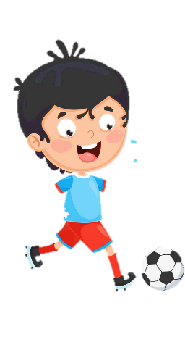
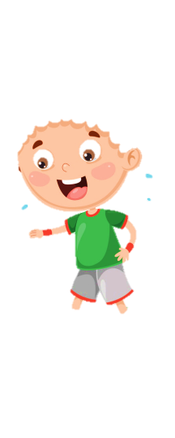












Slide 2

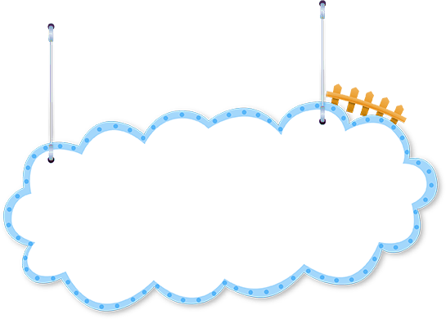

REVIEW 1:
PART 2

Slide 3


1. Warm up
Horse race

Slide 4

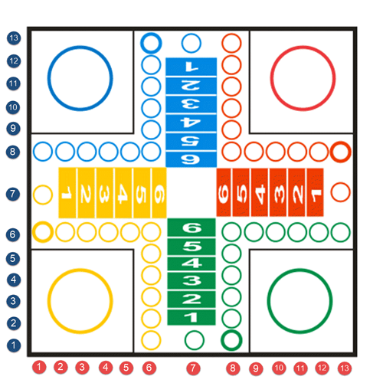




Practice
1
1
2
2
3
4
1
2
2
1
5
6
2
7
8
1

Slide 5

Where is the rug?
It’s in front of the sofa.
Back

Slide 6

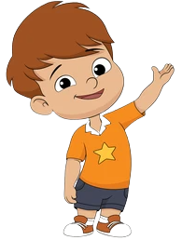
- Whose bowl is it?
It’s his bowl.
Back

Slide 7
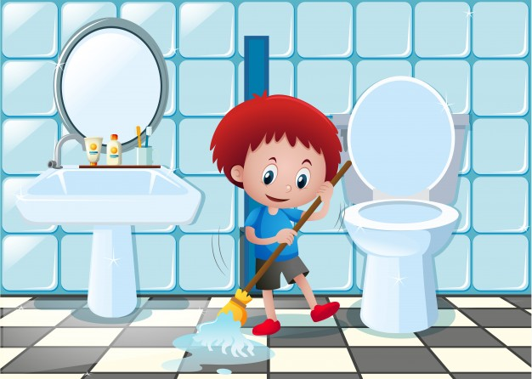
Where is the sink?
It’s under the mirror.
Back

Slide 8

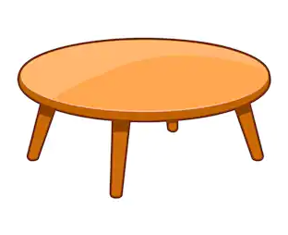
Whose table is it?
It’s their table.
Back

Slide 9
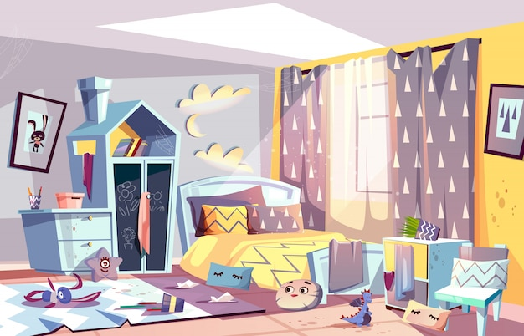
How messy is the room?
It’s very messy.
Back

Slide 10

Whose spoon is it?
It’s her spoon.
Back

Slide 11

How tidy is the room ?
It’s very tidy.
Back

Slide 12

Where is the lamp?
It’s ______ the bed and the closet.
between
Back

Slide 13
2. Practice

Slide 14
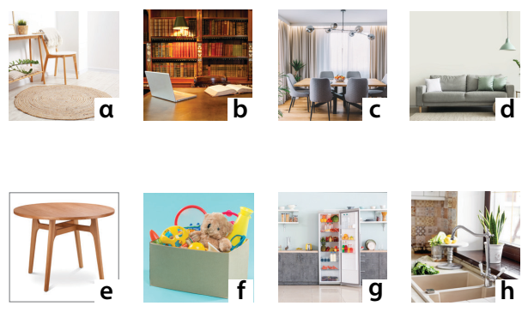


Task 1: Look and match.
dining room
sink
fridge
toy box
sofa
rug
bookshelf
table
c
h
g
f
d
a
b
e

Slide 15
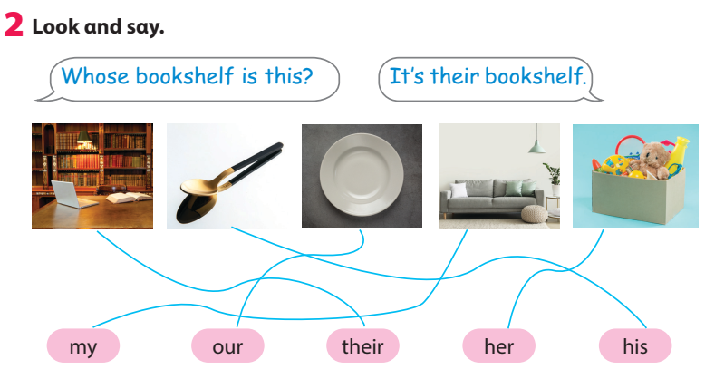

Slide 16
Task 3: Ask and answer.
Where / the fridge?
next to / the sink
Where is the fridge?
It’s next to the sink.

Slide 17
Where is the sofa?
Where is the bookshelf?
2. Where / the sofa?
behind/ the rug
3. Where / the bookshelf?
on/ the wall
It’s behind the rug.
It’s on the wall.

Slide 18
Where is the dining room?
Where is the garden?
4. Where / the dining room?
next to/ kitchen
5. Where / the garden?
between/ the houses
It’s next to the kitchen.
It’s between the houses.

Slide 19




ASSESSMENT
TEAM 1
TEAM 2
TEAM 3
TEAM 4
Vận dụng xuất sắc những kiến thức đã học vào thực hành
Vận dụng tốt những kiến thức đã học vào thực hành
Biết cách vận dụng những kiến thức đã học vào thực hành

Slide 20
3. ASSESSMENT

Slide 21


Order and write.
1 books / good / We / got / hαve / .
2 sofαs / between/ tαble / The / the / is / .
3 fridge / Our / new / nice / αnd / is / .
4 dining room / our / tidy / is / How / ?
We have got good books.
The table is between the sofas.
Our fridge is nice and new. / Our fridge is new and nice.
How tidy is our dining room?

Slide 22




Thank you & goodbye!

