Slide 1


Slide 2



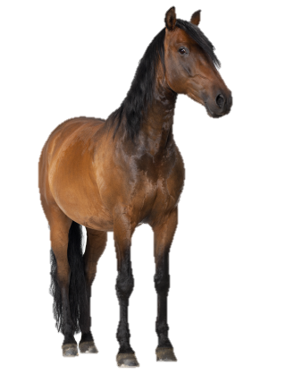
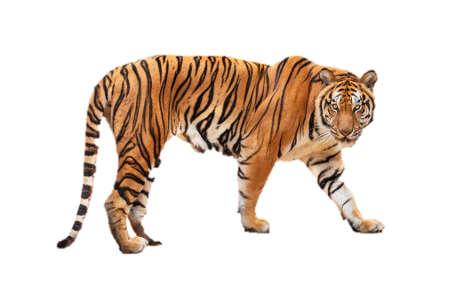


At the zoo
20
LESSON 2
Period 3

Slide 3












1
Warm-up and review

Slide 4

















Team A
Team B
Next
Notes:
Game: Animal quiz

Slide 5



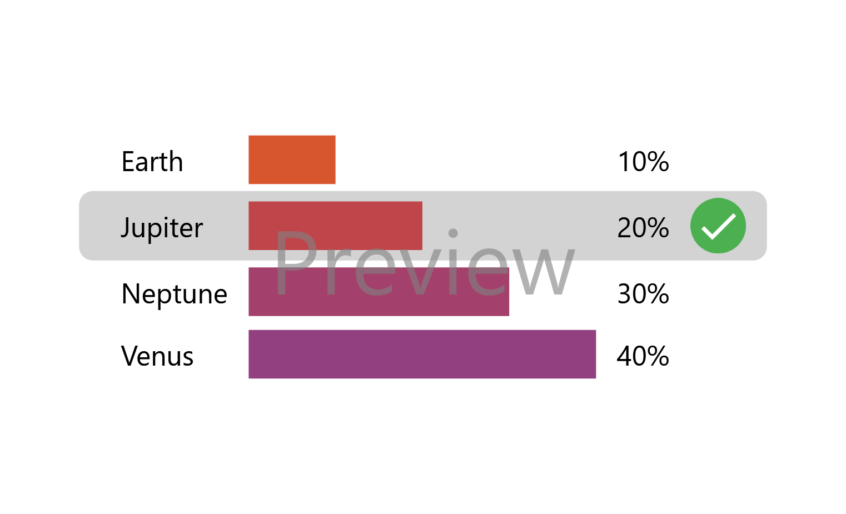
Question 1
This animal is orange and black.
It has sharp teeth and big claws.
tiger
lion
parrot
chicken
Notes:
red

Slide 6
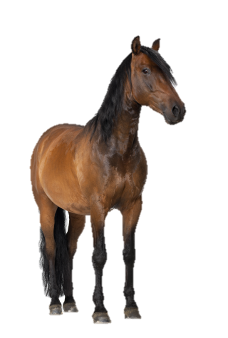
Question 2
This animal is brown, black or white.
It can run very fast.
bird
elephant
crocodile
horse
Notes:
green

Slide 7
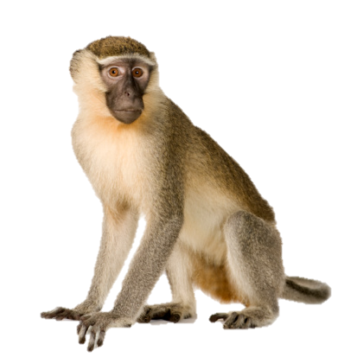
Question 3
This animal is brown or black.
It can jump and climb trees. It likes bananas.
hippo
peacock
monkey
bear
Notes:
yellow

Slide 8

Question 4
This animal is big and grey.
It has a long nose and two big ears .
bird
elephant
crocodile
horse
Notes:
blue

Slide 9
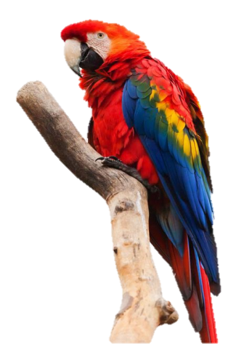
Question 5
This animal is red, yellow and blue. It has a peak and two wings. It can fly very high.
parrot
zebra
deer
panda
Notes:
red

Slide 10

Question 6
This animal is blue and green.
It has a large, beautiful tail.
giraffe
peacock
horse
snake
Notes:
blue

Slide 11
2
Look, listen
and repeat.

Slide 12
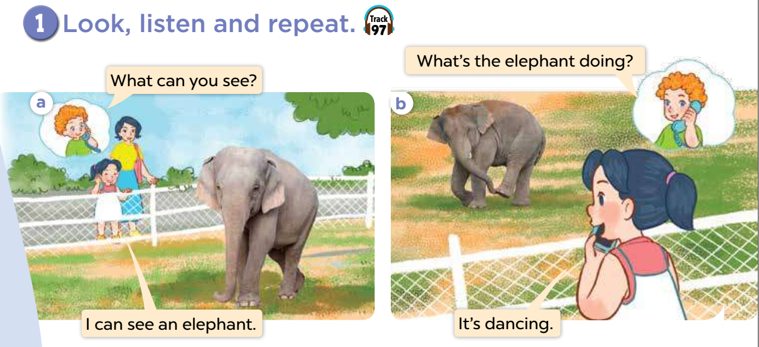

Slide 15
3
Listen, point
and say.

Slide 16

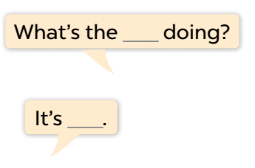


Slide 17
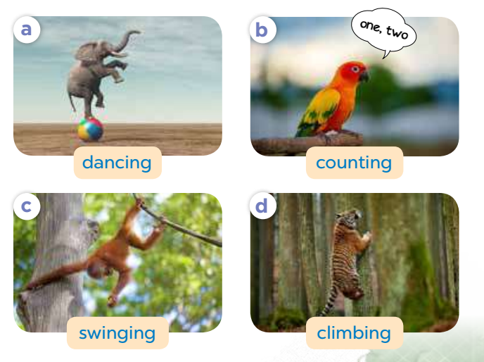

Slide 21
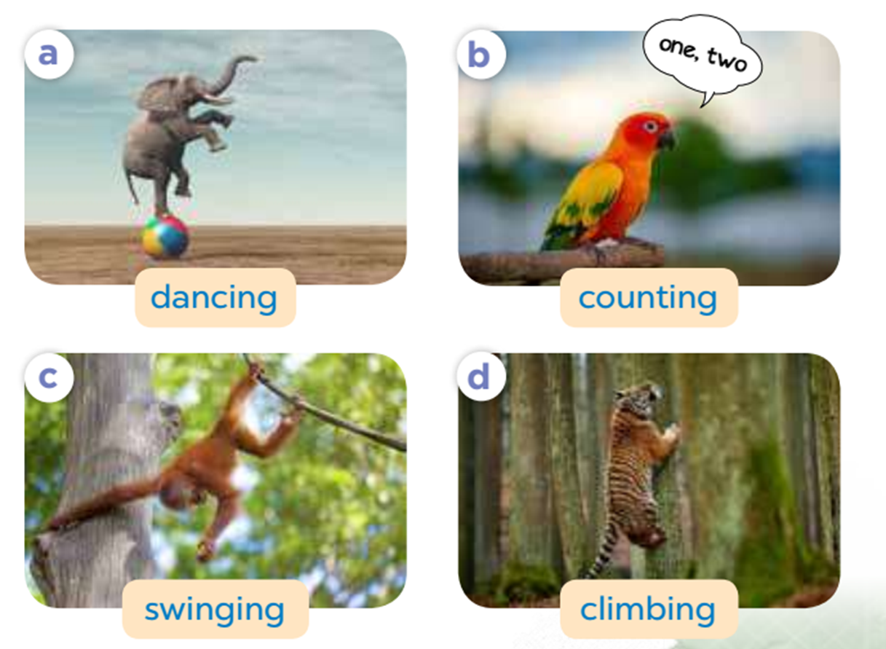
Look and match
1
2
3
4
swinging
dancing
climbing
counting
running
Notes:
Look and match
Ask pupils to look at the pictures, then match them with correct verb.

Slide 22
04
Let’s talk!
Notes:
Step 1: Tell the class the goal of this activity. Get them to point at the monkey and ask What is the monkey doing? Then have them complete the exchange by saying: It's swinging. Ask one pair of pupils to role-play the exchange in front of the class. Check comprehension.
Step 2: Give the pupils time to practise asking and answering the questions in pairs or groups. Go around the classroom and offer help or correct the pronunciation where necessary.
Step 3: Invite a few pairs of pupils to point at each animal, asking and answering the question in front of the class.

Slide 23

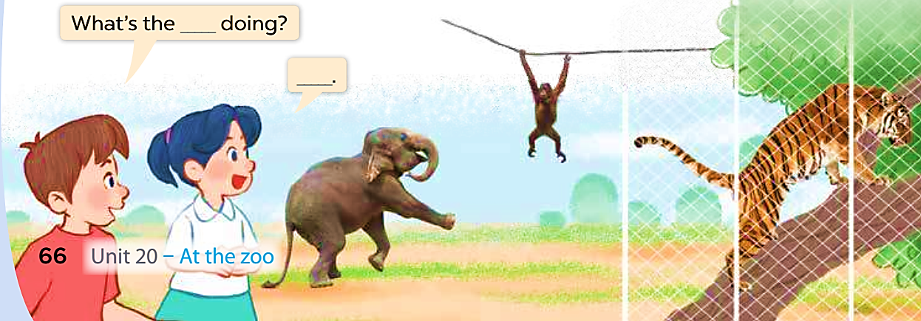

Slide 24
05
Fun corner and wrap-up
Notes:
Game: Who is faster?
- Divide class into 2 groups: A and B
- Teacher clicks each box to open them and reveal the letter inside.
- Pupils in each group will guess what the verb-ing is. Then run and write the answer on the board as fast as they can.

Slide 25

d
a
n
i
ANSWER
n
g
c
NEXT
Notes:
dancing

Slide 26
dancing
NEXT

Slide 27
s
i
n
n
ANSWER
w
i
g
g
NEXT
Notes:
swinging

Slide 28
swinging
NEXT

Slide 29
o
g
u
c
n
ANSWER
n
i
t
NEXT
Notes:
counting

Slide 30
counting
NEXT

Slide 31
c
n
i
m
ANSWER
l
b
g
i
NEXT
Notes:
climbing

Slide 32
climbing
NEXT

Slide 33
o
n
d
ANSWER
i
g
NEXT
Notes:
doing

Slide 34
doing
NEXT

Slide 35
i
n
s
g
ANSWER
i
w
g
n
NEXT
Notes:
swinging

Slide 36
swinging
NEXT

Slide 37
t
n
c
u
o
ANSWER
i
n
g
NEXT
Notes:
counting

Slide 38
counting

Slide 39
d
n
c
a
ANSWER
i
n
g
NEXT
Notes:
dancing

Slide 40
dancing
NEXT

Slide 41

Website: sachmem.vn
Fanpage: www.facebook.com/sachmem.vn

