Slide 1
Unit 7:
My Favorite sport
Lesson 2- Task 1,2,3

Slide 2
1.Warm up
What are you doing ?

Slide 4
2.Presentation

Slide 5
catching

Slide 6
hitting

Slide 7
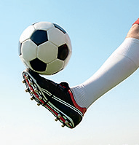
kicking

Slide 8
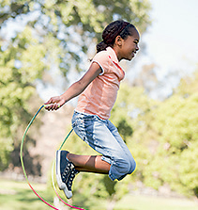
jumping

Slide 9
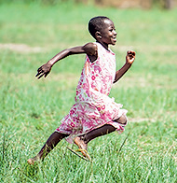
running

Slide 10
Tuesday, February 7th, 2023
Unit 7 – Lesson 2
New words
catching : đang bắt (bóng)
hitting : đang đánh
kicking: đang đá
jumping: đang nhảy
running: đang chạy

Slide 11
II. Sentences
(+) I am playing football. (I am = I’m)
He/She/It is jumping. (He’s/She’s/ It’s)
We/ They/ You are kicking the ball. (We’re/They’re/ You’re)

Slide 12
MINIGAME
VOCABULARY CHECKING
Listen the words and slap the board
Notes:
Slap the board

Slide 13
Task 1. Listen and point. Repeat

Slide 14
catching
hitting
kicking
jumping
running

Slide 15
3.Practice

Slide 16
Task 2. Listen and tick ( tr 7.5)
. TR: 7.
. TR: 7.
✓

Slide 17
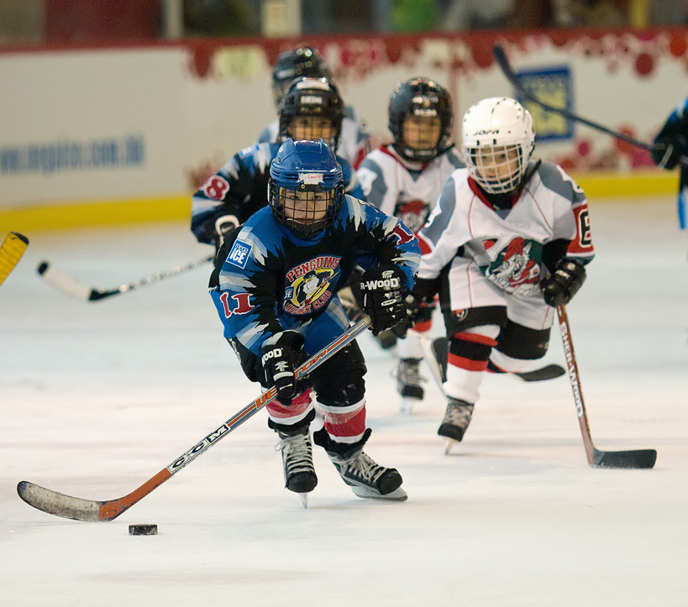
Hockey is a great sport. Look at the photo. I’m playing hockey with my friends. I’m running fast. I’m hitting the ball. I’m not jumping. I’m not kicking the ball. Hockey is cool!
✓
✓

Slide 18
4.Production

Slide 19
Task3. Ask and answer .
Use the words in 1
GUESS THE SPORT

Slide 20
He’s catching the ball.
He’s playing baseball.

Slide 21
She’s kicking the ball .
She’s playing football.

Slide 22
He’s hitting the ball .
He’s playing baseball.

Slide 23
5.Assessment
Use the words to make sentences

Slide 24
Use the words to make sentences
1. I/ catch/ the ball.
2. She/ jump.
3. She/ run.
4. He/ hit/ the
ball .

Slide 25
Use the words to make sentences
1.I’m catching
the ball.
2. She’s jumping.
3. She’s
running.
4. He’s hitting the ball.

Slide 26
Thank you & goodbye!

