Slide 1









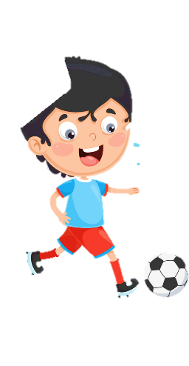
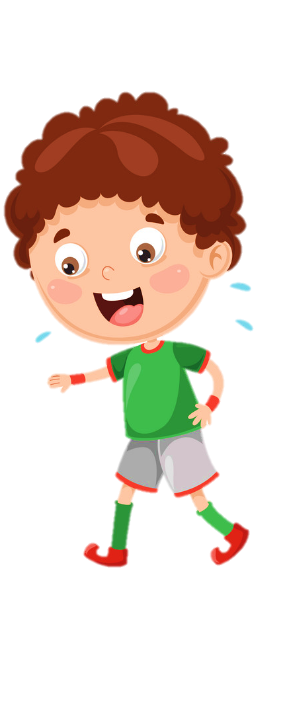










Unit 8
My Town
Lesson 2 – Task 4,5,6

Slide 2










1 Warm up

Slide 3

Puzzle word
1
w | r | i | t | e
2
j | u | m | p
3
s | w | i | m
4
d | a | n | c | e
5
r | u | n
6
r | e | a | d
Next

Slide 4
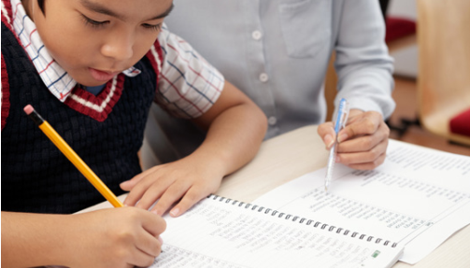
write
Back

Slide 5

jump
Back

Slide 6
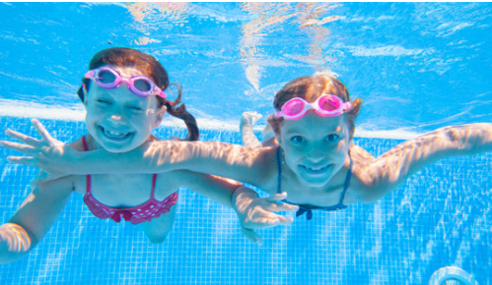
swim
Back

Slide 7
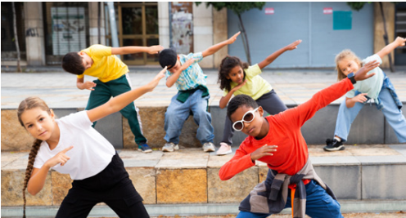
dance
Back

Slide 8
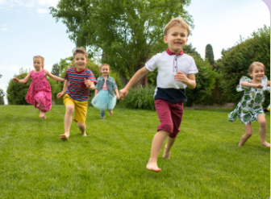
run
Back

Slide 9



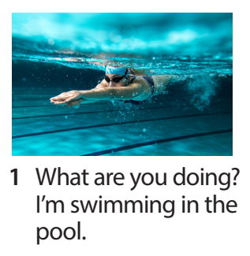
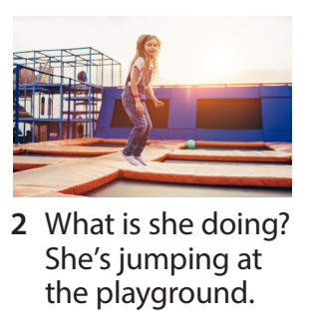
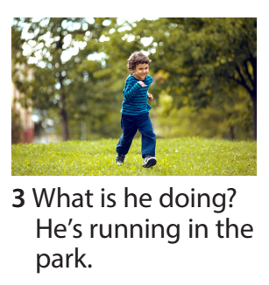
Task 4 Listen and repeat.

Slide 10

read
Back

Slide 11
2 Presentation

Slide 12
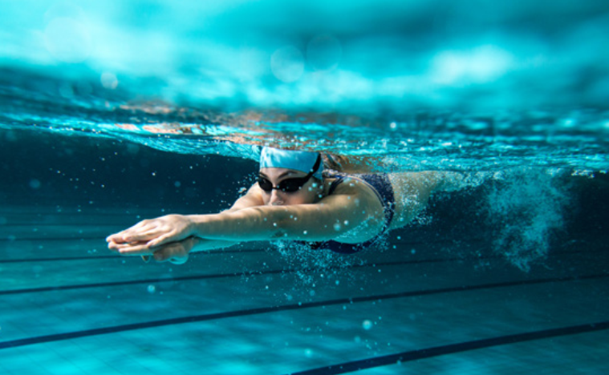
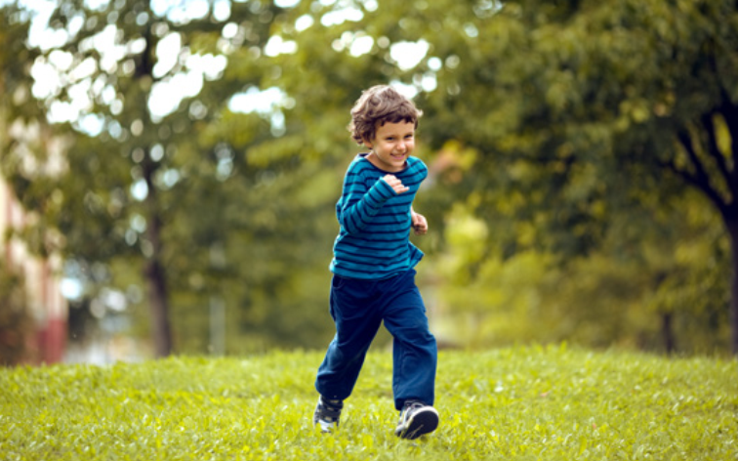
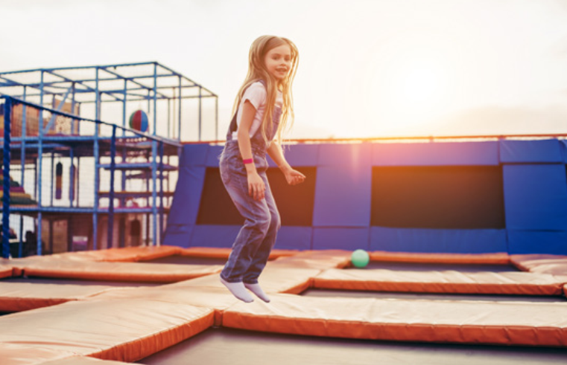

Slide 13

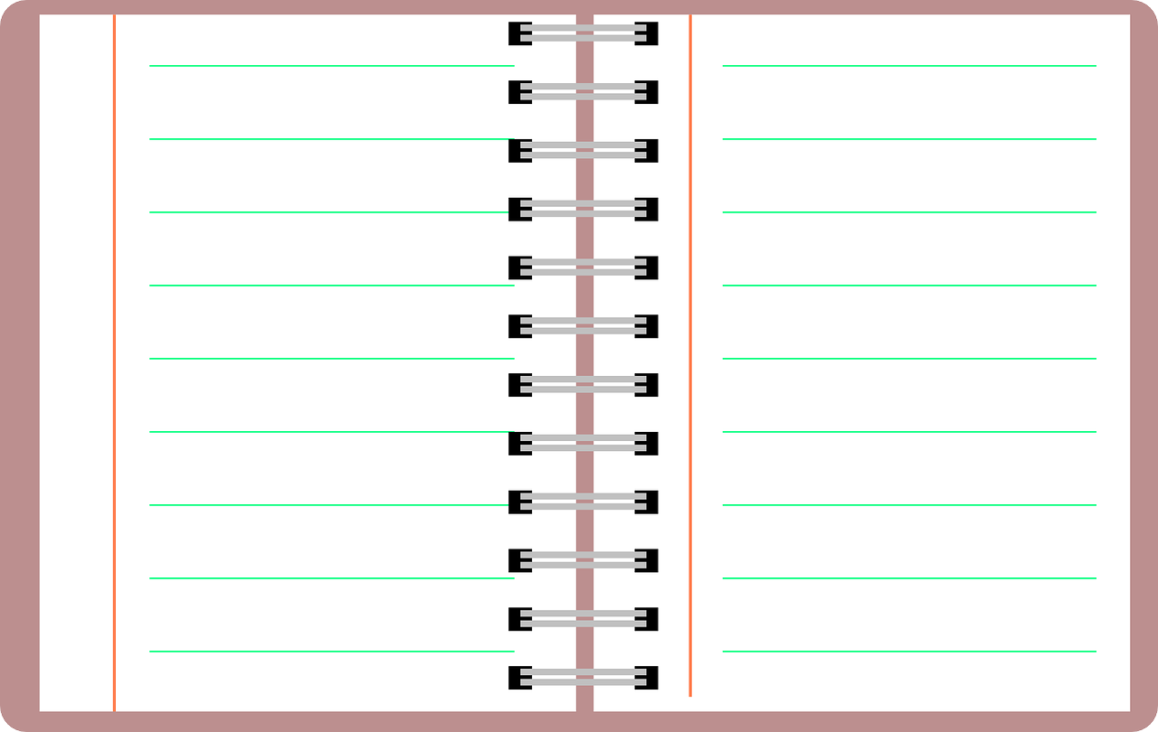
New structure
What are you doing?
I’m ____________.
What is he doing?
He’s __________.
What is she doing?
She’s __________.
What are they doing?
They’re__________.

Slide 14
Friday, March 3rd, 2023
Uni t 8 - Lesson 2 (P2)
II. Sentences
What are you doing?
I’m reading a book in the bedroom.
2. What is he/she doing?
He’s/She’s swimming in the pool.

Slide 15

Quick eyes, quick hands
Notes:
Đổi tên thành game
Câu hỏi đâu??? Nên cho câu hỏi lên, hs xem qua, đọc qua rồi mới chơi (bên cạnh câu hỏi để trong basket…)
- Prepare 4 baskets with many small flashcash (teacher has to cut a sentence into many small pieces).
-Invite 4 Ss go to the board. When T turns on the audio, Ss listen carefully and choose words from his/her own basket to stick on the board.
-Who is fastest will be the winner.

Slide 16
3 Practice

Slide 17

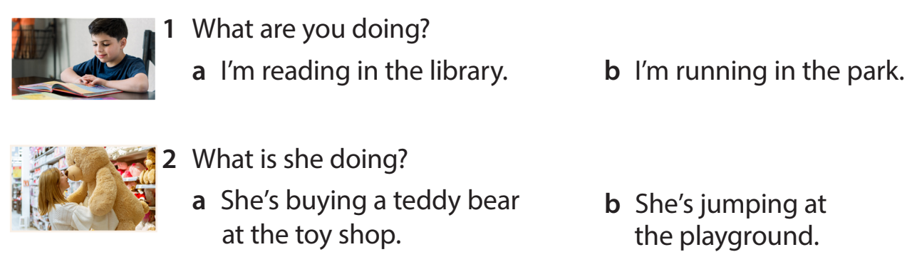
Task 5 Look and read. Circle and say.

Slide 18
4 Production

Slide 19
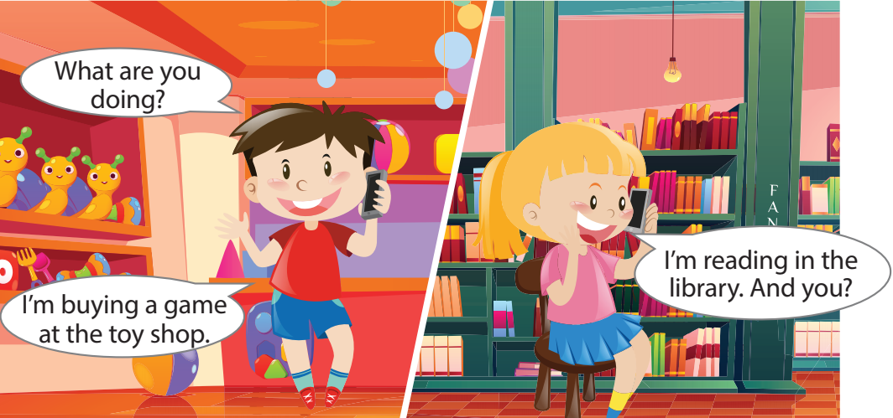
Task 6 Let’s talk.
Notes:
- Allow them enough time to make their own and practise the dialogue.
- Ask some volunteers to go to the broard to make a phone call( one is in the class, one is out of the class.)

Slide 20
5 Assessment

Slide 21
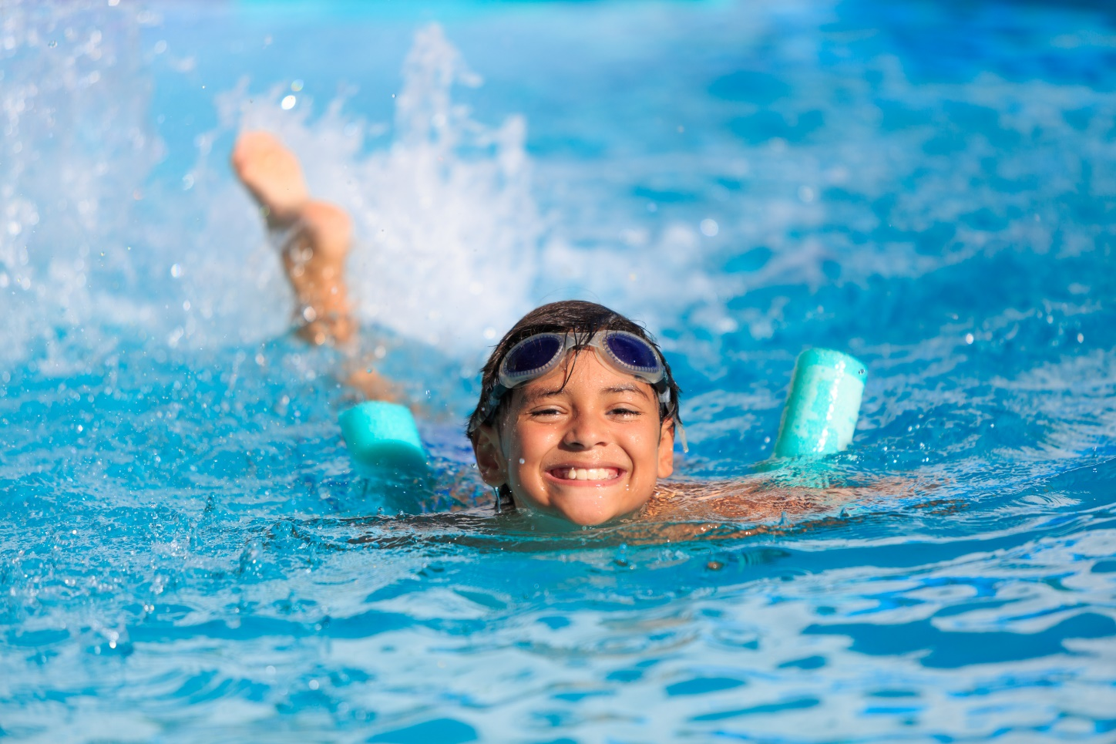
What is he doing?
A. He’s swimming in the pool.
B. He’s jumping.
C. He’s smiling.

Slide 22
What is she doing?
A. She’s singing.
B. She’s driving a car.
C. She’s jumping.

Slide 23
What is he doing?
A. He’s eating.
B. He’s running.
C. He’s run.

Slide 24
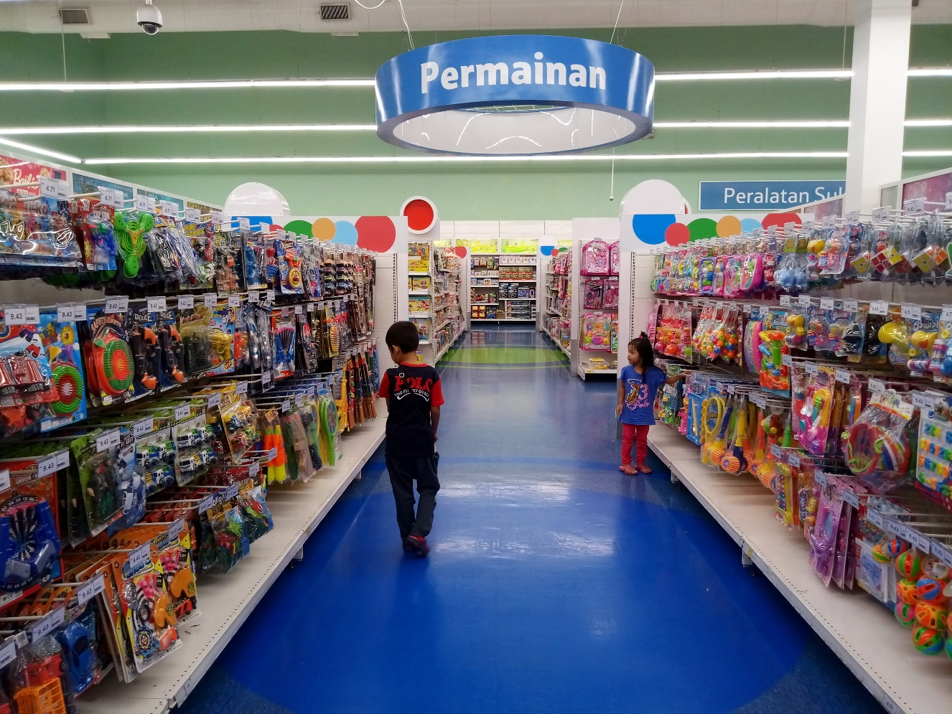
Fill in the blank.
We’re ______ balls at the toy shop now.
buying

Slide 25
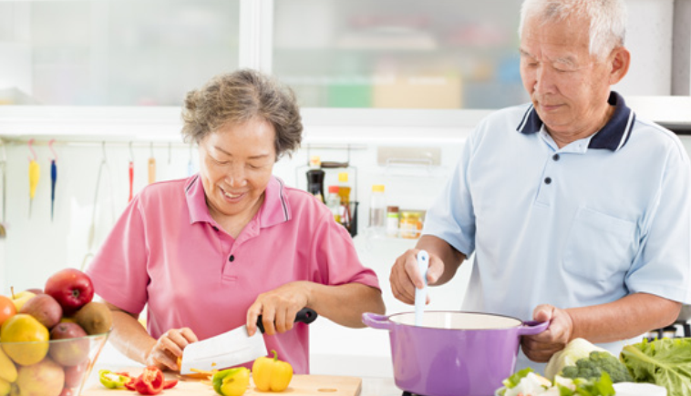
Fill in the blank.
They ’re ______ in the kitchen.
cooking

Slide 26




Thank you & goodbye!

