Slide 1
Ph uThi Secondary school.
Hello everyone!!!

Slide 2
Friday, January 19, 2024
Unit
7
ENVIRONMENTAL PROTECTION
LESSON 3: A CLOSER LOOK 2 (P. 75)

Slide 3
I. OBJECTIVES
By the end of this lesson, Ss will be able to:
1. Knowledge
- use the Complex sentences with adverb clauses of time;

Slide 4
* WARM-UP
* Game: Sentence puzzling
I / take a bath /always/ I go to bed./ before/
2. you/ Will / wait here / I am / until ready?
3. I / was not at home / he / to see / when / came / me.
4. I/ will / get home / you / call / as soon as/ I
→ I always take a bath before I go to bed.
→ Will you wait here until I am ready?
→ I was not at home when he came to see me.
I will call you as soon as I get home .

Slide 5
Mệnh đề trạng ngữ chỉ thời gian
* WARM-UP
* Game: Sentence puzzling
1. I always take a bath before I go to bed.
2. Will you wait here until I am ready?
ADVERB CLAUSES OF TIME
3. I was not at home when he came to see me.
4. I will call you as soon as I arrive at the station.
(Mệnh đề trạng ngữ chỉ thời gian)

Slide 6
* Grammar:
Complex sentences with adverb clauses of time
(Câu phức với mệnh đề trạng ngữ chỉ thời gian)
- A complex sentence contains one independent clause and at least one dependent clause.
(Một câu phức chứa một mệnh đề độc lập và ít nhất một mệnh đề phụ thuộc.)
* Example:
The roads were slippery when it rained.
independent clause
(mệnh đề độc lập)
dependent clause
(mệnh đề phụ thuộc)
+ An adverb clause is a dependent clause.
- Mệnh đề trạng ngữ là mệnh đề phụ thuộc.

Slide 7
– An adverb clause of time shows when something happens.
- It is usually introduced by time connectors: before, after, when, while, till / until, as soon as, …
Mệnh đề trạng ngữ thường bắt đầu với các liên từ chỉ thời gian
như:
+ before : trước khi
+ after : sau khi
+ when : khi
+ while : trong khi
+ till/ until : cho đến khi
+ as soon as : ngay khi
+ …

Slide 8
1
Read the sentences and write I.C if the underlined clause is an independent clause or D.C if it is a dependent clause
I.C
1. I’ll wait for you here until you get back. 2. Make sure you lock the door when you go out. 3. You must get a permit before you build a campfire at a national park. 4. Don’t use too much water while you are having a shower. 5. As soon as my friends come, we will pick up rubbish on the beach.
D.C
I.C
D.C
D.C

Slide 9
* PRACTICE
2
Choose A, B, or C to complete each sentence.
1. I was not at home ______ he came to see me yesterday. A. when B. until C. as soon as 2. We called the forest guard unit ______ we saw the bush fire. A. as soon as B. while C. until 3. I went straight to the gym ______ I left home. A. while B. before C. after 4. You can stay with us ______ you find a suitable place to stay. A. as soon as B. before C. until 5. We cleaned up everything at the campsite ______ we left. A. until B. before C. while

Slide 10
3
Match the clauses in the two columns to form complex sentences.

Slide 11
PRACTICE
4
Combine each pair of sentences, using the conjunction in brackets.
1. I arrive at the station. I will call you right after. (as soon as)
________________________________________________________
________________________________________________________
2. Many Vietnamese women wear conical hats. They work in the field. (when)
___________________________________________________________
3. My father taught me how to use the computer. Then he bought one for me. (before)
_______________________________________________________________
_______________________________________________________________
I will call you as soon as I arrive at the station.
As soon as I arrive at the station, I will call you.
Many Vietnamese women wear conical hats when they work in the field.
My father taught me how to use the computer before he bought one for me.
Before my father bought me a computer, he taught me how to use it.

Slide 12
PRACTICE
4
Combine each pair of sentences, using the conjunction in brackets.
4. Nick is reading a novel. Jack is reading a cartoon. (while)
________________________________________________________
________________________________________________________
5. The tornado hit. There were only a few houses left standing. (after)
________________________________________________________
________________________________________________________
Nick is reading a novel while Jack is reading a cartoon.
While Nick is reading a novel, Jack is reading a cartoon.
After the tornado hit, there were only a few houses left standing.
There were only a few houses left standing after the tornado hit.

Slide 13
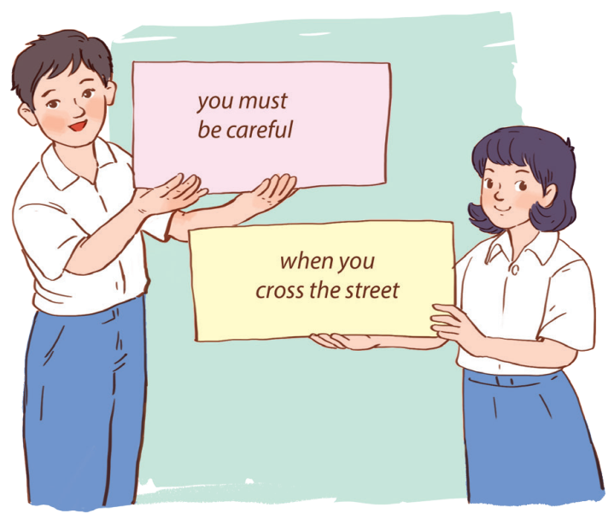
* PRODUCTION
5
Matching game:
Work in two groups, A and B.
Group A: write main clauses
Group B: write adverb clauses of time

Slide 14
* CONSOLIDATION
What have we learnt in this lesson?
use the Complex sentences with adverb clauses of time;

Slide 15
* Grammar:
Complex sentences with adverb clauses of time
– Câu phức gồm có một mệnh đề độc lập và ít nhất một mệnh đề phụ thuộc.
Example:
Eg: The roads were slippery when it rained.
independent clause dependent clause
(mệnh đề độc lập) (mệnh đề phụ thuộc)
- Mệnh đề trạng ngữ là mệnh đề phụ thuộc.
– Mệnh đề trạng từ chỉ thời gian diễn tả khi nào một việc gì đó xảy ra. Nó thường được giới thiệu bằng các từ nối thời gian:
before, after, when, while, till / until, as soon as, …

Slide 16
Homework
Do ex B4. (P. 56 )in the workbook.
Prepair lesson 4 – Communication

Slide 17
Thanks for your atendance!
Goodbye. See you again
Notes:
17

Slide 18
* Grammar:
Complex sentences with adverb clauses of time
– A complex sentence contains one independent clause and at least one dependent clause.
Example:
The roads were slippery when it rained.
independent clause dependent clause
– An adverb clause is a dependent clause.
– An adverb clause of time shows when something happens. It is usually introduced by time connectors: before, after, when, while, till / until, as soon as, …

Slide 19
* Grammar:
Complex sentences with adverb clauses of time
(Câu phức với mệnh đề trạng ngữ chỉ thời gian)
- A complex sentence contains one independent clause and at least one dependent clause.
(Một câu phức chứa một mệnh đề độc lập và ít nhất một mệnh đề phụ thuộc.)
* Example:
The roads were slippery when it rained.
independent clause
(mệnh đề độc lập)
dependent clause
(mệnh đề phụ thuộc)
+ An adverb clause is a dependent clause.
- Mệnh đề trạng ngữ là mệnh đề phụ thuộc.

