Slide 1
HELLO EVERY ONE !!!

Slide 2
Warm up:
Game: Pelmanism
1
2
3
4
GO
BE
DO
PLAY
Grammar
MEET
6
7
5
DRINK
WENT
WAS/
WERE
8
The past simple
Imperatives
Choose the correct answer A, B, or C.
Look at each picture and choose the correct answer.
Write the correct form of the verbs to complete the conversation.
PLAYED
MET
DID
DRANK
9
10
11
12
Tell your friends what to do and what not to do at the gym.
Work in groups. Ask and answer questions about your last weekend.

Slide 3
Thursday, February 15, 2024
Period 64: UNIT 8: SPORTS AND GAMES
LESSON 3
(P. 19)
Grammar
The past simple
Imperatives
Grammar:
The past simple
Choose the correct answer A, B, or C.
Look at each picture and choose the correct answer.
By the end of the lesson, students will be able to use the past simple tense and imperatives.
Write the correct form of the verbs to complete the conversation.
Tell your friends what to do and what not to do at the gym.
Work in groups. Ask and answer questions about your last weekend.

Slide 4
* Grammar:
The past simple ( Thì quá khứ đơn)
We use the past simple to talk about something that happened in the past.
A. To be: was/ were (not)
Example:
(+): I was at home yesterday.
(-): I wasn’t at home yesterday.
(?): Was you at home yesterday. Yes, I was. / No, I wasn’t
(+): S + was/ were + O.
(-): S + wasn’t/ weren’t +O.
- I/ he/ she/ it/ số ít: was/ wasn’t
- you/ we/ they/ số nhiều : were / weren’t
(?): Was/ Were + S + O.
→Yes, S + was/were.
→No, S + wasn’t/ weren’t.

Slide 6
* Grammar:
The past simple ( Thì quá khứ đơn)
We use the past simple to talk about something that happened in the past.
B. Verb
(+): I played badminton with Phong yesterday.
Example:
(-): I didn’t play badminton…………………………….
(?): I didn’t play badminton…………………………….?
Yes, I did.
No, I didn’t

Slide 7
* Grammar:
The past simple ( Thì quá khứ đơn)
We use the past simple to talk about something that happened in the past.
Example:
(+): I played badminton with Phong yesterday.
(-): I didn’t play badminton…………………………….
(?): I didn’t play badminton…………………………….?
Yes, I did.
No, I didn’t

Slide 8
* Grammar 1:
The past simple ( Thì quá khứ đơn)
 | To verb | To be
(+): | S + V(2/ed/) + … . | S + was/ were + … .
(-): | S + didn’t + Vo + … . | S + wasn’t/ weren’t + …
(?): | Did + S + Vo + … ? | Was/ Were + S + … .
Answer | →Yes, S + did. →No, S + didn’t. | →Yes, S + was/were. →No, S + wasn’t/ weren’t.
* Notes: Irregular verbs Regular verbs. Vo - V(2) Vo - V(ed) go - went play - played
Form:
Grammar
The past simple
Imperatives
Adverbs of time
yesterday, ago, last, in 2000, in the past, when (trong câu khẳng định)
Work in groups. Ask and answer questions about your last weekend.

Slide 9
Choose the correct answer A, B, or C.
1.
There _______ an interesting match on TV last night.
A.
is
B.
were
C.
were
2.
My dad _______ a lot of tennis some years ago.
Grammar
A.
plays
B.
played
C.
is playing
The past simple
Imperatives
3.
I was at the gym last Sunday, but I _______ you there.
A.
B.
don’t see
C.
didn’t see
not saw
Choose the correct answer A, B, or C.
Look at each picture and choose the correct answer.
4.
The teacher _______ us about our homework this morning.
Write the correct form of the verbs to complete the conversation.
A.
B.
not asking
C.
doesn’t ask
didn’t ask
Tell your friends what to do and what not to do at the gym.
5.
_______ sleep well last night?
Work in groups. Ask and answer questions about your last weekend.
A.
B.
Did you
C.
Were you
Do you

Slide 10
Lucky number Game
1
6
2
Team A
Team B
8
2
8
10
4
4
6
2
10
6
5
3
4
TIẾP

Slide 11
Choose the correct answer A, B, or C.
1.
There _______ an interesting match on TV last night.
A.
is
B.
were
C.
was

Slide 12
Choose the correct answer A, B, or C.
2.
My dad _______ a lot of tennis some years ago.
Grammar
A.
plays
B.
played
C.
is playing
The past simple
Imperatives

Slide 13
Choose the correct answer A, B, or C.
The past simple
Imperatives
3.
I was at the gym last Sunday, but I _______ you there.
A.
B.
don’t see
C.
didn’t see
not saw
Choose the correct answer A, B, or C.
Look at each picture and choose the correct answer.

Slide 14
Choose the correct answer A, B, or C.
Choose the correct answer A, B, or C.
Look at each picture and choose the correct answer.
4.
The teacher ______us about our homework this morning.
Write the correct form of the verbs to complete the conversation.
A.
B.
not asking
C.
doesn’t ask
didn’t ask
Tell your friends what to do and what not to do at the gym.

Slide 15
Choose the correct answer A, B, or C.
Tell your friends what to do and what not to do at the gym.
5.
_______ sleep well last night?
Work in groups. Ask and answer questions about your last weekend.
A.
B.
Did you
C.
Were you
Do you

Slide 16
LUCKY NUMBER!
Grammar
The past simple
Imperatives
Choose the correct answer A, B, or C.
Look at each picture and choose the correct answer.
Write the correct form of the verbs to complete the conversation.
Tell your friends what to do and what not to do at the gym.
Work in groups. Ask and answer questions about your last weekend.

Slide 17
Choose the correct answer A, B, or C.
1.
There _______ an interesting match on TV last night.
A.
is
B.
were
C.
was
2.
My dad _______ a lot of tennis some years ago.
Grammar
A.
plays
B.
played
C.
is playing
The past simple
Imperatives
3.
I was at the gym last Sunday, but I _______ you there.
A.
B.
don’t see
C.
didn’t see
not saw
Choose the correct answer A, B, or C.
Look at each picture and choose the correct answer.
4.
The teacher _______ us about our homework this morning.
Write the correct form of the verbs to complete the conversation.
A.
B.
not asking
C.
doesn’t ask
didn’t ask
Tell your friends what to do and what not to do at the gym.
5.
_______ sleep well last night?
Work in groups. Ask and answer questions about your last weekend.
A.
B.
Did you
C.
Were you
Do you

Slide 18
Choose the correct answer A, B, or C.
1.
There _______ an interesting match on TV last night.
A.
is
B.
were
C.
was
2.
My dad _______ a lot of tennis some years ago.
Grammar
A.
plays
B.
played
C.
is playing
The past simple
Imperatives
3.
I was at the gym last Sunday, but I _______ you there.
A.
B.
don’t see
C.
didn’t see
not saw
Choose the correct answer A, B, or C.
Look at each picture and choose the correct answer.
4.
The teacher _______ us about our homework this morning.
Write the correct form of the verbs to complete the conversation.
A.
B.
not asking
C.
doesn’t ask
didn’t ask
Tell your friends what to do and what not to do at the gym.
5.
_______ sleep well last night?
Work in groups. Ask and answer questions about your last weekend.
A.
B.
Did you
C.
Were you
Do you

Slide 19
Write the correct form of the verbs to complete the conversation.
Nick: Hi, there.
Sonny: Hello, Nick. Did you have a nice weekend?
Nick: Yeah, it was OK. On Sunday, I (1. go) _______ fishing with my dad. How about you?
Sonny: Oh, I (2. have) _______ a good weekend, too.
Nick: Really? What _______ you (3. do) _______?
Sonny: I (4. visit) _______ the museum with my family, then we (5. eat) _______ at my favourite restaurant.
Nick: Did you watch football last Sunday
Sonny: Oh, yeah! My favourite team (6. score) _______ a fantastic goal!
went
had
did
do
visited
ate
scored

Slide 20
Work in groups. Ask and answer questions about your last weekend.
Example:
A: Did you do any sport last weekend?
B: Oh yes, and I was exhausted.
C: Really? What did you do?
…

Slide 21
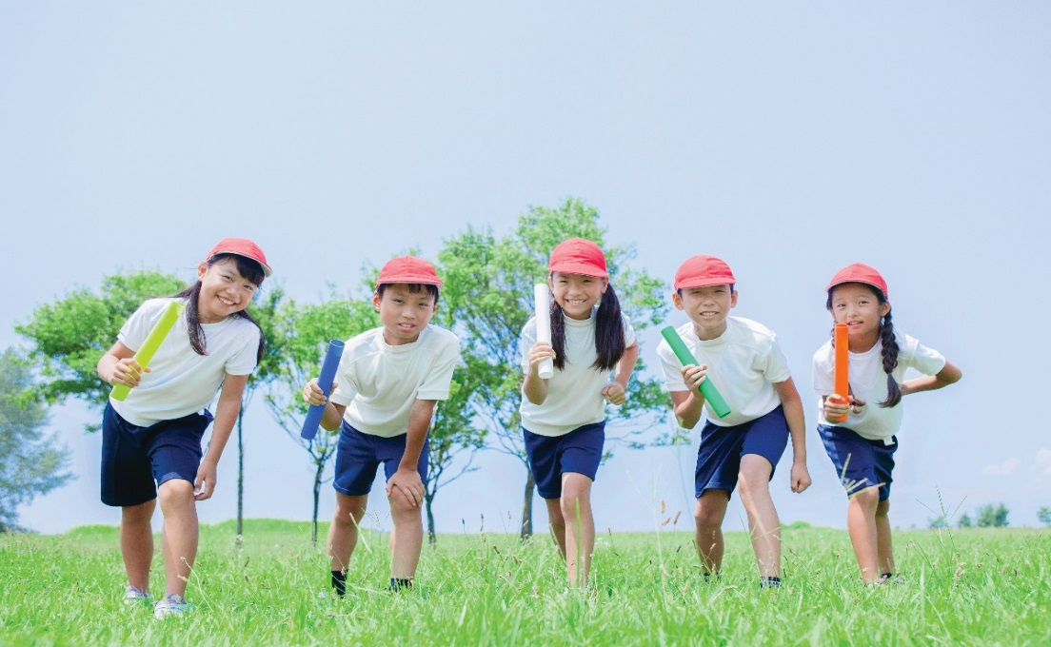
Work in groups. Ask and answer questions about your last weekend.
Example:
A: Did you do any sport last weekend?
B : Yes, I played football with some friends . And you?
C: Oh no, I visited my grandparents.
……

Slide 22
Grammar 2:
Imperatives
We use imperatives to tell someone to do something, or to give a direct order.
Chew it.
Don’t swallow it.
Positive: Vo
Negative: Don’t + Vo

Slide 23
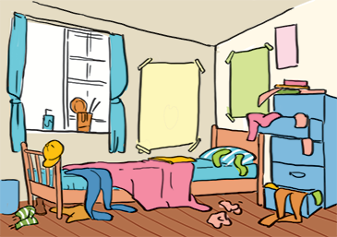
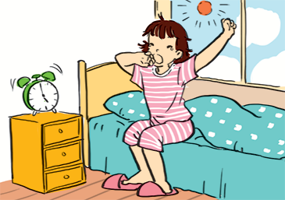
Look at each picture and choose the correct answer.
2. (Close / Open) the window. It’s windy outside.
3. (Tidy up / Don’t tidy up) your room.
1.(Park / Don’t park) here.
4.
(Use / Don’t use) the lift when there is ﬁre.
5. (Try / Don’t try) to get up early to do some exercise.
Lift : thang máy

Slide 24
Look at each picture and choose the correct answer.
1.
(Park / Don’t park) here.

Slide 25
Look at each picture and choose the correct answer.
2.
(Close / Open) the window. It’s windy outside.

Slide 26
Look at each picture and choose the correct answer.
3.
(Tidy up / Don’t tidy up) your room.

Slide 27
Look at each picture and choose the correct answer.
4.
(Use / Don’t use) the lift when there is ﬁre.
Lift : thang máy

Slide 28
Look at each picture and choose the correct answer.
5.
(Try / Don’t try) to get up early to do some exercise.

Slide 29
Tell your friends what to do and what not to do at the gym.
GYM RULES
Example:
Change your clothes.
Don’t speak loudly.
_______
_______
_______
Do as the instruction on equipment.
Don’t litter.
Put on your sports shoes.
Pay your fee first.
Don’t eat or drink at the gym.

Slide 30
Homework:
- Do ex B1,2,4 (P. 9,10,11)
- Make 3 sentences about yourself, using the past simple.
- Give 3 orders or tell your friends to do an activity / everyday routine.
- Prepare lesson 5- skills 1..

Slide 31
Goodbye!
See you again
Thank you!
Have a nice day!

Slide 32
* Grammar 1:
The past simple ( Thì quá khứ đơn)
Form:
 | To verb | To be
Positive | S + Ved + … . | S + was/ were + … .
Negative | S + didn’t + Vo + … . | S + wasn’t/ weren’t + …
Interrogative | Did + S + Vo + … ? | Was/ Were + S + … .
Answer | →Yes, S + did. →No, S + didn’t. | →Yes, S + was/were. →No, S + wasn’t/ weren’t.
W/H questions | W/H + did + S + Vo + … ? | W/H + was/were + S + ...?
* Notes: There are regular and irregular verbs in past simple tense. Ex: go - went ; play - played
Grammar
The past simple
Imperatives
* Adverbs of time are used with the past simple are: yesterday, 2 weeks/ 3 months… ago, last week/ month/ year/
Work in groups. Ask and answer questions about your last weekend.

Slide 33
Look at each picture and choose the correct answer.

Slide 34
* Grammar 1:
The past simple ( Thì quá khứ đơn)
 | To verb | To be
(+): | S + V(2/ed/) + … . | S + was/ were + … .
(-): | S + didn’t + Vo + … . | S + wasn’t/ weren’t + …
(?): | Did + S + Vo + … ? | Was/ Were + S + … .
Answer | →Yes, S + did. →No, S + didn’t. | →Yes, S + was/were. →No, S + wasn’t/ weren’t.
W/H questions | W/H + did + S + Vo + … ? | W/H + was/were + S + ...?
* Notes: Irregular verbs Regular verbs. Vo - V(2/ed) Vo - V(2/ed) go - went play - played
Form:
Grammar
The past simple
Imperatives
Adverbs of time
yesterday, ago, last, in 2000, in the past, when I was…
Work in groups. Ask and answer questions about your last weekend.

