Slide 1










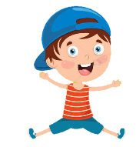










Review 1
Part 4
Notes:
Để nguyên trang bìa như này, chỉ thay đổi tên bài trong quá trình làm. Logo của sách Wonderful World

Slide 2







Warm up
Game: Who’s missing?
Notes:
- Show all the pictures of family members on the screen.
- Ask Ss to read.
- Ask them to close their eyes.
- Choose a student from each team and go to the board.
- Tell the rule and let children do a trial.
- Check children’s understanding. (If children can’t understand well, T can explain the rule in Vietnamese).
- T removes a family member and asks pupils to identify who is missing.
- The winner is who can say the correct member first.

Slide 3


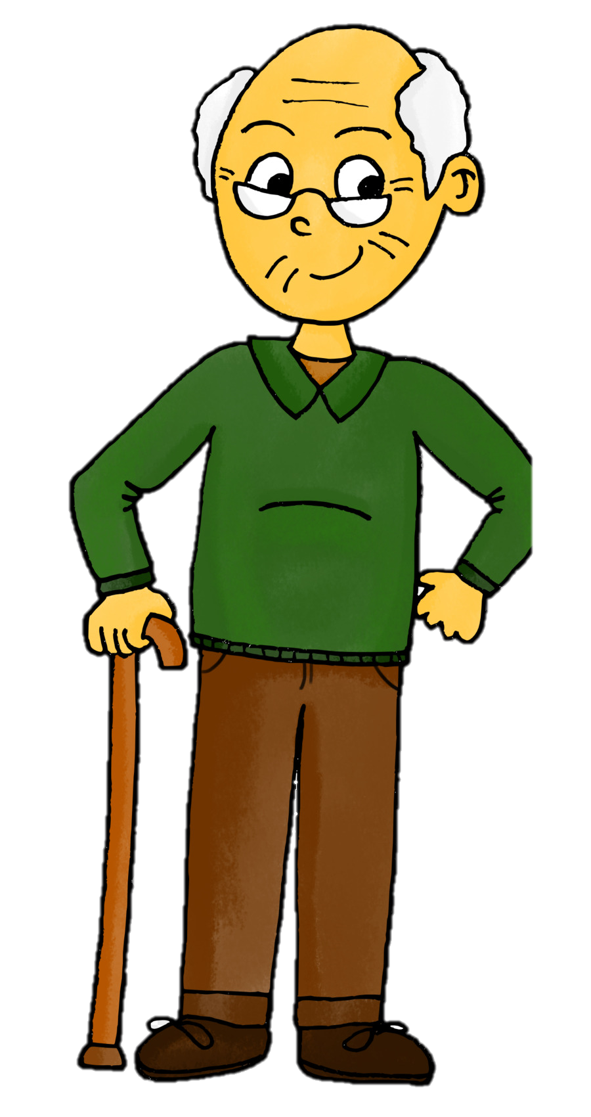
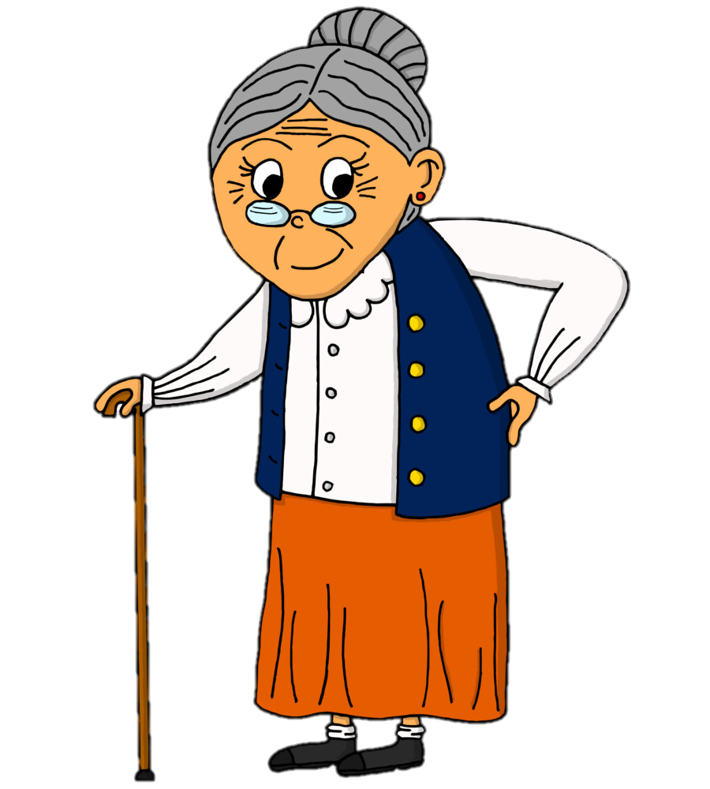

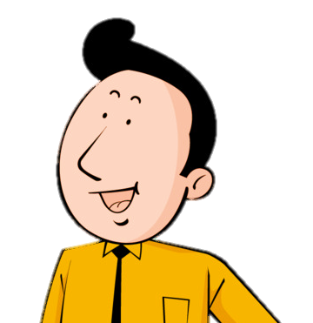
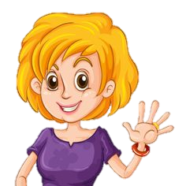
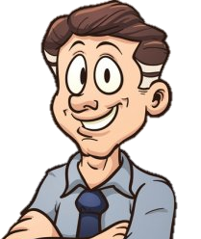
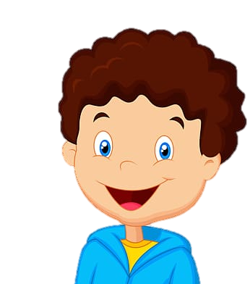
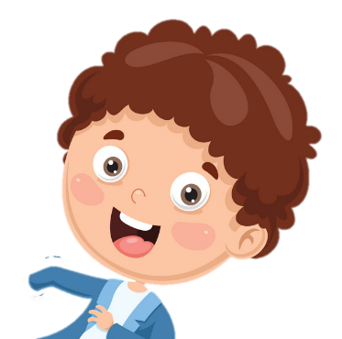
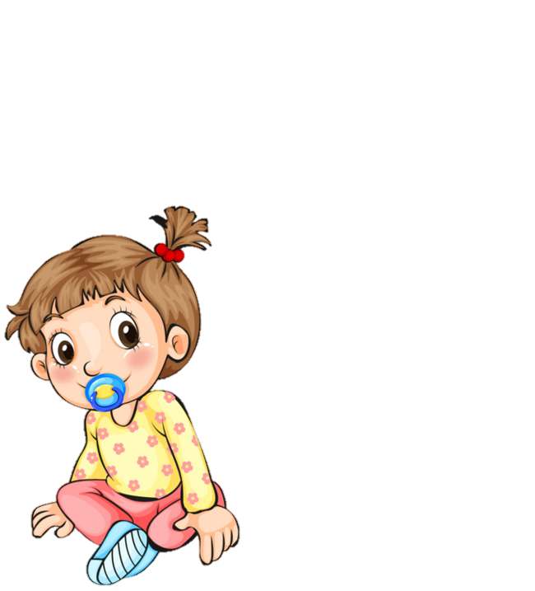
grandpa
grandma
mum
aunt
uncle
dad
brother
sister
cousin
Notes:
- Show all the pictures of family members on the screen.
- Ask Ss to read.
- Ask them to close their eyes.
- Choose a student from each team and go to the board.
- Tell the rule and let children do a trial.
- Check children’s understanding. (If children can’t understand well, T can explain the rule in Vietnamese).
- T removes a family member and asks pupils to identify who is missing.
- The winner is who can say the correct member first.

Slide 4
grandpa
grandma
dad
aunt
mum
uncle
brother
sister
cousin

Slide 5
grandpa
grandma
dad
aunt
mum
uncle
brother
cousin
sister

Slide 6
grandpa
grandma
dad
brother
mum
uncle
aunt
cousin
sister

Slide 7
grandpa
cousin
grandma
brother
mum
uncle
aunt
dad
sister

Slide 8
grandpa
brother
sister
cousin
dad
uncle
aunt
mum
grandma

Slide 9
grandpa
brother
dad
cousin
sister
uncle
aunt
mum
grandma

Slide 10
grandpa
brother
dad
cousin
aunt
uncle
sister
mum
grandma

Slide 11
grandpa
grandma
dad
cousin
aunt
uncle
sister
mum
brother

Slide 12
grandpa
grandma
dad
cousin
aunt
uncle
sister
mum
brother

Slide 13










2. Review

Slide 14

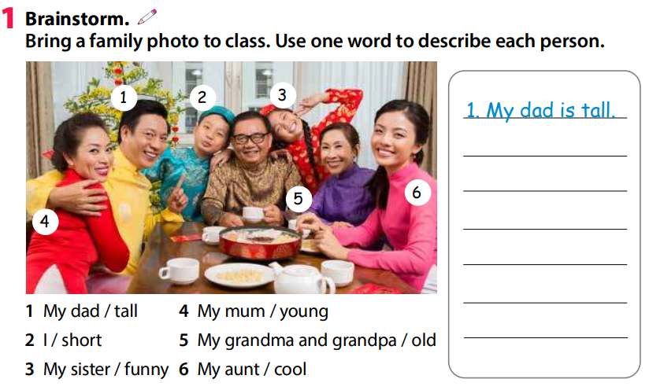
2 Presentation
2. I’m short.
3. My sister is funny.
4. My mum is young.
5. My grandma and grandpa are old.
6. My aunt is cool.

Slide 15


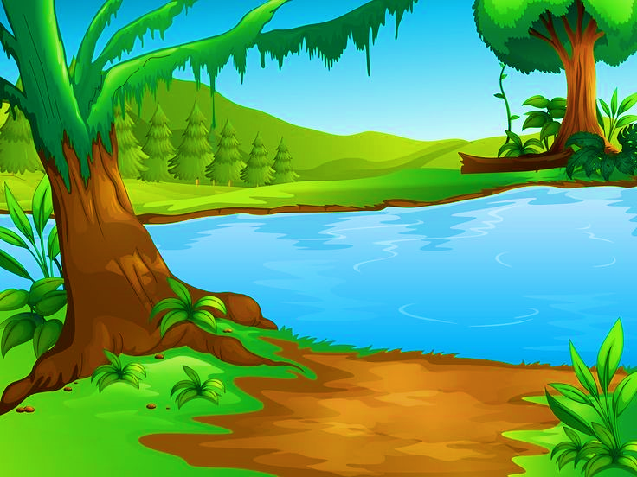
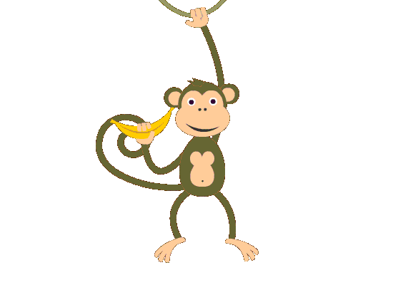


“Cross river “ Game

Slide 16
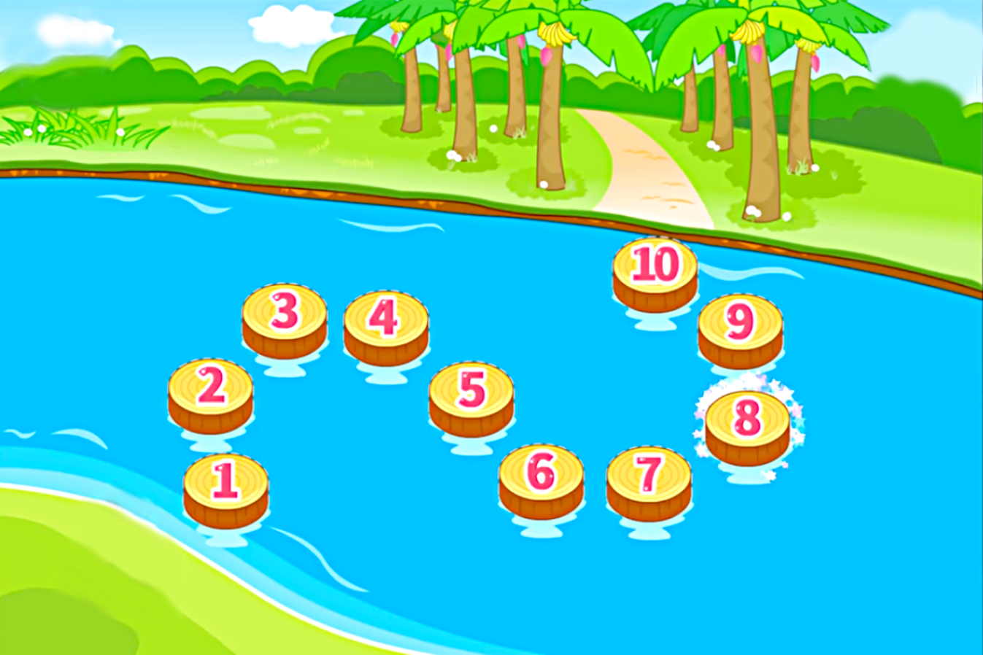












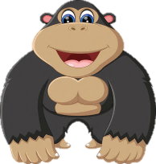
Congratulations!

Slide 17







Odd one out
A. dad
B.cousin.
C. mum
BACK
Notes:
Câu có dấu câu không

Slide 18
Odd one out
A. great
B.happy
C. sad
BACK
Notes:
Dấu câu

Slide 19

Look at my ………..
A. mum.
B. cousin.
C. sister.
BACK
Notes:
Dấu câu

Slide 20
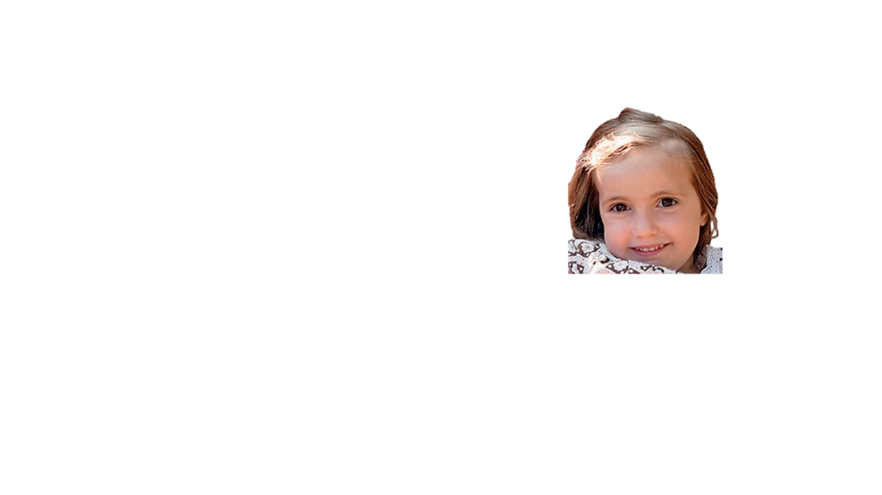
Look at my ………..
A. mum.
B. grandma
C. sister
BACK

Slide 21

Listen and choose
A. It is my ant.
B. This is my aunt.
C.This is mine aunt.
BACK
Notes:
Không bẫy lỗi ngớ ngẩn ntn

Slide 22
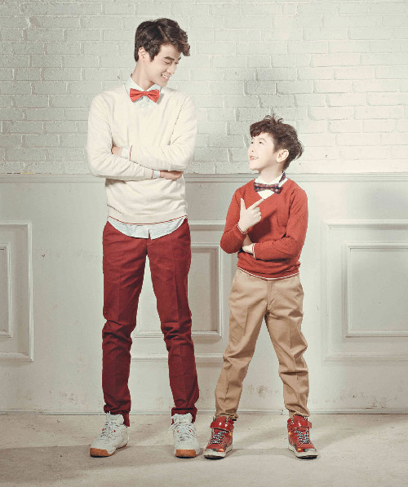
Who is this?
A. Dave brother.
B. My brother is Dave.
C. My brother, Dave.
Brother/Dave
BACK
Notes:
Không thấy cung cấp đáp án

Slide 23
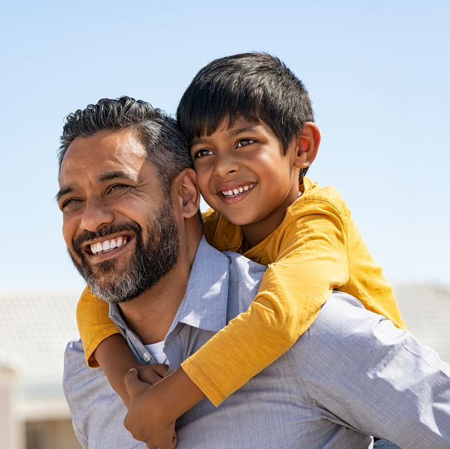
Who is this?
A. My dad Mike.
B. Mike is dad.
C. My dad is Mike.
Dad/Mike
BACK

Slide 24
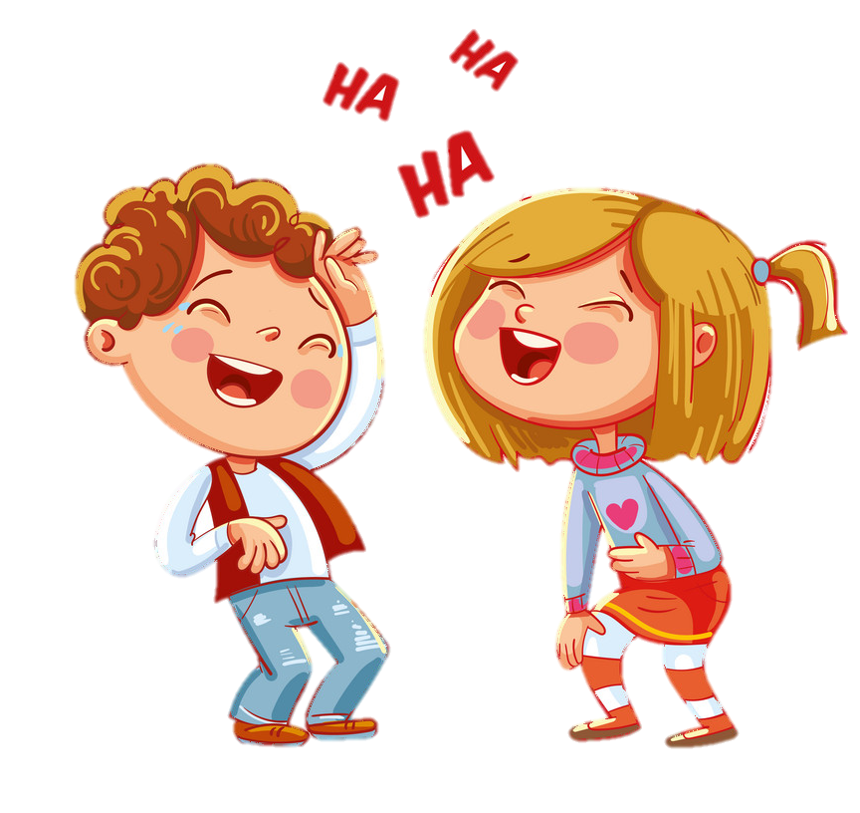
Look and choose.
A.They’re funny.
B.They’re old.
C. They’re sad.
BACK

Slide 25
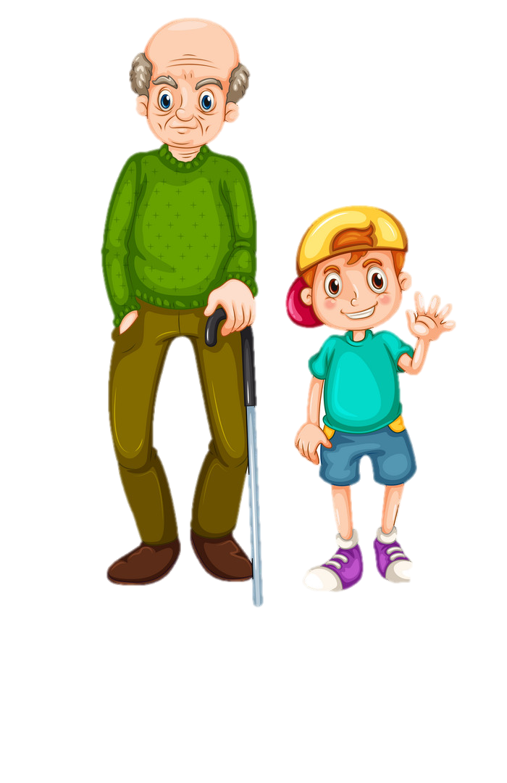
Look and choose.
Mr.John
A. Mr.John is short.
Bean
B. Bean is young.
C. Bean is tall.
BACK

Slide 26
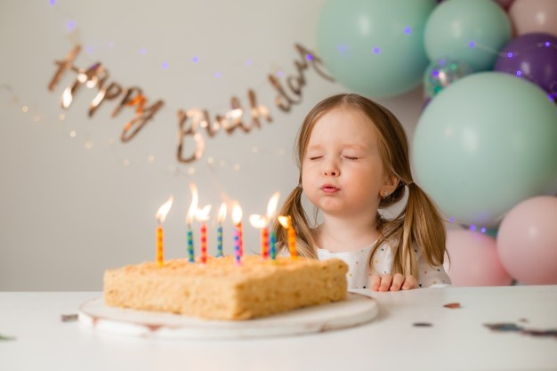
Fill in the blank.
Sh
s
s
BACK
__e is _ix year_ old.
Notes:
Sao nến lại có 8 cái???

Slide 27

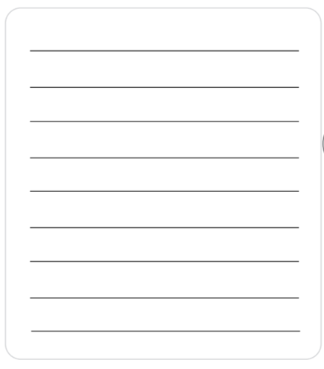
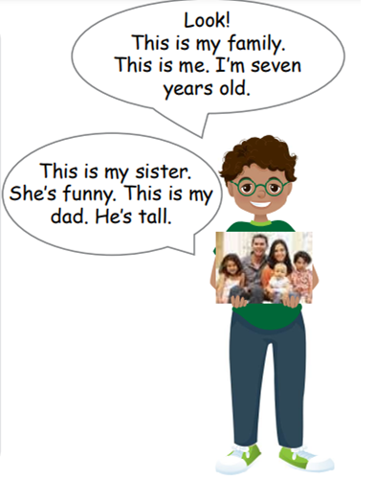
2 Write and talk about your family.
Write one sentence about each member of your family. Tell your class about it.

Slide 28

Extra Activity

Slide 29
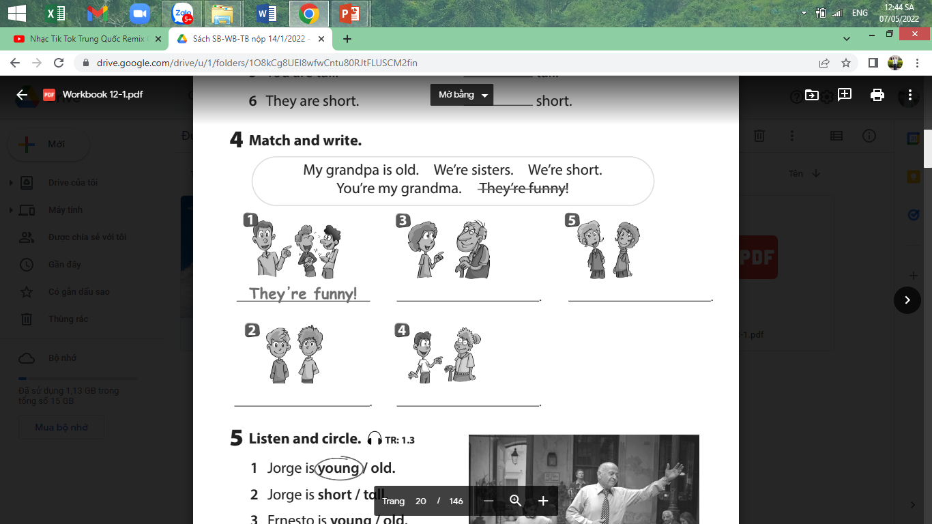
Task 1:Fill in the blank
My grandpa is old.
We’re sisters.
We’re short.
You’re my grandma.

Slide 30




Good bye.
See you again!

