Slide 1
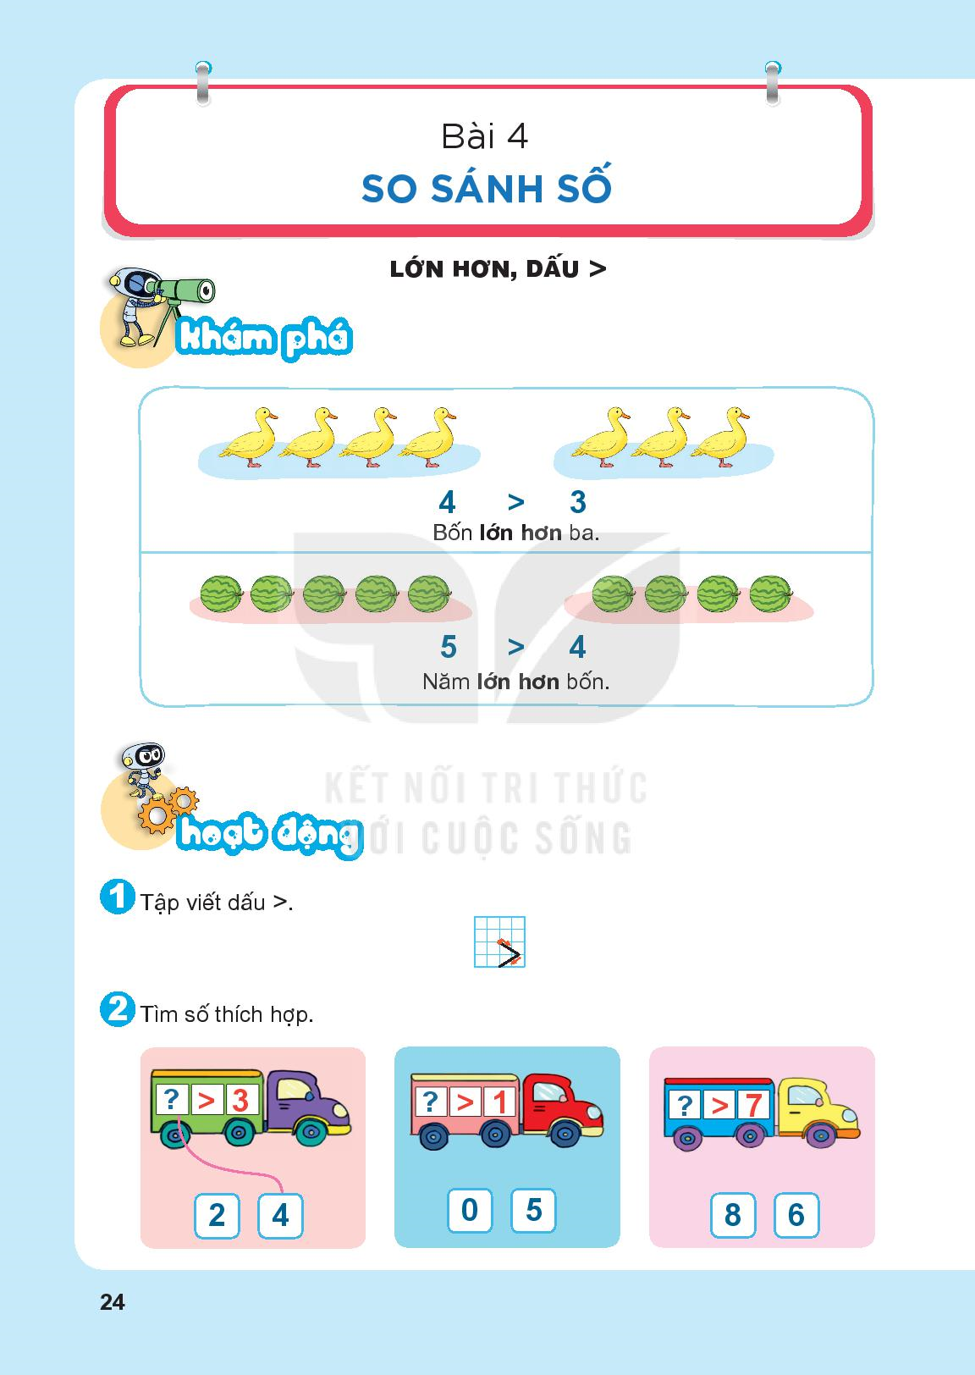

Slide 5
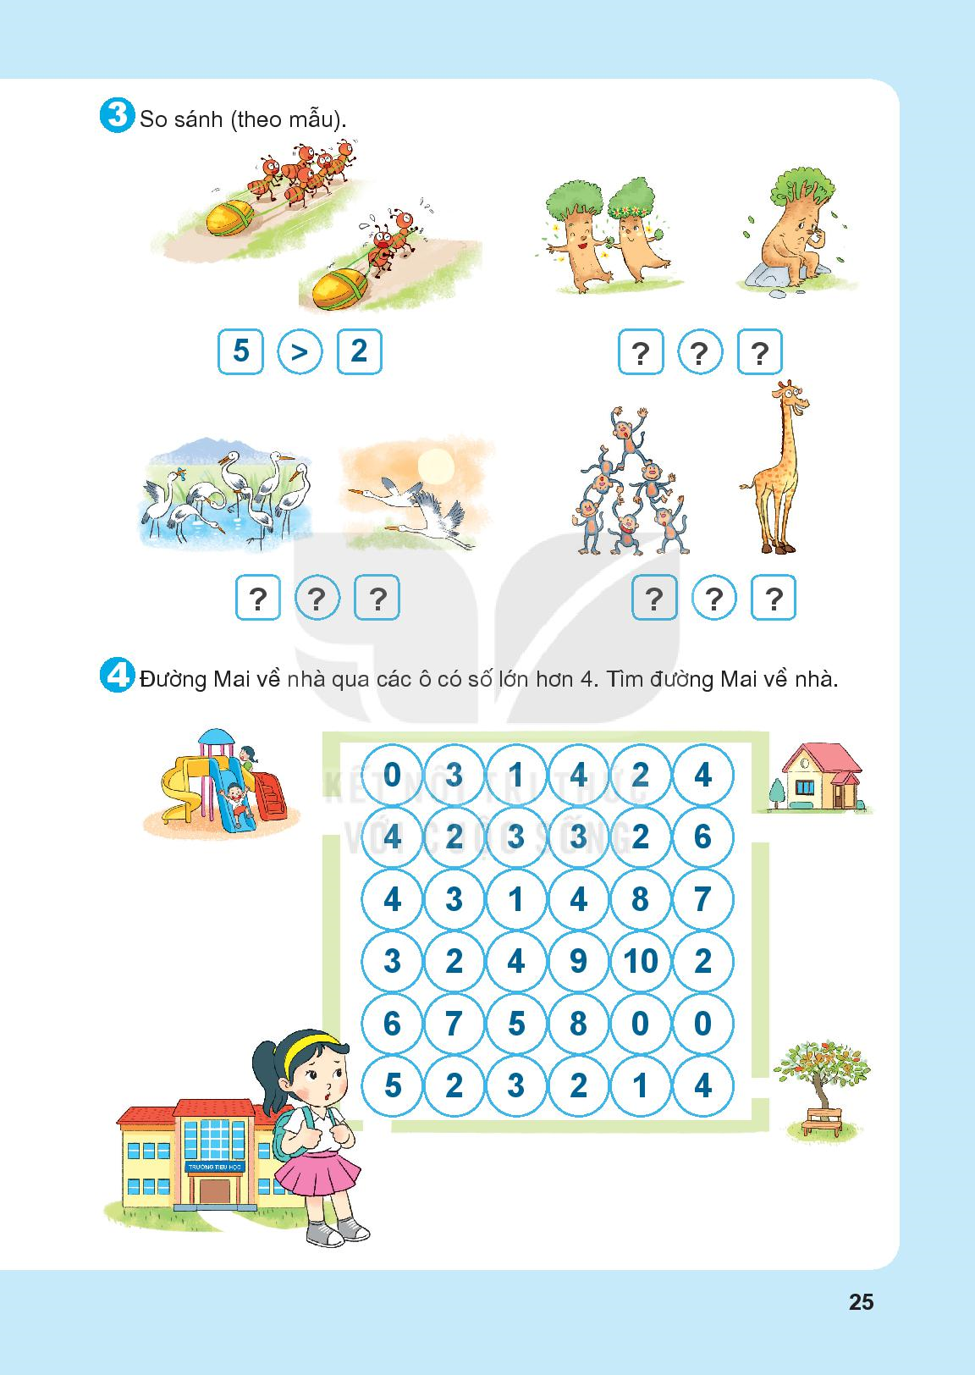
2
>
1
6
>
2
6
>
1

Slide 8
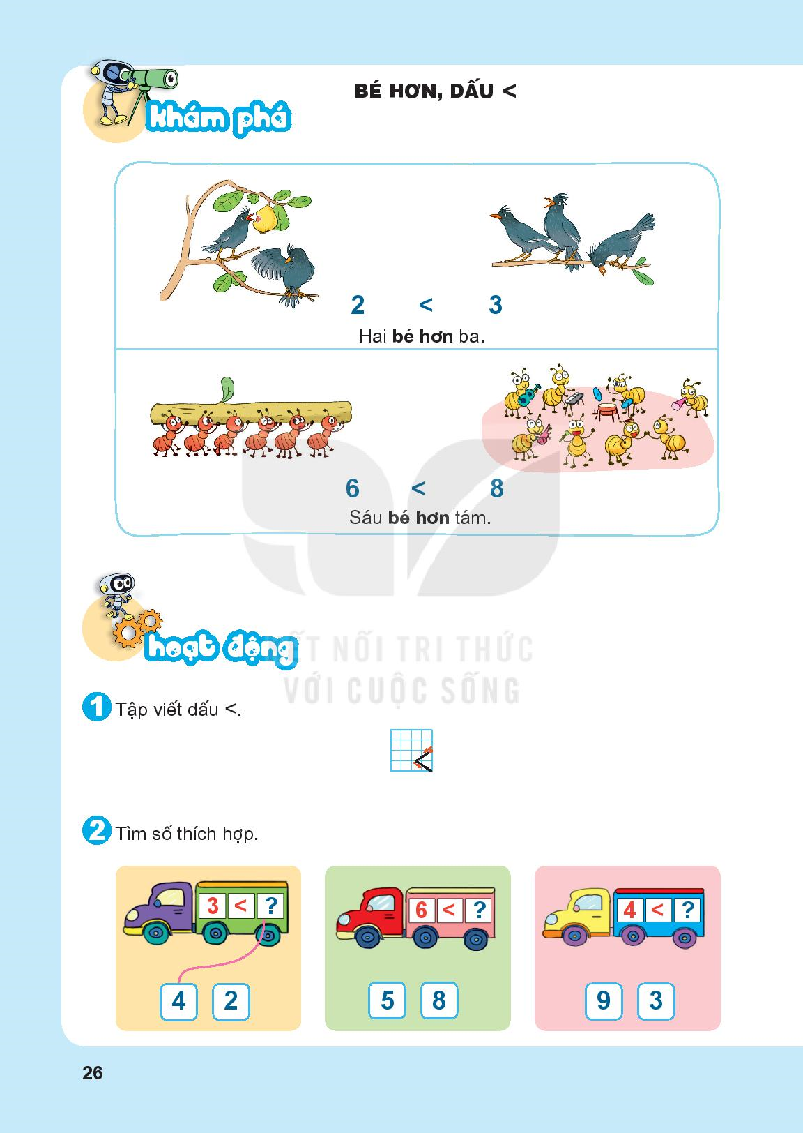

Slide 11
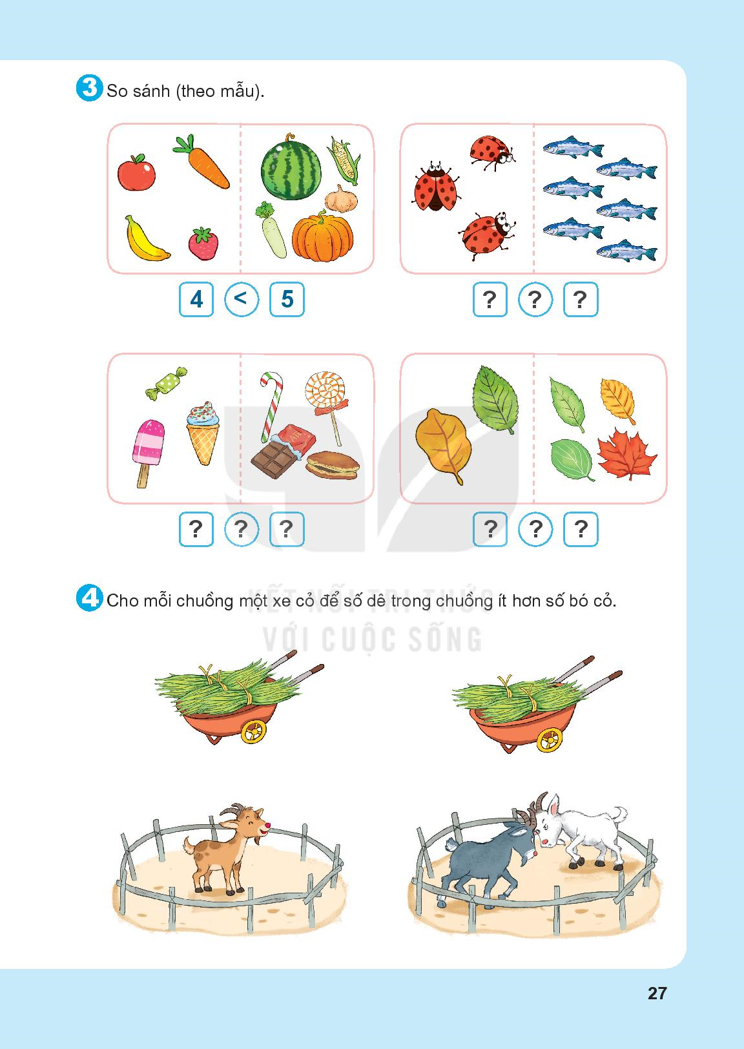
3
<
6
3
<
4
2
<
4

Slide 14
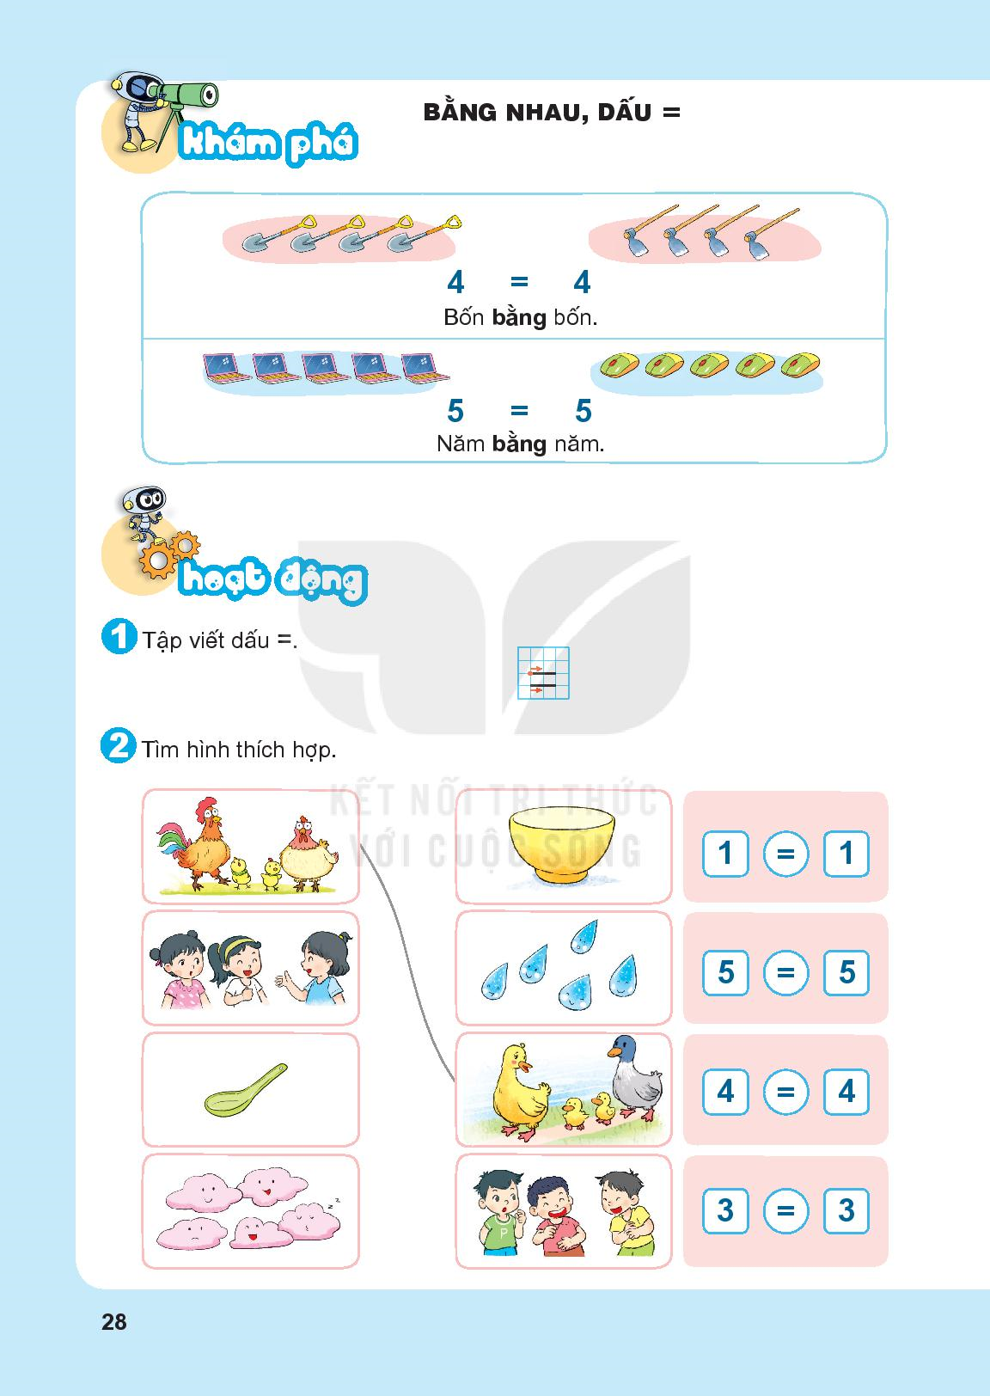

Slide 17
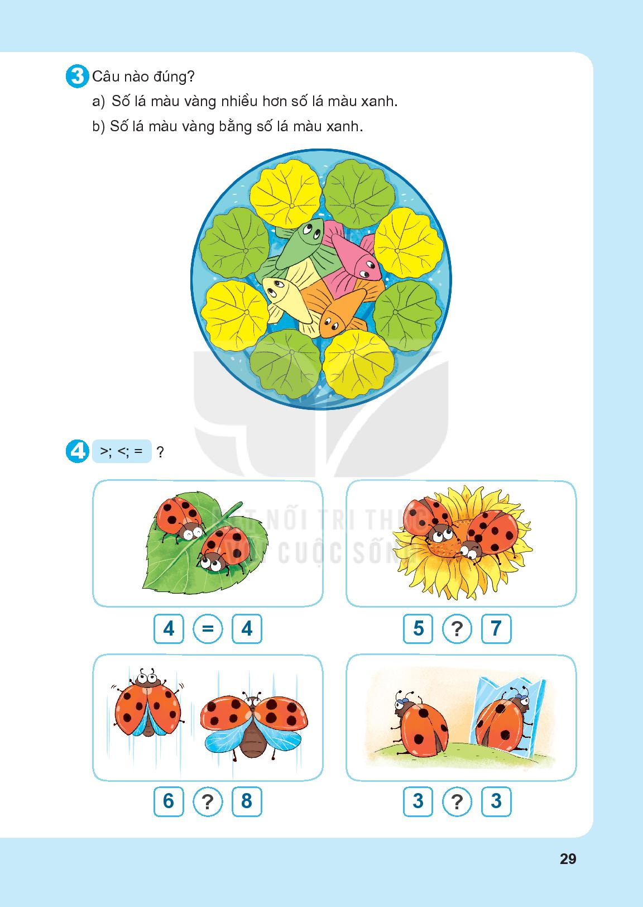

Slide 18
<
<
=

Slide 20
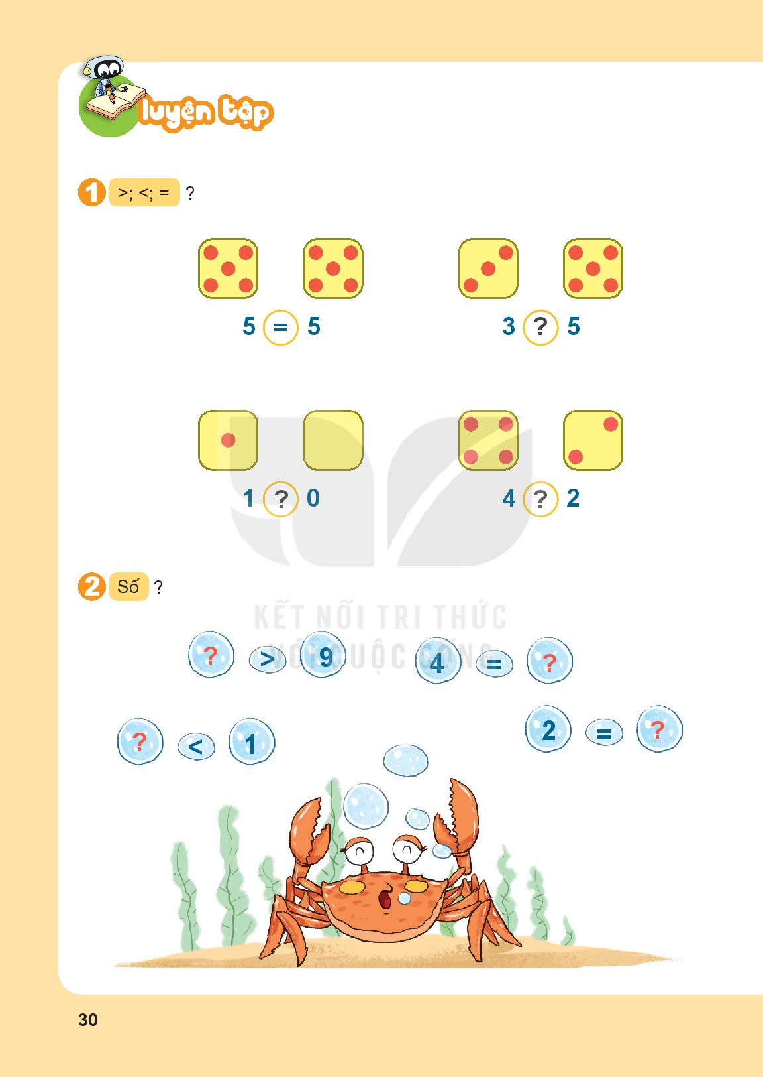
<
>
>

Slide 21
10
4
2
0

Slide 22
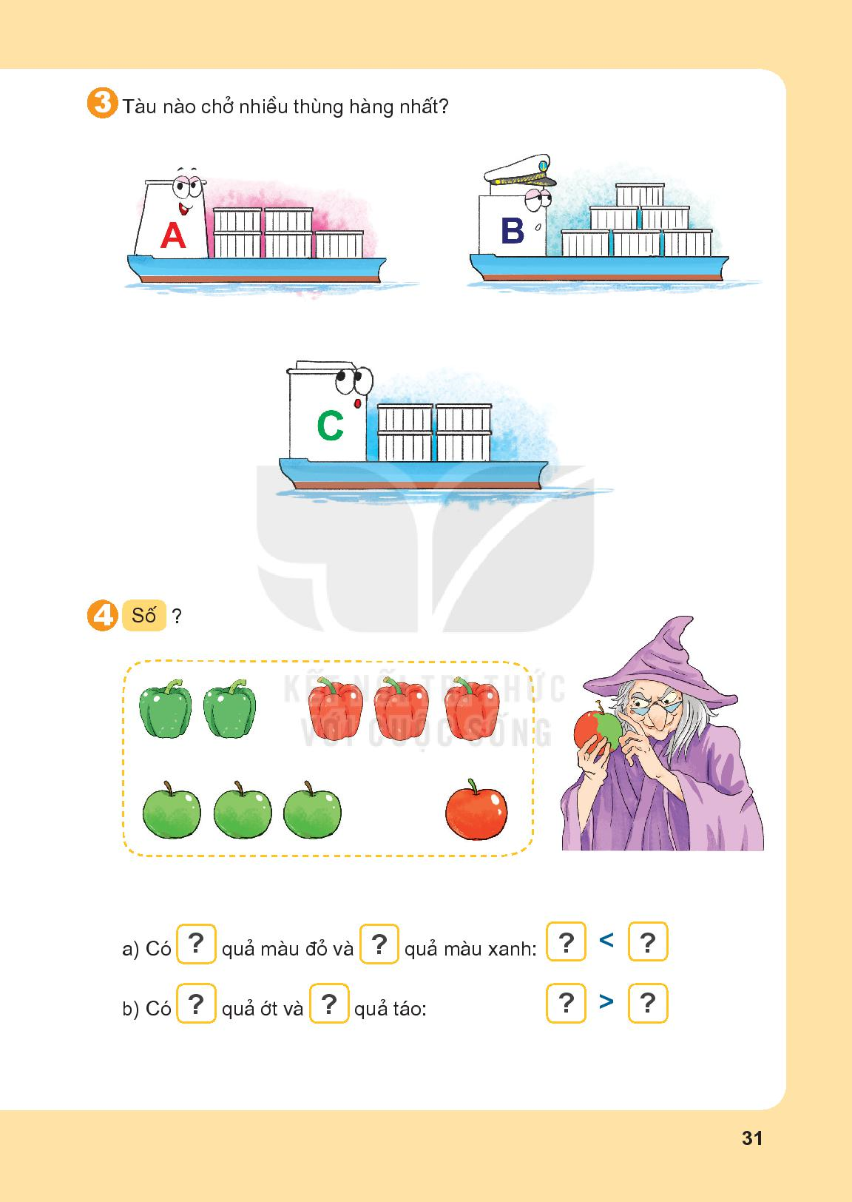
5
6
4

Slide 23
3
2
3
2
5
4
5
4

