Slide 1
Unit 7
THAT’S MY SCHOOL
Lesson 2
Teacher: Ms.Thom

Slide 2
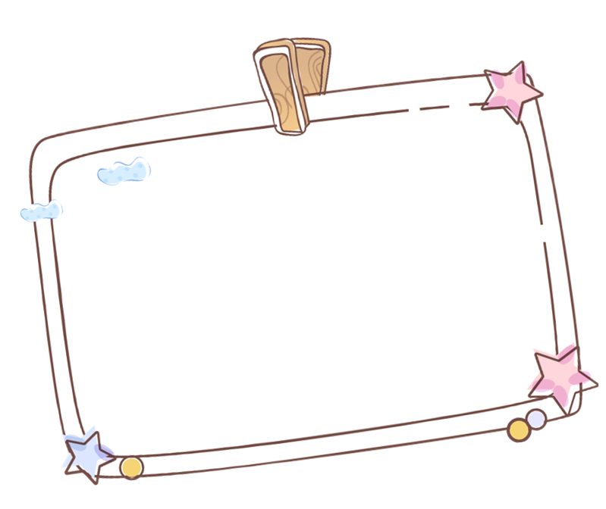
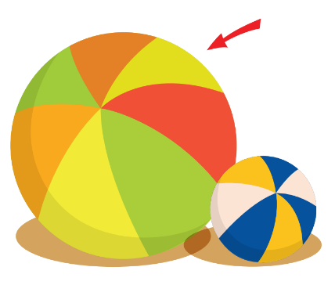
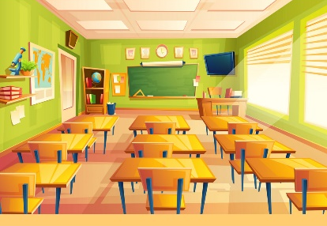
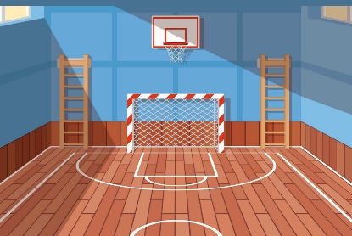
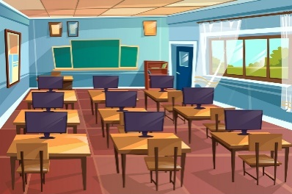
Review
Small
School
Classroom
Big
Library
Playground
Computer room
Gym

Slide 3
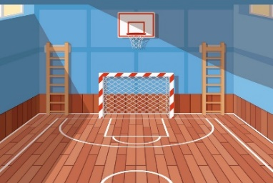
Structure
That’s the ___________.
(Kia là ____________.)
Classroom
School
Gym
Computer
room
Library
Playground

Slide 4
Vocabulary

Slide 5
Vocabulary
Small
Big

Slide 6
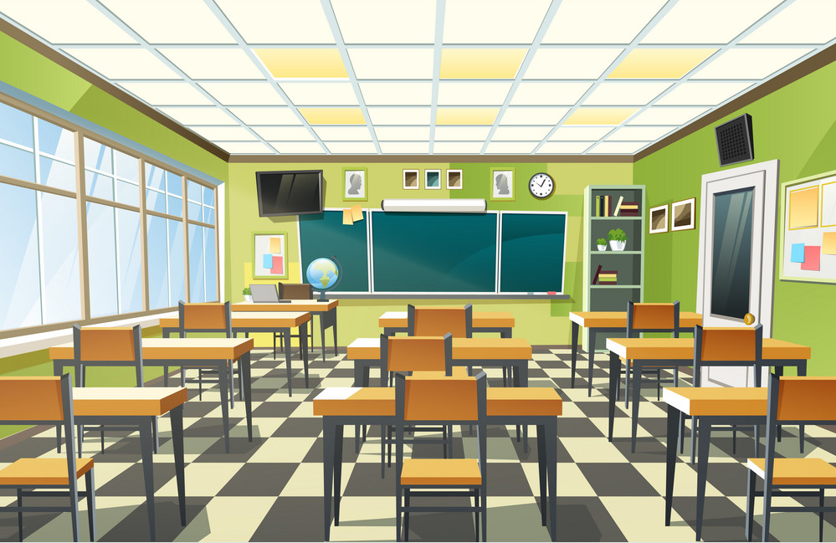
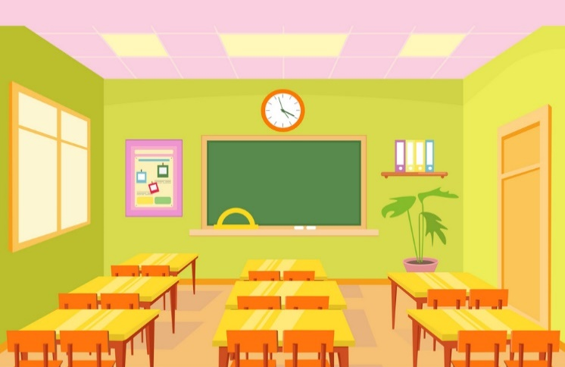
Vocabulary
Small
Large

Slide 7
Vocabulary
New
Old

Slide 8
Vocabulary
Nice
Beautiful

Slide 9
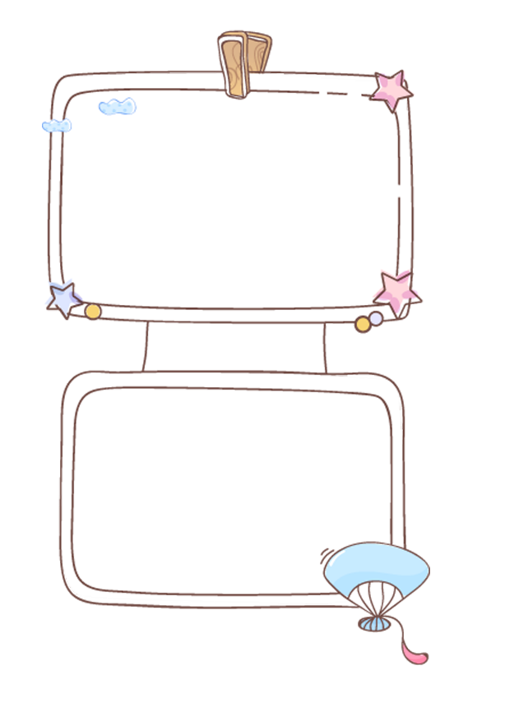
Review
Large
Big
New
Nice
Beautiful
Small
Small
Old

Slide 10
Grammar

Slide 11
1. Look, listen and repeat.

Slide 12
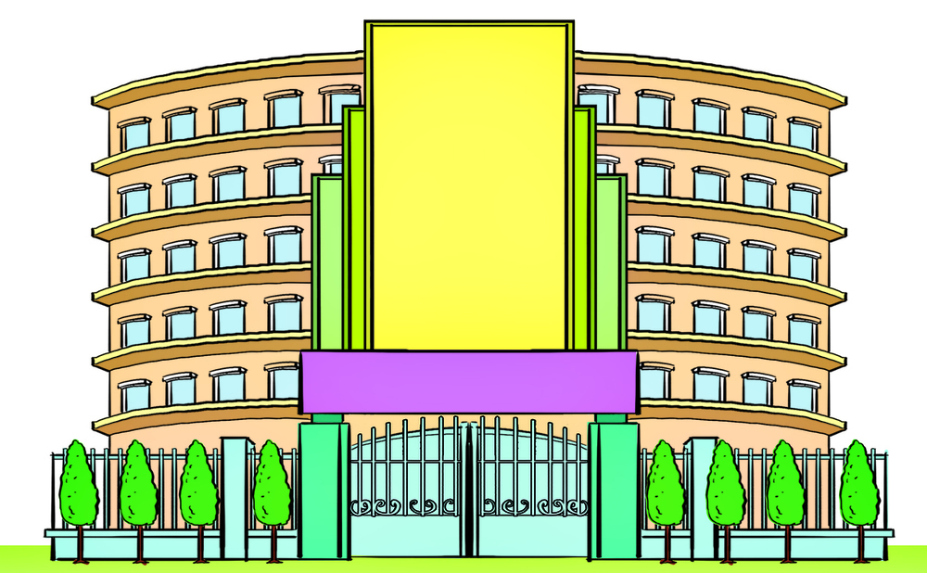
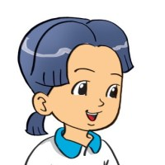
2. Point and say
school new
Is the __________?
Yes, it is.

Slide 13
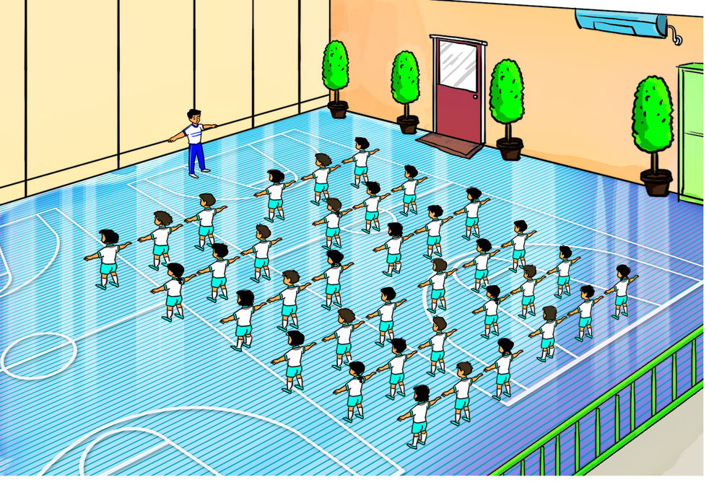
2. Point and say
gym big
Is the __________?
Yes, it is.

Slide 14
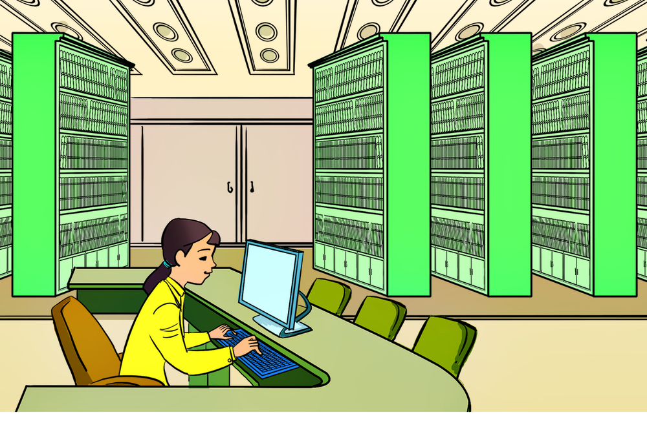
2. Point and say
library old
Is the __________?
No, it isn’t.

Slide 15
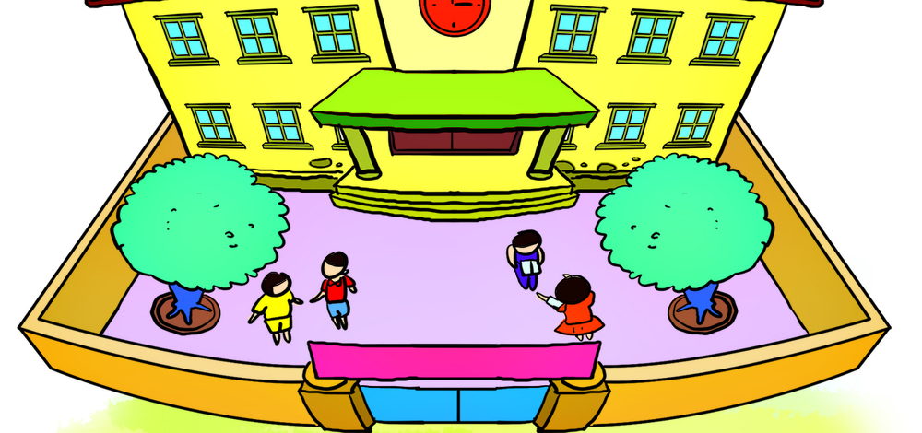
2. Point and say
playground large
Is the _____________?
No, it isn’t.

Slide 16
Structure
Yes, it is.
Is ______ ____?
(________ _______ có phải không?)
No, it isn’t.
Classroom
School
beautiful
big
Gym
Computer
room
small
Library
Playground
new
old
large

Slide 17
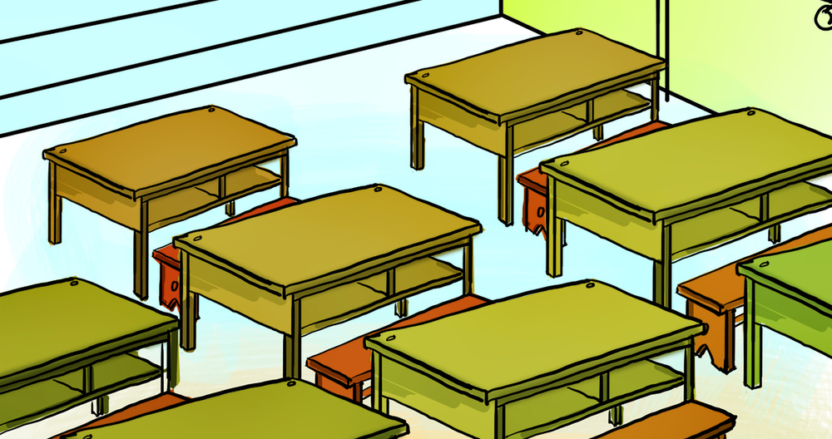
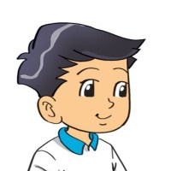
3. Let's talk.
Is the classroom new?
Yes, it is.

Slide 18
3. Let's talk.
Is the library old?
No, it isn’t.

Slide 19
Ms Huyền Phạm
0936.082.789
Ms Huyền Phạm
0936.082.789
Ms Huyền Phạm
0936.082.789
Ms Huyền Phạm - 0936.082.789 – YOUTUBE: MsPham. Facebook: Dạy và học cùng công nghệ.
Ms Huyền Phạm
0936.082.789
Notes:
Ms Huyền Phạm - 0936.082.789 – YOUTUBE: MsPham. Facebook: Dạy và học cùng công nghệ.

Slide 20
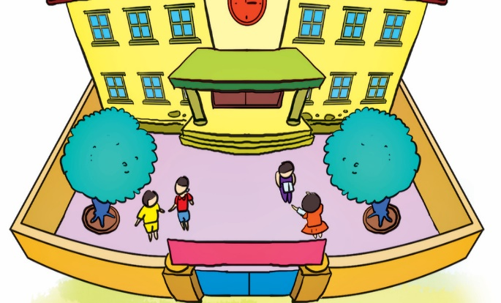
Is the playground small?
Next
No, it is.
Yes, it is.
No, it isn’t.
Yes, it isn’t.
Notes:
Ms Huyền Phạm - 0936.082.789 – YOUTUBE: MsPham. Facebook: Dạy và học cùng công nghệ.

Slide 21
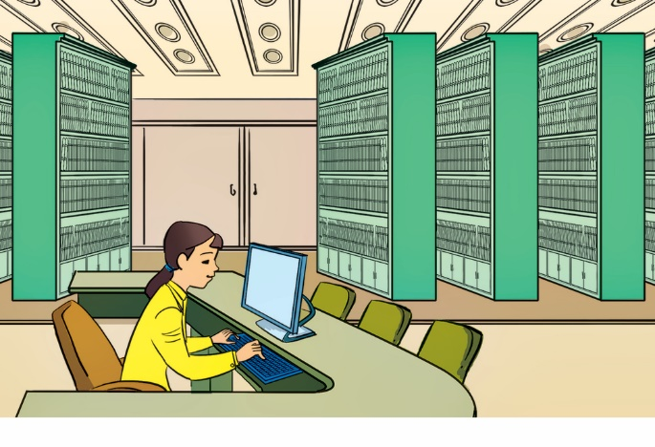
Is the library new?
Next
Yes, please.
Yes, you can.
Yes, it is.
No, it isn’t.
Notes:
Ms Huyền Phạm - 0936.082.789 – YOUTUBE: MsPham. Facebook: Dạy và học cùng công nghệ.

Slide 22
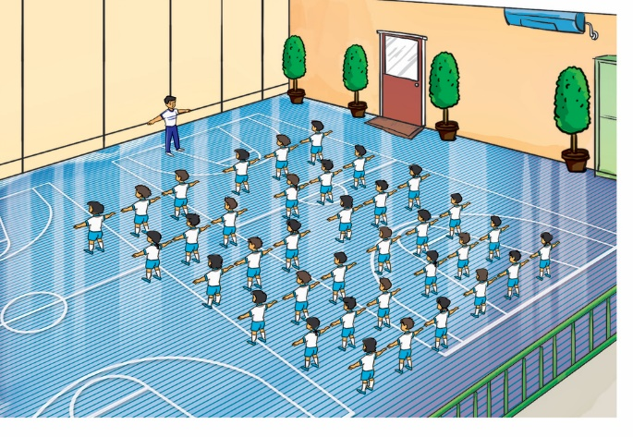
Is the gym old?
Next
No, it isn’t.
Yes, it is.
No, it aren’t.
Yes, it are.
Notes:
Ms Huyền Phạm - 0936.082.789 – YOUTUBE: MsPham. Facebook: Dạy và học cùng công nghệ.

Slide 23
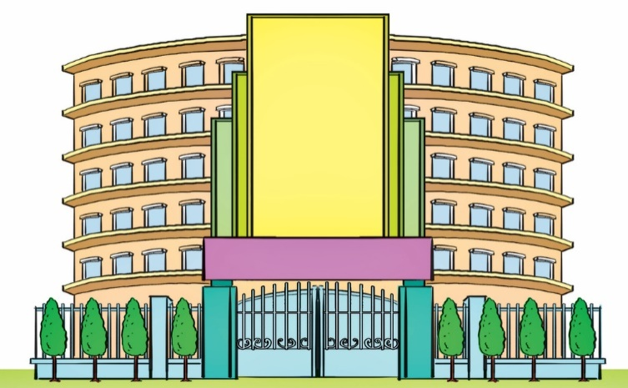
Is the school big and new?
Next
Yes, it is.
Yes, you can.
No, it isn’t.
No, you can’t.
Notes:
Ms Huyền Phạm - 0936.082.789 – YOUTUBE: MsPham. Facebook: Dạy và học cùng công nghệ.

Slide 24
Is the classroom beautiful?
Next
Yes, please.
No, thanks.
No, it isn’t.
Yes, it is.
Notes:
Ms Huyền Phạm - 0936.082.789 – YOUTUBE: MsPham. Facebook: Dạy và học cùng công nghệ.

Slide 25
Is the computer room old?
Next
No, isn’t.
Yes, I am.
No, it isn’t.
Yes, it is.
Notes:
Ms Huyền Phạm - 0936.082.789 – YOUTUBE: MsPham. Facebook: Dạy và học cùng công nghệ.

Slide 26
__________?
Yes, it is.
Next
Is the
school new
the school
new
the school
is ne?
That’s the
school new
Notes:
Ms Huyền Phạm - 0936.082.789 – YOUTUBE: MsPham. Facebook: Dạy và học cùng công nghệ.

Slide 27
______________?
No, it isn’t.
Next
the gym big
Is the
big gym
the gym is big
Is the
gym big
Notes:
Ms Huyền Phạm - 0936.082.789 – YOUTUBE: MsPham. Facebook: Dạy và học cùng công nghệ.

Slide 28
Is the playground large?
Yes, _________.
Next
Is it
It is
ok
true
Notes:
Ms Huyền Phạm - 0936.082.789 – YOUTUBE: MsPham. Facebook: Dạy và học cùng công nghệ.

Slide 29
Is the classroom nice?
No, it ________.
Next
I’m not
not
Aren’t
Isn’t.
Notes:
Ms Huyền Phạm - 0936.082.789 – YOUTUBE: MsPham. Facebook: Dạy và học cùng công nghệ.

Slide 30
Notes:
Ms Huyền Phạm - 0936.082.789 – YOUTUBE: MsPham. Facebook: Dạy và học cùng công nghệ.

Slide 31
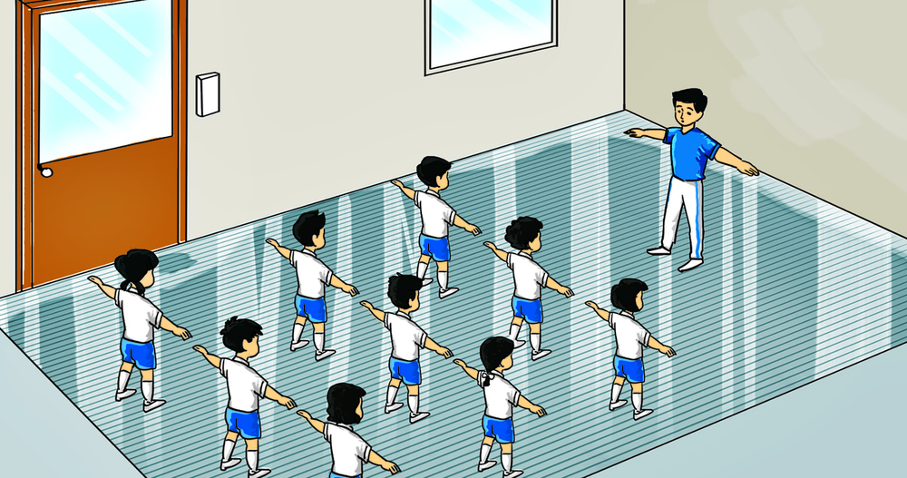
3. Let's talk.
Is the gym big?
No, it isn’t.

Slide 32
3. Let's talk.
Is the computer room new?
Yes, it is.

Slide 33
4. Listen and number.
3
1
4
2
1
2
3
4

Slide 34
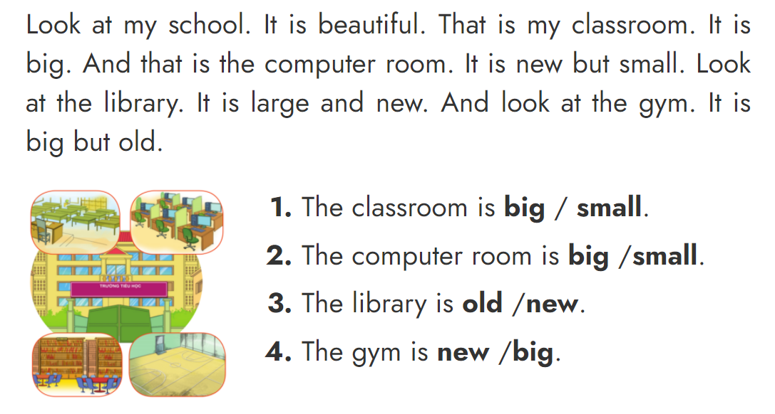
5. Read and circle.

Slide 35
6. Write about your school
Is your school big?
_______________________________.
2. Is the computer room new?
_______________________________.
3. Is the gym large?
_______________________________.
4. Is the library big?
_______________________________.
Yes, it is.
/
No, it isn’t.
Yes, it is.
/
No, it isn’t.
Yes, it is.
/
No, it isn’t.
Yes, it is.
/
No, it isn’t.

Slide 36
THANK YOU!
Welcome to join with me!

