Slide 1






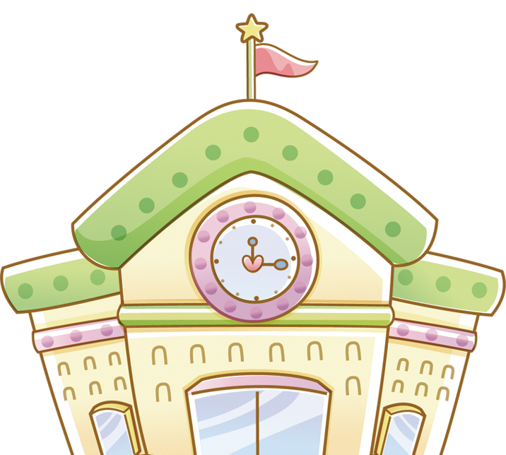




Unit 7
THAT’S MY SCHOOL
Lesson 3
Teacher: Ms.Thom

Slide 2
Warm-up

Slide 3





Play

Slide 4


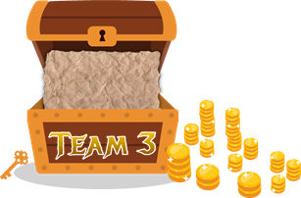





1
2
3
4
5
6
7
8
1
2
3
4
5
6
7
8
1
2
3
4
5
6
7
0
8
1
0
2
3
4
5
6
7
8
0
Exit

Slide 5
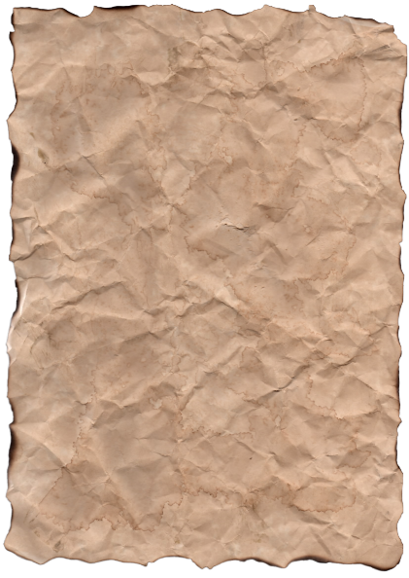





A
No, it isn’t.
It’s old.
Is the library new?
B
Wow, it isn’t.
C
No, it isn’t.
It’s beautiful.
Back

Slide 6
A
Wow. It’s beautiful.
Is the playground large?
B
Yes, it is.
C
Oh, no. It’s beautiful.
Back

Slide 7
A
Oh. It’s big.
B
Yes, It’s small
Is the computer game big?
C
No, it’s small.
Back

Slide 8
A
Is that my school.
B
That is school my.
Is / school / that / my .
C
That is my school.
Back

Slide 9
A
Is this the gym.
B
This is the gym.
Gym / this / the / is.
C
This the gym.
Back

Slide 10
A
The library is large?
B
Is the large library?
Large / library / is / the ?
C
Is the library large?
Back

Slide 11
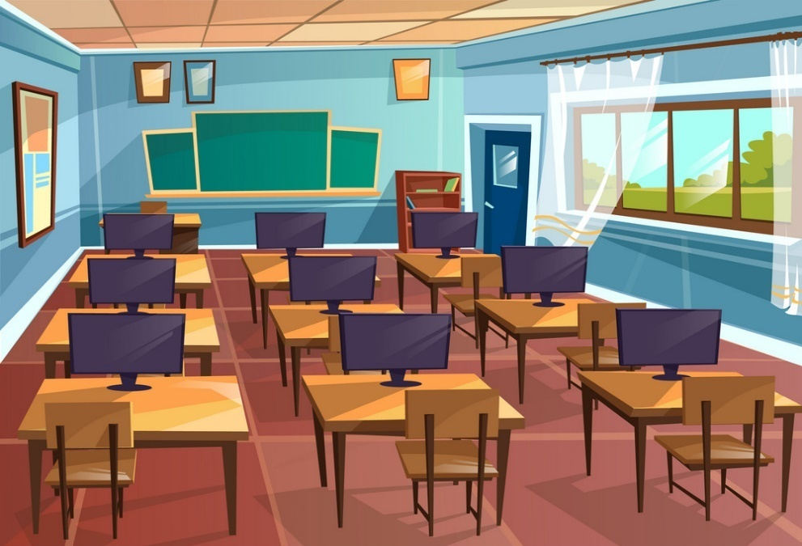
A
Yes, it is
Is the computer room
new?
B
No, it isn’t.
C
Wow, it’s new.
Back

Slide 12
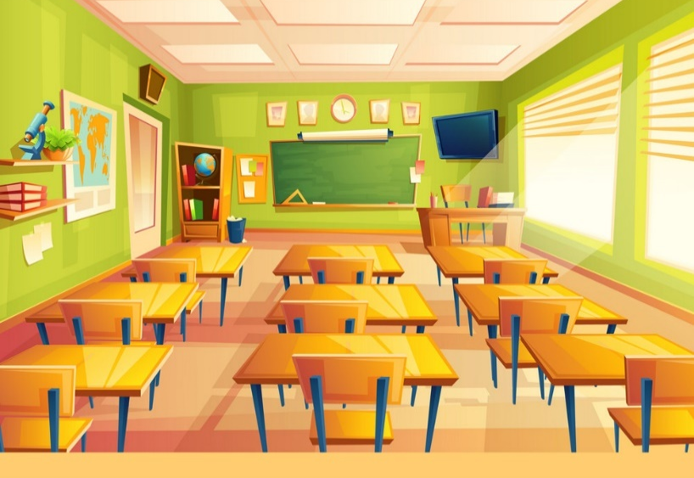
A
nice
Is the classroom _____?
B
old
C
small
Yes, it is.
Back

Slide 13
Phonic

Slide 14
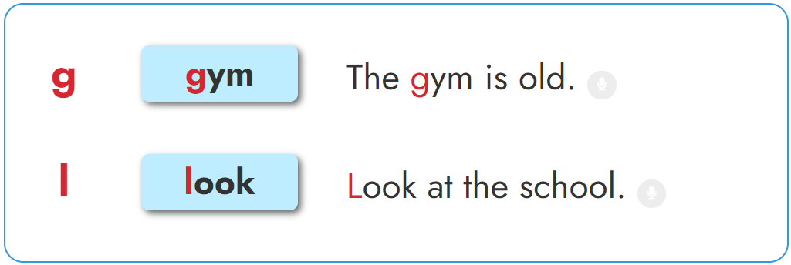

1. Listen and repeat.

Slide 15
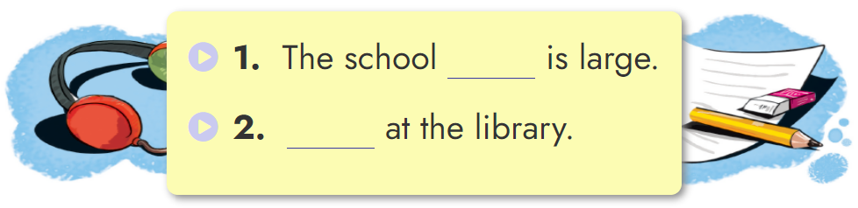
2. Listen and write.
gym
Look

Slide 16
Grammar

Slide 17
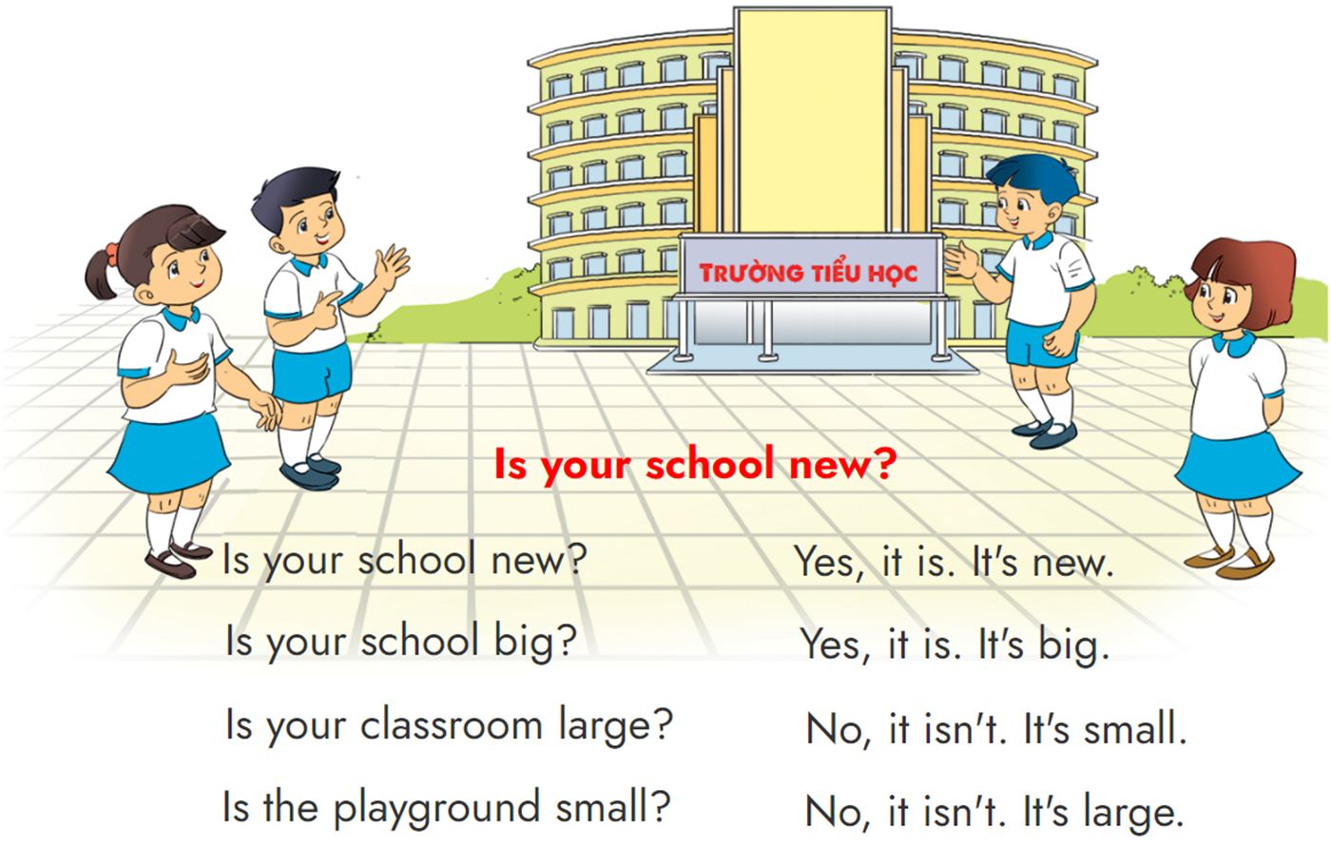


3. Let's chant.

Slide 18
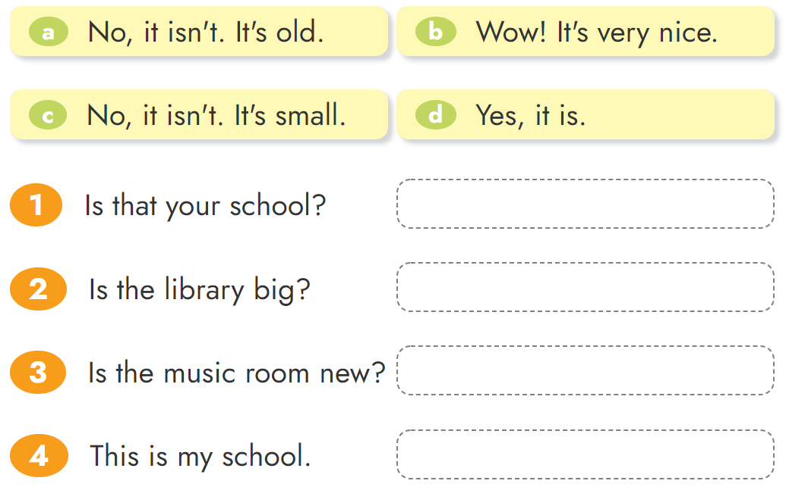





4. Read and match.

Slide 19
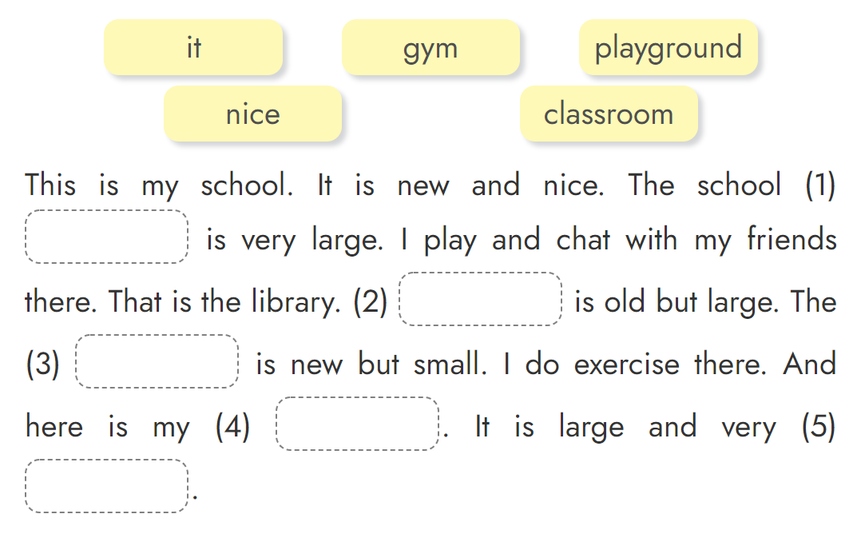
5. Read and complete.
playground
It
gym
classroom
nice

Slide 20
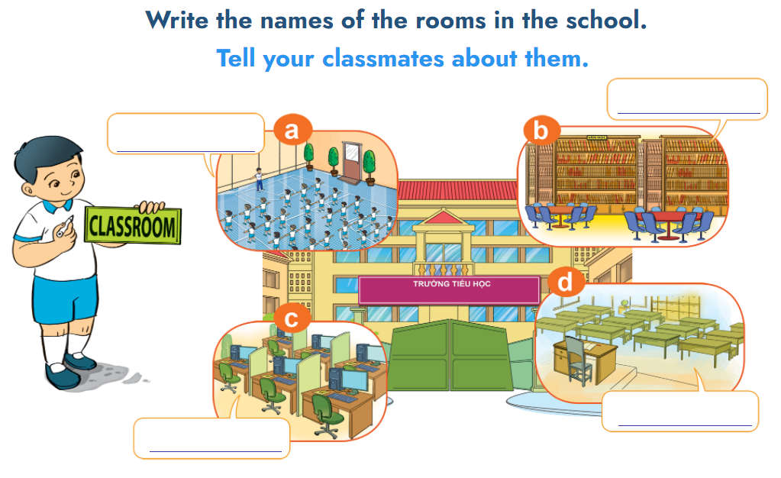
6. Project.

Slide 21
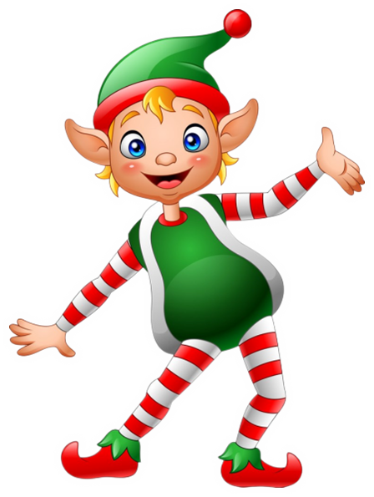
THANK YOU!
Welcome to join with me!

