Slide 1
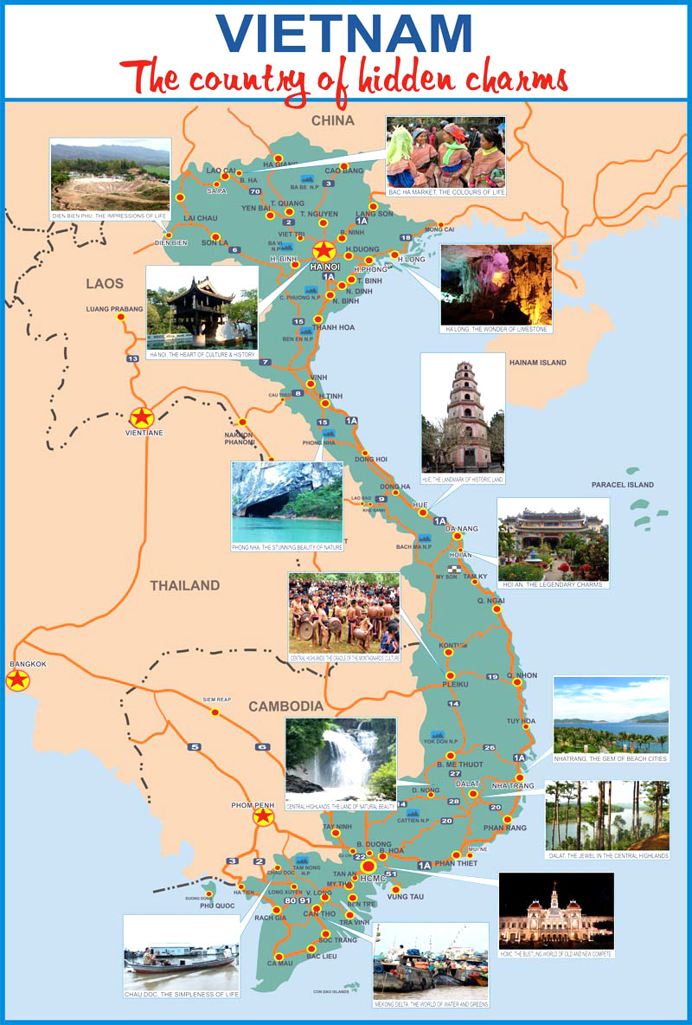
Weather
Travelling
Natural attraction

Slide 2
Weather
1
What is the hottest place in Vietnam?
→ Cua Rao village in Nghe An
2
What is the coldest place in Vietnam?
→ Mau Son mountain in Lang Son

Slide 3
Travelling
1
What is the biggest city in Vietnam?
→ Ho Chi Minh city
2
What is the most convenient time to travel
Vietnam?
→ in summer

Slide 4
Natural attraction
1
What is the highest mountain in Vietnam?
→ Fansipan mountain
2
What is the longest river in Vietnam?
→ Mekong river

Slide 5
Weather
Travelling
Natural attraction
A big applause
A big applause
9 mark
A pencil
A ruler
10 mark
1
3
5
2
4
6

