Slide 1
WELCOME TO OUR CLASS TODAY
Subject: English 7

Slide 2
Warmer

Slide 3
GOOD MORNING
EVERYONE !!!

Slide 4
Cteahelrha
=> HEALTHCARE
Yvopetr
=> POVERTY
Itmlounrinat
=> MALNUTRITION
Emcir
=> CRIME
Ceorovwedrd
=> OVERCROWDED
rogtdhu
=> DROUGHT

Slide 5
Unit 12: An overcrowded world
Lesson 3: A closer look 2

Slide 6
Grammar
Comparisons of quantifiers: more , less / fewer
1. Read the sentences.
Children in the slums have more diseases than those in wealthy areas.
The countryside has fewer problems than a big city.

Slide 7
Comparisons of quantifiers
>
traffic, pollution, food,...
more _____________________________ than
problems, solutions,...
<
less nutrition, clean water,...
_____ ________________________ than
fewer diseases, criminals,...

Slide 8
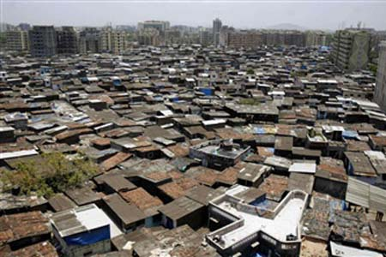
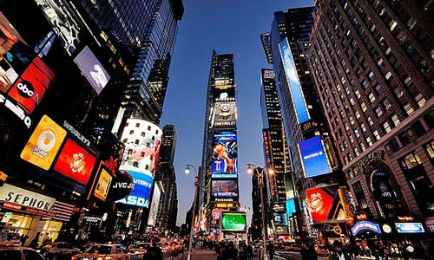
2a. Read the information about the two cities.
Brumba
Density: 4,509 people/km2
Accommodation: 57% in slums
Average earnings: 4$/day
Enough food: 45% population
Children over ten going to school: 71%
Crystal
Density: 928 people/km2
Accommodation: 3% in slums
Average earnings: 66$/day
Enough food: 98% population
Children over ten going to school: 98%

Slide 9
2b. Read the comparisons of the two cities, and decide if they are true. If they are not, correct them.
1. In Brumba, there are more people
per square kilometre.
2. In Brumba, fewer people live in slums.
3. People in Crystal earn less per day.
4. More people in Crystal have enough food.
5. In Brumba, fewer children over ten
go to school.
Correct
Incorrect
In Brumba, more people live in slums.
Incorrect
People in Crystal earn more per day.
Correct
Correct

Slide 10
3. Fill the sentences with more, less or fewer.
fewer
February has ________ days than January.
Overpopulation is causing ________ problems than we can imagine.
Big cities suffer ________ pollution than the countryside.
A teacher needs ________ calories than a farmer.
A healthy child requires ________ care than a sick one.
more
more
fewer
less

Slide 11
Tag questions
Study the example:
You are Phuong,
aren’t you?
Yes, I am.
And you play for our school football team, don’t you?
No, I don’t.

Slide 12
Remember!
A tag question is a short question. It follows a statement. It’s added at the end, after a comma.
Overpopulation is a serious problem,
isn’t it?
You haven’t bought the ticket,
have you?
Most children want to have the freedom to do what they want,
don’t they?
Note: A positive sentence has a negative tag.
A negative sentence has a positive tag.

Slide 13
4. Check if the tags are correct. If they are not, correct them.
You live in the countryside, do you?
Immigration causes overpopulation in big cities, isn’t it?
The city will have to find a solution to reduce traffic jams, won’t it?
The lives of people in overcrowded cities are getting more difficult, aren’t they?
Lower death rate is one reason for population growth, is it?
These narrow streets can’t support more traffic, can’t they?
Incorrect
do you => don’t you
Correct
Correct
Incorrect
aren’t they => don’t they
Incorrect
is it => isn’t it
Incorrect
can’t they => can they

Slide 14
5. Complete the interview with the tags in the box.
is it
can’t we
don’t they
isn’t it

Slide 15
Interviewer: Overcrowded places have a lot of problems, (1) _______________?
Guest speaker: Sure. Traffic jams, pollution, noise,...
Interviewer: Traffic jam is the most serious problem, (2) _______________?
Guest speaker: Not really. We can see homeless people in many places in big cities, (3) _______________? The city cannot build enough houses for all of its people.
Interviewer: So they live wherever they can, under a bridge, in a deserted house ...
Guest speaker: Yes, and some of them become criminals.
Interviewer: This shortage of accommodation is not easy to solve, (4) _______________?
Guest speaker: No, it isn’t.
don’t they
isn’t it
can’t we
is it

Slide 16
Thanks for your attention
GOODBYE
And
SEE YOU AGAIN

