Slide 2
Checking- up
Things in a living room
Things in a kitchen
table
dishwasher

Slide 3
Warm - up
Chatting
- Do you live in a house or in an apartment?
- How many rooms are there in your house?
- Is there a TV in your house?

Slide 4
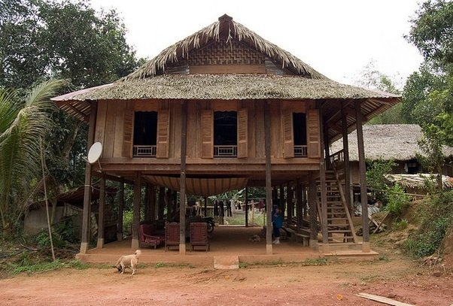
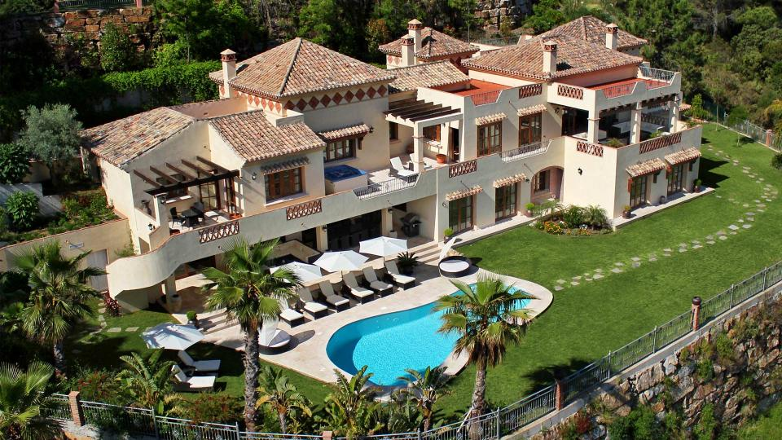
Period 12
Unit 2: MY HOME
Lesson 4: Communication
1. Vocabulary
- villa (n) :
biệt thự
- stilt house (n) :
nhà sàn

Slide 5
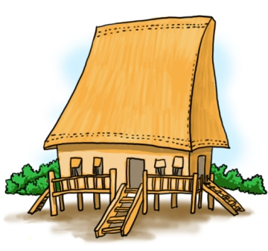
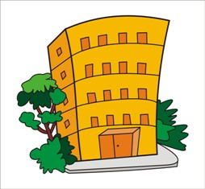
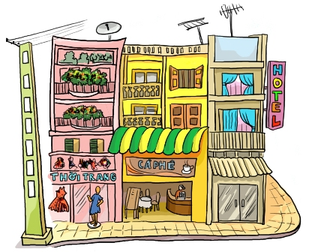
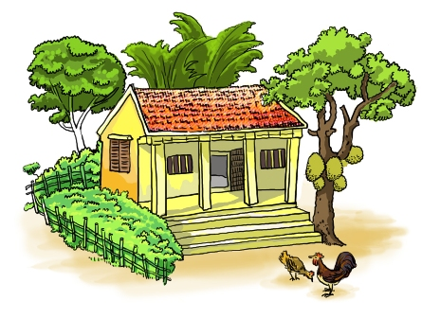
Types of house
apartment
stilt house
villa
town house
country house

Slide 6
2. Practice
Mi’s grandparents’ house

Slide 7
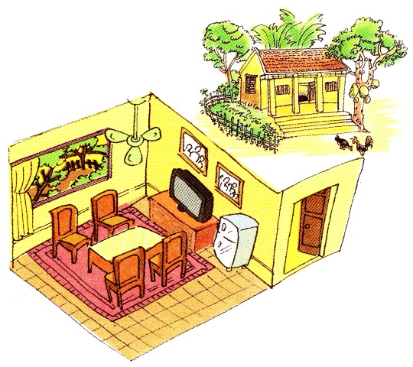

Slide 8
Exercise 1/ p.20: Complete the sentences
Game: Lucky Number
One Correct answer = 1 point.
Lucky number = 3 points.

Slide 10
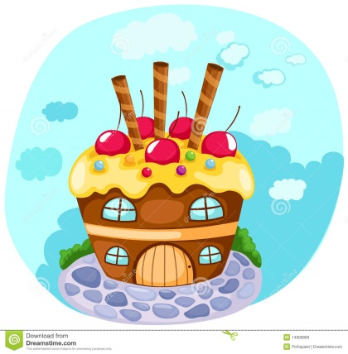
1. My grandparents live in a ______ house in Nam Dinh.
country

Slide 11
are
2. There _____ four rooms in the house and a big garden.

Slide 12
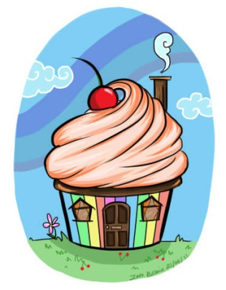

Slide 14
3. I like the living room. There ____ a big window in this room.
is

Slide 15
4. There ______ four chairs and a table in the middle of the room.
are

Slide 16
5. There are two family photos _____ the wall.
on

Slide 17
6. There is a small fridge ________ the cupboard.
next to

Slide 18
7. A television is ______ the cupboard.
on

Slide 19
8. There ___ also a ceiling fan.
is

Slide 20
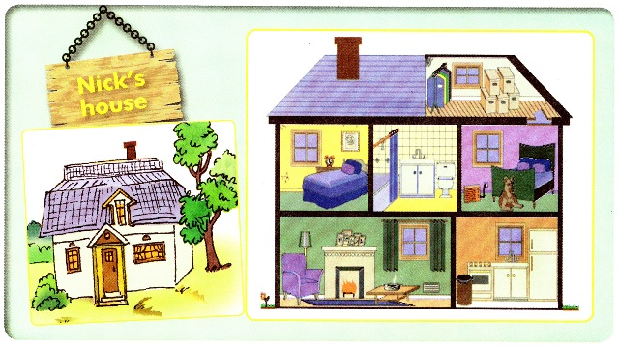
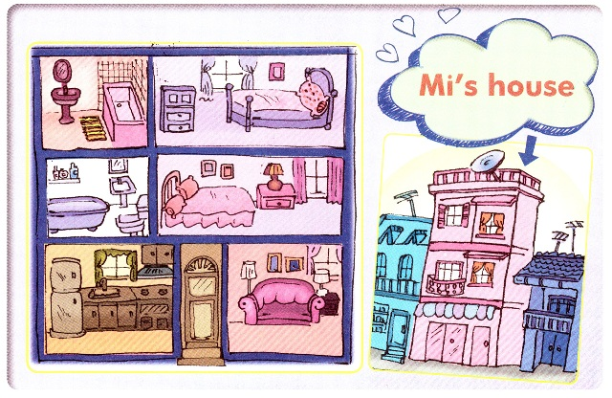
2. Find the differences between the two houses
Nick’s house
Mi’s house

Slide 21
Describe Nick’s house and Mi’s house
Group A
Group B

Slide 22
- Where is the house? In the country or in the town?
How many floors does it have?
How many rooms are there in the house?
What rooms are they?
….
=> Practice:
A: Nick lives in a country house. Where does Mi live?
B: Mi lives in a town house.

Slide 23
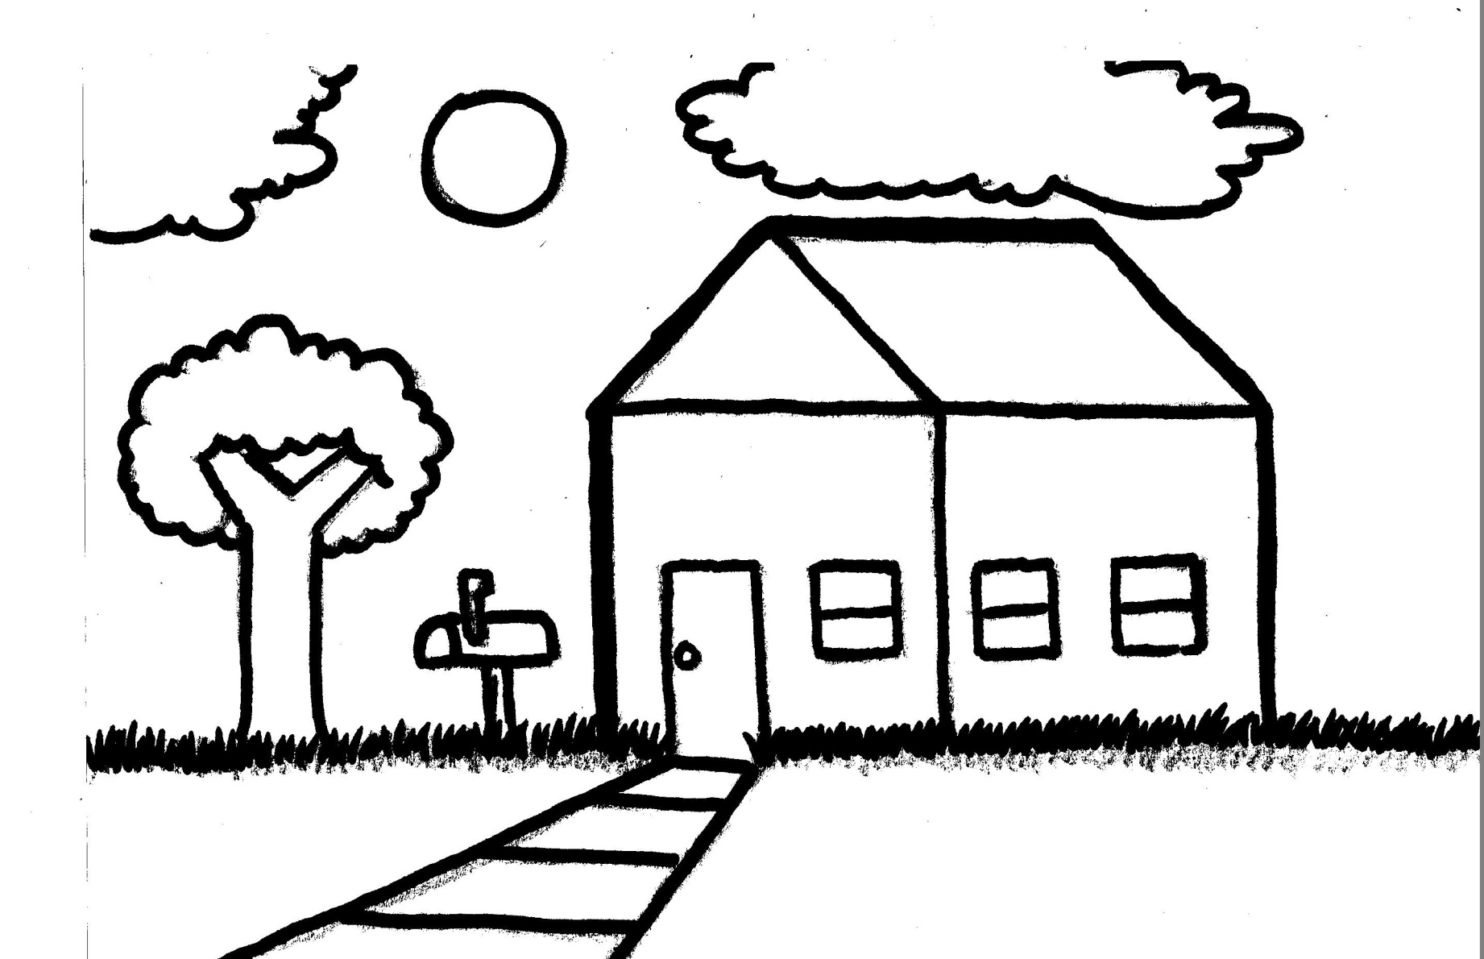
3. Tell your partner about your house and ask him/ her about his/ her house.
Example: I live in a country house. Where do you live?

Slide 24
- Learn new words
- Draw a simple plan of your house and write a short description about it.

