Slide 1

WELCOME TO OUR CLASS TODAY
Subject: English 8

Slide 2

* WARM UP
chatting
+ How many people are there in your family?
+ What does your father do in his free time?
+ What about your mother?
+ And you. Do you like reading in your free time?
+ Do you often read articles on the magazine?

Slide 3
UNIT 1: LEISURE ACTIVITIES
Lesson 4: communication (P11)

Slide 4
Unit 1: Leisure activities
Lesson 4: Communication (P. 11)
I. Vocabulary:
- window shopping (n):
ngắm đồ bày ở cửa hàng
yêu thích cái gì
- to be hooked on something (adj):
có vẻ kỳ cục
- to sound weird (v):
nghiện (thích) cái gì
- to be addicted to (adj) :
tụ tập với bạn bè
- to hang out (v):
- netlingo (n):
ngôn ngữ dùng để giao tiếp trên mạng

Slide 5
Unit 1: Leisure activities
Lesson 4: Communication (P. 11)
I. New words:
II. Reading:
1. Read the following article on the 4Teen website.
This week 4Teen has opened a forum for friends around the world to share how they spend their free time.

Slide 6
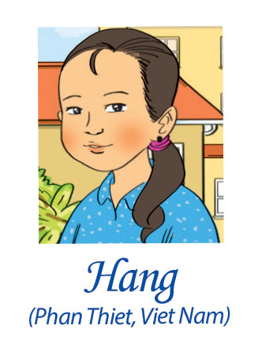
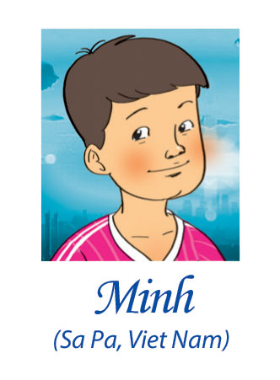
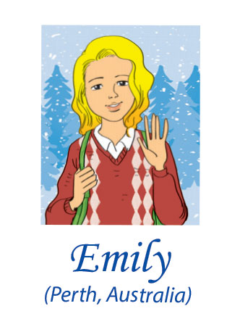
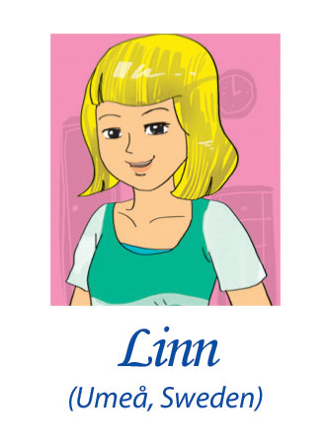
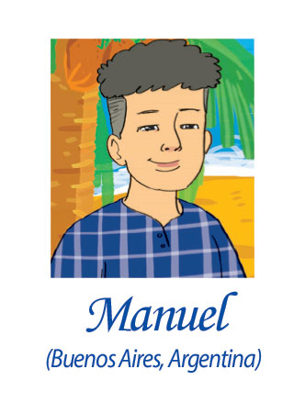

Slide 7
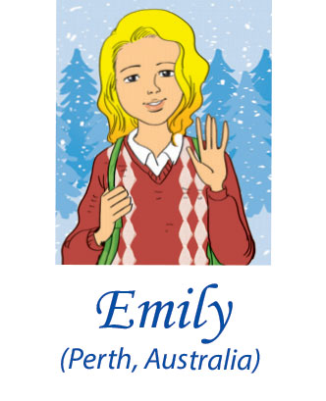

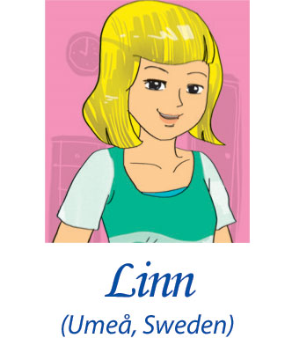
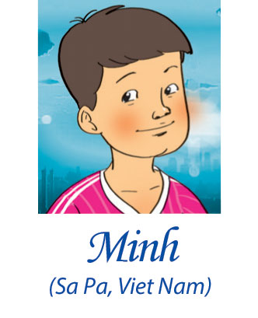
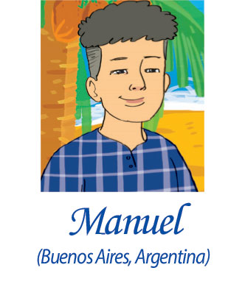
I love hanging out w/ my best friend Helen in my spare time, like going ‘window shopping’. J4F! We also work as volunteers for an animal protection organization. 2moro we r going to a farm.
posted Tue 3.20 pm
This may sound weird, but I adore cloud watching. Find an open space, lie on ur back, n’ look at the clouds. Use ur imagination. EZ! DYLI too?
posted Wed 8.04 pm
This year my city is the European Capital of Culture, so lots goin’ on. At weekends my bro n’ I go 2 our city community centre where we dance, paint, and do drama. I’m hooked on drama! <3 it!
posted Thu 6.26 pm
I like doing sports – I’m in my school’s football team. But what I mostly do in my free time is help my aunt. She has cooking classes 4 small groups of tourists. It’s WF 4 me!
posted Fri 7.19 pm
I’ve been kind of addicted to the net. I just love sitting in front of my computer for hours! But now my mum has said it’s NUFF! I’ll start my judo class this weekend. It’s OK. WBU?
posted Fri 8.45 pm

Slide 8
*) Answer the questions:
Who loves hanging out with friends?
2. Who adores cloud watching?
3. Is Linn hooked on drama?
4. Who cooks in his free time?
5. Does Manuel love the net?
→ Emily loves hanging out with friends.
→ Hang adores cloud watching.
→ Yes, she is.
→ Minh cooks in his free time.
→ Yes, he does.

Slide 9
I love hanging out w/ my best friend Helen in my spare
time, like going ‘window shopping’. J4F!
We also work as volunteers for an animal protection
organization. 2moro we r going to a farm.
with
Just for fun
Tomorrow
are

Slide 10
This may sound weird, but I adore cloud
watching. Find an open space, lie on ur back, n’
look at the clouds. Use ur imagination. EZ!
DYLI too?
your
and
your
easy
Do you like it?

Slide 11
This year my city is the European Capital of
Culture, so lots goin’ on. At weekends my bro n’ I
go 2 our city community centre where we dance,
paint, and do drama. I’m hooked on drama! <3 it!
going
brother and
to
love

Slide 12

I like doing sports – I’m in my school’s football team.
But what I mostly do in my free time is help my aunt.
She has cooking classes 4 small groups of tourists. It’s
WF 4 me!
for
way fun for

Slide 13

I’ve been kind of addicted to the net. I just love sitting
in front of my computer for hours! But now my mum
has said it’s NUFF! I’ll start my judo class this
weekend. It’s OK. WBU?
for
What about you?

Slide 14
2. These abbreviations are informal language that is used on line and in texting message ( P11).
2moro | tomorrow
4 | for
<3 | love
bro | brother
DYLI | Do you love it?
EZ | easy
J4F | just for fun
goin’ | going
n’ | and
NUFF | enough

Slide 15
*) Now add to the dictionary other abbreviations used for online chatting/texting that you know.
G9
NGU
Gr8 | great
dat | that
Ru5
Cul8r | See you later
OMG
Good night
Never give up
Are you fine?
Oh my god

Slide 16
3. Complete the table (Part 3. P11).
Who? | What activity is mentioned? | What does he/ she think of it?
Emily

Slide 17
Who? | What activity is mentioned? | What does he/ she think of it?
Emily
Hang
Linn
Minh
Manuel
+ hanging out with friends (window shopping)
She loves it.
+ working as a volunteer
She adores it. It’s easy
+ cloud watching
+ going to community centre, painting, dancing, doing drama
She loves it
+ playing football
He likes it. It’s fun
+ helping his aunt in running cooking class
+ playing computer games
He’s addicted to it. It’s OK.
+ doing judo

Slide 18
4. Pair work (P11).
Ss work with their partner and put the activities in 3 in order from the most interesting to the most boring. Then compare their ideas with other pairs.
Emily, Hang, Linn, Minh, Manuel
Keywords: + The most interesting, the most boring, First, Second, . Next, And,…….
+ cloud watching, going “window shopping”, cooking, dancing, playing games, reading books,….
Ex: In our opinion, the most interesting activity is dancing, painting and doing drama. The second is cooking and doing sports because we like playing soccer after school. The next activity is hanging out with friends.

Slide 19
III. Homework:
- Do the exercises in the workbook: Ex C 1, 2 p. 6
- Prepare the new lesson: Unit 1: Lesson 5: Skills 1.

Slide 20
Unit 1: Leisure activities
Lesson 4: Communication (P. 11)
I. New words:
+ window shopping (n): đi chơi ngắm đồ bày ở cửa hàng
+ be hooked on (adj) : yêu thích cái gì
+ to sound weird (v): có vẻ điên dồ
+ be addicted to (adj) : nghiện (thích) cái gì
+ hang out (v): tụ tập với bạn bè
+ netlingo (n):ngôn ngữ dùng để g/tiếp trên mạng
II. Reading:
IIi. Homework:
- Do the exercises in the workbook: Ex C 1, 2 p. 6
- Prepare the new lesson: Unit 1: Lesson 5: Skills 1.

Slide 21


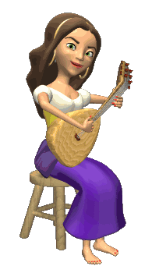

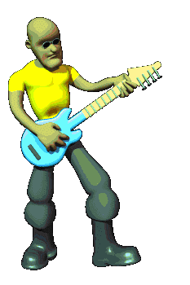
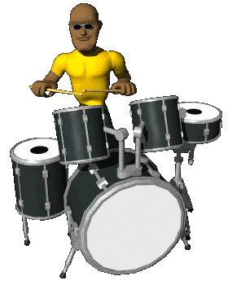






THANK YOU FOR ATTENTION!
GOOD BYE!
the end

