Slide 2
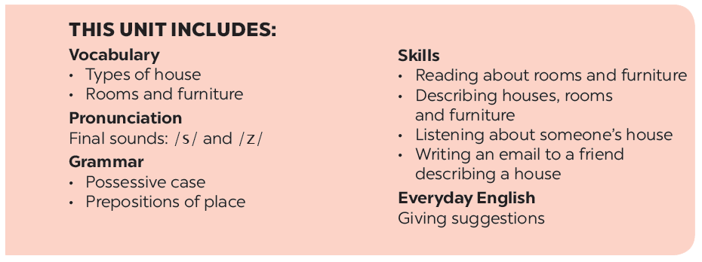

Slide 3
A look inside
Listen and read.
Complete the word web. Use the words from the conversation and the ones you know.
Which family members does Mi talk about? Put a tick ().
Work in groups. Ask your friends where they live. Then report their answers.
Read the conversation again. Complete each sentence with ONE word.

Slide 4
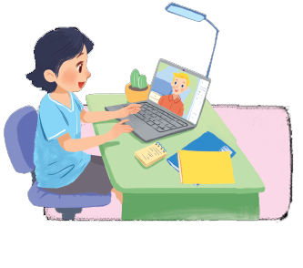
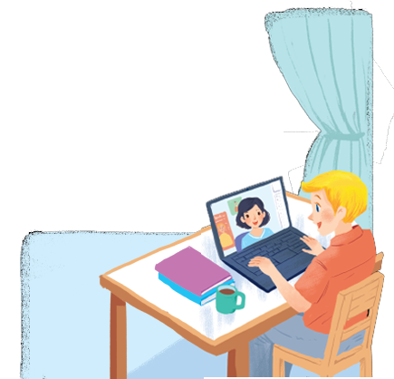
Listen and read.
A look inside
Notes:
Thiếu tên bài đọc.

Slide 5
A look inside
Mi: Wow! Your room looks so big, Nick.
Nick: It’s elena’s room. she’s my sister.
Mi: I see. Is there a TV behind you?
Nick: Yes, there is. Where do you live, Mi?
Mi: I live in a town house. And you?
Nick: I live in a country house. Who do you live with?
Mi: My parents and younger brother. We’re moving to a ﬂat next month!
Nick: Are you?
Mi: Yes. My aunt lives near there, and I can play with my cousin.
Nick: Are there many rooms in your new ﬂat?
Mi: Yes, there are. There’s a living room, three bedrooms, a kitchen and two bathrooms.

Slide 6
Which family members does Mi talk about?
Put a tick ().
1. | parents
2. | sister
3. | brother
4. | aunt
5. | cousin





Slide 7
Read the conversation again. Complete each sentence with ONE word.
sister
1.
Elena is Nick’s .
2.
TV
There is a in Elena’s room.
3.
Now Mi lives in a house.
town
country
4.
Nick lives in a house.
5.
Mi’s new flat has bedrooms.
three

Slide 8
Complete the word web. Use the words from the conversation and the ones you know.
town house
TYPES OF HOUSE

Slide 9
Complete the word web. Use the words from the conversation and the ones you know.
villa
cottage
town house
country house
TYPES OF HOUSE
flat
stilt house
farmhouse

Slide 10
Work in groups. Ask your friends where they live. Then report their answers.
A: Where do you live?
B: I live in a flat.

