Slide 2
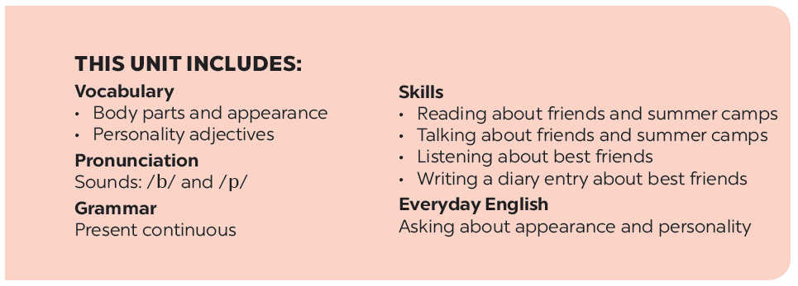

Slide 3
Vocabulary
Pronunciation
Personality adjectives
/b/ and /p/
Match the adjectives to the pictures.
Listen and circle the words you hear. Then repeat.
Use the adjectives in the box to complete the sentences.
Pay attention to the highlighted words / phrases.
Listen. Then practise the chant. Notice the rhyme.
Friendship ﬂower.

Slide 4
Vocabulary
Personality adjectives

Slide 5
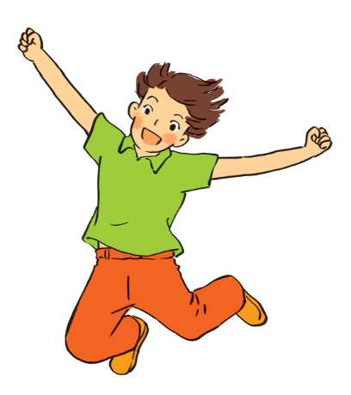
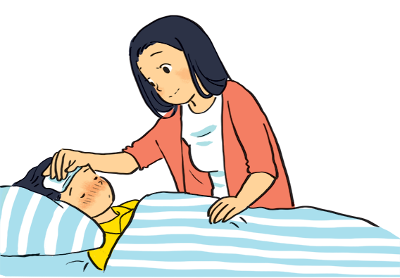
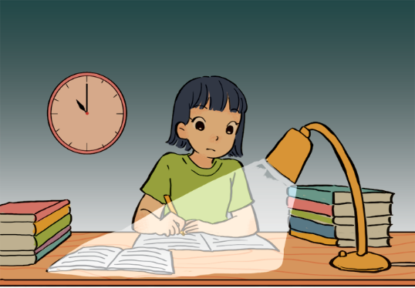
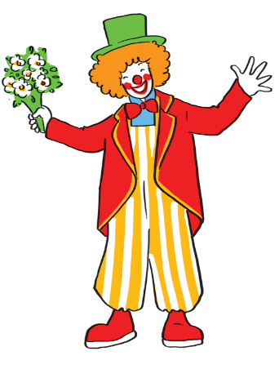
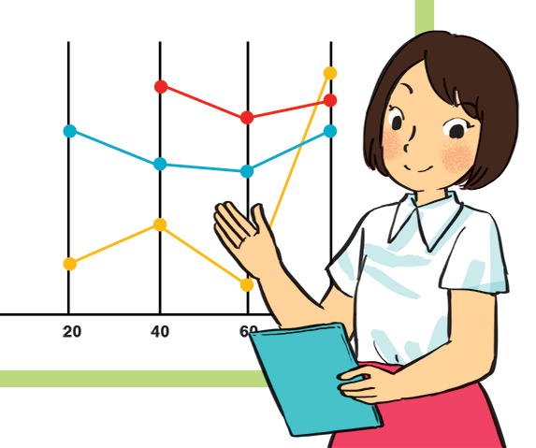
Match the adjectives to the pictures.
a
a
1. hard - working
b
b
2. confident
4. caring
3. funny
4. caring
4. caring
5. active
5. active
5. active
c
d
e
1. hard - working
3. funny
2. confident

Slide 6
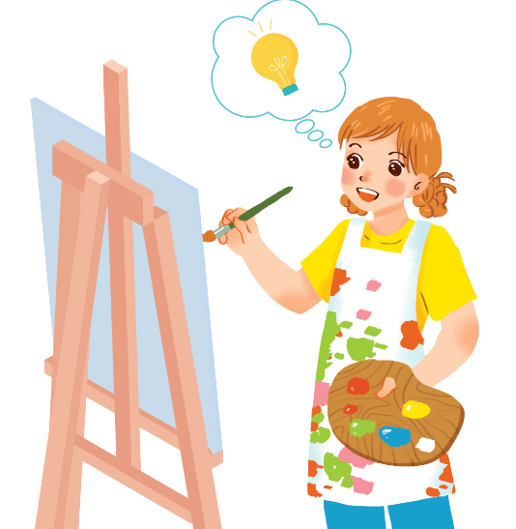
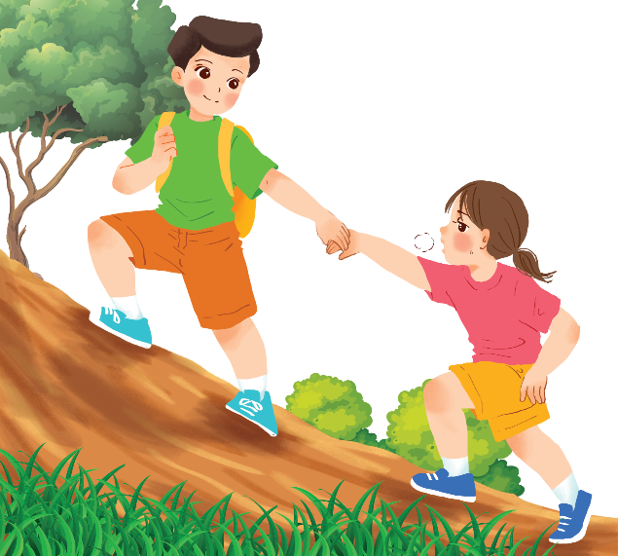
Use the adjectives in the box to complete the sentences.
Pay attention to the highlighted words / phrases.
carefull
clever
shy
kind
creative
friendly
1.
Mina is very . She likes drawing pictures. She always has lots of new ideas.
creative
Nam is .
He likes helping his friends.
2.
kind

Slide 7
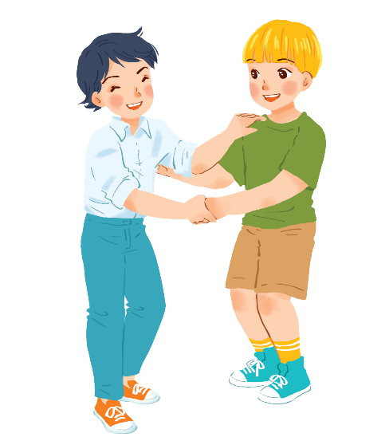
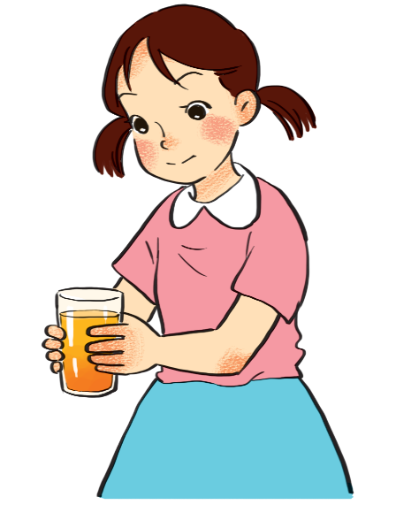
Use the adjectives in the box to complete the sentences.
Pay attention to the highlighted words / phrases.
carefull
clever
shy
kind
creative
friendly
Minh Duc is
He likes meeting new people.
3.
friendly.
.
Kim is very .
She pays attention to what she’s doing.
4.
carefull

Slide 8
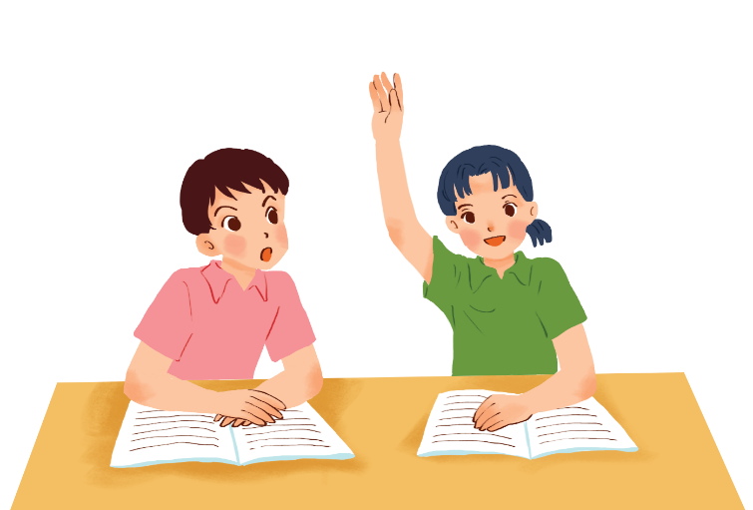
Use the adjectives in the box to complete the sentences.
Pay attention to the highlighted words / phrases.
carefull
clever
shy
kind
creative
friendly
5.
Mai is .
She learns things quickly and easily.
clever

Slide 9
Friendship ﬂower.
Work in groups. Write two personality adjectives for each group member.
Minh: kind funny

Slide 10
Pronunciation
/b/ and /p/

Slide 11
Listen and circle the words you hear. Then repeat.
 | /b/ | /p/
1. | big | pig
2. | bear | pear
3. | buy | pie
4. | robe | rope

Slide 12
Listen. Then practise the chant. Notice the rhyme.
We’re having a picnic
We’re having a picnic
Fun! Fun! Fun!
We’re bringing some biscuits
We’re bringing some biscuits
Yum! Yum! Yum!
We’re playing together
We’re playing together
Hurrah! Hurrah! Hurrah!

