Slide 1
Unit 4: MUSIC AND ARTS Period 31: Skills 2
Teacher: Pham Lan

Slide 2
Unit 4: Skills 2
I. Listening : A celebrity
II. Writing: an informal letter (an appointment )

Slide 3
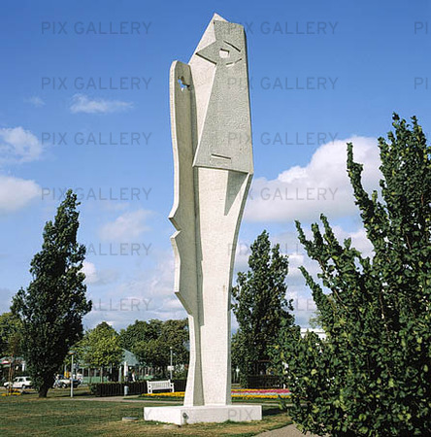
Picasso sculpture in Halmstad Sweden

Slide 4
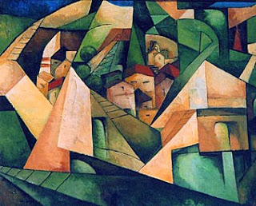
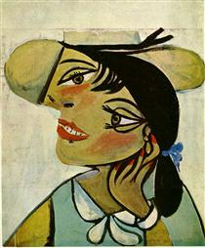
Cubism
Surrealism

Slide 5
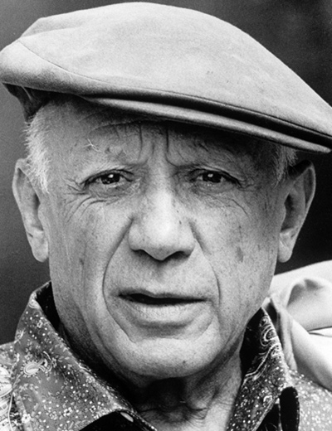
“The portrait of Aunt Pepa” - 1896
Pablo Picasso

Slide 6
A: LISTENING
EXERCISE 1
Great produce Works Formal enormous Artistic early Drawing
Drawing enormous produce expensive training painting
skill school

Slide 7
About a celebrity
Name
Where and when (born; die)
Famous for what
Celebrity
Achievement
Special events

Slide 8
1. When was Picasso born?
A. In 1881 B. In 1896 C. In 1973
2. Picasso received artistic training from his father at ______.
A. thirteen . seven C. thirty
3. How many works of art did Picasso produce?
A. 50,000 B. 1,885 C. 1,973
4. Where did Picasso die?
A. In Malaga B. In Barcelona C. In Mougins
A. In 1881
B. seven
A. 50.000
C. In Mougins

Slide 9
Exercise 3
A. He was admitted to a school of fine art when he was thirteen
B. He was born on 25th October in Malaga- Spain
C. He died in 1973 in Mougins
D. He received formal artistic training from his father when he was seven
1… 2…. 3…..4……..
1-B 2- D 3- A 4- C
Time line

Slide 10
Listening skill
Knowledge about the topic
+ Key words
+ Main information

Slide 11
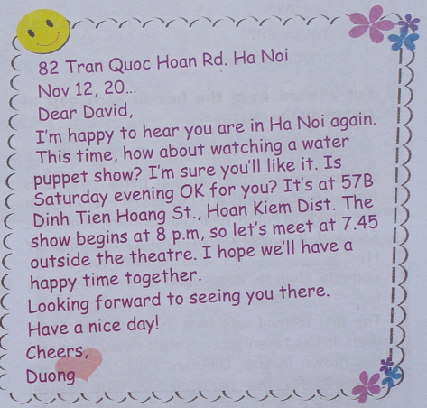
WRITING : An Informal letter

Slide 12
Parts of an informal letter
82 Tran Quoc Hoan Rd. Ha Noi
Nov 12, 20…
Dear David,
I m happy to hear you are in Ha Noi again.
This time, how about watching a water
puppet show? I m sure you ll like it. Is
Saturday evening OK for you? It s at 57B
Dinh Tien Hoang St., Hoan Kiem Dist. The
show begins at 8 p.m, so let s meet at 7.45
outside the theatre. I hope we ll have a happy time together.
Looking forward to seeing you there.
Have a nice day!
Cheers,
Duong
OPENING: address; date; greeting
Body: main content
Closing : wish; signature

Slide 13
Invitation and making an appointment
Purpose
Where and when
Who goes with
Making an appointment
Activities
How to travel

Slide 14
82 Tran Quoc Hoan Rd. Ha Noi
Nov 12, 20…
Dear David,
I m happy to hear you are in Ha Noi again.
This time, how about watching a water
puppet show? I m sure you ll like it. Is
Saturday evening OK for you? It s at 57B
Dinh Tien Hoang St., Hoan Kiem Dist. The
show begins at 8 p.m, so let s meet at 7.45
outside the theatre. I hope we ll have a happy time together.
Looking forward to seeing you there.
Have a nice day!
Cheers,
Duong
- Event: ……………………………………
- Time: …………………………………..
- Place…………………………………...
- Time to meet:..........................

Slide 15
82 Tran Quoc Hoan Rd. Ha Noi
Nov 12, 20…
Dear David,
I m happy to hear you are in Ha Noi again.
This time, how about watching a water
puppet show? I m sure you ll like it. Is
Saturday evening OK for you? It s at 57B
Dinh Tien Hoang St., Hoan Kiem Dist. The
show begins at 8 p.m, so let s meet at 7.45
outside the theatre. I hope we ll have a happy time together.
Looking forward to seeing you there.
Have a nice day!
Cheers,
Duong
- Event: watching a water
puppet show
- Time: 8pm
- Place: outside the theatre
- Time to meet:7.45.

Slide 16
Form used in invitation
How about + V-ing
Ex: How about going fishing?

Slide 17
Writing tip When you write an informal letter of invitation, you use: + How about + V-ing + Form of a letter

Slide 18
Now write a letter to invite a friend to an art exhibition
using the following cues:
- Event: Exhibition of Modern Art
- Time: 9 o’clock, Saturday morning
- Place: Arts Centre
- Time to meet: 8.15

Slide 19
Homework

