Slide 1

UNIT 1: My new school
Lesson 6: SKILLS 2

Slide 2
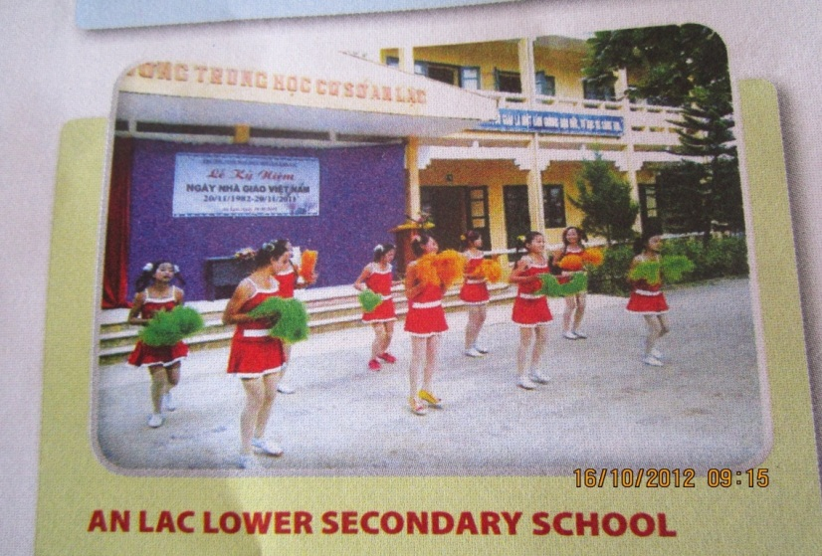
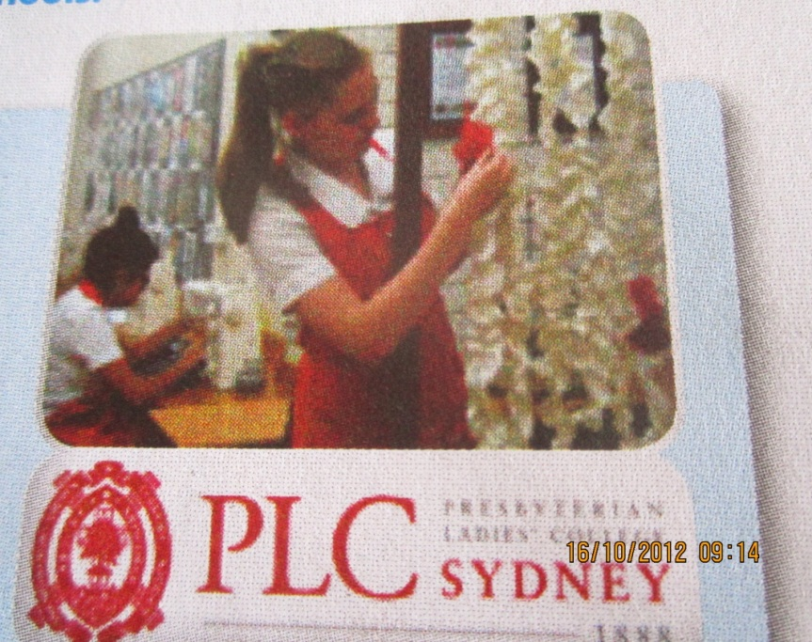
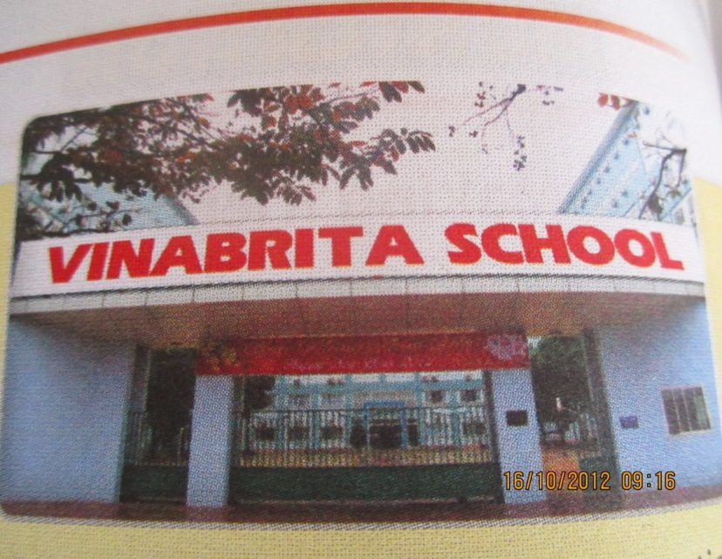
Which school do you like best? Talk about it.

Slide 3
I. Vocabulary:
title: (n): tiêu đề, tên sách, nhan đề
punctuation (n): sự chấm câu, phép chấm câu, cách đánh dấu chấm
favourite (adj): yêu thích
uniform (n): đồng phục
great (adj): tuyệt vời, vĩ đại

Slide 4

LISTENING
Guess
A | B
1. Listen and choose the correct answers:
1. Susie…………..being at a girl’s school
○
a. likes b. doesn’t like
2. Susie’s favorite teacher is her……………teacher
○
a. maths b. science
3. Today, Susie……………….
is wearing her uniform
b. isn’t wearing her uniform
○
4. Susie studies………………for three hours a week
○
a. English b. Vietnamese
5. Susie does her homework……………..
○
a. at breaktime b. in the evening

Slide 5
2. Listen and complete the sentences:
eleven
1. Susie is………………….years old
six
2. She is in grade……………..now
helpful
3. The teachers at her school are nice and……………
afternoon
4. She studies Vietnamese in the………………
every day
5. They wear uniform………………

Slide 6
WRITING: punctuation
1. Capital letters
- Starting a sentence: When we are free….
- Proper names: David, Ba….
- Days and months: Monday, September….
- Pronoun: I, She, He….
- Places: London, Ha Nam….
2. Commas (,)
- To separate long sentences and lists of things
She has a book, a pen, a pencil and an ruler.
3. Full stops (.), question marks (?), or exclamation mark (!)
- They are put at the end of the sentences.
We are learning English.
Are you a student?
What a nice girl!

Slide 7
Correct the punctuation
1. school starts on the 5th september
-> School starts on the 5th September.
2. does he live in ha noi
-> Does he live in Ha noi?
3. i am excited about the first day of school
-> I am excited about the first day of school.
4. are you doing your homework
-> Are you doing your homework?
5. we’re having an english lesson in class
-> We’re having an English lesson in class.

Slide 8
Correct the passage
hi im phong and im from ho chi minh city I wear my uniform to school every day my favorite teacher is mr trung he teaches me science.
Correct:
Hi. I’m Phong and I’m from Ho Chi Minh City. I wear my uniform to school every day. My favorite teacher is Mr Trung. He teaches me sciences.

Slide 9
Write a webpage about your school
1. Name of the school: Yen Thuong Secondary School
2. Location: Ha Noi City
3. Number of students and teachers: 60 teachers / more than 1,300 students
4. Activities at school: study in the morning and afternoon with well-qualified teachers/ take part in outdoor activities/ read books in the library at break time.
5. Great things about school: big, well-equipped…
6. Clothing: wear our uniforms every day
7. Subject you like: Math, Literature, English…. because….
8. Activities after school: play sports/ go home

Slide 10
Hi. My name is ............ I am now a student at ……………………….. lower secondary school. My school is in ………………………… district. It is not a large school. ………

Slide 11

HOMEWORK
1. Learn by heart the new words
2. Do exercise E1,2 (workbook)
  3. Prepare: Looking back - Project

Slide 12

Thank for your attention.
GOOD BYE.

