Slide 1

Unit 1: My new school.
Lesson 7
LOOKING BACK + PROJECT

Slide 2

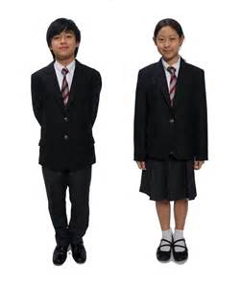
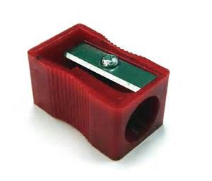

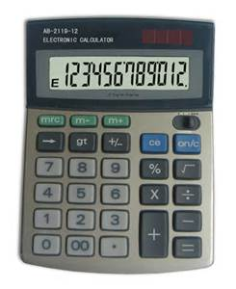

Vocabulary
Write words that match the pictures.
1. 2. 3.
4.
4. 5. 6.
dictionary
uniform
pencil sharpener
notebook
compass
calculator

Slide 3
2. Match the words in A with the ones in B
B
the piano
Vietnamese
exercise
breakfast
A
study
do
play
have

Slide 4

3. Listen. Then write down the words you hear in the correct places.
play
do
sports
badminton
music
morning exercise
homework
study
have
new words
geography
English lesson
a new book

Slide 5
4. Complete the sentences with the present simple.
1. He ______(come) from Da Nang.
2. Do you study English? No, I______(do not ).
3. She _______ (walk) to school with her friends.
4. I ______ (do) my homework after school.
5. Mr Vo _______(teach) physics at my school.
6. The team _________ (play) football on Saturday.
comes
don’t
walks
do
teaches
play

Slide 6
5. Complete the sentences with the present continuous.
1. They __________( do) judo in the gym.
2. My friends __________( ride ) to school with me.
3.___ he __________ (study) vocabulary?
4. Mr Lee __________ (have) lunch with his students.
5. I _____________(walk) to class with my class.
6. Ms Huong _________ (teach) the class maths.
are doing
are riding
Is
studying
is having
am walking
is teaching

Slide 7
6. Complete the text with the correct form of the verbs in the brackets.
Hoang (1. live) ______ in a small house in the center of the village. His house (2. be) ______ near his new school. Every day, he (3.have) _____ breakfast at 6 o’clock. Now, he (4.walk) _________ to school with his friends. They (5.go) ________to school together every day. Hoang and his friends (6.study) ________ in grade 6 at An Son Lower Secondary school. This week they (7.work) __________
on a project about their neighbourhood. Hoang (8.love) __________ his new school.
lives
is
has
is walking
go
study
are working
loves

Slide 8
Communication
7. Match the questions with the correct answers.
Yes, she does.
How many classes are there in your school?
I do my homework and watch TV.
How is your first week at school?
Does Mai live near her school?
Oh, wonderful.
Sixteen.
What do you do in the evening?
7. Key answers: b- g d-f e-a h-c

Slide 9
8. Now role-play the questios and answers
Finished! Now you can……. | V | VV | VVV
ask and answer questions about school Talk about things that are fixed or often happen Talk about things that are happening now

Slide 10
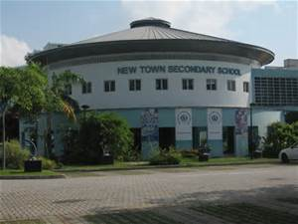
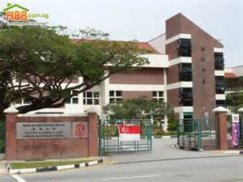
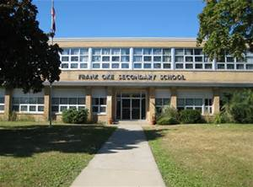
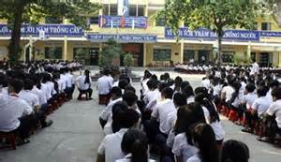
Project
Your dream school

Slide 11
Homework
Revise unit 1 for a fifteen-minute test
Be ready for Unit 2: Getting started

