Slide 2
Guessing word
s
c
h
o
o
l
a
b
t
d
e
f
g
l
h
i
j
k
e
m
n
s
c
q
o
h
o
p
v
w
x
y
z

Slide 3
UNIT 1: MY NEW SCHOOL Lesson 5: Skill 1
READING

Slide 4
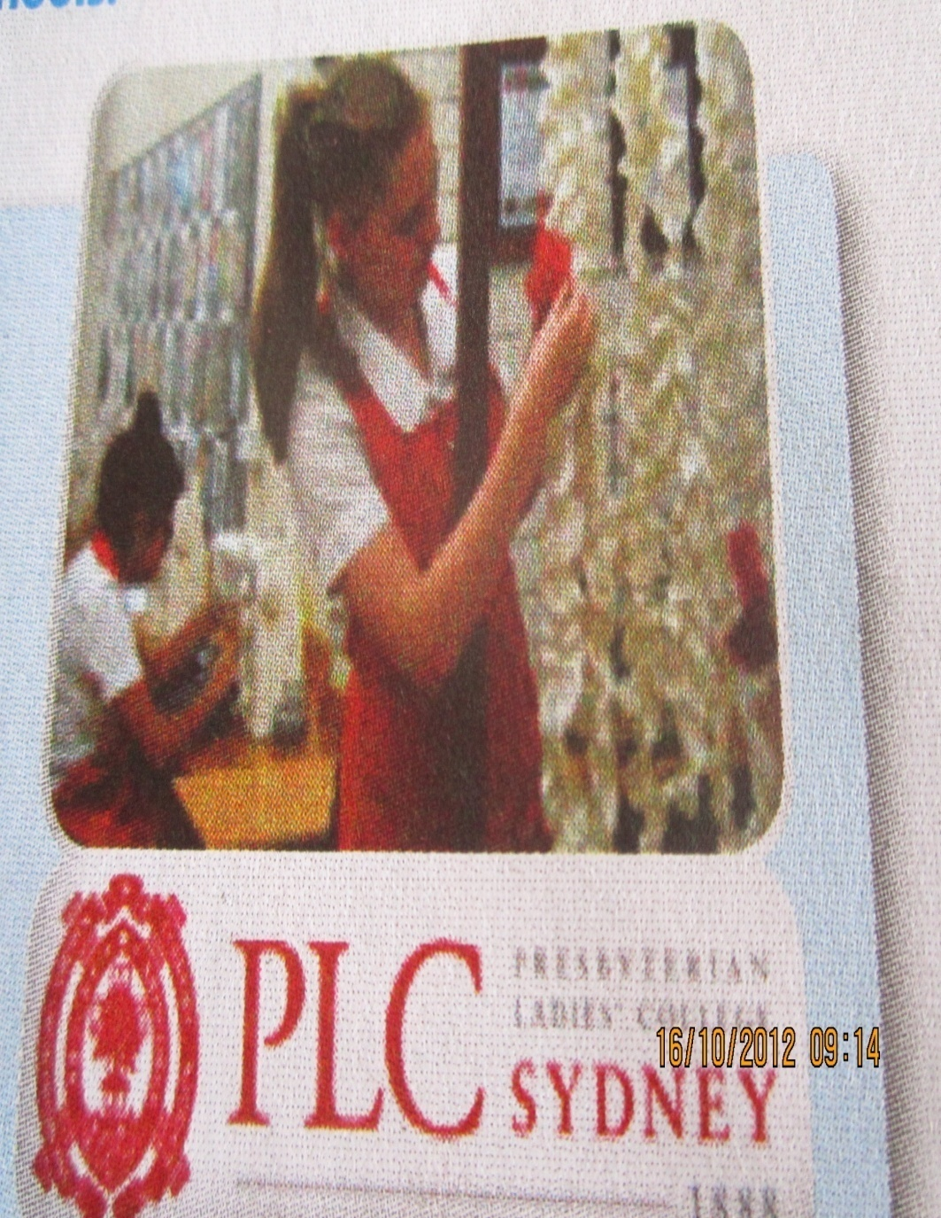
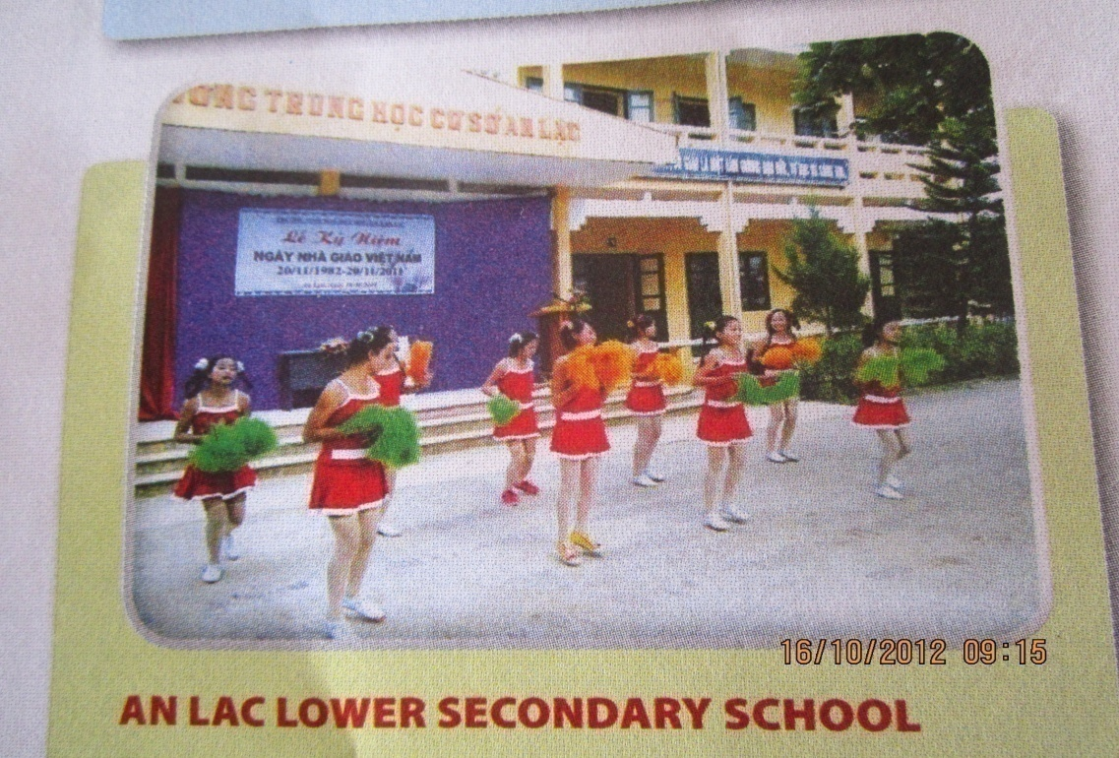
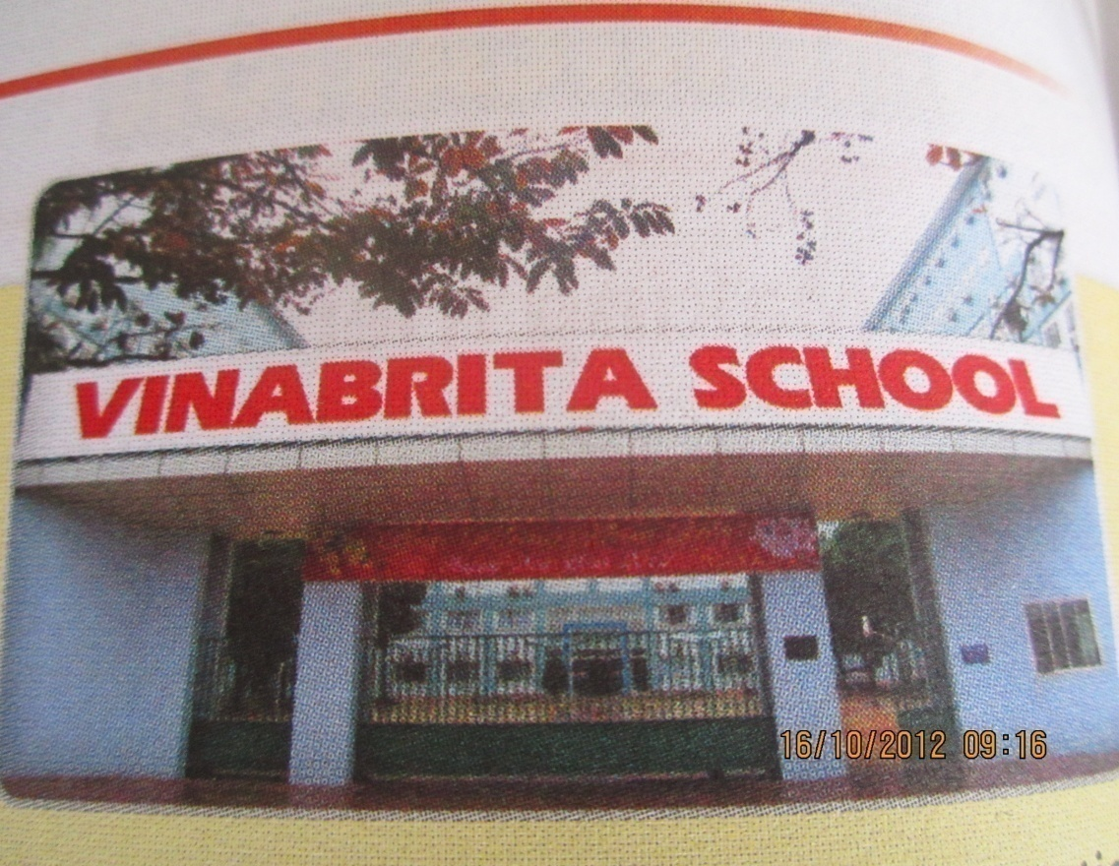

Slide 5
Ex1. Read three passages quickly and answer:
What are these passages about?
→ They are about school.

Slide 6
* Now underline these words in the text. What do they mean?
boarding surrounded
international creative

Slide 7
* The word in its sentence
boarding
- It is a ……………… school. Students study and live there.
- The school is ……………………by the mountains and green fields.
- Vinabrita school is an ………………………school for Ss from year 1 to year 12.
- Some …………………students do drawings and painting in the art club.
surrounded
international
creative

Slide 8
New words:
- boarding /'bɔ:diη/ (n):
- (be) surrounded / sə'raundid/ (v):
- international / intə'næ∫ənl/ (adj):
- creative / kri:'eitiv/ (adj):
nội trú
được bao quanh
quốc tế
sáng tạo

Slide 9
EX2/ Matching: Match the words with their meaning:
A B
1. boarding a. sáng tạo
2. international b. được bao quanh
3. (be)surrounded c. quốc tế
4. creative d. nội trú

Slide 10
3. Read the text again and complete the table.
Name of school | PLC Sydney | An Lac Lower Secondary School | Vinabrita School
Place
Age
Number of student
Facilities

Slide 11
3. Read the text again and complete the table.
Name of school | PLC Sydney | An Lac Lower Secondary School | Vinabrita School
Place | In Australia | In Bac Giang-Vietnam | No information
Age | From age 4 to age 18 | No information | From grade 1 to grade 12 (7-18 years old)
Number of student | 1250 girls | 194 students | No information
Facilities | No information | A computer room A library, a school garden and a playground. | Big buildings, modern equipment

Slide 12
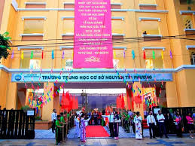
SPEAKING
Topic: “Talk about your school”.
……………..

Slide 14
Homework
Learn new words by heart.
Do exercise 3/page 12
Rewrite a passage about 5-7 sentences about your school.

Slide 15
Thanks for joining us today !
GOOD BYE!

