Slide 3
Warm – up song
Notes:
- Audio: letter A, /a/, apple, ant

Slide 4
Unit 12
Lesson 4

Slide 5
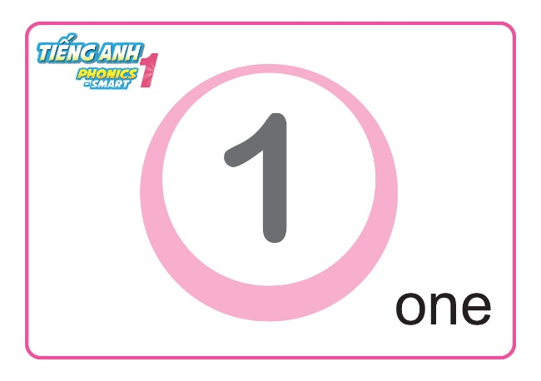
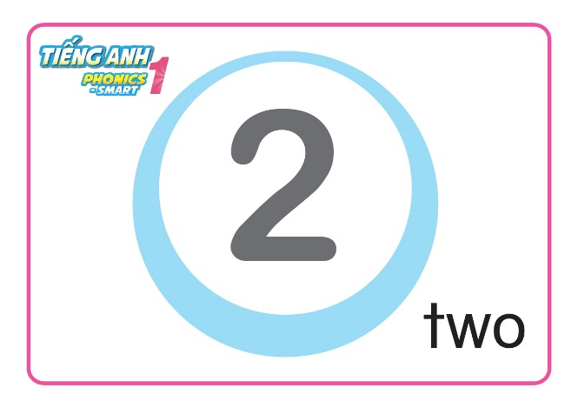
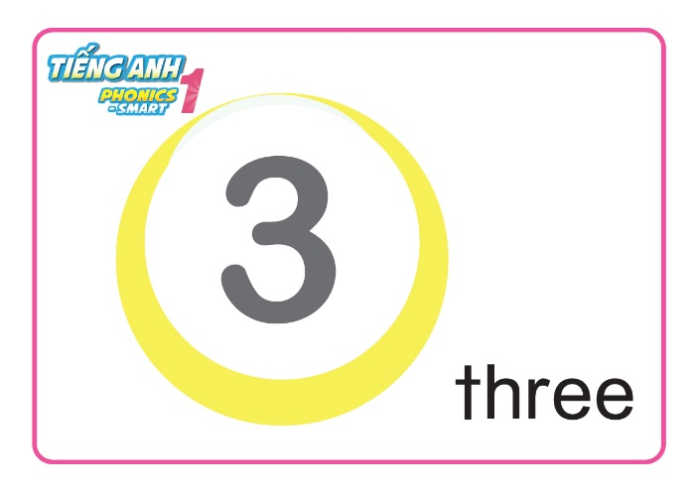
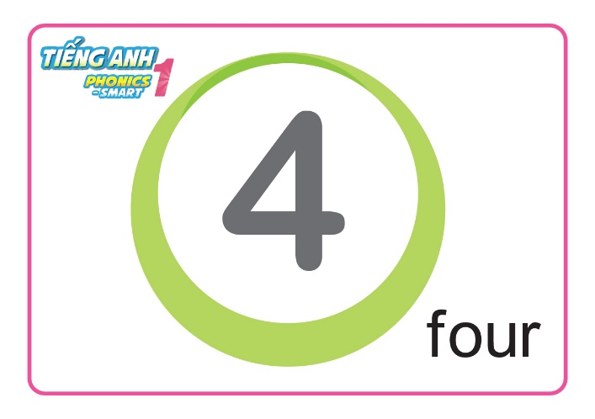
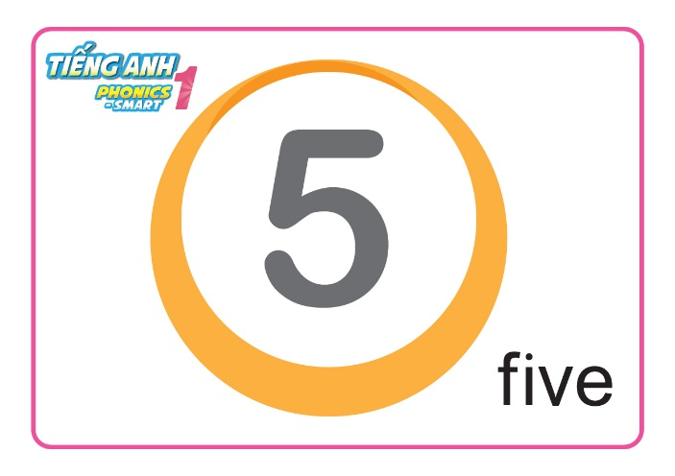
Unit 12:
Lesson 4
1. Listen and repeat.
Revision

Slide 6
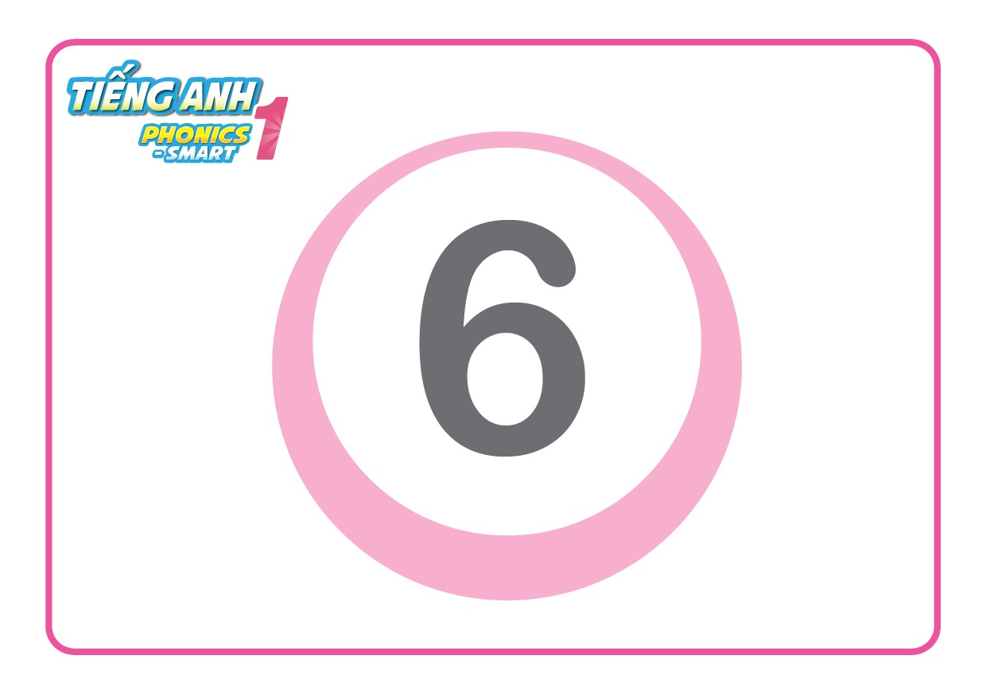
Unit 12:
Lesson 4
1. Listen and repeat.
six

Slide 7
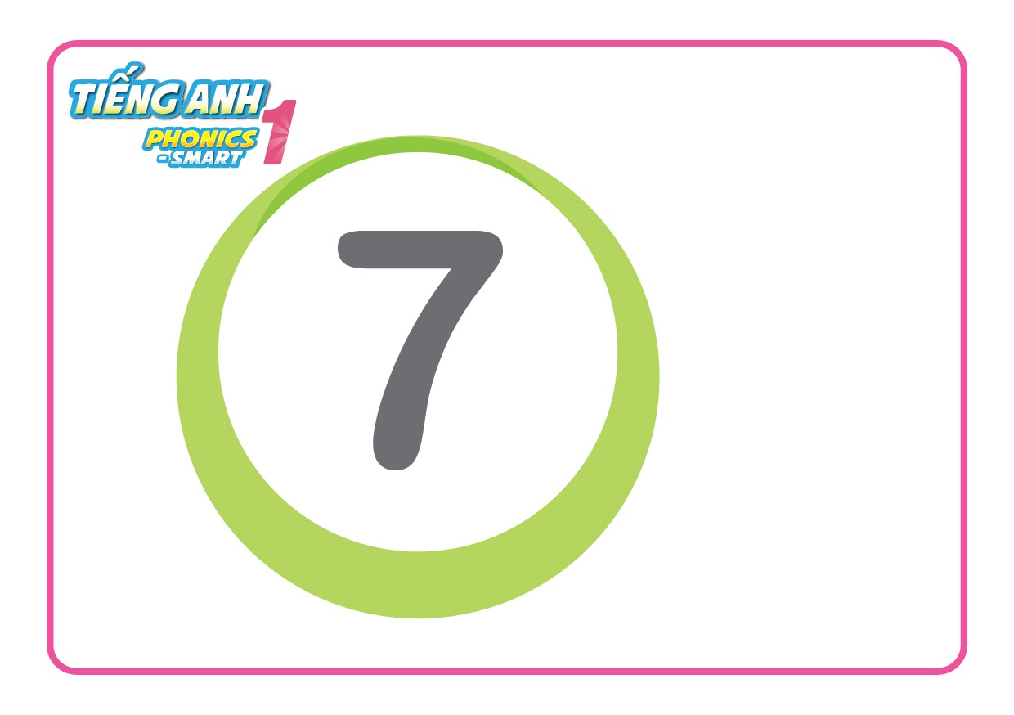
Unit 12:
Lesson 4
1. Listen and repeat.
seven

Slide 8
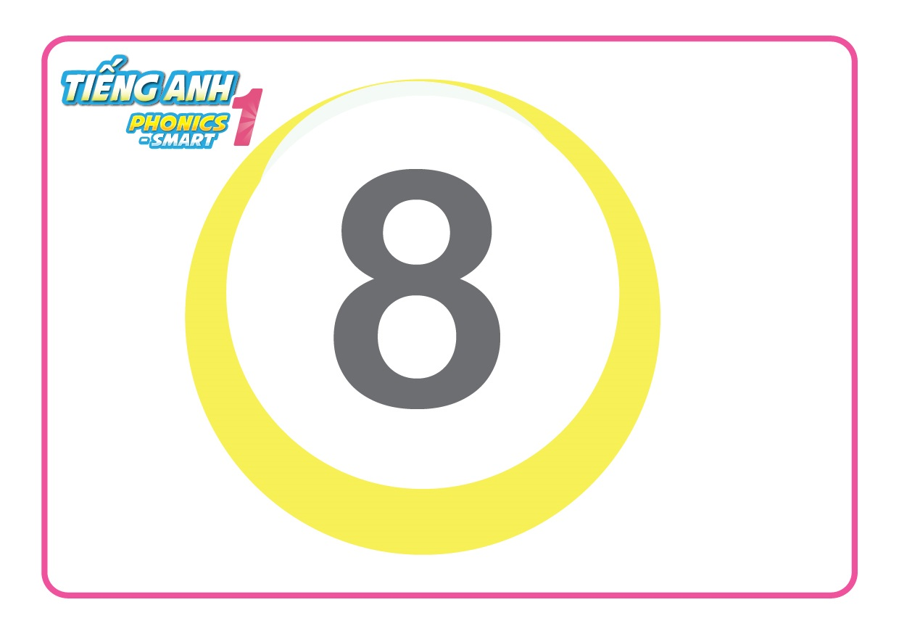
Unit 12:
Lesson 4
1. Listen and repeat.
eight

Slide 9
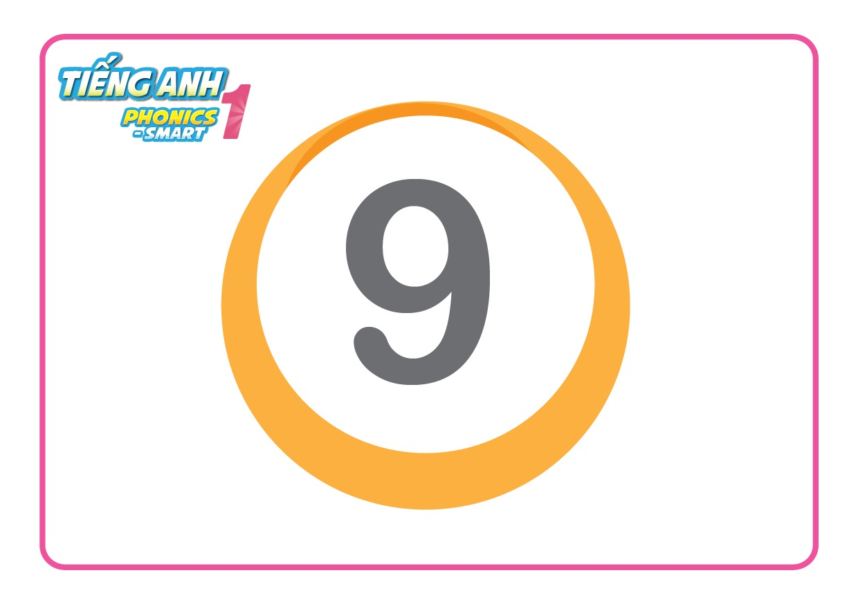
Unit 12:
Lesson 4
1. Listen and repeat.
nine

Slide 10
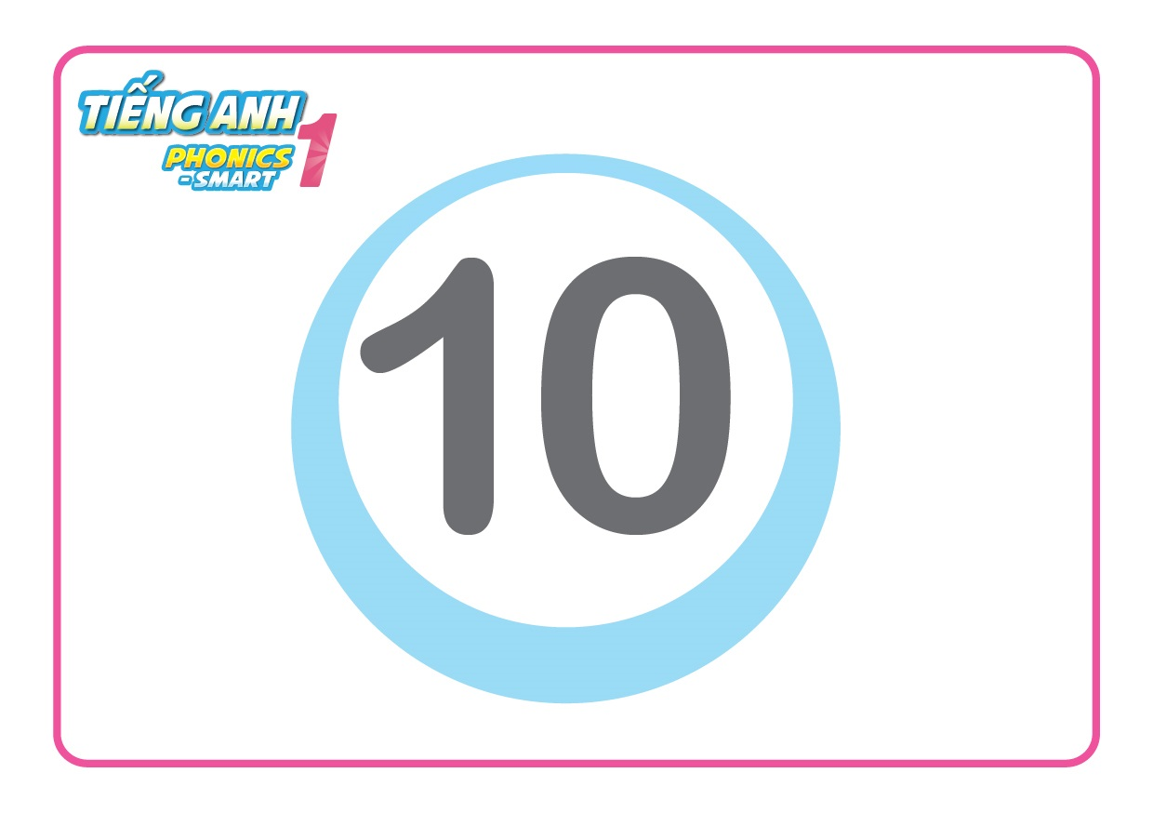
Unit 12:
Lesson 4
1. Listen and repeat.
ten

Slide 11
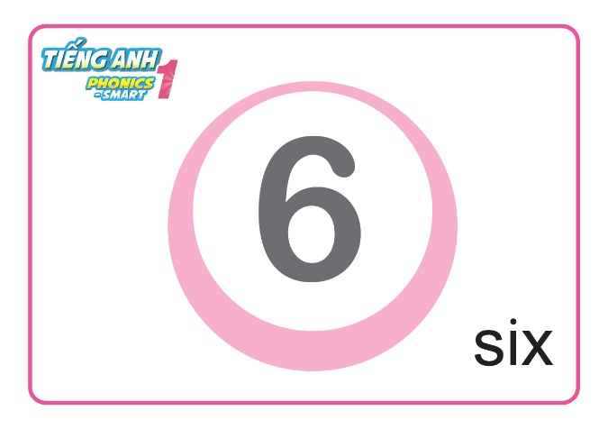
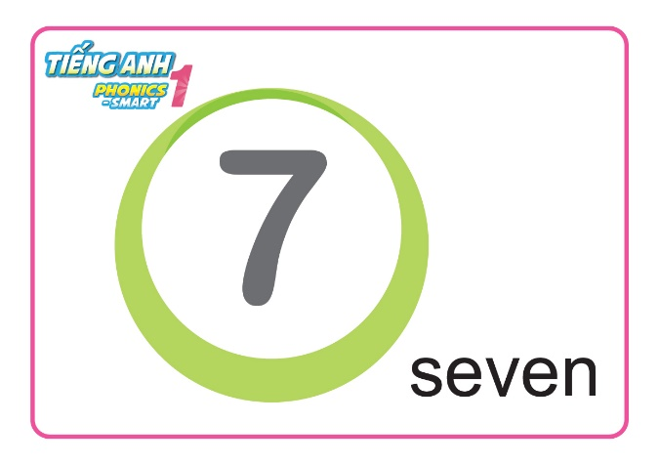
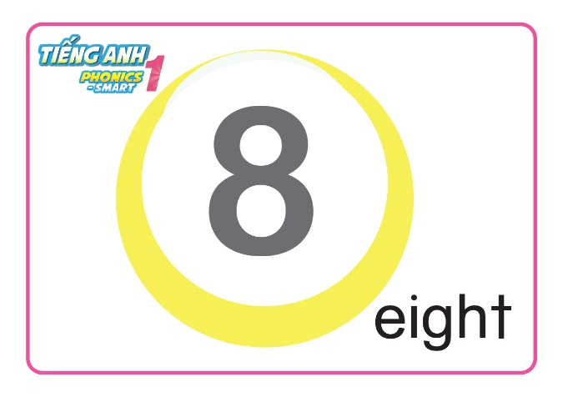
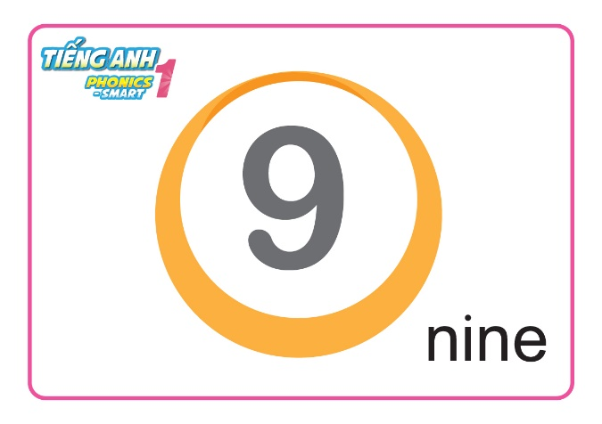
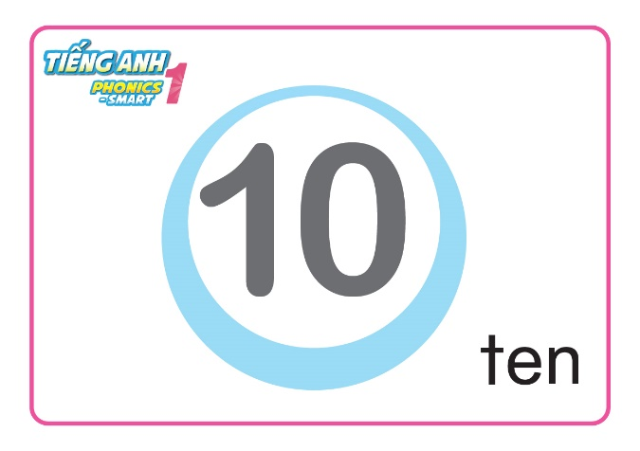
Unit 12:
Lesson 4
1. Listen and repeat.
Look, say and show your fingers

Slide 12
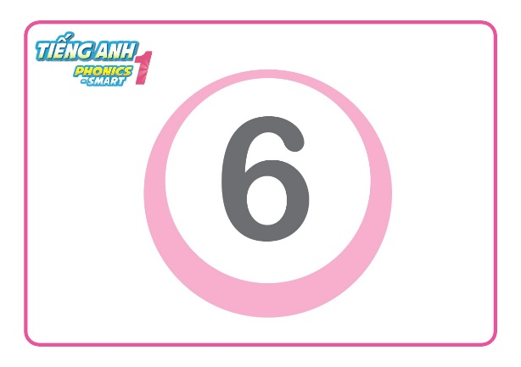
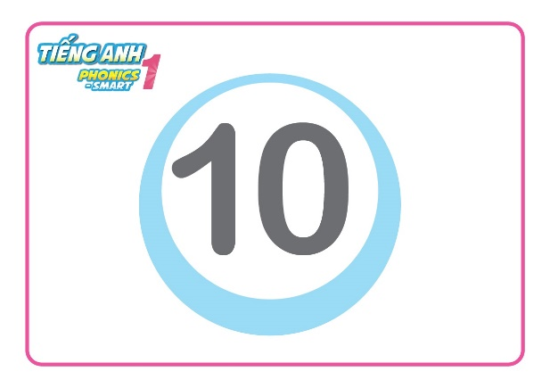
Unit 12:
Lesson 4
What's wrong?
nine
seven
six
ten
eight
nine

Slide 13
Unit 12:
Lesson 4
What's wrong?
nine
seven
eight
eight
six
ten

Slide 14
Unit 12:
Lesson 4
What's wrong?
nine
seven
nine
eight
six
ten

Slide 15
Unit 12:
Lesson 4
What's wrong?
nine
seven
eight
six
ten
ten

Slide 16
Unit 12:
Lesson 4
What's wrong?
nine
ten
seven
six
ten
eight
nine

Slide 17
Unit 12:
Lesson 4
What's wrong?
nine
seven
eight
seven
eight
six
ten

Slide 18
Unit 12:
Lesson 4
1. Listen and repeat.
55
Notes:
- HD học sinh sử dụng SGK.

Slide 19
Unit 12:
Lesson 4
1. Listen and repeat.
2. Look, match and say.
55

Slide 20
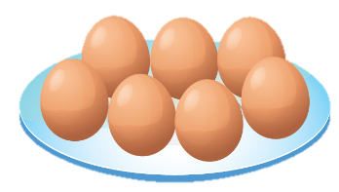
How many eggs?
1
2
3
4
7
5
6
seven eggs

Slide 21
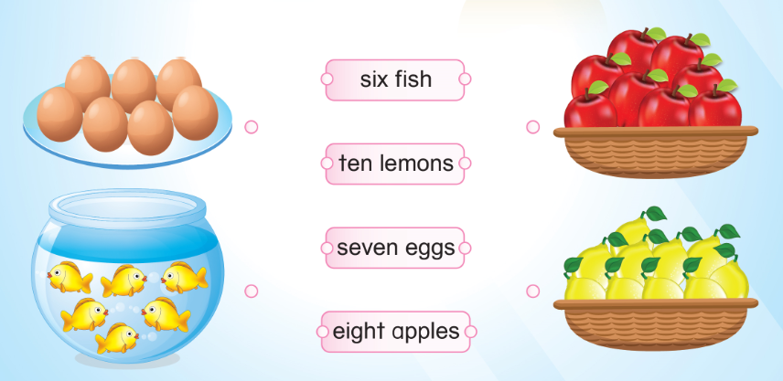
Unit 12:
Lesson 4
1. Listen and repeat.
2. Look, match and say.

Slide 22
How many fish?
1
2
3
6
4
5
six fish

Slide 23
Unit 12:
Lesson 4
1. Listen and repeat.
2. Look, match and say.

Slide 24
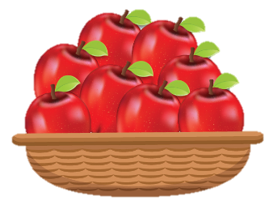
How many apples?
1
2
8
3
6
7
5
4
eight apples

Slide 25
Unit 12:
Lesson 4
1. Listen and repeat.
2. Look, match and say.

Slide 26
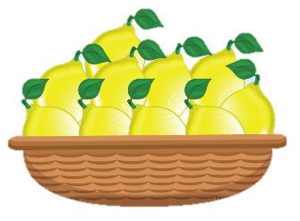
How many lemons?
1
5
2
3
4
6
10
9
8
7
ten lemons

Slide 27
Unit 12:
Lesson 4
1. Listen and repeat.
2. Look, match and say.

Slide 28
Unit 12:
Lesson 4
1. Listen and repeat.
2. Look, match and say.
Let’s say
seven eggs
ten lemons
six fish
eight apples

Slide 29
Unit 12:
Lesson 4
1. Listen and repeat.
2. Look, match and say.
3. Let’s talk.

Slide 30
Unit 12:
Lesson 4
3. Let’s talk.
I have got nine apples.
I like apples.

Slide 31
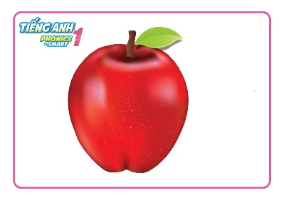
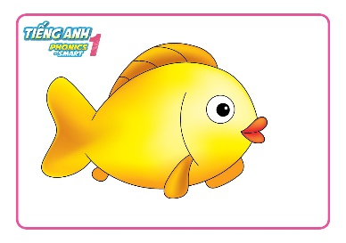
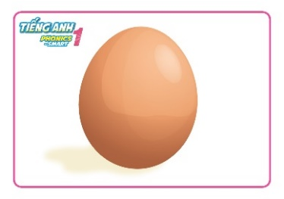
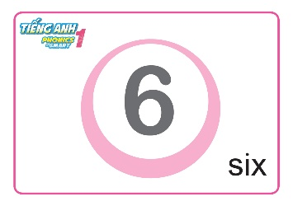
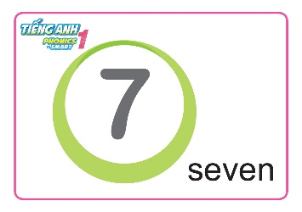
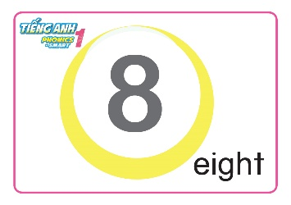
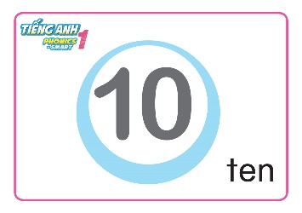
Unit 12:
Lesson 4
1. Listen and repeat.
2. Look, match and say.
3. Let’s talk.
I have got six apples
I have got seven fish
I have got eight lemons
I have got nine eggs
I have got ten lemons

Slide 32
