Slide 1
Unit 3
Where did you go
on holiday?
Lesson 3

Slide 2
Warm-up

Slide 3
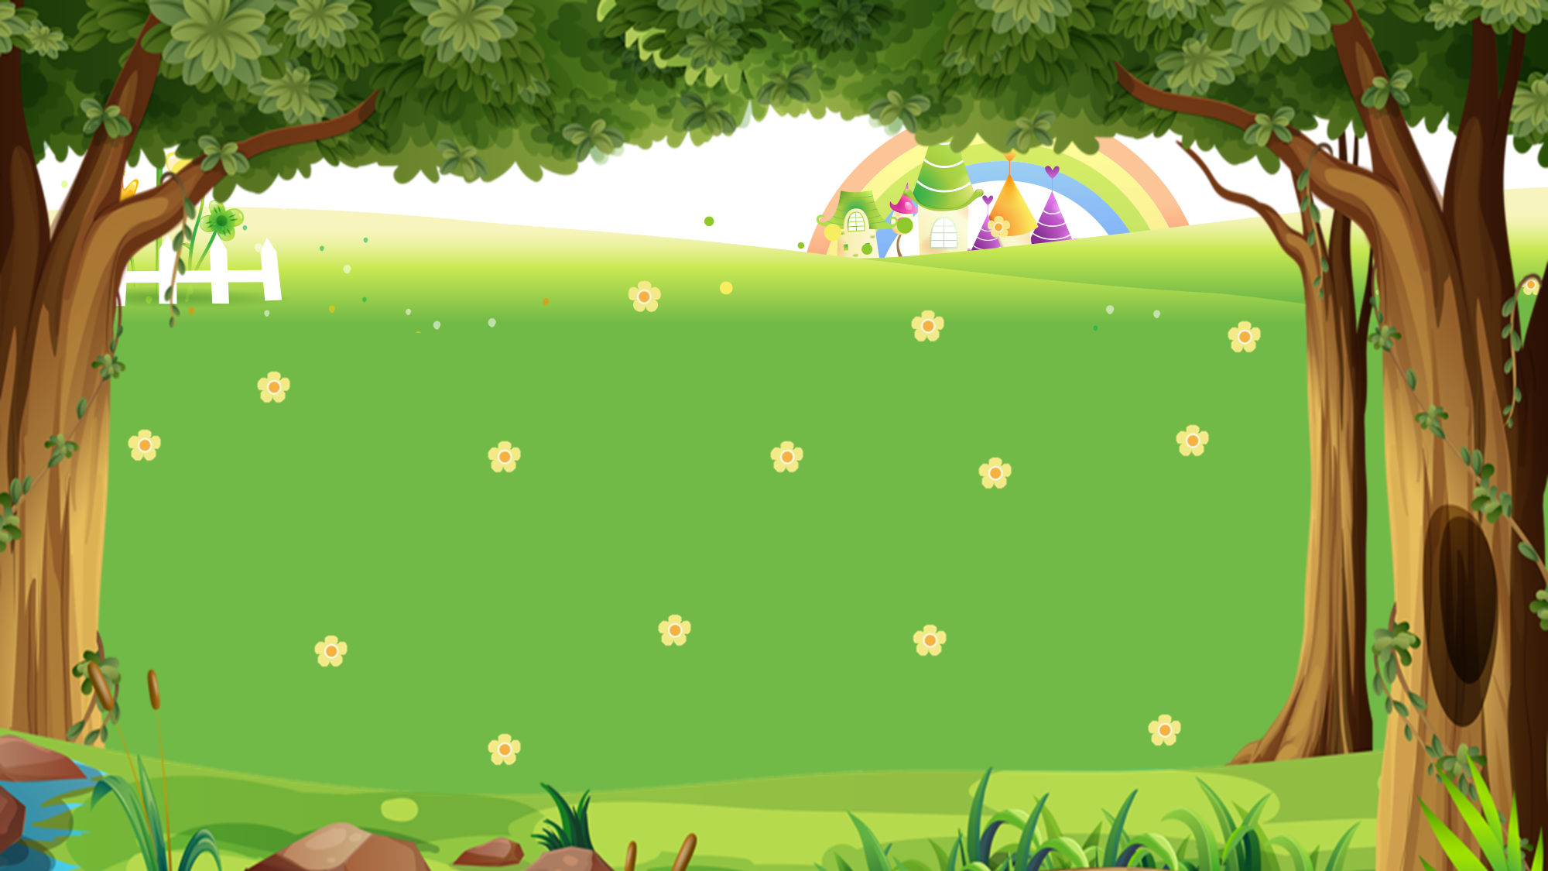
PICKING MUSHROOMS
1
2
3
Các đội CHỌN lần lượt các Ô SỐ để trả lời câu hỏi.
Đội nào trả lời NHANH HƠN và ĐÚNG thì được CỘNG 1 điểm.
CLICK hình hoặc hình để cộng điểm.
4
5
6
7
8
9
10

Slide 4
Time’s up
1
2
3
4
5
6
7
8
9
10
How did you get there?
Back
A. I went by motorbike.
B. I went to Ha Long Bay.
C. I went swimming.
A.

Slide 5
Time’s up
1
2
3
4
5
6
7
8
9
10
I went by bus.
Back
A. Where did you go on holiday?
B. How did you get there?
C. Where did you do?
A.

Slide 6
Time’s up
1
2
3
4
5
6
7
8
9
10
How did you get there?
_____ coach.
Back
A. I went
B. I went to
C. I went by
A.

Slide 7
Time’s up
1
2
3
4
5
6
7
8
9
10
____ was the trip ___?
It was great.
Back
A. How / like
B. Where / like
C. What / like
A.

Slide 8
Time’s up
1
2
3
4
5
6
7
8
9
10
Where did you go on holiday?
Back
A. I went by bus.
B. I went to Hue Imperial City.
C. I go to Hue Imperial City.
A.

Slide 9
Time’s up
1
2
3
4
5
6
7
8
9
10
Where ____ you go on holiday?
Back
A. do
B. did
C. are
A.

Slide 10
Time’s up
1
2
3
4
5
6
7
8
9
10
How did you get there?
Back
A. I went bike train
B. I went to train
C. I went by train.
A.

Slide 11
Time’s up
1
2
3
4
5
6
7
8
9
10
How did you get there?
Back
A. To taxi
B. By taxi
C. Go taxi
A.

Slide 12
Time’s up
1
2
3
4
5
6
7
8
9
10
______ did you do on holiday?
I went to Ho Chi Minh City.
Back
A. What
B. Where
C. How
A.

Slide 13
Time’s up
1
2
3
4
5
6
7
8
9
10
It was really wonderful.
Back
A. Where di you go?
B. How did you get there?
C. What was the trip like?
A.

Slide 14
PRONUNCIATION

Slide 15
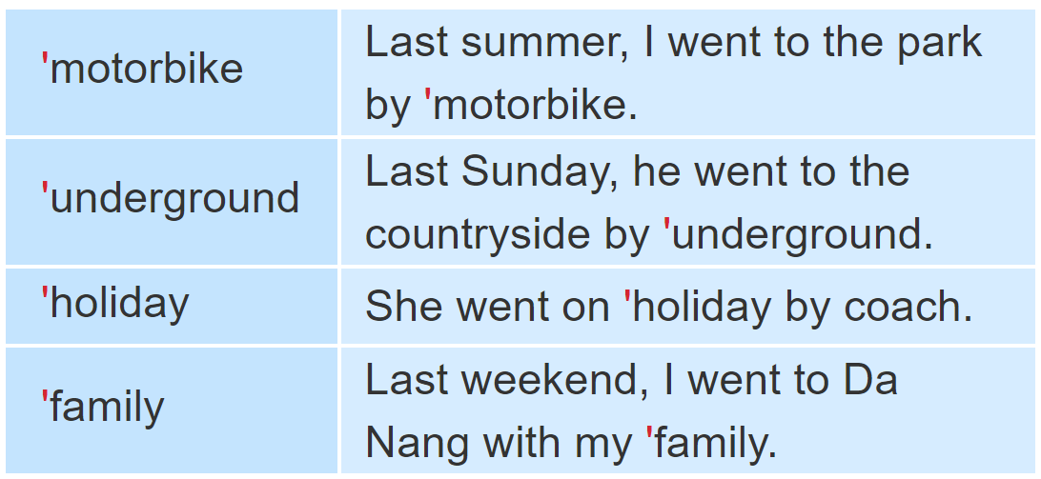
1. Listen and repeat

Slide 16
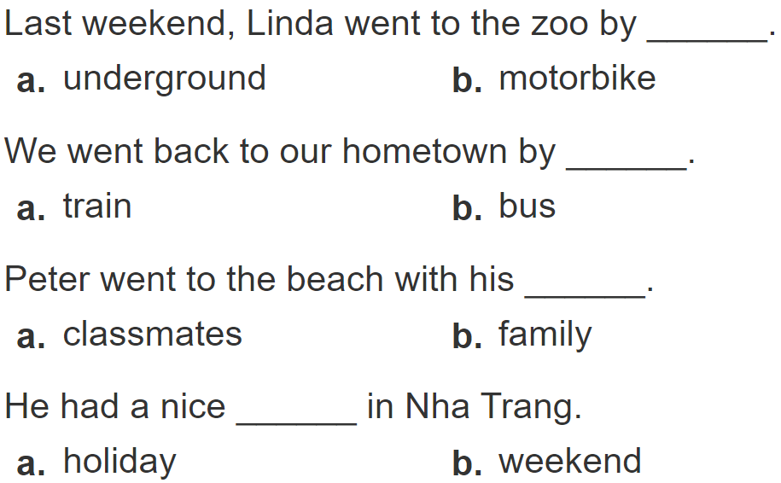
2.
Listen and circle a or b. Then say the sentences aloud.
1
2
3
4

Slide 17
PRACTISE

Slide 18
3. Let’s chant.

Slide 19
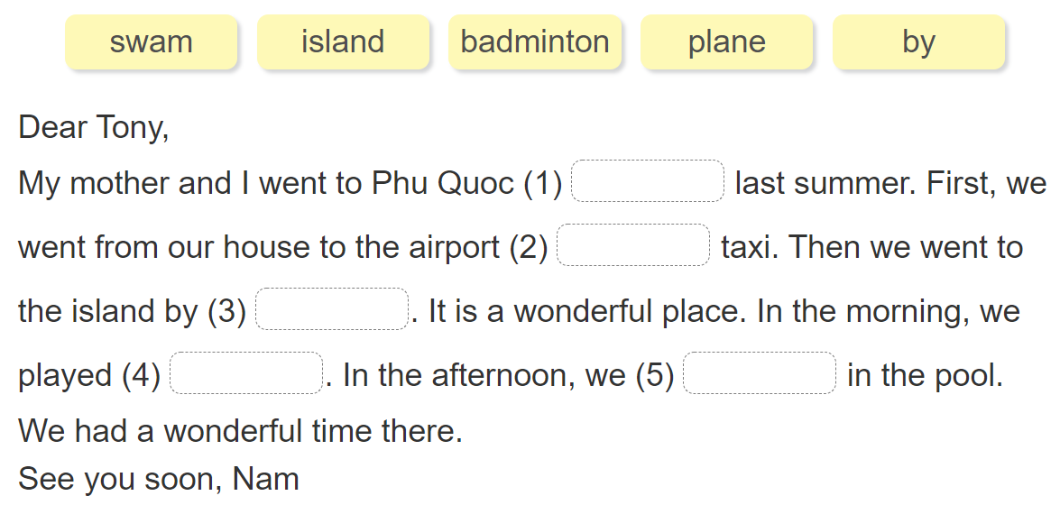
4. Read and answer.

Slide 20
5. Write about your day.

Slide 21
6. Project.

Slide 22
THANK YOU!
Welcome to join with me!
MsNga Powerpoint
MsNga

