Slide 1
Unit:14 Are there any posters in the room? Lesson 2

Slide 2
* Vocabulary:
- fan: cái quạt
- mirror: cái gương
- window: cửa sổ
- count: đếm
- how many: có bao nhiêu
- cup: cái ly
- lamp: cái đèn

Slide 3
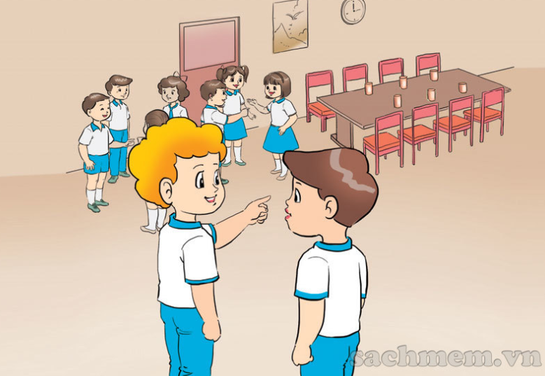

Slide 4
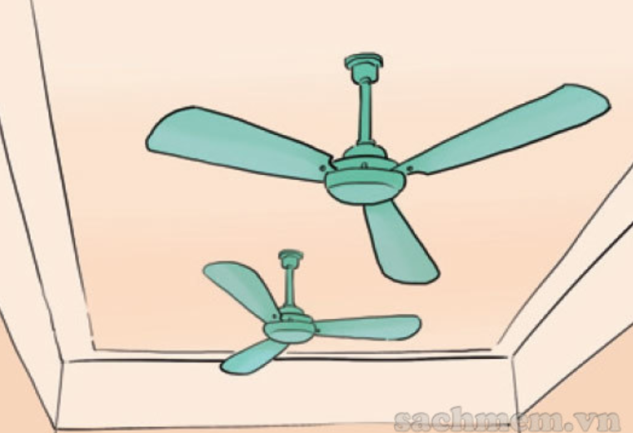
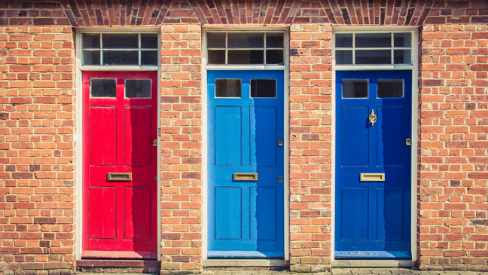
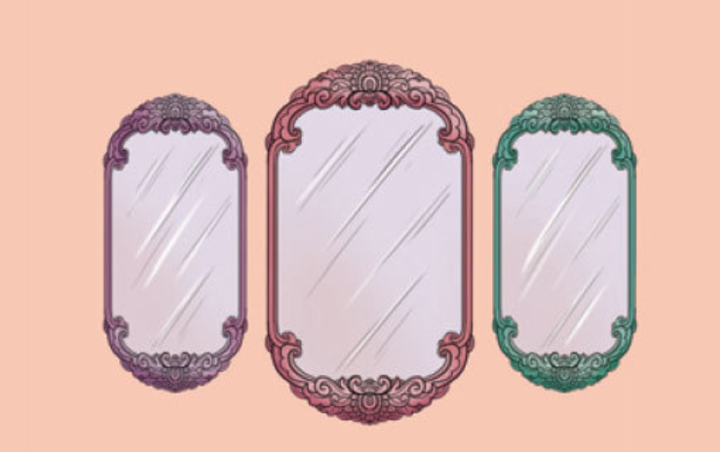
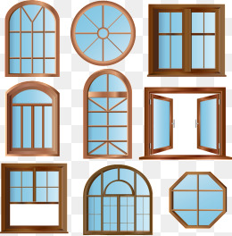
A
C
1. Windows
2. fans
3. doors
B
4. mirrors
D

Slide 5
*Model sentence:
(?) How many ______ are there?
=> There are _________.
Ex: (?) How many fans are there?
=> There are two.

Slide 6
(a) How many fans are there?
=> There are two.

Slide 7
(b) How many mirrors are there?
=> There are three.

Slide 8
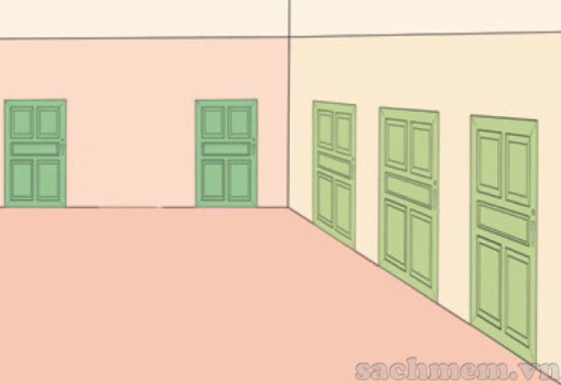
(c) How many doors are there?
=> There are five.

Slide 9
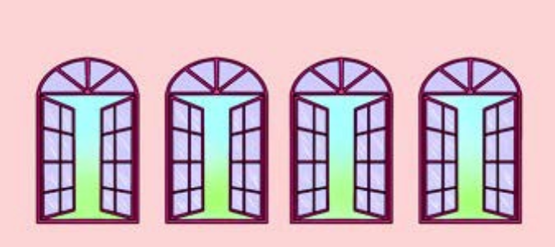
(d) How many windows are there?
=> There are four.

Slide 10
(a) How many fans are there?
=> There are two.
(b) How many mirrors are there?
=> There are three.
(c) How many doors are there?
=> There are five.
(d) How many windows are there?
=> There are four.

Slide 11
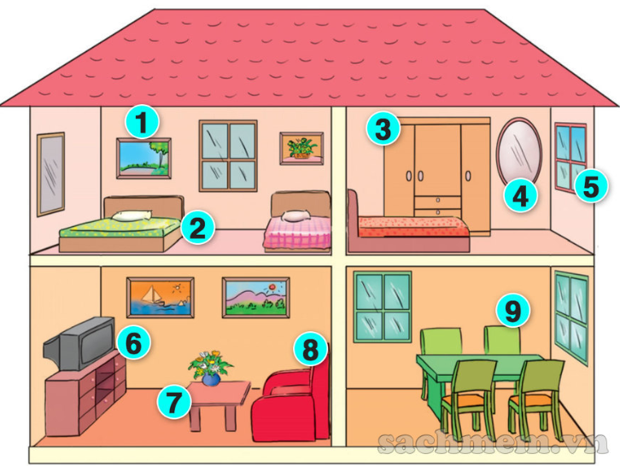

Slide 12
2
1
4
3

Slide 13
This is my living room. There are many things in the room. There are two windows and one door. There are a sofa, a desk and eight chairs. There is a lamp on the desk and a TV on the cupboard. There are four pictures and two fans on the walls.
This is my living room. There are many things in the room. There are two windows and one door. There are a sofa, a desk and eight chairs. There is a lamp on the desk and a TV on the cupboard. There are four pictures and two fans on the walls.
1. How many doors are there in the living room?
=>There is one door.

Slide 14
This is my living room. There are many things in the room. There are two windows and one door. There are a sofa, a desk and eight chairs. There is a lamp on the desk and a TV on the cupboard. There are four pictures and two fans on the walls.
This is my living room. There are many things in the room. There are two windows and one door. There are a sofa, a desk and eight chairs. There is a lamp on the desk and a TV on the cupboard. There are four pictures and two fans on the walls.
2. How many windows are there ?
=>There are two windows.

Slide 15
This is my living room. There are many things in the room. There are two windows and one door. There are a sofa, a desk and eight chairs. There is a lamp on the desk and a TV on the cupboard. There are four pictures and two fans on the walls.
This is my living room. There are many things in the room. There are two windows and one door. There are a sofa, a desk and eight chairs. There is a lamp on the desk and a TV on the cupboard. There are four pictures and two fans on the walls.
4. How many pictures are there ?
=>There are four pictures.

Slide 16
This is my living room. There are many things in the room. There are two windows and one door. There are a sofa, a desk and eight chairs. There is a lamp on the desk and a TV on the cupboard. There are four pictures and two fans on the walls.
This is my living room. There are many things in the room. There are two windows and one door. There are a sofa, a desk and eight chairs. There is a lamp on the desk and a TV on the cupboard. There are four pictures and two fans on the walls.
3. How many chairs are there ?
=>There are eight chairs.

Slide 17
This is my living room. There are many things in the room. There are two windows and one door. There are a sofa, a desk and eight chairs. There is a lamp on the desk and a TV on the cupboard. There are four pictures and two fans on the walls.
This is my living room. There are many things in the room. There are two windows and one door. There are a sofa, a desk and eight chairs. There is a lamp on the desk and a TV on the cupboard. There are four pictures and two fans on the walls.
5. How many fans are there ?
=>There are two fans.

