Slide 1
UNIT 15 DO YOU HAVE ANY TOYS?
Lesson 1

Slide 2
1. New words
toy ( n):
đồ chơi

Slide 3
car ( n):
ô tô

Slide 4
doll ( n):
búp bê

Slide 5
robot ( n):
con rô bốt

Slide 6
teddy bear ( n):
Gấu bông

Slide 7
puzzle ( n):
Trò chơi ghép hình

Slide 8
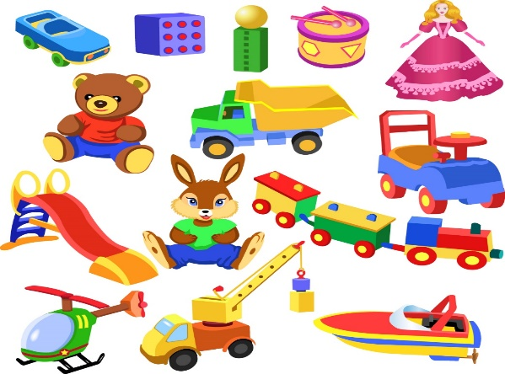
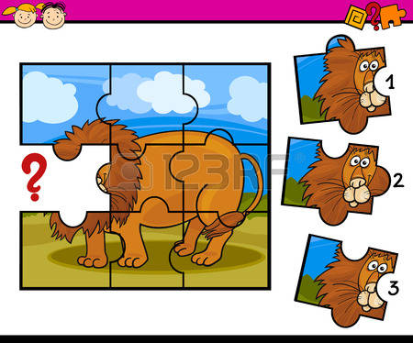
1
2
Matching
3
4
5
6
a. car
c. doll
e. puzzle
b. toy
d. robot
f. teddy bear

Slide 9
2. Model sentence
Ex1: Do you have a car?
Ex2: Do you have a doll?
Yes, I do
No, I don’t
No, I don’t
=>
/
Yes, I do
/
=>
Do you have+ ( tên đồ vật) ?
=>
Yes, I do
No, I don’t
/

Slide 10
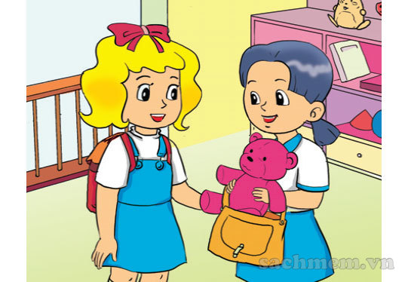
3. Practice
a. Look, listen and repeat
Do you have a teddy bear?
Yes, I do
It’s my robot.
Do you have a robot?
What’s that ?
No, I don’t

Slide 11
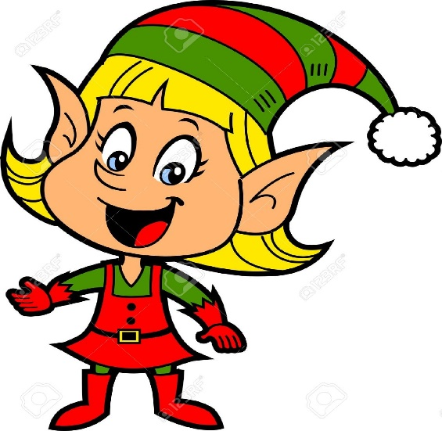
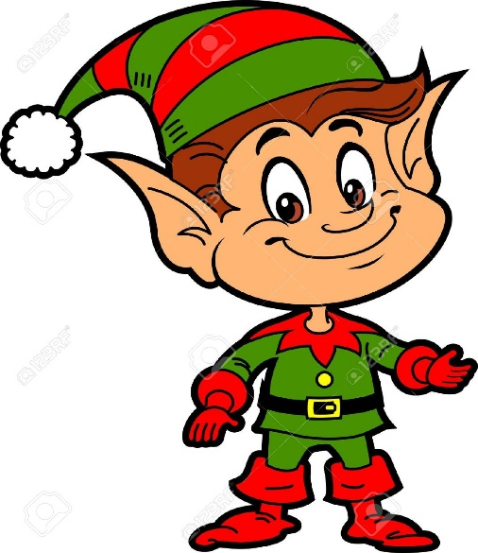
b. Point and say
Do you have ……..?
a doll
Yes, I do
a doll/ yes

Slide 12
1Slide 13
2
3
4
6
5Slide 17
7
8

Slide 13
1. What is it ? It is a …………
1. robot
1. robot
2. doll
3. car

Slide 14
2.What is it ?
→ It is a doll

Slide 15
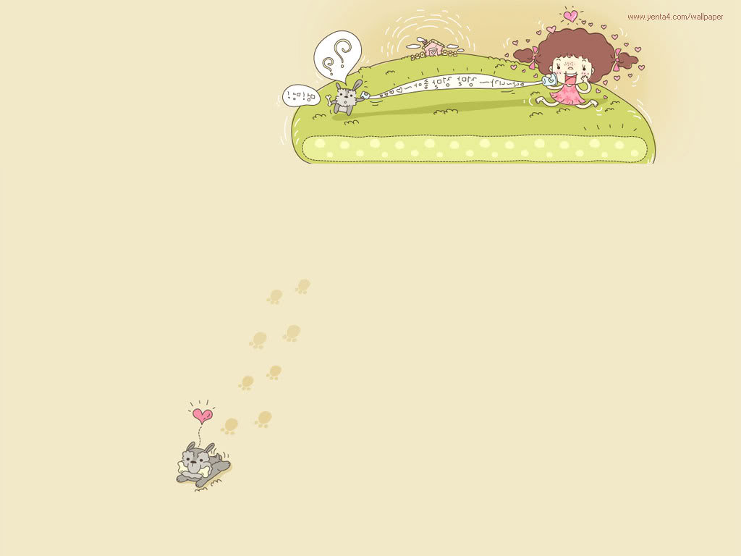
3.Re-order the words:
P / z / l / u / z / e
→ Puzzle

Slide 16
4. What is it ?
→ It’s a teddy bear

Slide 17
5. Do you have a ……………… ?
→ yes, I do
1. Toys
2. car
2. car
3. Teddy bear

Slide 18
6.Re-order the words:
o / s / T / y
→ Toys

Slide 19
7.Do you have a doll ?
B: ………………………..
1. No, I do
2. yes, I don’t
3. yes, I do
3. yes, I do

Slide 20
8. Re-order the words:
have / a / Do / you / puzzle / ?
→ Do you have a puzzle ?

Slide 21
G
O
O
D
Y
!
B
E

