Slide 1
Tien Phong Primary School
Welcome to our English lesson

Slide 2
1. What time is it ?
TIME’S UP
a. It’s eight o’clock.
b. It’s eight fifteen.
c. It’s eight fifty.

Slide 3
2. What does she do ?
TIME’S UP
a. She’s a teacher.
b. She’s a farmer.
c. He’s a taxi driver.

Slide 4
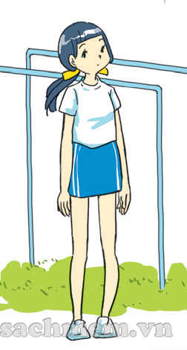
3. What does she look like ?
TIME’S UP
a. She’s old and big.
b. She’s young and short.
c. She’s tall and slim.

Slide 5
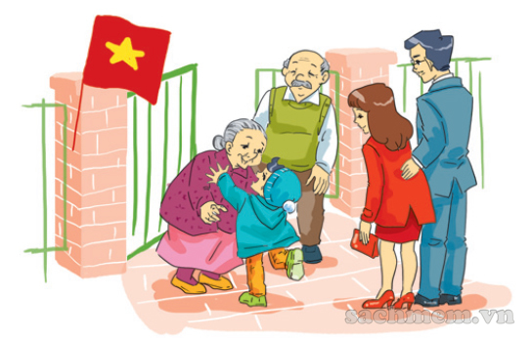
4. What do you do at Tet ?
TIME’S UP
a. I make banh chung.
b. I visit my grandparents.
c. I decorate the house .

Slide 6
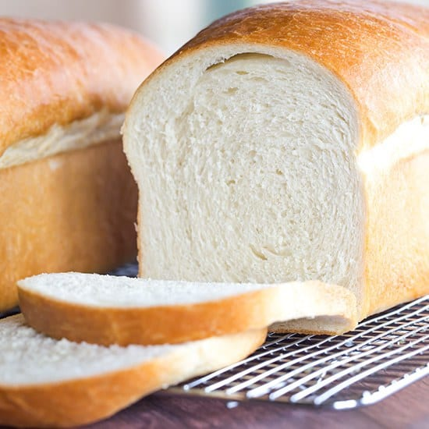
5. Would you like some bread ?
TIME’S UP
a. Yes, please.
b. Yes, I do.
c. Yes, I am.

Slide 7
Monday, March 22nd 2021
Unit 16 : Let’s go to the bookshop.
(Lesson 1)

Slide 8
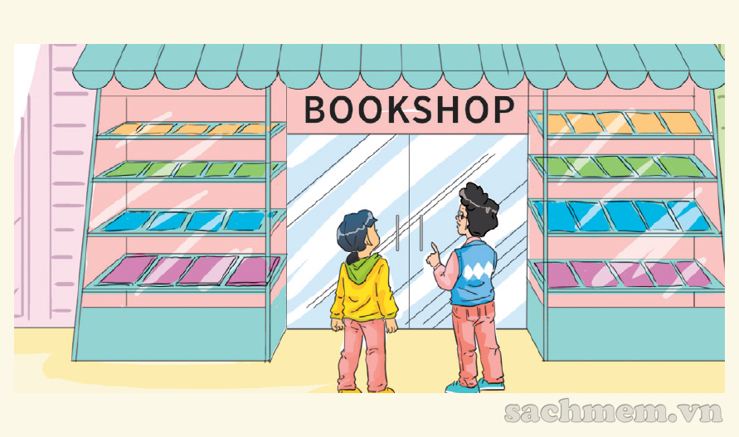
Unit 16 : Let’s go to the bookshop
A. New words
Bookshop : tiệm sách

Slide 9
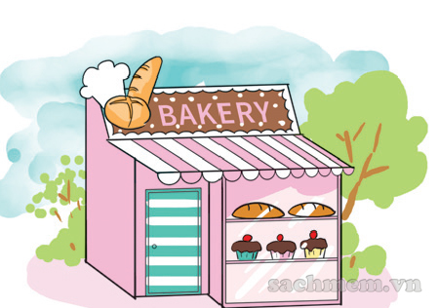
Unit 16 : Let’s go to the bookshop
A. New words
bakery : cửa hàng bánh

Slide 10
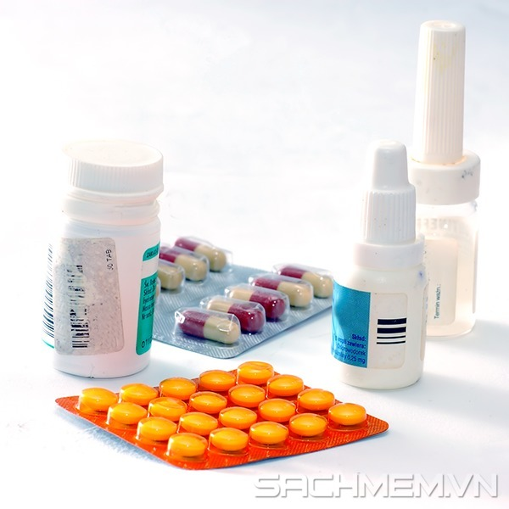
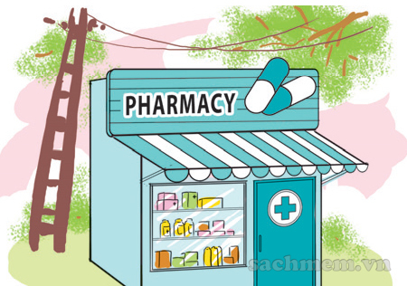
Unit 16 : Let’s go to the bookshop
A. New words
medicine : thuốc
Pharmacy : tiệm thuốc

Slide 11
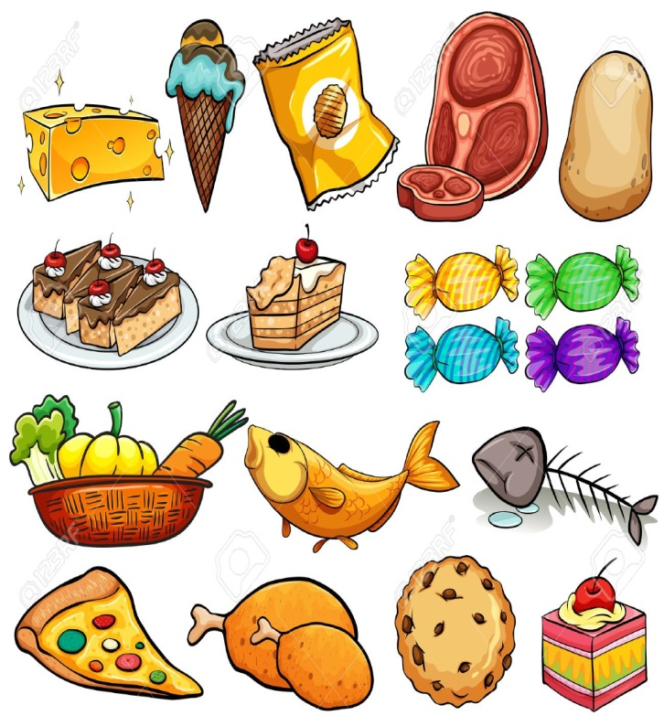
Unit 16 : Let’s go to the bookshop
A. New words
supermarket : siêu thị

Slide 12
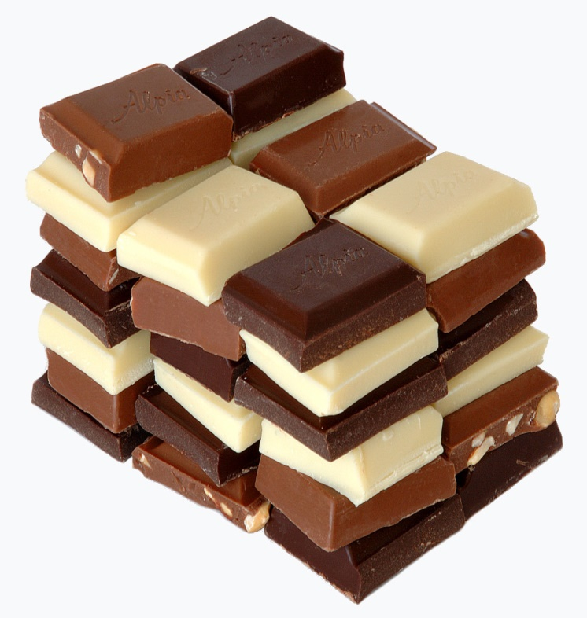
Unit 16 : Let’s go to the bookshop
A. New words
chocolate : sô- cô -la
Sweet shop : cửa hàng kẹo

Slide 13
Unit 16 : Let’s go to the bookshop
A. New words
buy : mua

Slide 14
Unit 16 : Let’s go to the bookshop
A. New words
busy : bận rộn

Slide 15
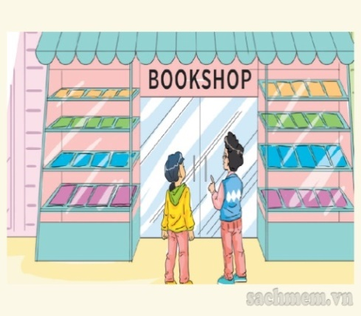

Slide 16
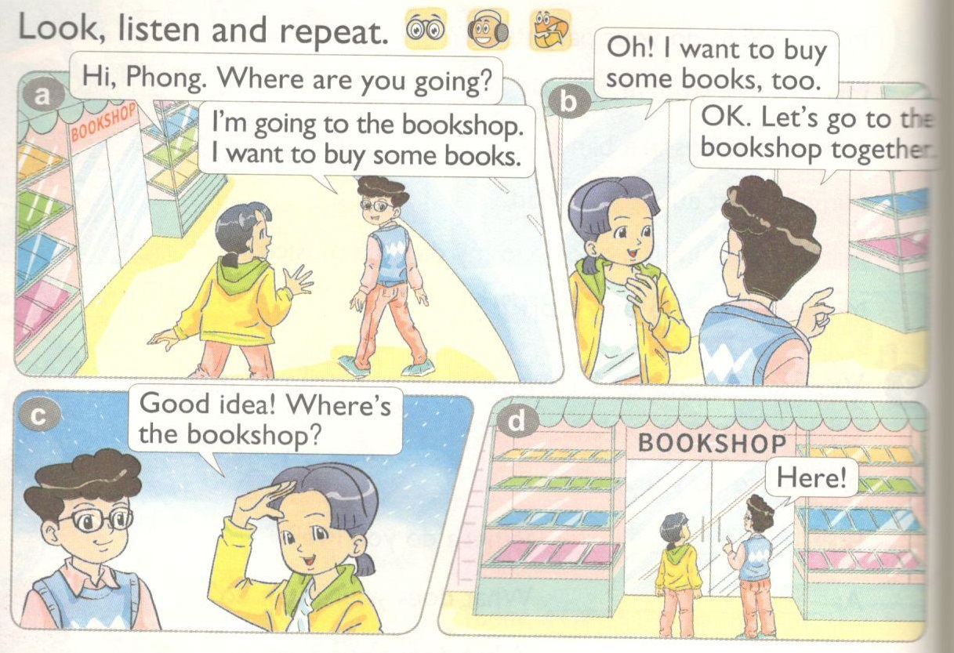

Slide 17
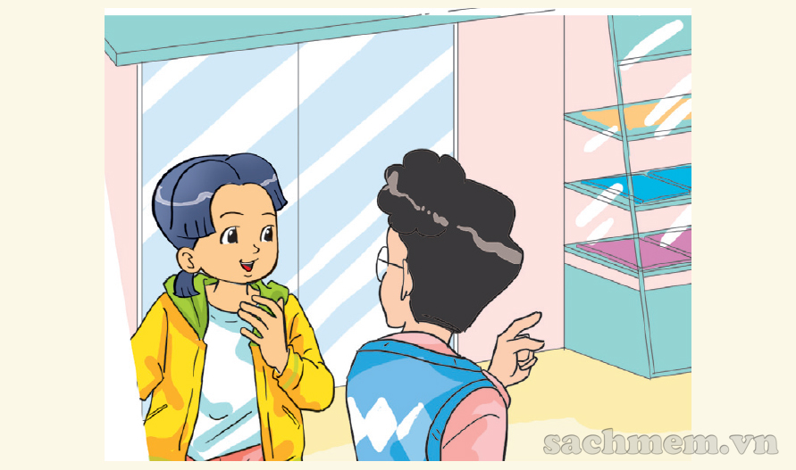

Slide 18
go to the____.
I want to______.
Let’s
Let’s = Let us

Slide 19
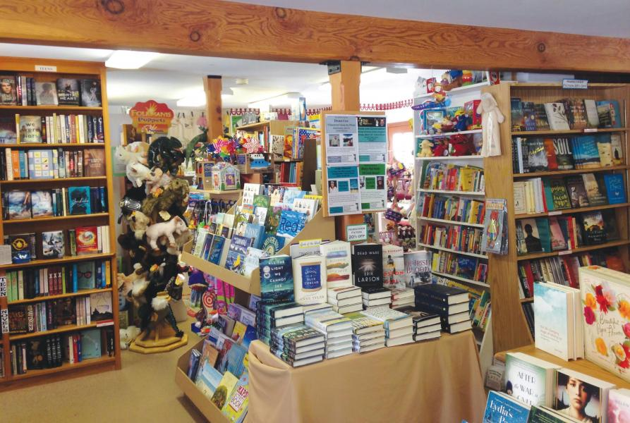
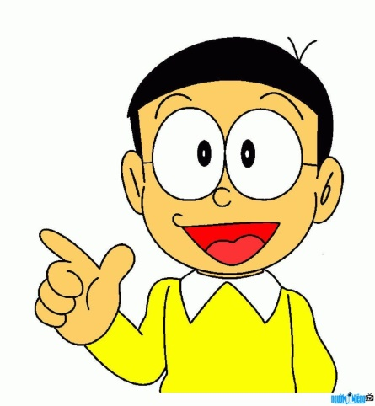
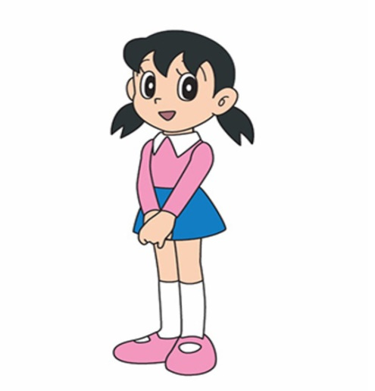
Let’s go to the bookshop.
I want to buy some books.
Sorry. I’m busy.
Great idea !

Slide 20
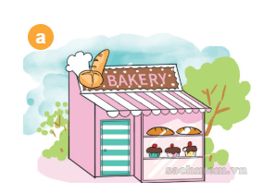
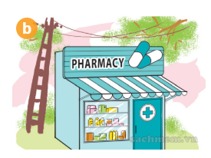
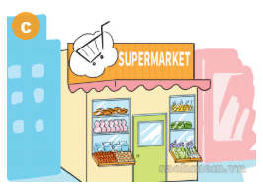
Let’s go to the _______.
I want to _________.
Great idea !
Sorry. I’m busy.

Slide 21
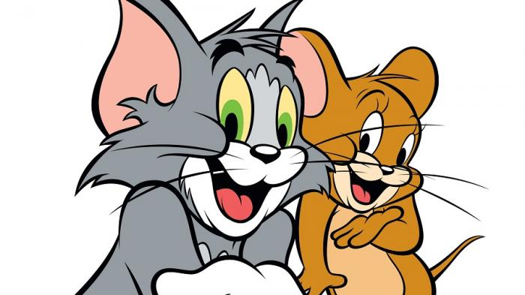
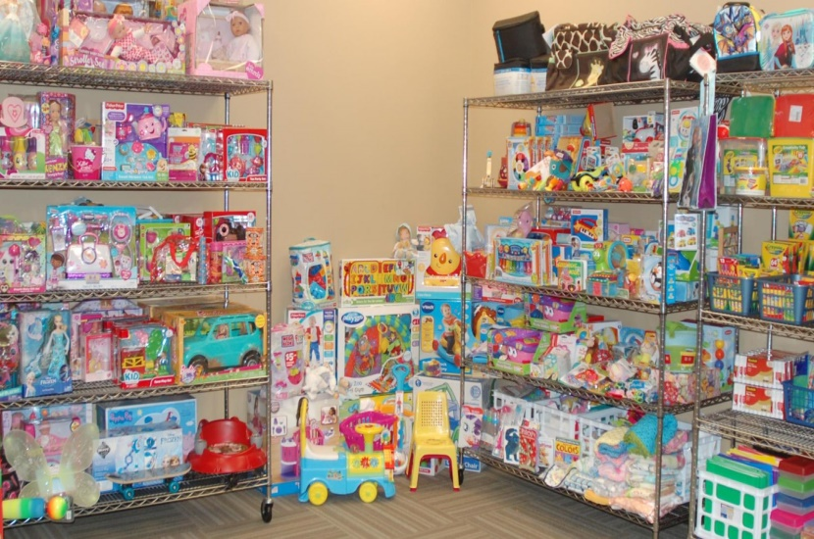
Work in pairs.
Suggest some places to go and say why.
Toys shop

Slide 22
Work in group.
Put the places with the correct things.
Let’s go to the ___________ | I want to buy _________

Slide 23
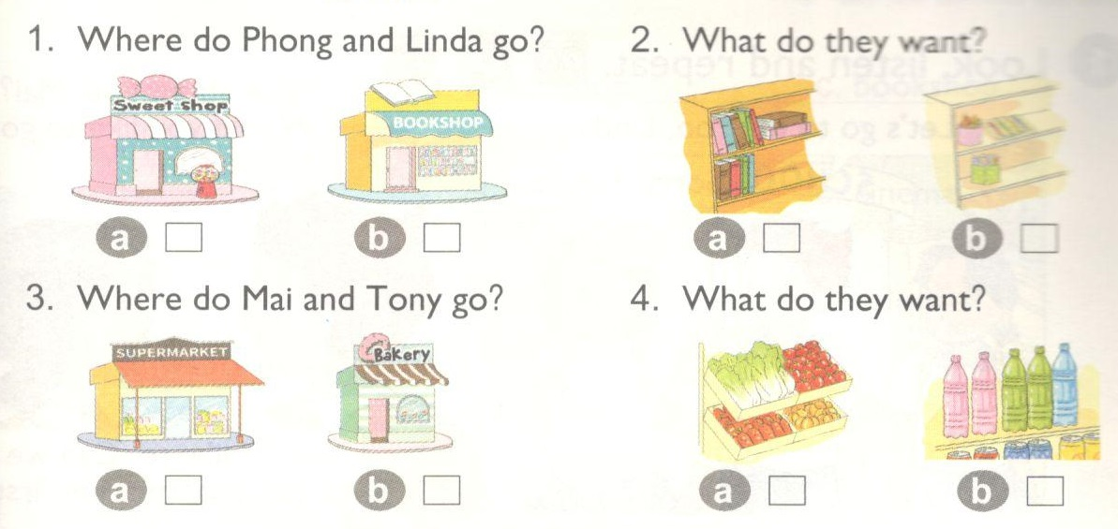
Unit 16 : Let’s go to the bookshop
3. Listen and tick

Slide 24
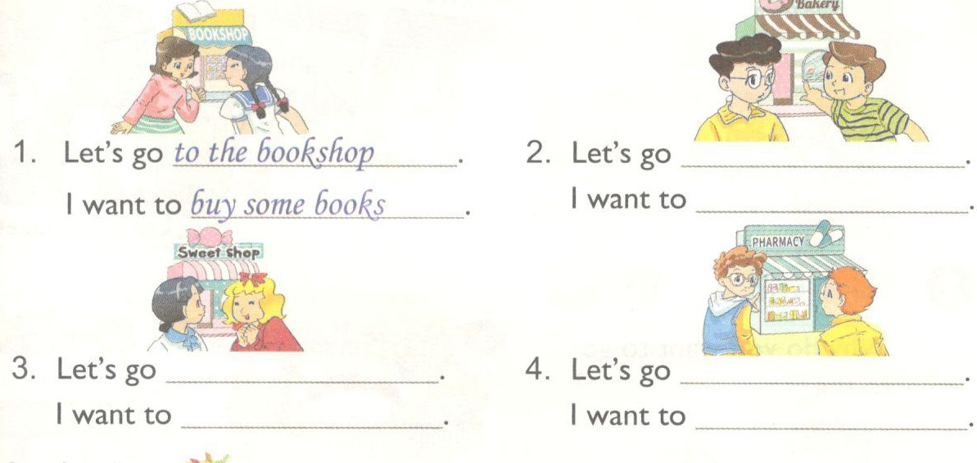
Unit 16 : Let’s go to the bookshop
4. Look and write.
to the bakery
buy some bread
to the sweetshop
to the pharmacy
buy some chocolate.
buy some
medicine.

Slide 25
Write each new words 3 lines
Practice more the structures you have learnt.
Prepare new lesson 2

