Slide 1
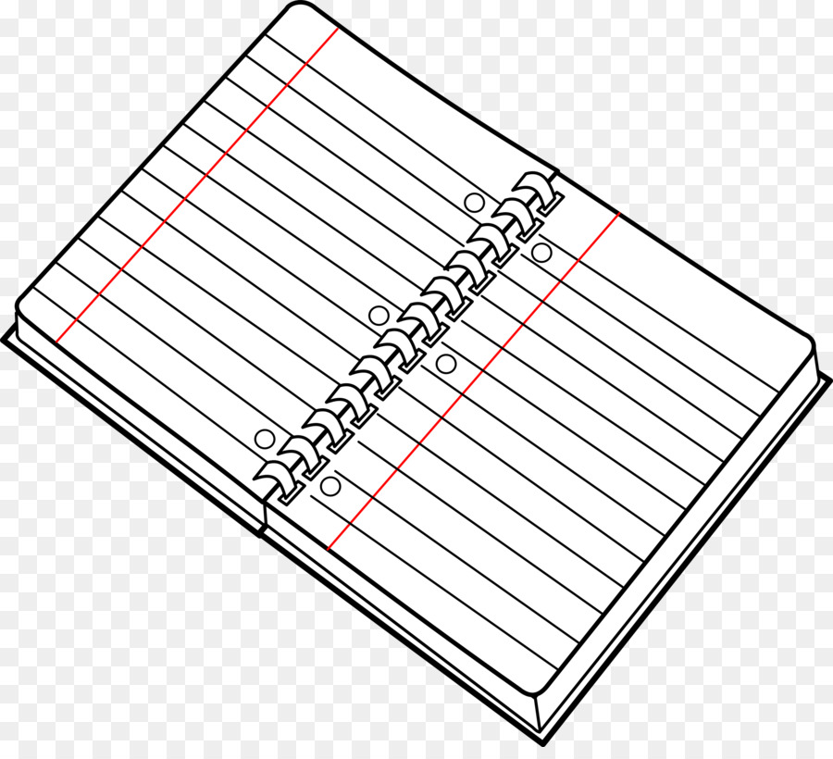

Slide 2
blue

Slide 3
yellow
orange

Slide 4
white
saf

Slide 5
brown
green

Slide 6
UNIT 9 : WHAT COLOUR IS IT ?
LESSON 2 : PART 1,2,3

Slide 7
1. Look, listen and repeat.
1. blue
2. white
3. yellow
4. brown
5. green
6. orange
7.Colour

Slide 10
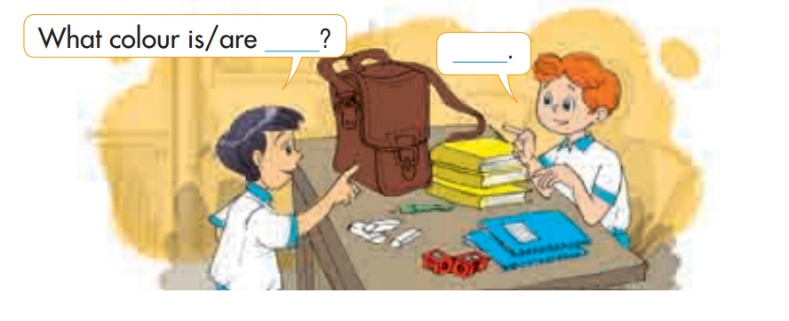
3. LET’S TALK.

Slide 11
Matching
A
1. Blue
2. White
3. Yellow
4. Brown
5. Green
6. Orange
B

